Slide 1
Emirates Schools Establishment Assessment Unit
Cycle 1 Bridge to Success 4
English Listening Task
Term 1 2021
Level 2.2
Term 1 Academic Year 2021-2022

Slide 2
Part 1: Preparation – Vocabulary.
Learn these words for the listening task.

Slide 3
Part 1: Listening Task.

Slide 4
Part 1. Listen and choose True or False. Example: The cat is white.
True False
Notes:
My family drives to Dubai.

Slide 5
1. Alia has coloured pencils.
True False
Notes:
My family drives to Dubai.

Slide 6
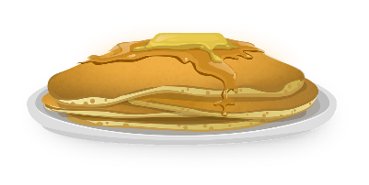
2. Ali’s family eats pancakes for breakfast.
True False
Notes:
My family drives to Dubai.

Slide 7
3. Ahmed is good at running.
True False
Notes:
My family drives to Dubai.

Slide 8
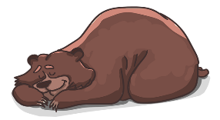
4. The mammal has two legs.
True False
Notes:
My family drives to Dubai.

Slide 9
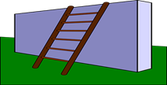
5. Rashid is climbing the wall.
True False
Notes:
My family drives to Dubai.

Slide 10
Part 2. Listen and write/type the answer to the question. Example: What can your brother do?
My brother can play football.
Notes:
Children read books at school.

Slide 11
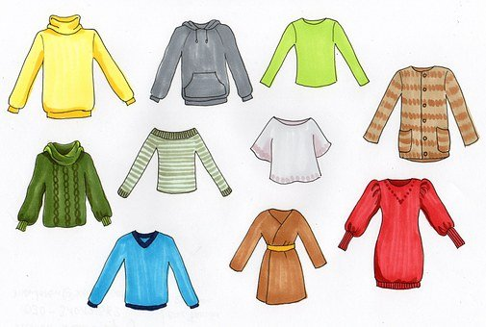
6. What does Maryam’s family buy for Eid?
Maryam’s family buys new ___ for Eid.
Notes:
Children read books at school.

Slide 12
7. Who can carry the boxes?
My ______ can carry the boxes.
Notes:
Children read books at school.

Slide 13
8. What are the students doing?
The students are ________ out the pictures.
Notes:
Children read books at school.

Slide 14
9. What is Rawan good at?
Rawan is good at ________________.
Notes:
Children read books at school.

Slide 15
10. What do you need?
I need ____ to stick my picture to the poster.
Notes:
Children read books at school.

Slide 16
Well Done!

