Slide 1
English

Slide 3
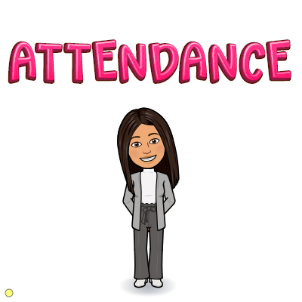

Slide 4
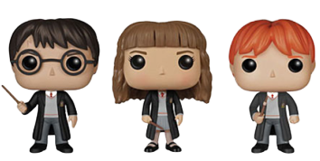
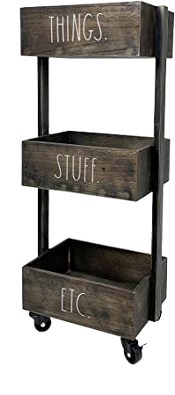
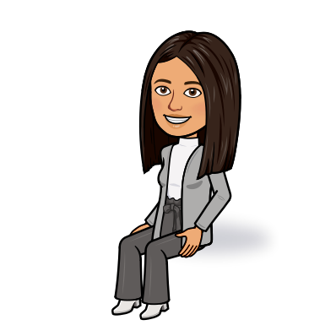
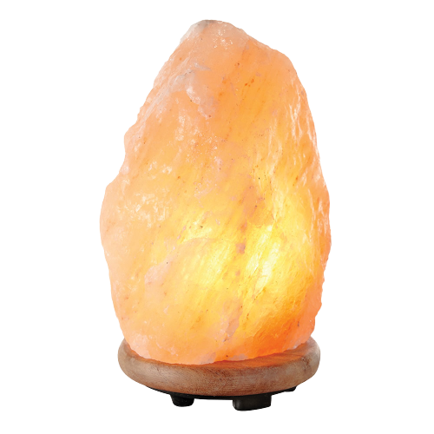
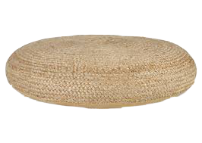
English:
Page 52-53
Lesson 10:
The boy and the wolf
Welcome Back,
Grade 4’s!

Slide 6
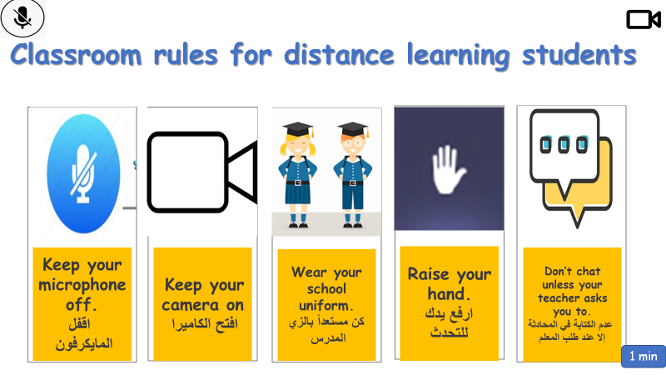

Slide 8
Outcomes
I can read a folktale.
I can listen to a folktale for general comprehension.
I can retell a folktale.

Slide 11
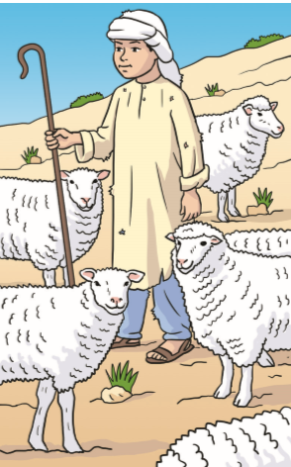
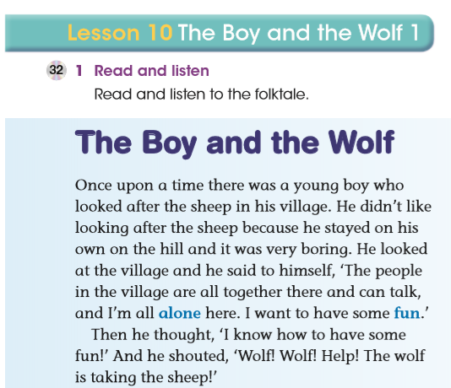

Slide 12
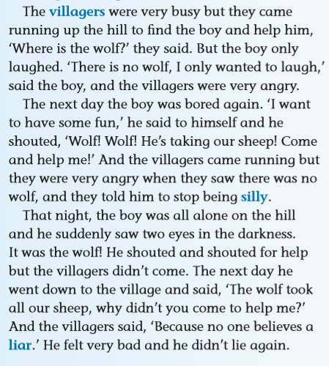
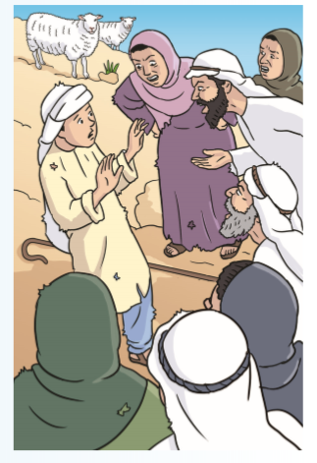

Slide 13
Answers:
He was at the top of the hill.
They were in the village.
He shouted. “Wolf! Wolf! Help! The wolf is taking the sheep.”

Slide 17
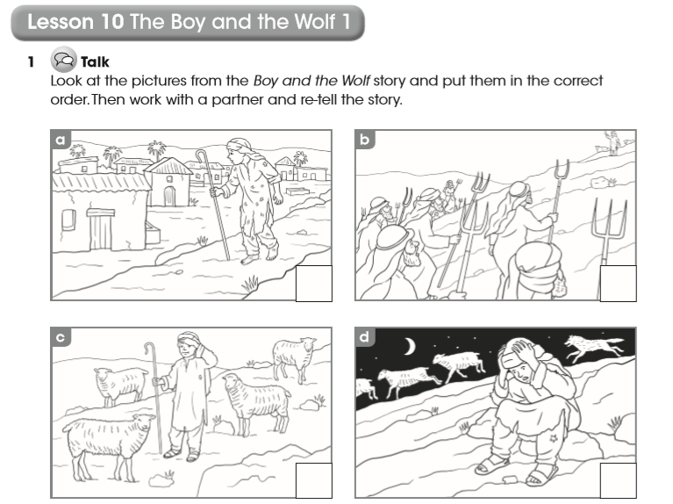
Page 39
4
2
1
3

Slide 18
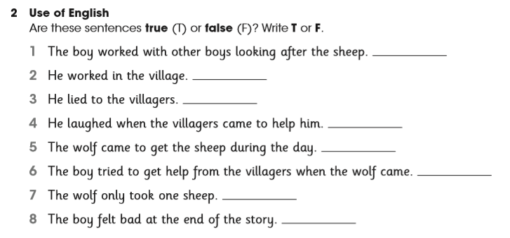
F
F
T
T
F
T
F
T

Slide 20
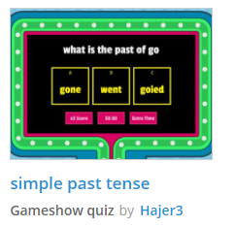
https://wordwall.net/resource/1987983/simple-past-tense

Slide 21
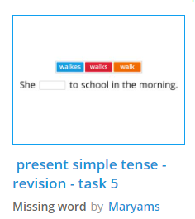
https://wordwall.net/resource/4550429/present-simple-tense-revision-task-5

Slide 22
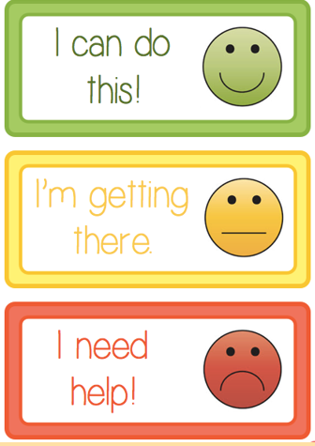
1.
How well do I know my work?.
2.
3.

