Slide 1
Bridge to Success 4
Term 1
Week 4
Unit 2
Lesson 7
English
Grade 4
Ms Maram Al Zubaidy

Slide 2
National Anthem

Slide 3
Today is
of
Sunday
Monday
Tuesday
Wednesday
Thursday
Today’s weather is...
January
July
1
4
st
February
August
1
5
nd
2
6
rd
March
September
2
7
th
April
October
3
8
9
May
November
3
0
June
December
Notes:
Slide 5: Warm-up Activity

Slide 4
Class Rules
These are our online class rules
Notes:
Slide 2: Class Rules (home and at school).

Slide 5
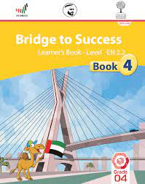
You will need:
Always be ready, if you don’t have your books you will find them on LMS and AlDiwan
Learner’s Book Activity Book Pencil
Notes:
Slide 1: Welcome slide to include your name, your subject and the grade.

Slide 6
Lesson 7 Skill Outcome
En.2.R.CS.1 Read and understand the overall meaning of short, simple texts on familiar topics.
En.2.L.CS.2 Listen and understand the overall meaning of short, simple texts on familiar topics.
Lesson 7 Vocabulary
feelings and emotions, environment: sad, memory, teddy bear, beach, rock, forgot
Grammar Topic
FL.31 Describing past experiences and events Talking about a special memory
Notes:
Slide 4: Success Criteria (objectives in child-friendly language).

Slide 7
Warm up
January
March
May
July
August
October
November
December
Notes:
Slide 6: Vocabulary

Slide 8
Introduction Memory
Notes:
Slide 6: Vocabulary

Slide 9
Learner’s Book Page 22
Do you have a special memory from when you were young?
Is it happy, sad or funny?
Tell us about it
Listen and answer the questions
1- Who was Bruno?
2- Where did the family go?
3- What did the father do?
Find words with long vowel sounds
He was a teddy bear.
The family went to the beach.
He went back to the beach but he couldn’t find Bruno.
Bruno, beach, see, sea, sleep, even
Notes:
Slide 7: Lesson Introduction

Slide 10
Let’s Practice short or long vowel
Get out your white board, marker and eraser
Read the question
Draw the symbol of the correct answer
Count you point

Slide 11
Activity Book Page 17
2
3
We went to the beach.
My teddy bear sat on a rock while we played.
Homework
4
1
We forgot Bruno.
I had a teddy bear called Bruno.
summer
forgot
sad
HW
Notes:
Slide 9: Practice Time

Slide 12
Tell me a word with a long vowel
Notes:
Slide 13: Self-Assessment as part of re-visiting Success Criteria
https://forms.office.com/Pages/ResponsePage.aspx?id=ZN_eq0qrBUuqA_TbXZ4ii7O9TMQh9a1GsKkJOakIdThUMVREQkhERExDVDMyNUVXWEkwSjVWSk9ZMy4u

Slide 13
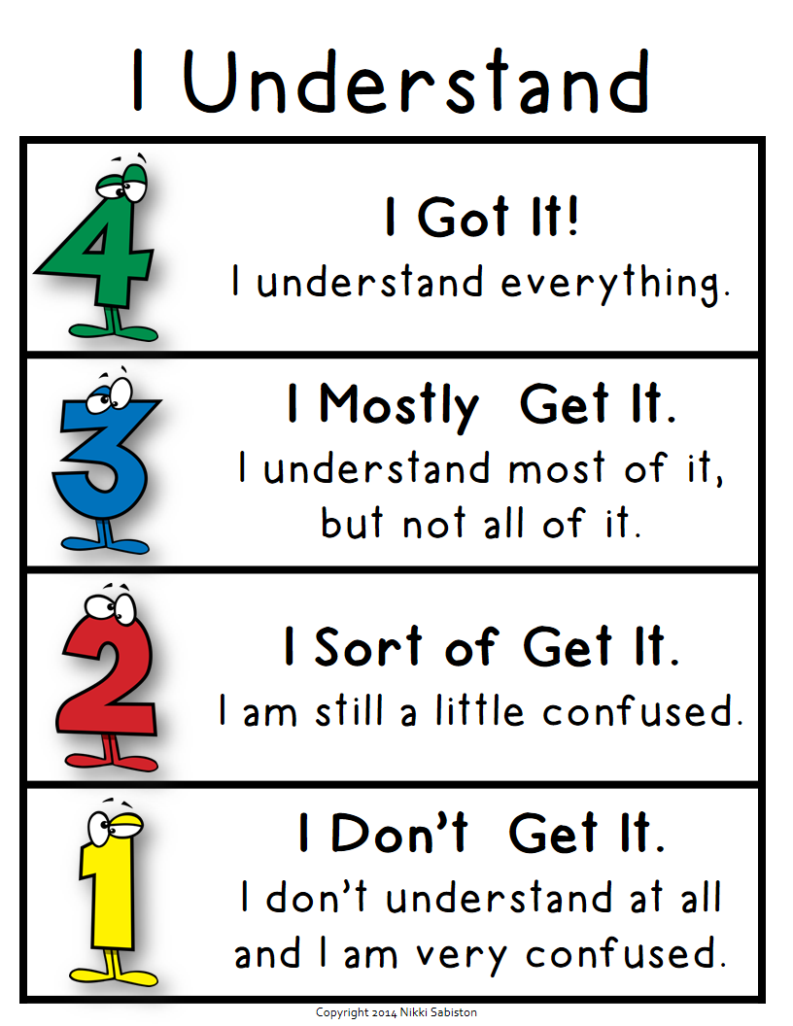
Type your self assessment in the chat
I will take the attendance
Notes:
Slide 13: Self-Assessment as part of re-visiting Success Criteria
https://forms.office.com/Pages/ResponsePage.aspx?id=ZN_eq0qrBUuqA_TbXZ4ii7O9TMQh9a1GsKkJOakIdThUMVREQkhERExDVDMyNUVXWEkwSjVWSk9ZMy4u

Slide 14
Don’t forget
Notes:
Slide 14: Good-bye slide with various reminders (Stay safe, stay healthy, next lesson, PPT on LMS etc.)

Slide 15
4-5 Wheel
4-6 Wheel

