Slide 1
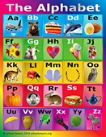
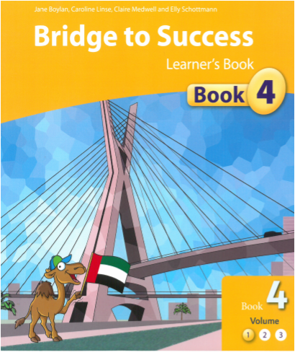
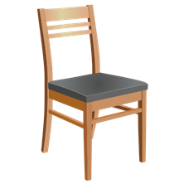
Welcome to
Ms. Meenoti’s
Grade 4
English Class
Week 9
Unit 3
The UAE Desert
L9 If wolves live
in the desert.
PCAT 3 must be completed on LMS.

Slide 2
Notes:
Please indicate how you are feeling today. Remember even though you are at home you are still cared for. You are NOT alone.

Slide 3
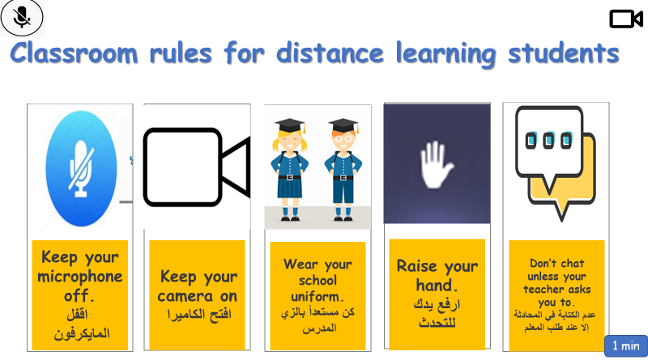

Slide 4
What will you need?
Ears ready
to listen
Lips ready
to speak
Hands ready
to write
Eyes ready
to read
Bridge to Success Book 4
to write in.
Pens, pencils to
write with

Slide 5
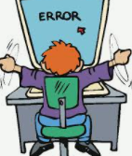
Classroom Helpers
attendance
behaviour
messenger
technical issues

Slide 6
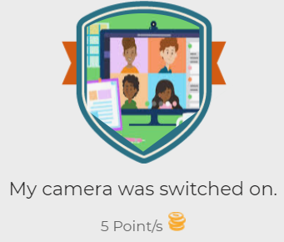
Badges on LMS

Slide 7
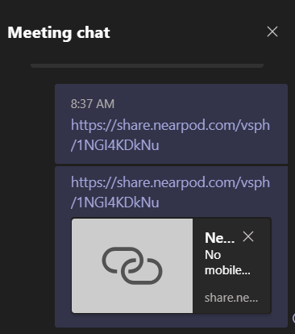
Please go to the chat box,
Nearpod is great to use.
and click on the link,

Slide 8
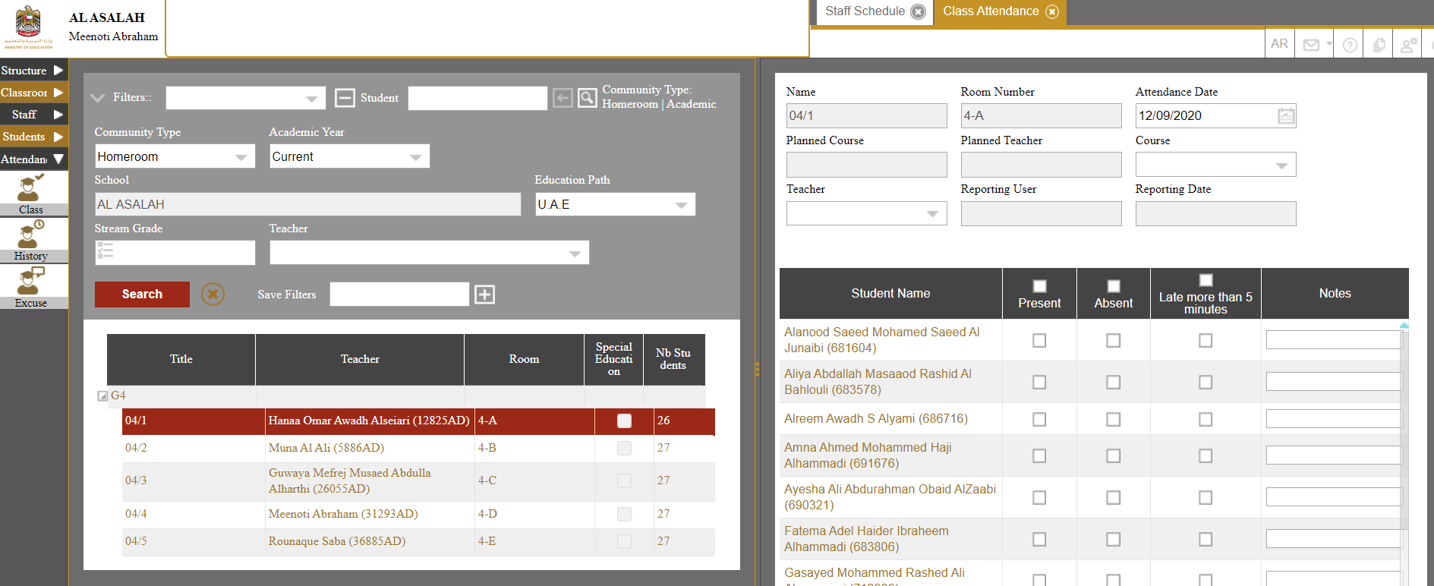
Attendance

Slide 10
.

Slide 11
.
your
about
called
off

Slide 13
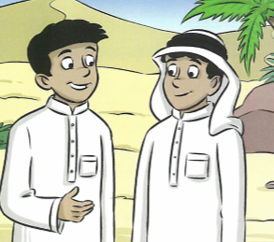
Tick( ✓) the correct sentence.
Ibrahim feeled hurt and upset.
Ibrahim felt hurt and upset.

Slide 14
Tick( ✓) the correct sentence.
Ibrahim feeled hurt and upset.
Ibrahim felt hurt and upset. ✓

Slide 15
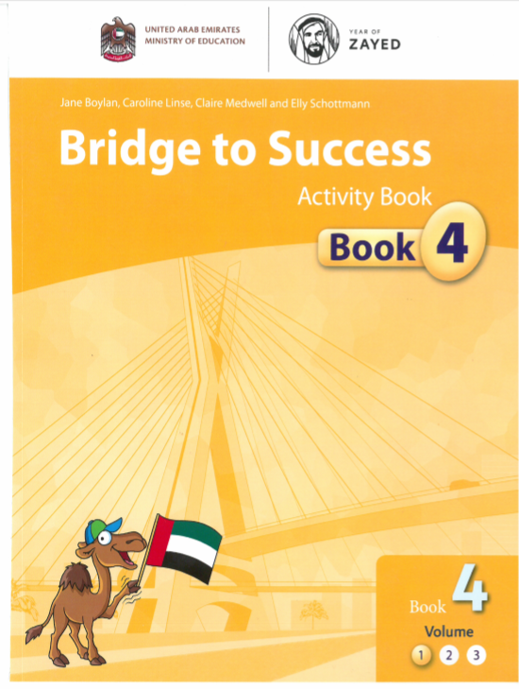
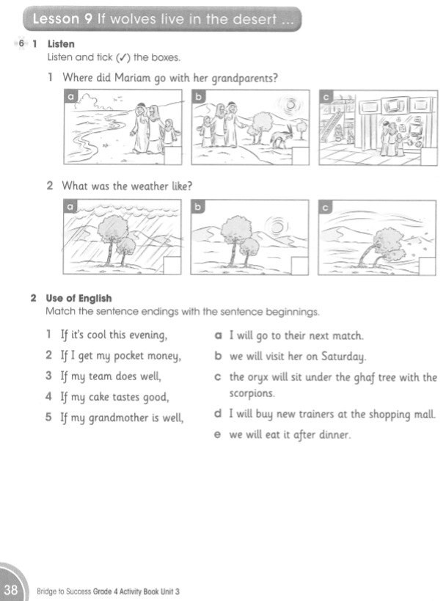
Unit 3 Lesson 9
Page 51
Page 38

Slide 16
Learning Outcomes:
Lesson Objective:
We are learning to read and re-read short and simple texts and predict what will happen.
Success Criteria:
I can complete sentences using the word “will”.

Slide 17
Learning Outcomes:
Success Criteria:
I can complete sentences using the word “will”.
.
Red | Orange | Green | Blue
Number: 1,2 | Numbers: 1,2,3 | Numbers: 1,2,3,4 | Numbers: 1,2,3,4,5,

Slide 18
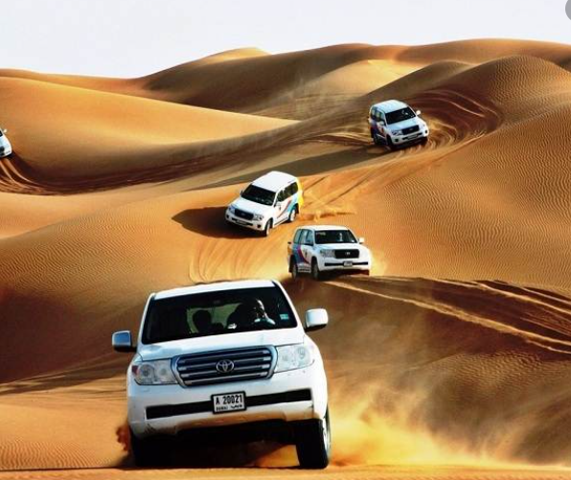
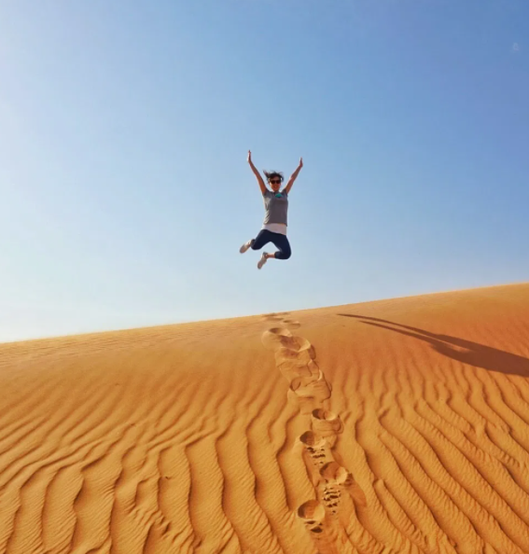
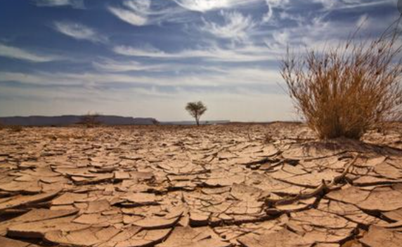
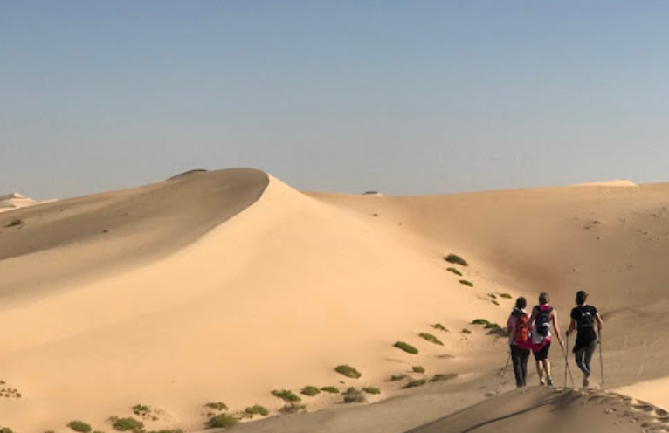
desert safari
amazing
dry
sand dunes

Slide 19
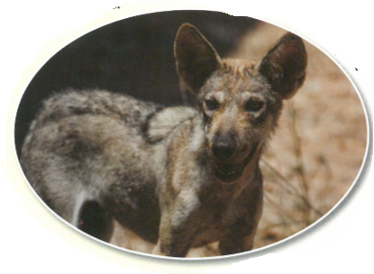
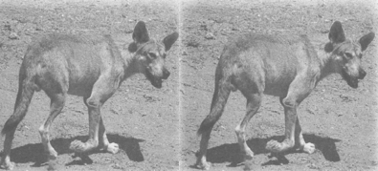
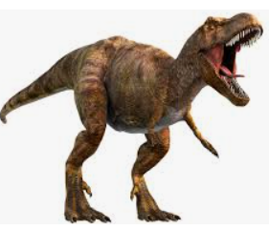
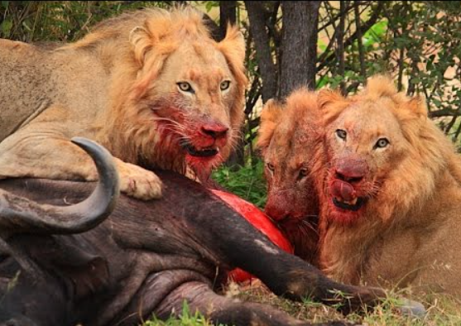
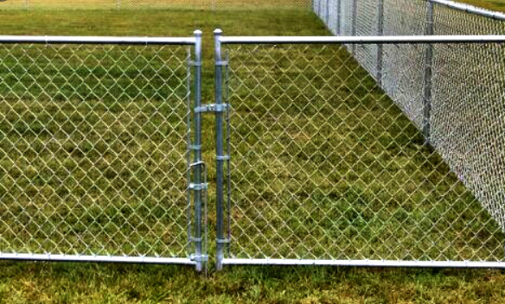
wolf
wolves
extinct
kill
fence

Slide 20
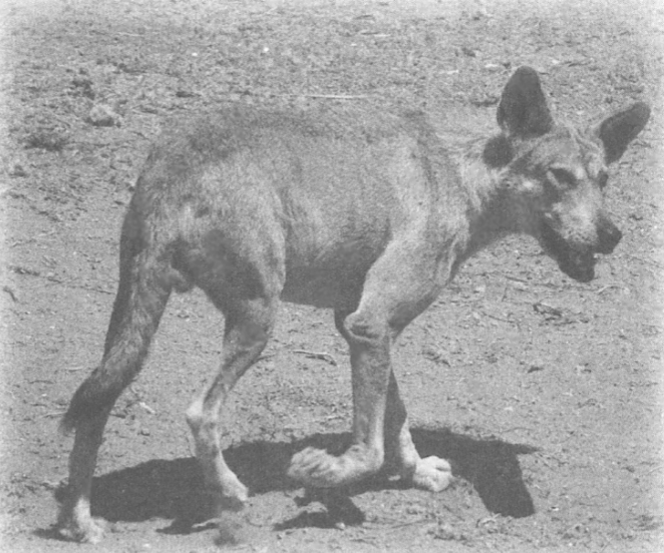
Scientists think that the are only between 1000 and 2000 left in Syria, Lebanon, Oman and Saudi Arabia.
Let’s Review .
Scientists want to bring the Arabian Wolf back into the desert, because there are too many animals and not enough food for them.
In the 1970’s the Arabian Wolf lived in the UAE, but not anymore.
If wolves live in the desert, they will kill the animals and keep their numbers low. Then there will be enough food for all the animals
The Arabian Wolf ate birds, insects, sheep and goats.
People killed wolves to keep their sheep and goats safe.
Notes:
Can you remember the name of this desert animal?

Slide 21
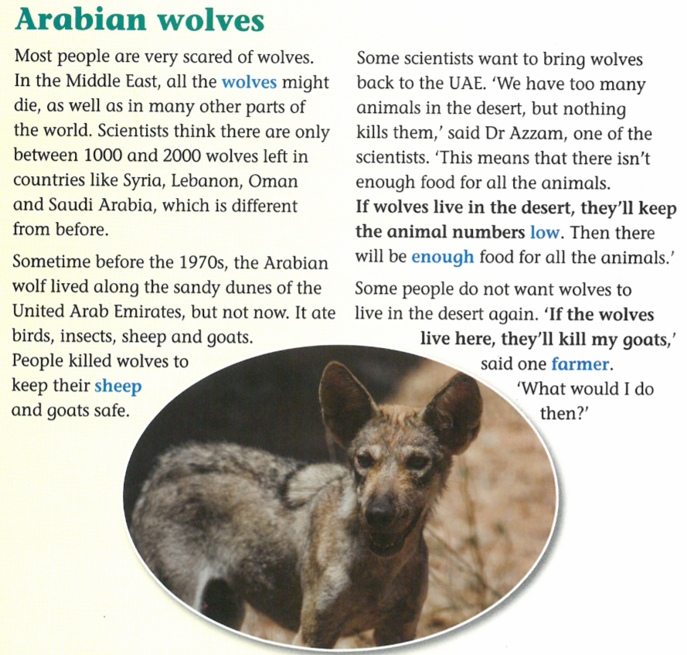
Do wolves live in the desert at the moment?
Is it possible wolves will live in the desert?
Page 51
Notes:
Look at the words in bold print and answer the questions.

Slide 22
Page
51
Notes:
Let’s discuss. What does the word extinct mean? Complete the rest by yourself.

Slide 23
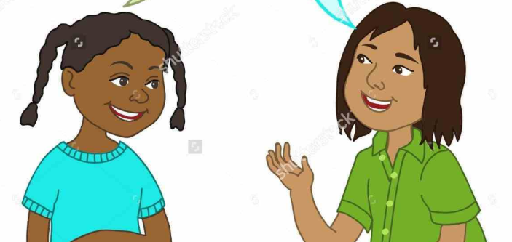
Page
51
Speaking partners:
If I work hard in English, I will……..
If my mother makes my favourite food for dinner, I will……..
If I work hard in English, I will…..
If my mother makes my favourite food for dinner, I will……..

Slide 24
Page
38
Notes:
1a) Where are they? 1b) Can you name the animal in the picture? Can you see the sand dunes in the picture? 1c) What are the doing?

Slide 25
Page
38
✓
✓
Notes:
Listen to the audio and tick the boxes.

Slide 26
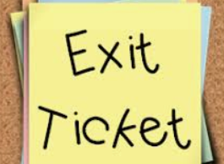
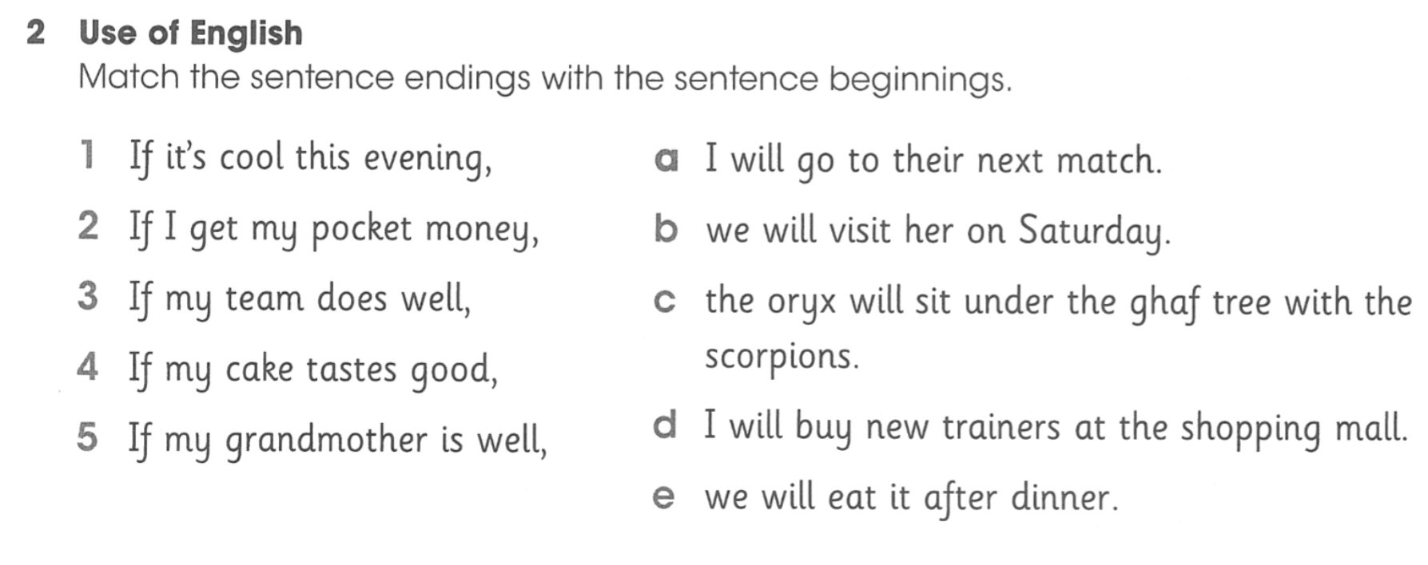
Page
38
1 and 2 | 1, 2, 3 | 1,2,3,4 | 1,2,3,4,5

Slide 27
Page
38
1 and 2 | 1, 2, 3 | 1,2,3,4 | 1,2,3,4,5

Slide 28
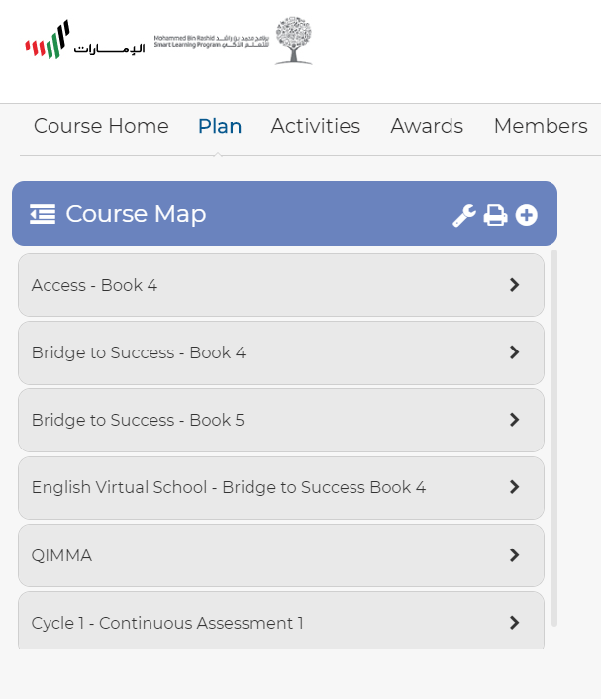
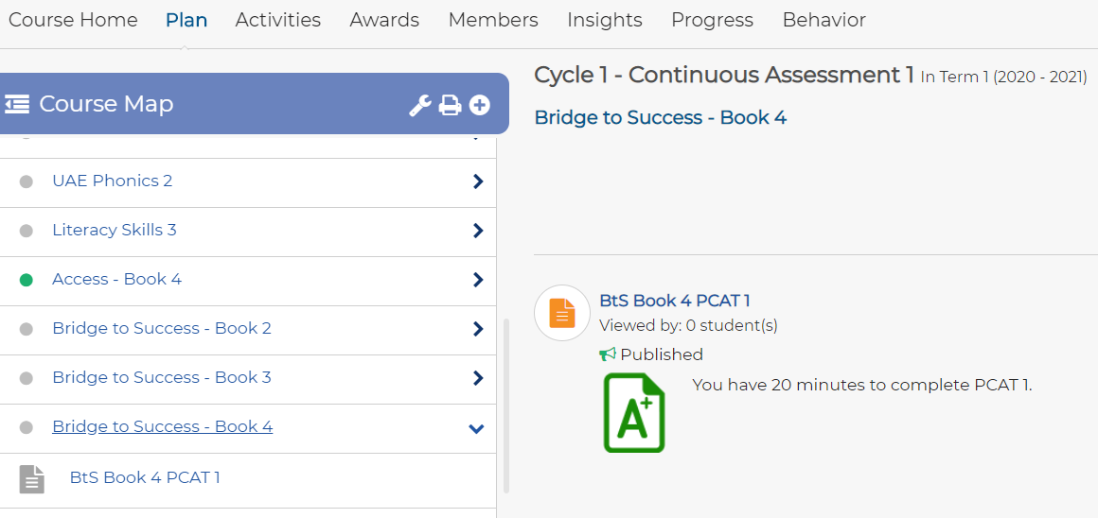

Slide 29
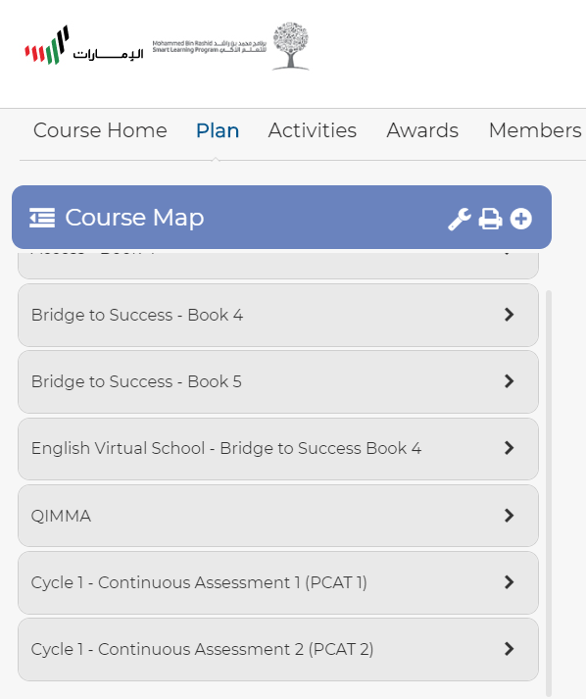
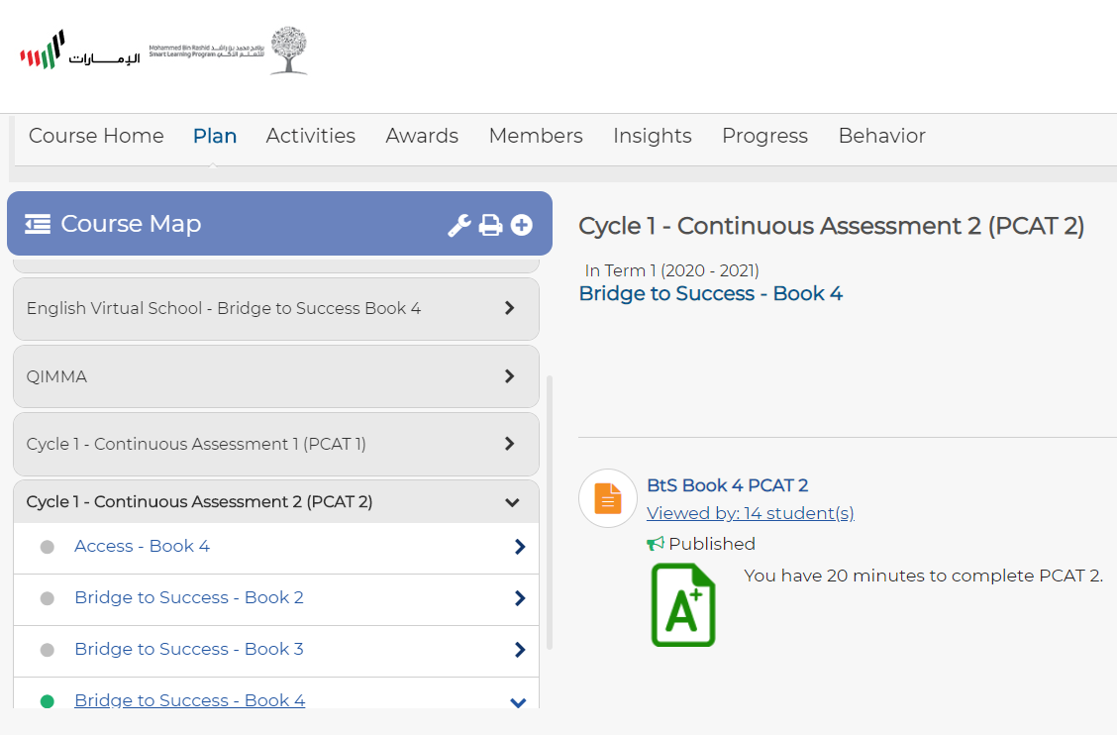

Slide 30
