Slide 1
Welcome to English Class
Welcome to WEEK 9 Lesson 1
Unit 3 Lesson 8

Slide 2
Our class rules

Slide 3
WARM UP
Guess the word
lwfo
wolf

Slide 4
To find meanings from context.
• To form questions.
To compare extinct vs. endangered.

Slide 5
LB
AB
Page 37
Pages 50

Slide 6
50

Slide 7
https://www.liveworksheets.com/1-cj1211644yp

Slide 11
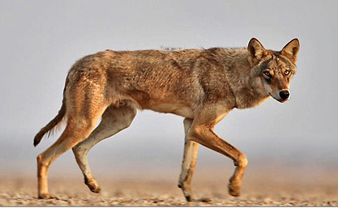
Arabian Wolf
What is the problem that the wolf facing????

Slide 12
So the Arabian wolf is endangered.

Slide 14
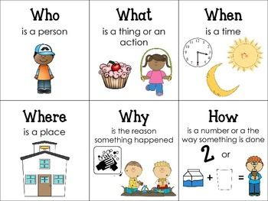

Slide 16
1.How many Arabian wolves are there left?
2.Where do they live?
3.When did they live in the UAE?
4. What did the wolves eat?
5.Why did the farmers kill the wolves?
50

Slide 17
Gorilla
Dolphin
37

Slide 18
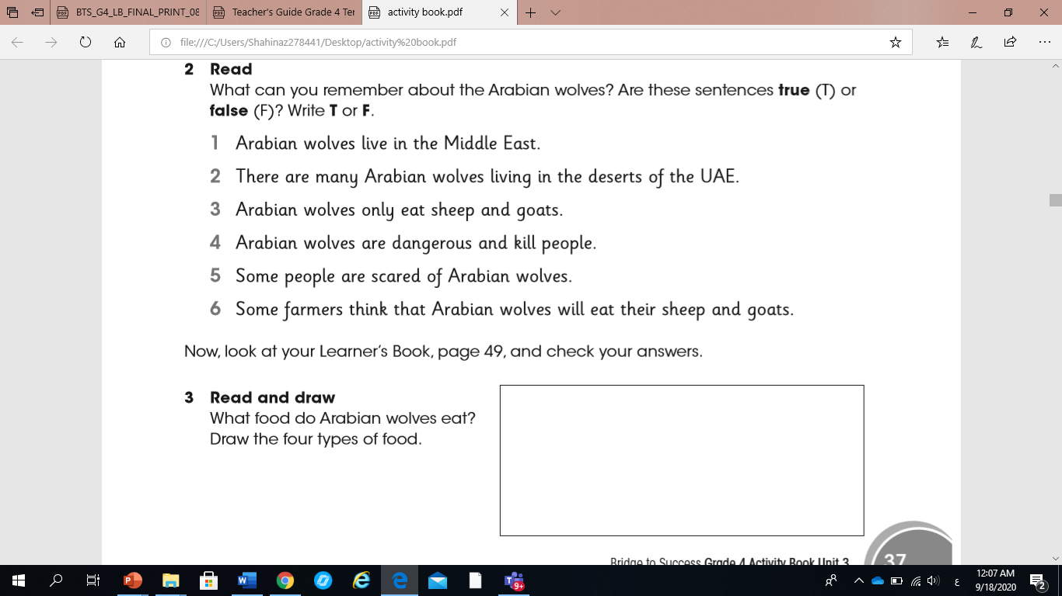
T
F
F
T
T
T
37

Slide 19
https://share.nearpod.com/JcFxmLkiS9

