Slide 1
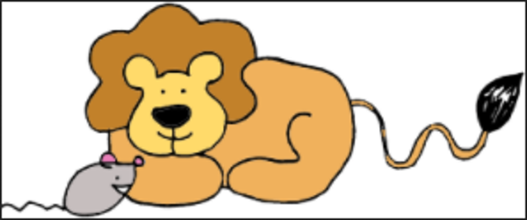
Watch a video about the story of the lion and the mouse.
Have you heard this story before?

Slide 3
Key Words
lion | nap
mouse | run
king | swallow
jungle | catches
little | trapped

Slide 4
Vocabulary

Slide 5
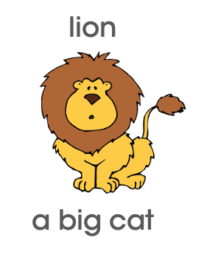

Slide 6
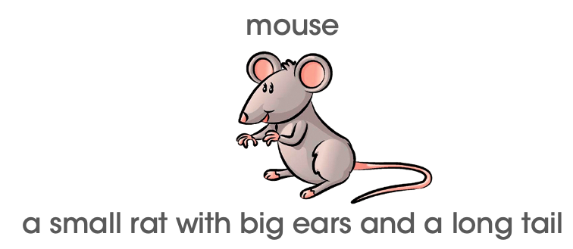

Slide 7
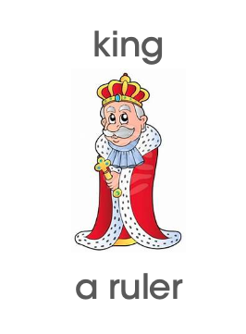

Slide 9
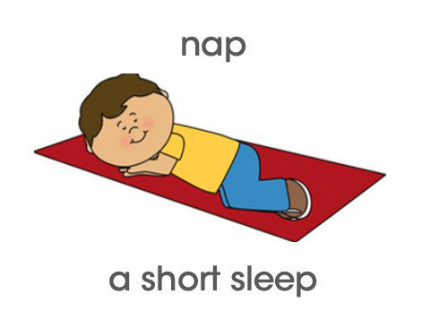

Slide 11
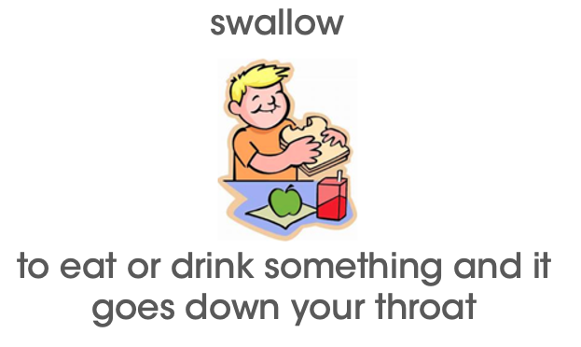

Slide 12
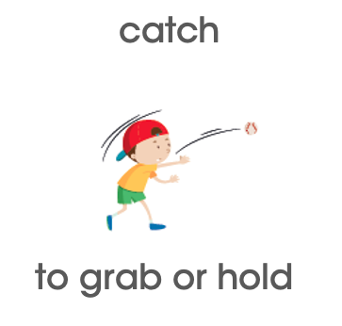

Slide 13
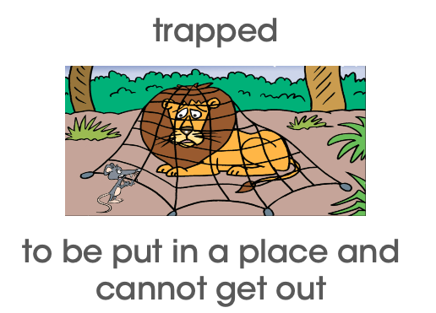

Slide 14
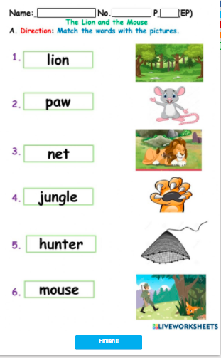
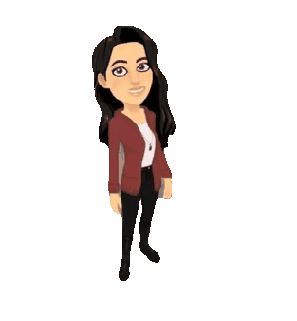
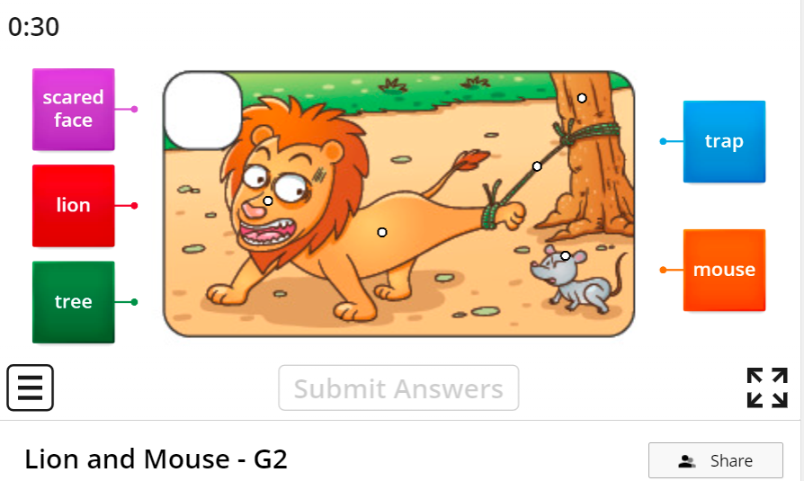
Check our understanding
https://www.liveworksheets.com/xh2411545de
https://wordwall.net/resource/2853625/lion-and-mouse-g2

Slide 16
The Lion and The Mouse

Slide 17
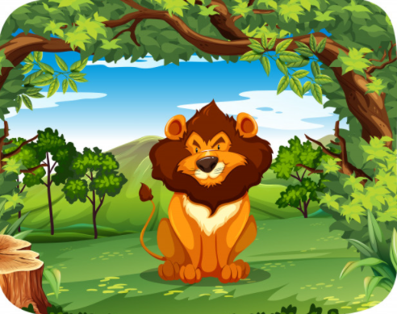
I’m the king of the jungle!

Slide 18
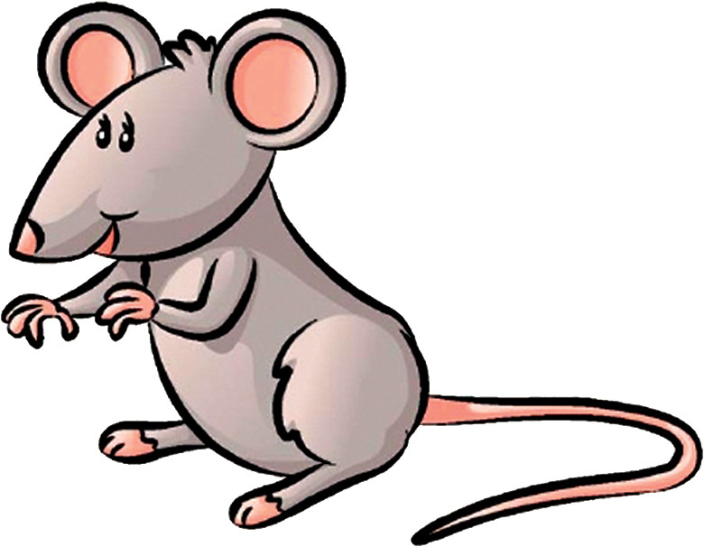
I am a little
mouse.

Slide 19
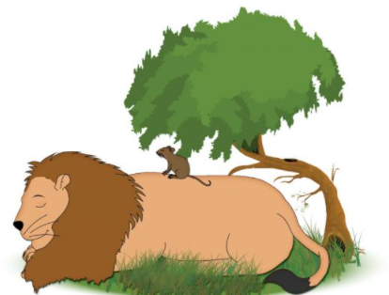
zzzz
Z Z Z
The lion takes a nap.

Slide 20
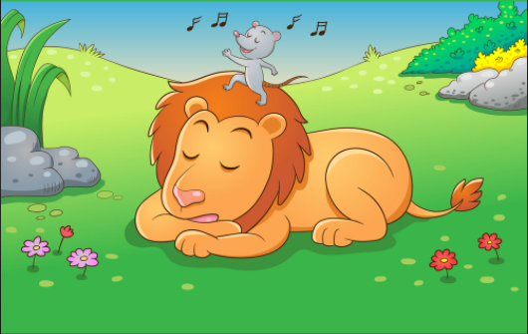
The mouse runs on the lion.

Slide 21
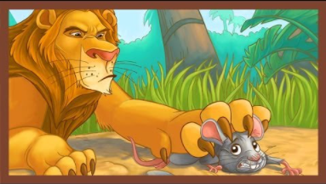
I’ll swallow you!
Lion catches mouse.

Slide 22
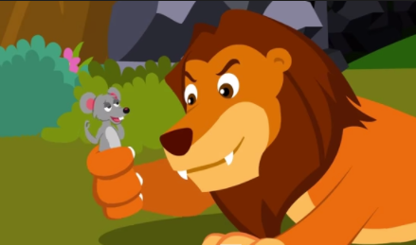
Don’t eat me!
I’ll help you.

Slide 23
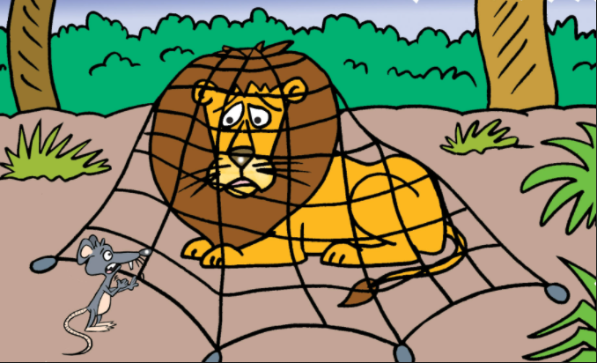
Lion was trapped in a net.

Slide 24
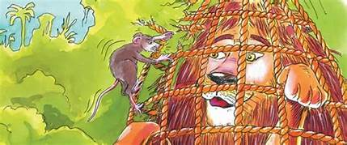
The mouse helped. They became friends.

Slide 25
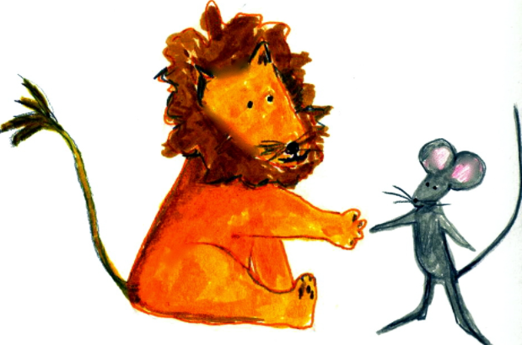
The End

Slide 26
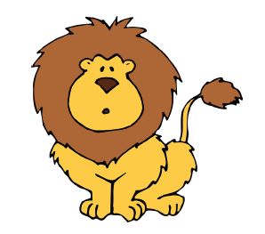
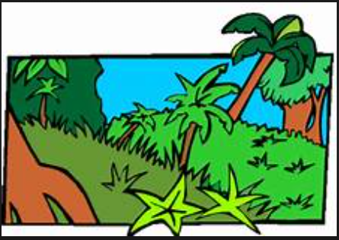
Who are the main characters in the story?
Where is the story set?

Slide 27
What happens at the start of the story?

Slide 28
What happens in the middle of the story?

Slide 29
What happens at the end of the story?

Slide 30
What lesson can we learn from this story?

Slide 31
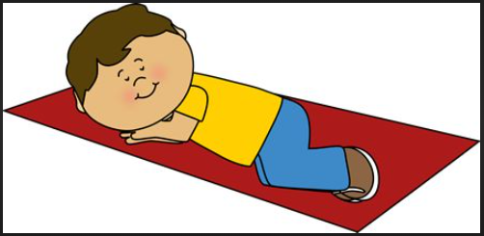
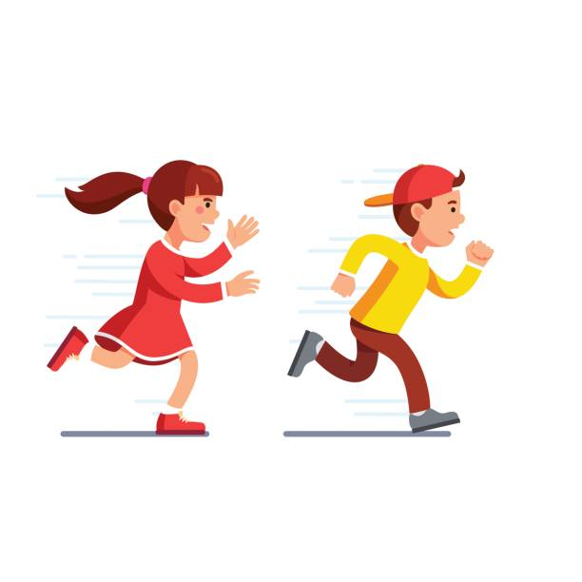
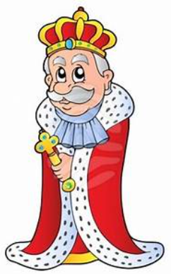
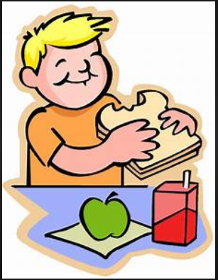
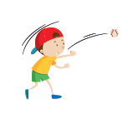
Glossary
lion (n)- a big cat |  | nap (n)- a short sleep
mouse (n)- a small rat with big ears and a long tail |  | run(s) (v)- to go quickly by moving legs and feet
king (n)- a ruler |  | swallow (v)- to put in mouth and chew
jungle (n)- land with trees and tall leaves |  | catch(es) (v)- to grab or hold
little (adj)- tiny or small |  | trapped (v)- to be put in a place and cannot get out

Slide 32
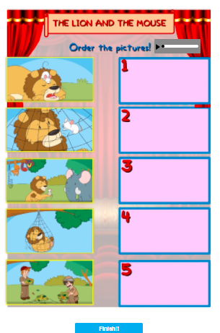
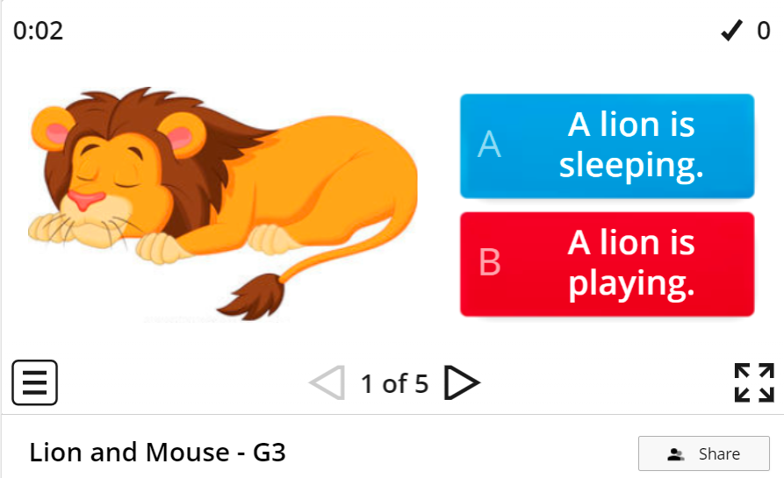
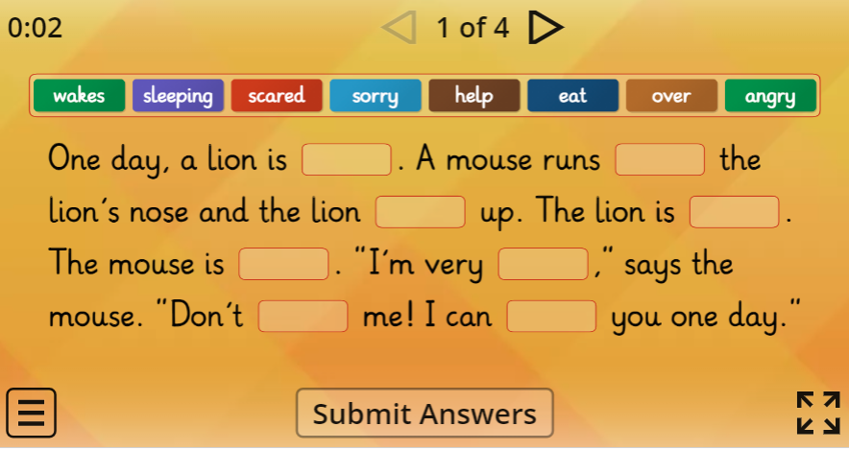
Check our comprehension
Easy
https://www.liveworksheets.com/worksheets/en/English_as_a_Second_Language_(ESL)/Storytelling/The_lion_and_the_mouse_zc477468og
Medium
https://wordwall.net/resource/2853271/lion-and-mouse-g3
Hard
https://wordwall.net/resource/7884182/the-lion-and-the-mouse

Slide 33
Questions​
Question 1:
What can you learn from the story?
“I can learn__________.”

Slide 34
Questions​
Question 2:
Who is the story about?
“The story is about a _______ and a _______.”

Slide 35
Questions​
Question 3:
What was the lion trapped in?
“The ______ was trapped in a ______.”

Slide 36
Questions​
Question 4:
How would you feel if a lion opened his big jaws to swallow you?
“I would feel _________.”

Slide 37
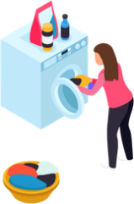
Questions​
Question 5:
How can you help someone?
“I can help someone by _______.”

Slide 38
​Reflection Question
Question 6: Reflection
I think that question number ______ was difficult because ______________.
I like question number ______ because _____________________________.

Slide 39
Glossary
lion (n)- a big cat |  | nap (n)- a short sleep
mouse (n)- a small rat with big ears and a long tail |  | run(s) (v)- to go quickly by moving legs and feet
king (n)- a ruler |  | swallow (v)- to put in mouth and chew
jungle (n)- land with trees and tall leaves |  | catch(es) (v)- to grab or hold
little (adj)- tiny or small |  | trapped (v)- to be put in a place and cannot get out

