Slide 1
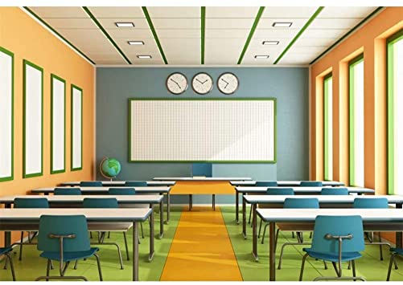
Good morning my dear students!
How are you?

Slide 2
Please keep quiet while your teacher is taking the attendance.

Slide 5
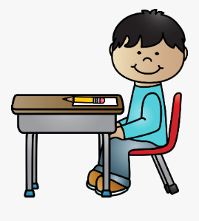
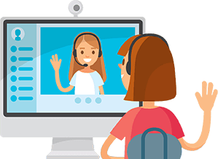
Class Rules
Be ready on time
Sit in a good position
Mute your microphone
Respect your friends

Slide 6
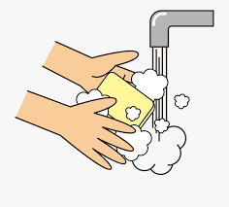
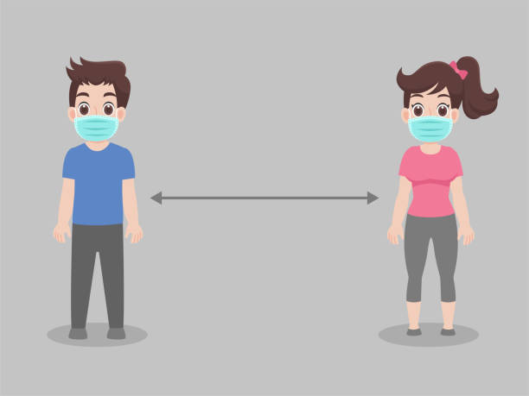
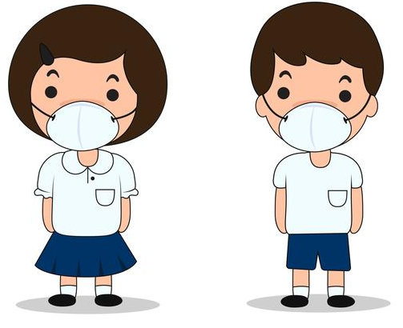
Read the message
Golden message
1
Stay at home
2
Wash your hands for 20 second
3
Wear a mask when you go out
4
Keep distance with others.
Stay at home For UAE and for your health.

Slide 7
Unit 3: Outdoor pursuit Lessons 8-9
What are your plans?

Slide 8
LB P. 66 AB P. 59

Slide 9
Wednesday, Nov. 18th, 2020
Lesson 9

Slide 10
Lesson 9
Learning Objectives:
Speaking: To ask about and discuss plans using future forms.
Writing: To complete sentences and write statements about plans using future forms.

Slide 12
2 I’m going to watch a falconry demonstration next week. (going to – plan)
3 My bus leaves at 10 o’clock tomorrow morning.
(present simple)
4 I think I’ll try kayaking on Tuesday. (will – prediction)

Slide 13
5 I’m seeing old friends tomorrow afternoon. (present continuous)
6 It’s going to start raining soon. (going to – prediction)

Slide 16
How do you feel about the lesson today?
Did you learn something new?
1
I need more help! (Hard!)
2
I am getting there. (It was ok!)
3
I can do it! (Easy!)

Slide 17
Golden message
Wash your hands every hour using water with soap for 20 seconds.
Wear your mask.

Slide 18
Our session has ended.
Bye – bye !

