Slide 1
Welcome to our English class
Teacher: Baraah Almourad

Slide 2
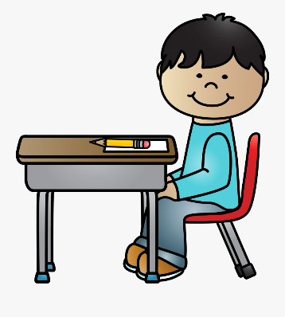
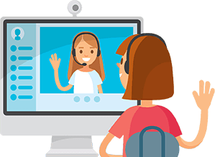
Online class rules
Be ready on time
Sit in a good position
Mute your microphone
Respect your friends

Slide 3
U5: Dinosaurs Lesson 8: Different dinosaurs

Slide 5
Hello!
Are you ready?

Slide 6
Vocabulary

Slide 7
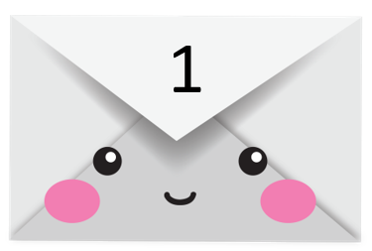
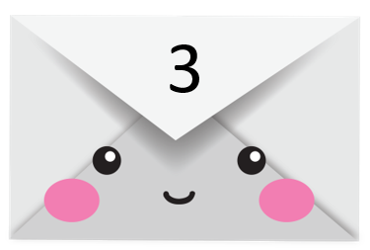
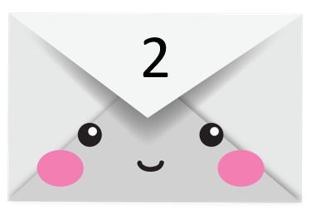
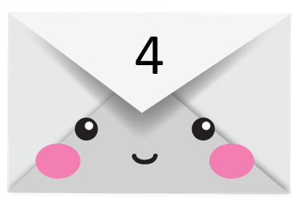

Slide 8
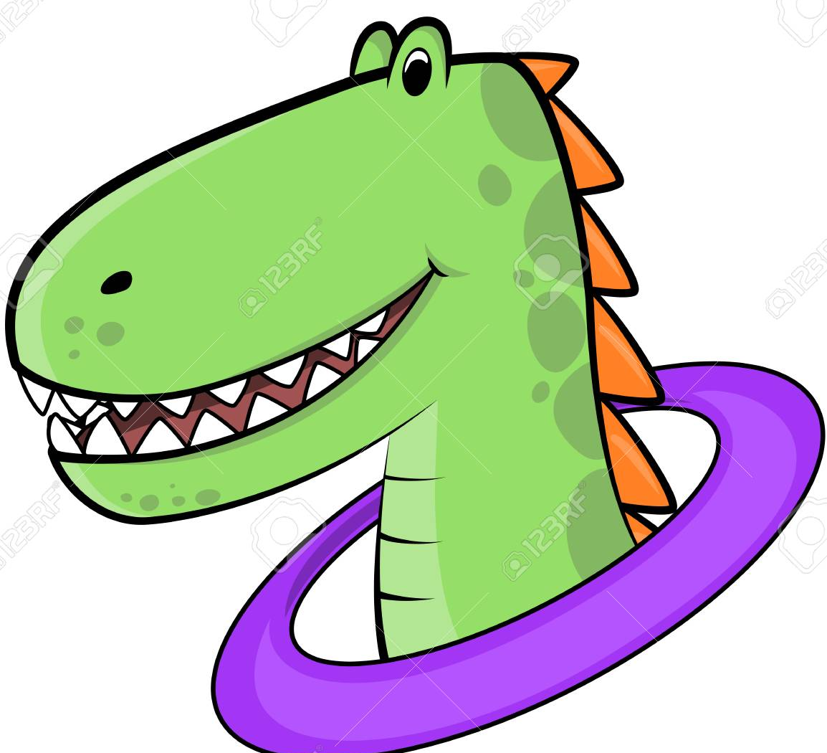
head

Slide 9
body

Slide 10
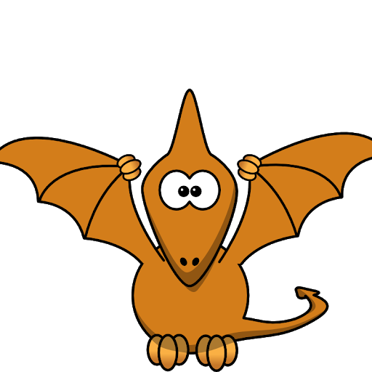
wings

Slide 11
eyes

Slide 12
plants

Slide 13
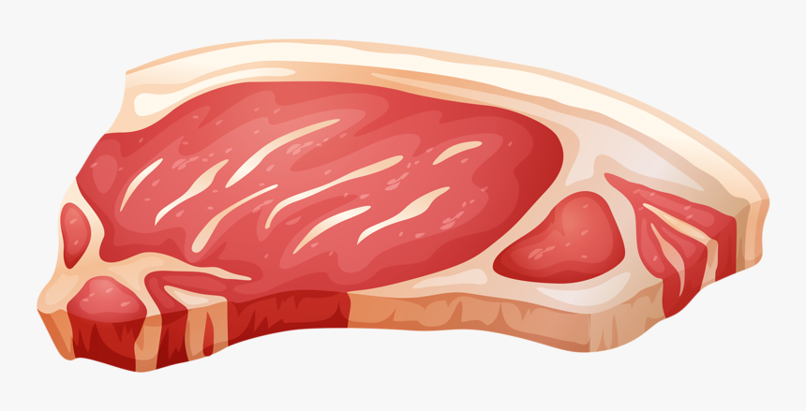
meat

Slide 14
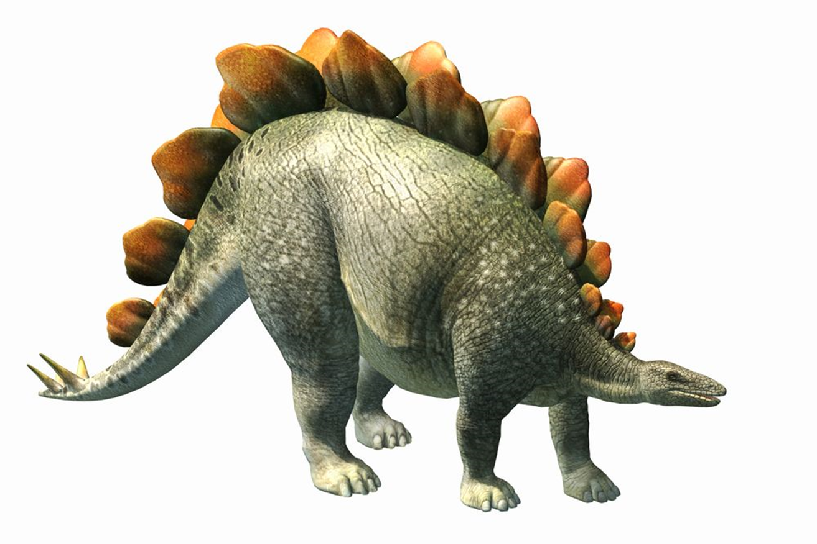
Stegosaurus

Slide 15
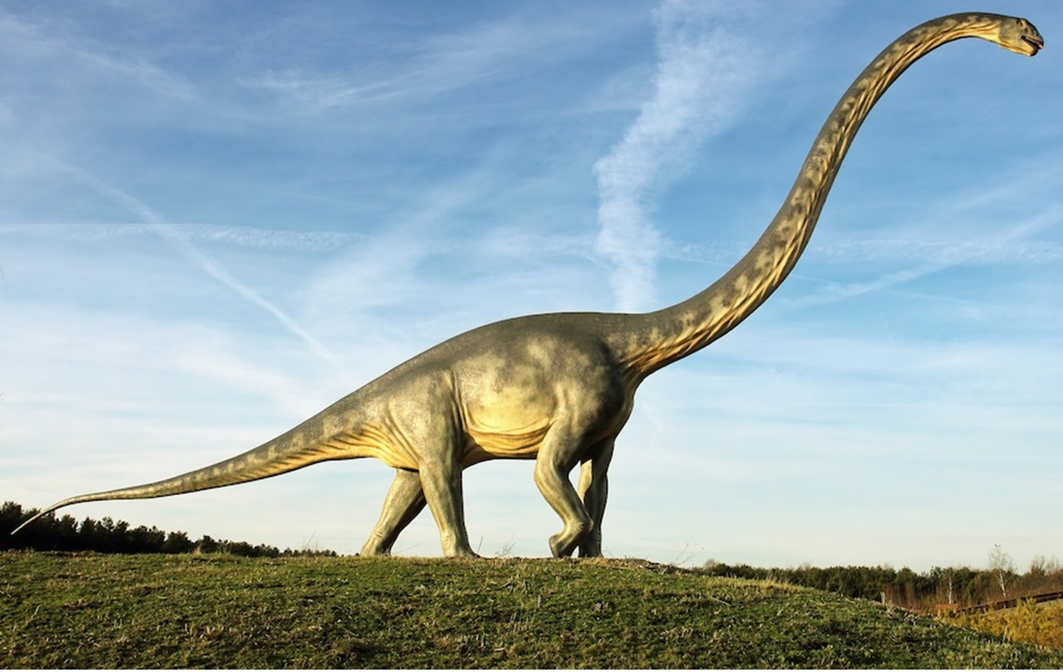
Diplodocus

Slide 16
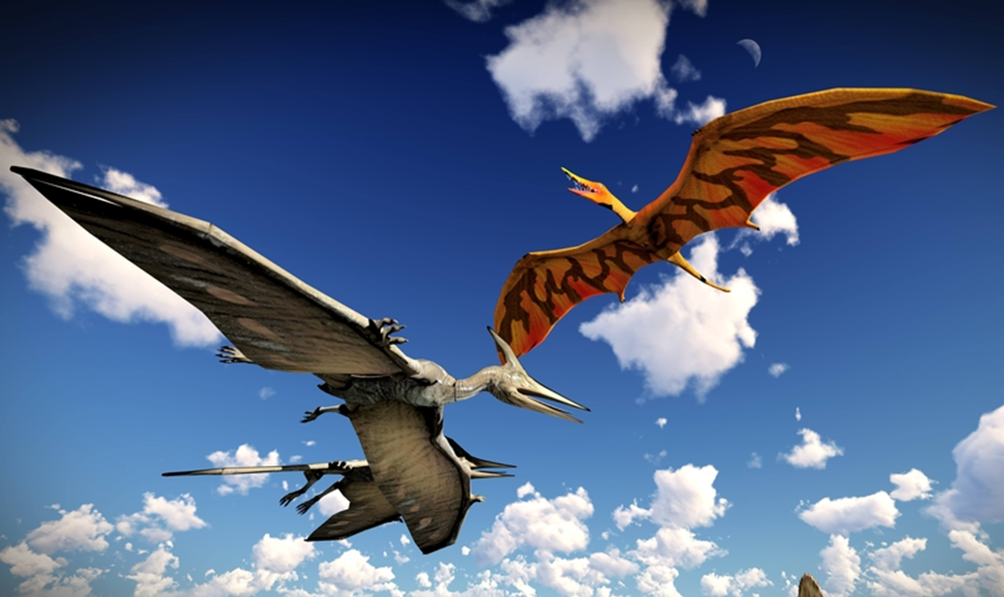
Pterodactyl

Slide 17
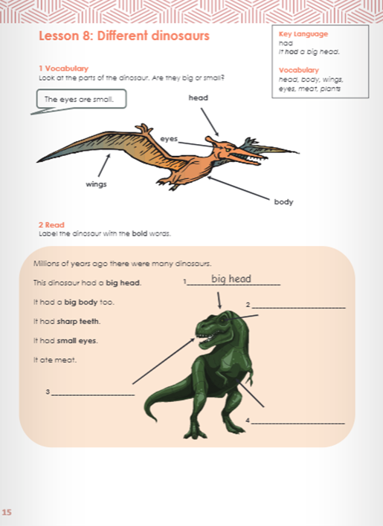
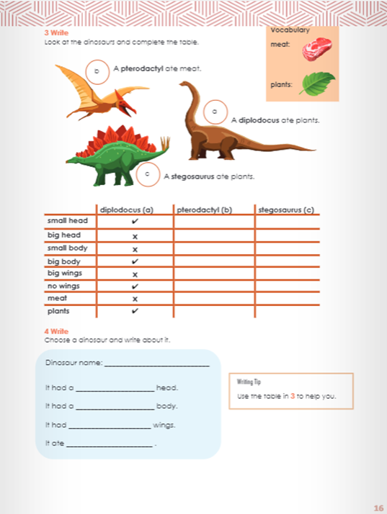
Page: 15
Page: 16

Slide 18
Pages 15 & 16

Slide 19
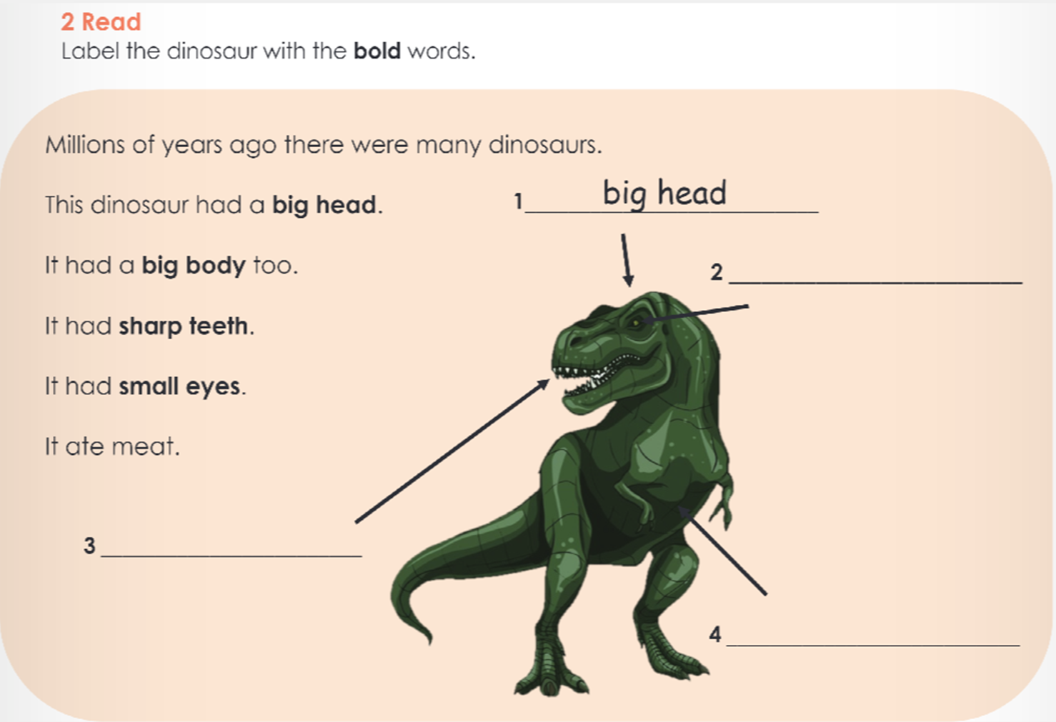
small eyes
sharp teeth
big body

Slide 21
Stegosaurus
small
big
no
plants

Slide 22
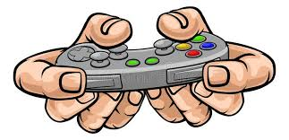
Level 1: Easy
https://wordwall.net/play/141/869/172

Slide 23
Level 2: Medium
https://www.liveworksheets.com/tu1050650jd

Slide 24
Self - Assess
How do you feel about today’s lesson?

