Slide 1
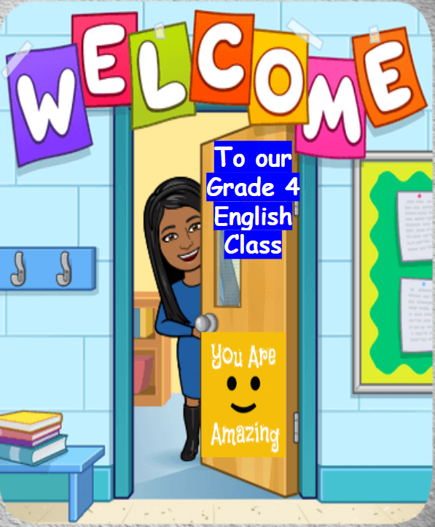

Slide 2
Online Class Rules
Be ready and on time.
Sit on a chair at a table.
Mute your microphone.
Respect your friends.

Slide 3
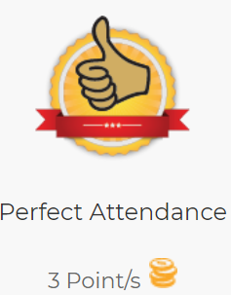
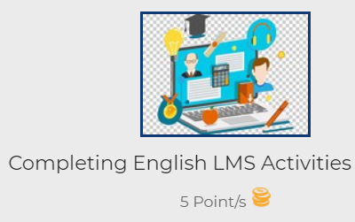
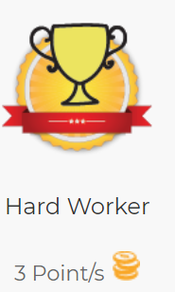
Nada Yousef | Marayem Abdulrahman | Nada Yousef |  | Nada Yousef
Shahad Fahmi | Moodi Mohamed | Shahad Fahmi |  | Shahad Fahmi
Shaikha Mohammed | Noora Hamad | Shaikha Mohammed |  | Shaikha Mohammed
Wedad Yaaqoob | Noora Mohamed | Wedad Yaaqoob |  | Wedad Yaaqoob
Alhanoof Salem | Rawdha Khamis | Mahra Mahmood |  | Ghaya Mabkhut
Meera Abdulrazzaq | Saada Abdulrazzaq | Moodi Mohamed |  | Saada Abdulrazzaq
Alhtoon Jaber | Shama Bandar | Shama Bandar
Hind Mohamed | Wadeema Abdulqader
Mahra Matar
Maitha Mohammed
Malak Eisa
4D
Star Students Week 2

Slide 4
Week 2
Nada Yousef
Shahad Fahmi
Shaikha Mohammed
Wedad Yaaqoob

Slide 5
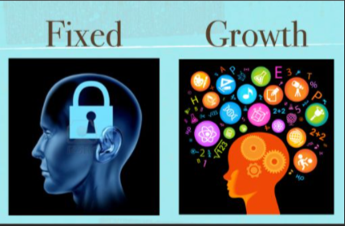
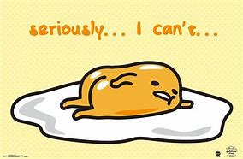

Slide 6
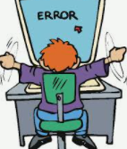
Classroom Helpers
attendance
behaviour
messenger
technical issues

Slide 7
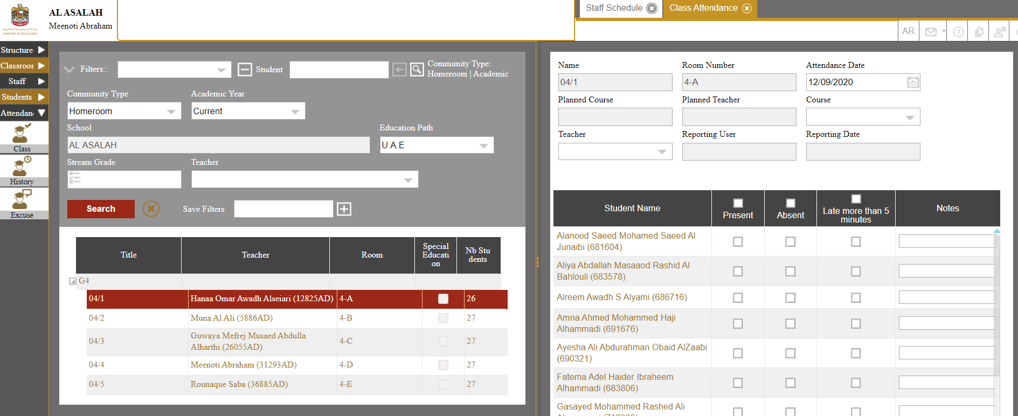
It is considered as skipping if you do not complete the activities.

Slide 8
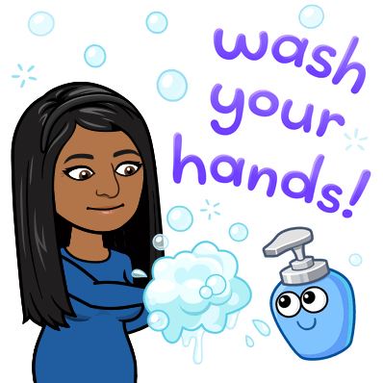
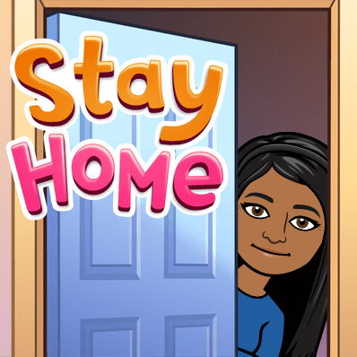
لسلامتك وسلامة الآخرين
For your safety and the safety of others:
Don’t leave home without a mask.

Slide 9
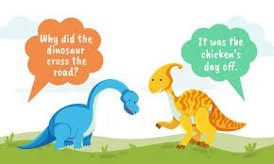
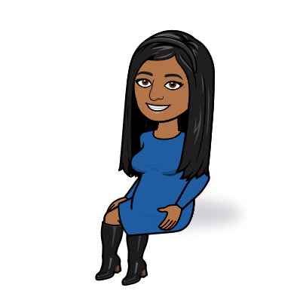
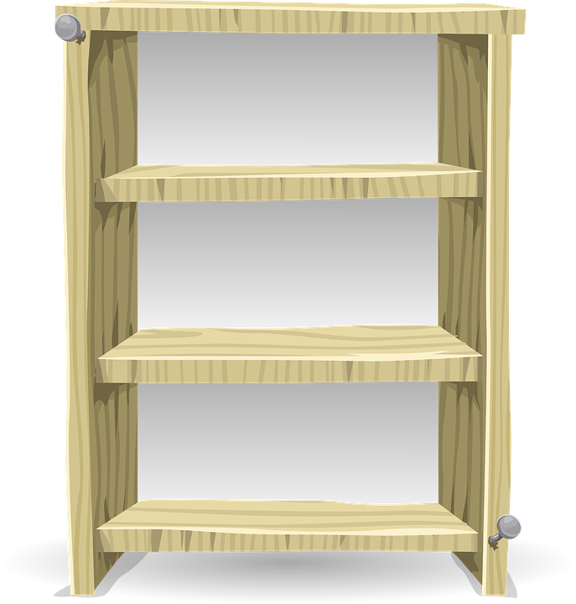
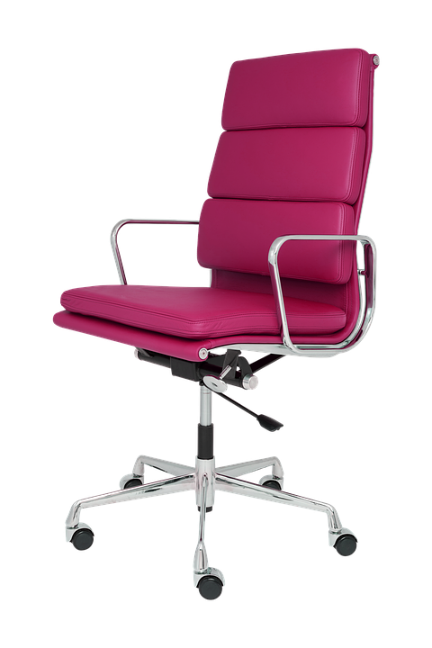
Unit Dinosaurs
Lesson 10 Review
Week 3

Slide 10
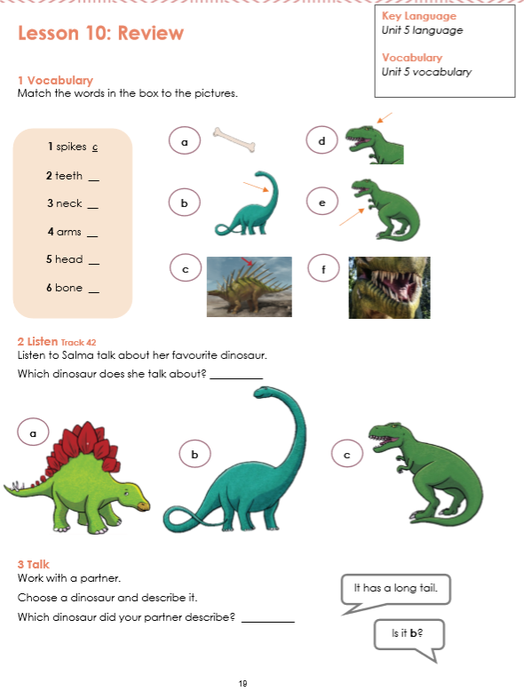
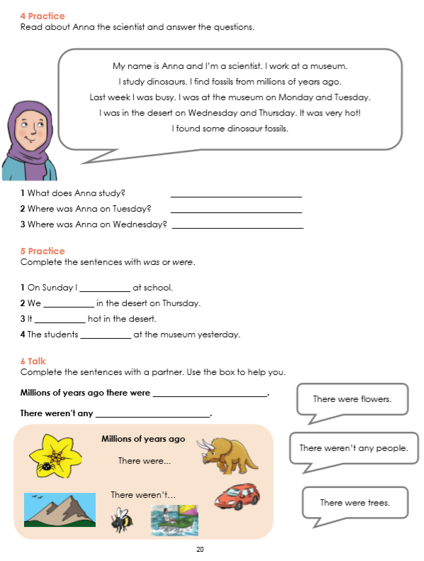
01
Page 19
Page 20

Slide 11
Are you ready to review what you have learnt about dinosaurs?

Slide 12
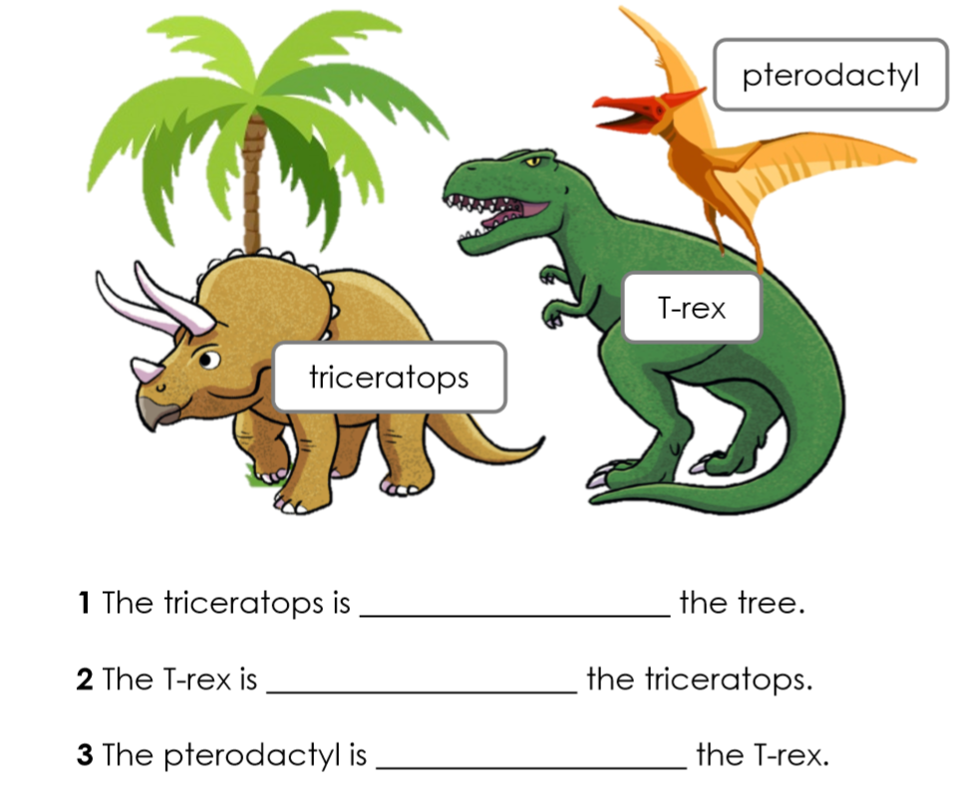
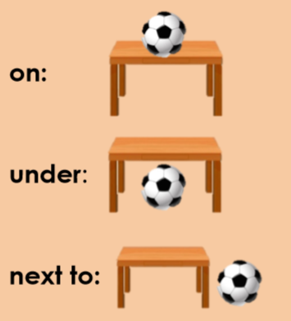
What do you remember
from our previous lesson?
under
next to
on

Slide 13
Lesson Objectives
LISTENING
Listen to Salma talk about her favourite dinosaur.
SPEAKING
Speak about things that were and weren’t found millions of years ago.
READING
We will read and answer questions about Amna the scientist.
WRITING
Complete sentences with was or were

Slide 14
Review of Unit 5 Vocabulary Words.

Slide 15
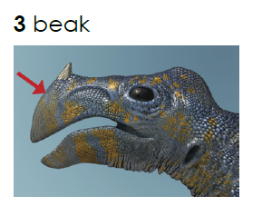
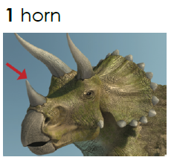
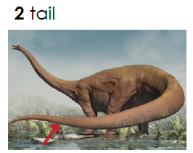
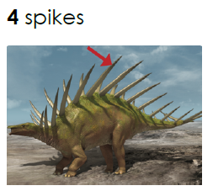
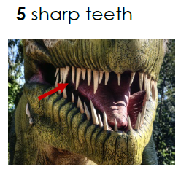

Slide 16
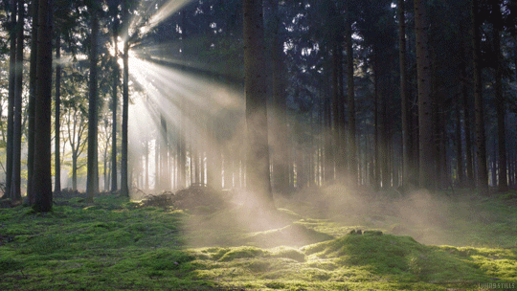
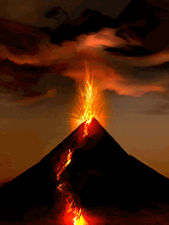
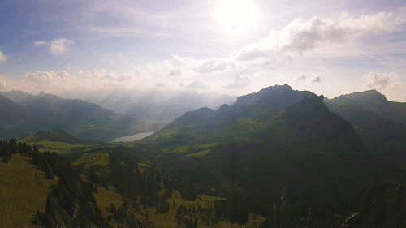
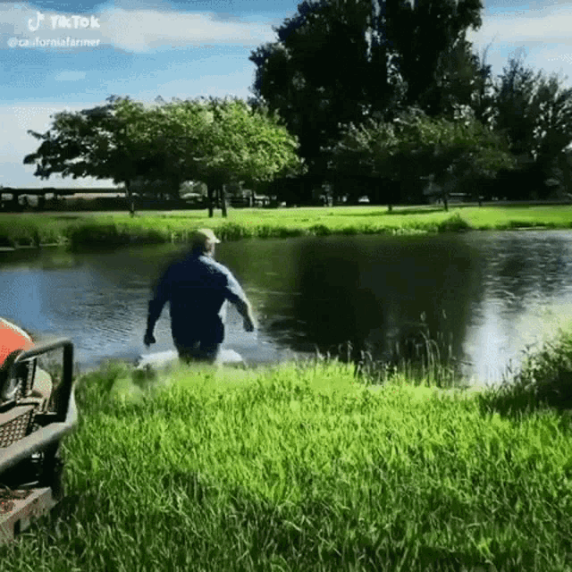
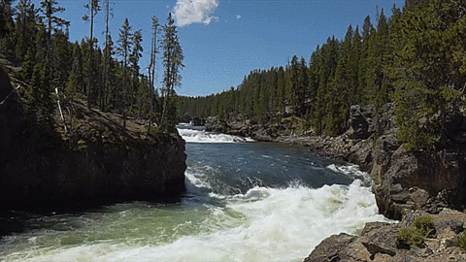
forest
volcano
mountain
lake
river

Slide 17
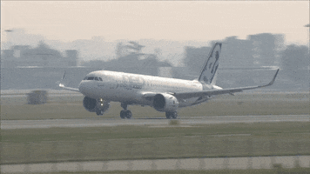
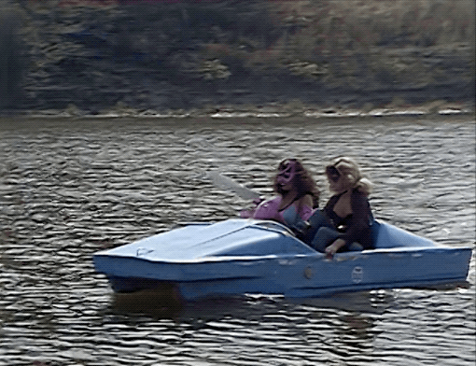
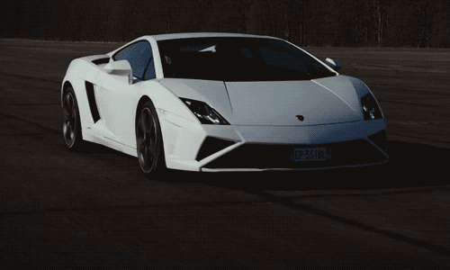
plane
boat
car

Slide 18
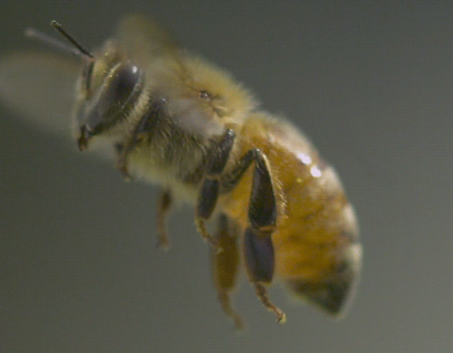
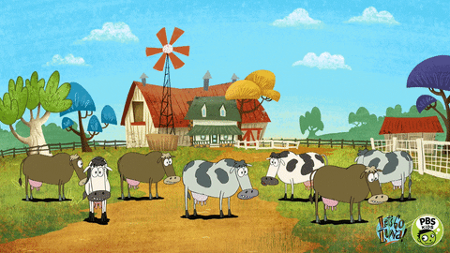
bee
road
house
farm

Slide 19
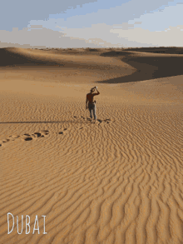
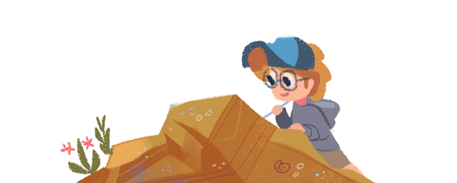
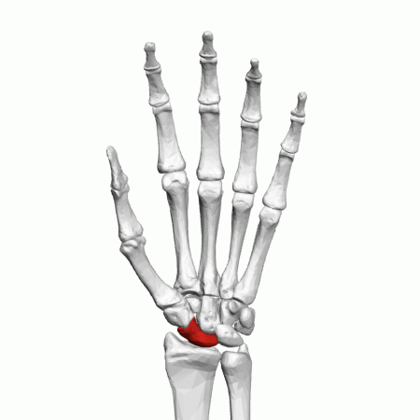
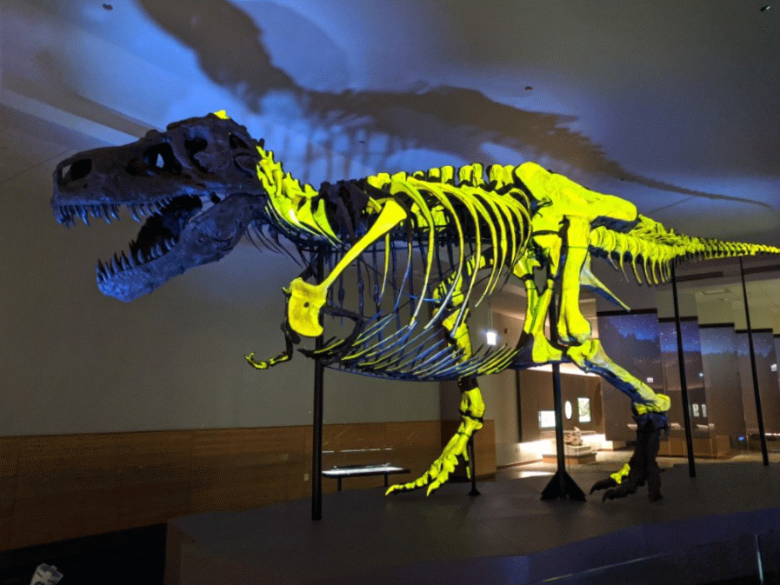
scientist
footprints
bones
museum

Slide 20
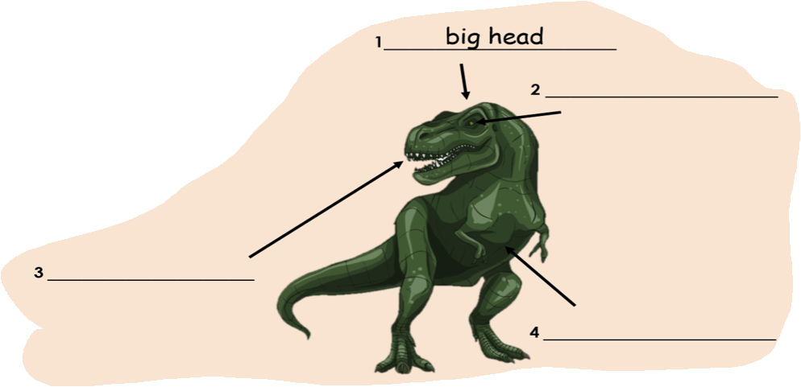
head
eyes
arms
teeth
body

Slide 22
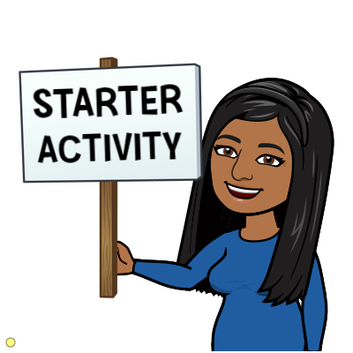
Where was Anna on Wednesday?
What does Anna study?
Where was Anna on Tuesday?

Slide 23
Can you remember the names of these dinosaurs? Choose your favourite one on Mentimeter?

Slide 24
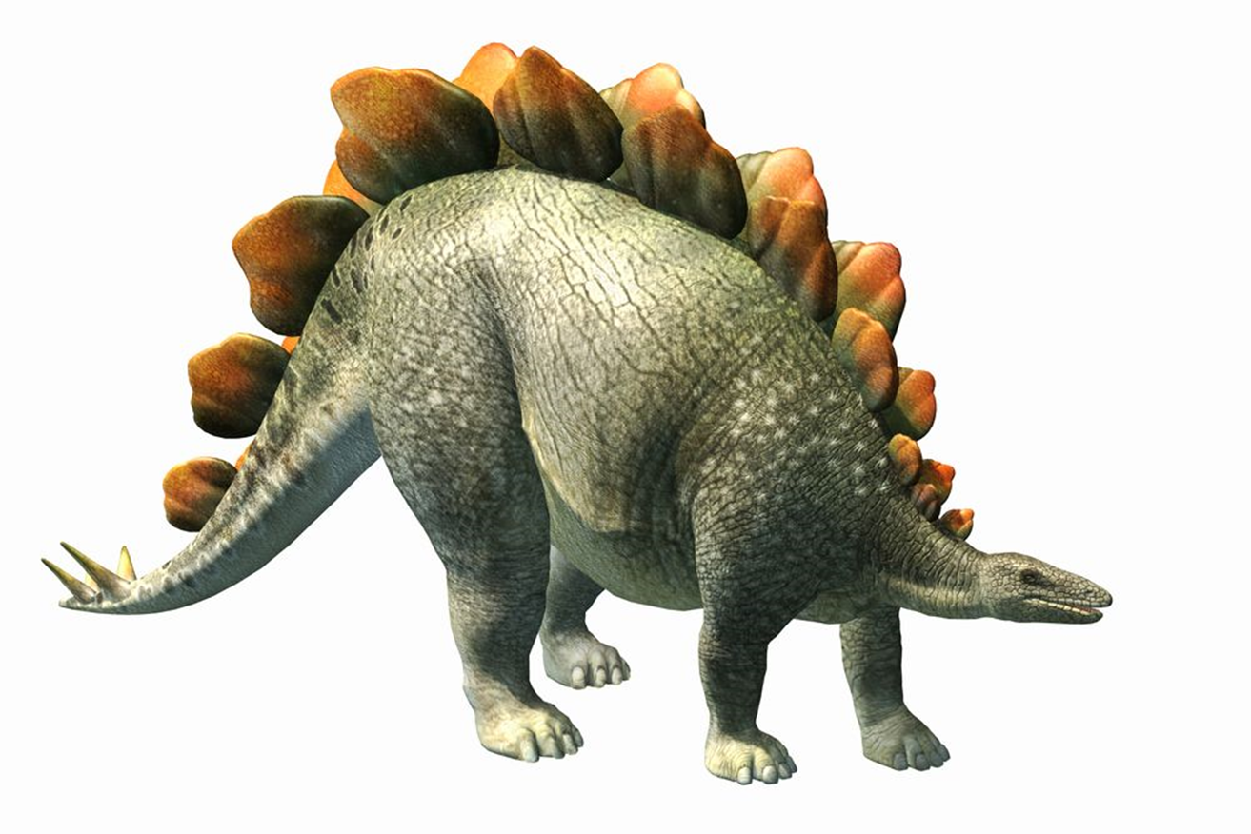
Stegosaurus

Slide 25
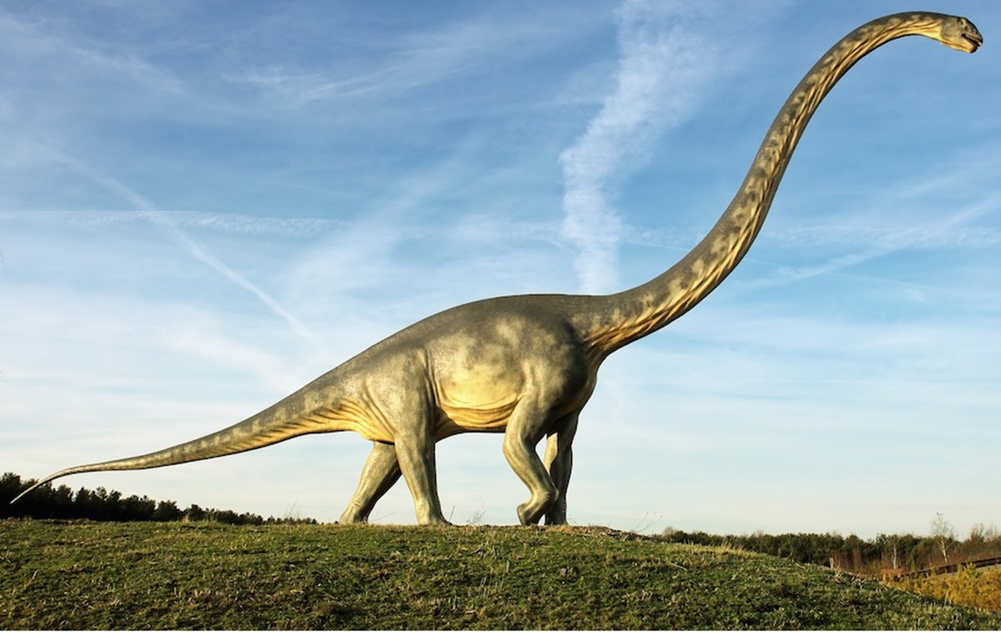
Diplodocus

Slide 26
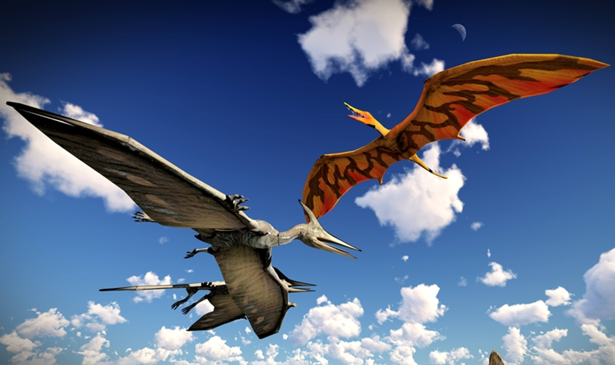
Pterodactyl

Slide 27
https://www.mentimeter.com/s/2595573cdb1a0b19c012203b8f9df4dd/dce2ca8f649d
Choose your favourite dinosaur.

Slide 28
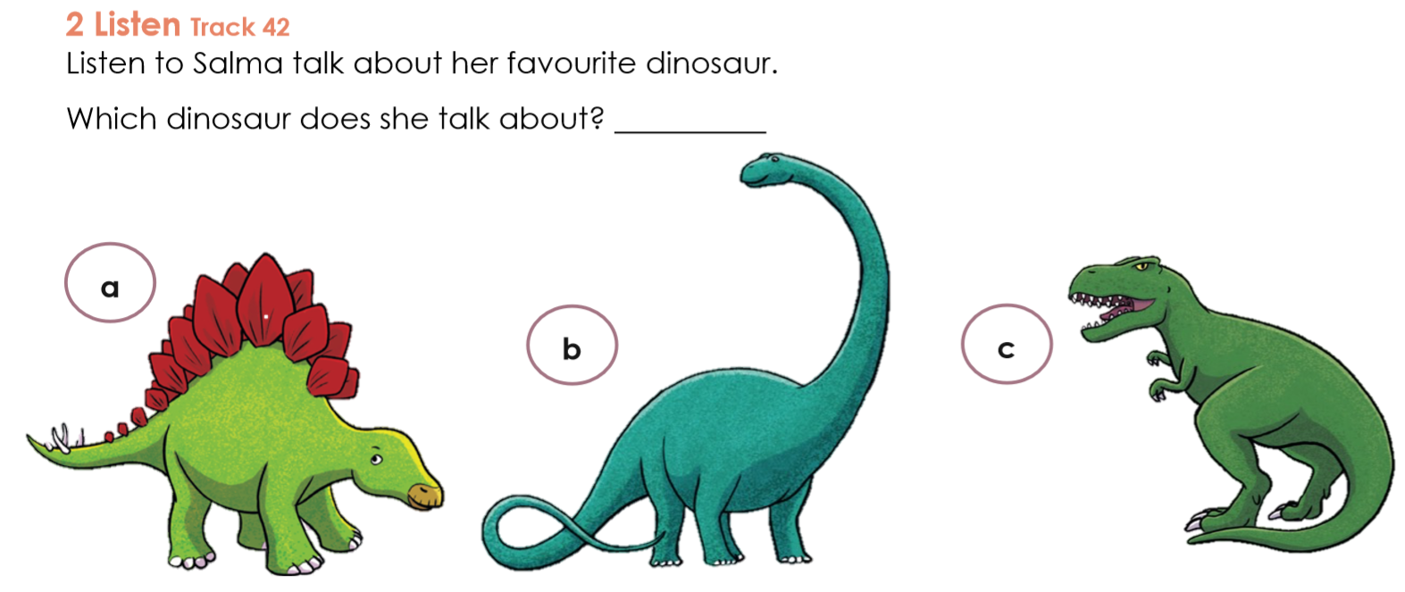
CCQ
Type your answer in the text box.

Slide 30
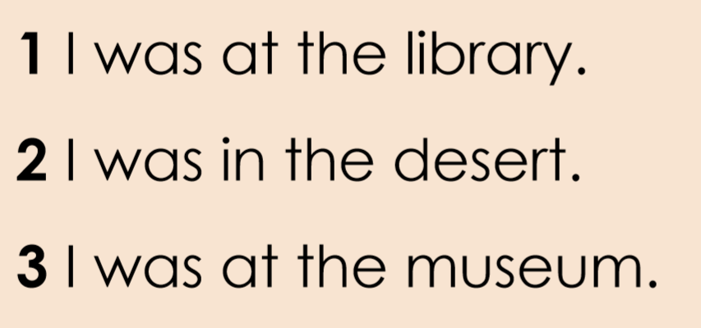

Slide 32
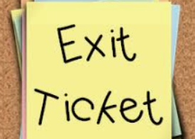
2 questions | 2 questions | 3 questions | 4 questions
Write the answers in your books or the chat box.
CCQ

Slide 33
In your groups(Breakout Rooms) discuss the things that there were and there weren’t found millions of years ago.
CCQ

Slide 34
I can use was and were in sentences.

Slide 35
Would you like to become a dinosaur scientist one day? Why? Why not

Slide 37
In Channels
lesson
lesson
lesson
lesson

Slide 38
You may record yourself reading and post it on LMS.

Slide 39
https://www.liveworksheets.com/xf131979vo
https://quizizz.com/admin/quiz/5ec1cd2451cbc3001c54e4d6/was-wasn-t-were-weren-t
https://www.liveworksheets.com/ej1267350fc

Slide 41
Thank you

