Slide 1
Learner book
Activity book

Slide 2
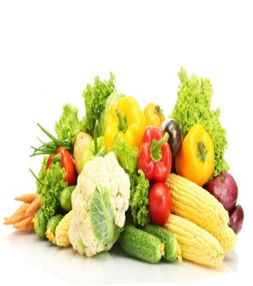
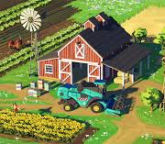
2021-2022
Trimester 2
Grade 2
Speaking Outcome Tracker
Assessment
PRACTICE

Slide 3
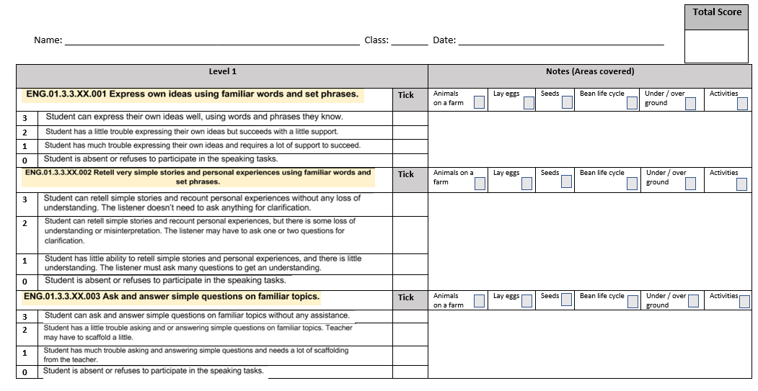
Wellbeing
Introduction
Calendar
Covid-19 safety
Class rules
Class Helpers
Warm up: Phonics, Tricky words, HFWs
Resources
Outcomes & Success Criteria
Starter: Prior learning, video, vocabulary
Main Activity: Video, vocabulary, Text book
Critical Thinking
Differentiated Activities
Plenary
UAE link
Self-Assessment
Enrichment
Exit ticket
SPEAKING ASSESSMENT PRACTISE
Marks

Slide 4
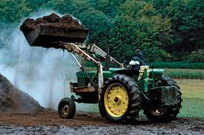
Wellbeing
Introduction
Calendar
Covid-19 safety
Class rules
Class Helpers
Warm up: Phonics, Tricky words, HFWs
Resources
Outcomes & Success Criteria
Starter: Prior learning, video, vocabulary
Main Activity: Video, vocabulary, Text book
Critical Thinking
Differentiated Activities
Plenary
UAE link
Self-Assessment
Enrichment
Exit ticket
Vocabulary
Let’s practise.
This is a tractor.

Slide 5
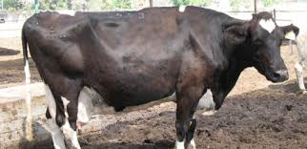
Wellbeing
Introduction
Calendar
Covid-19 safety
Class rules
Class Helpers
Warm up: Phonics, Tricky words, HFWs
Resources
Outcomes & Success Criteria
Starter: Prior learning, video, vocabulary
Main Activity: Video, vocabulary, Text book
Critical Thinking
Differentiated Activities
Plenary
UAE link
Self-Assessment
Enrichment
Exit ticket
Vocabulary
Let’s practise.
This is a cow.

Slide 6
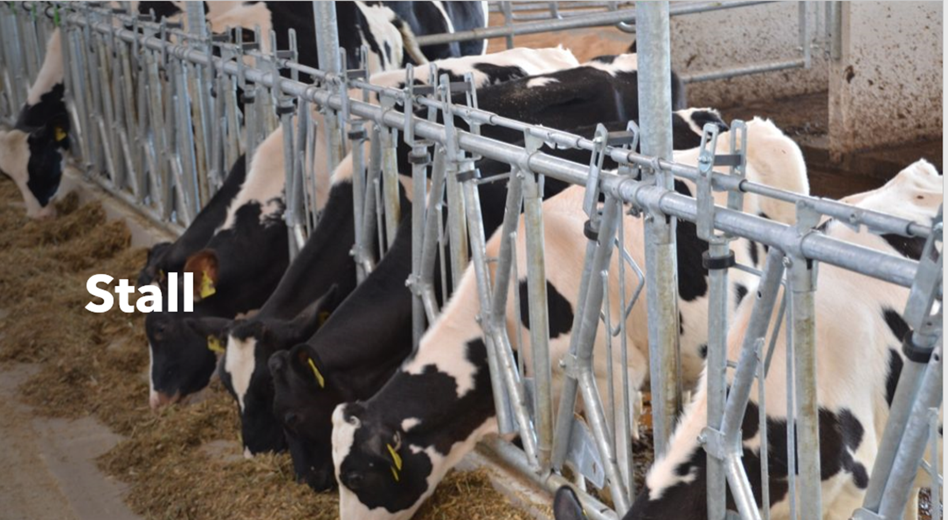
Wellbeing
Introduction
Calendar
Covid-19 safety
Class rules
Class Helpers
Warm up: Phonics, Tricky words, HFWs
Resources
Outcomes & Success Criteria
Starter: Prior learning, video, vocabulary
Main Activity: Video, vocabulary, Text book
Critical Thinking
Differentiated Activities
Plenary
UAE link
Self-Assessment
Enrichment
Exit ticket
Vocabulary
Let’s practise.
The cows are in the stall.

Slide 7
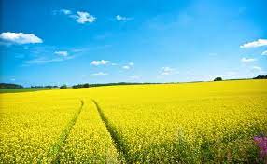
Wellbeing
Introduction
Calendar
Covid-19 safety
Class rules
Class Helpers
Warm up: Phonics, Tricky words, HFWs
Resources
Outcomes & Success Criteria
Starter: Prior learning, video, vocabulary
Main Activity: Video, vocabulary, Text book
Critical Thinking
Differentiated Activities
Plenary
UAE link
Self-Assessment
Enrichment
Exit ticket
Vocabulary
Let’s practise.
This is a field.

Slide 8
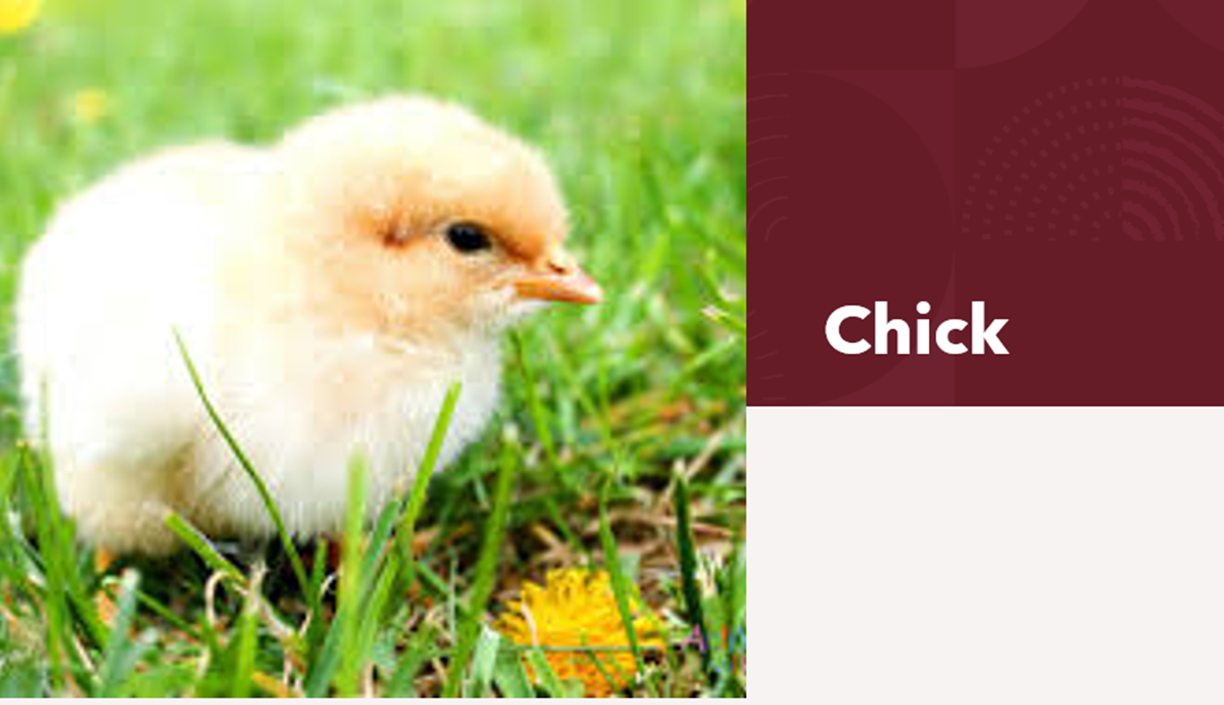
Wellbeing
Introduction
Calendar
Covid-19 safety
Class rules
Class Helpers
Warm up: Phonics, Tricky words, HFWs
Resources
Outcomes & Success Criteria
Starter: Prior learning, video, vocabulary
Main Activity: Video, vocabulary, Text book
Critical Thinking
Differentiated Activities
Plenary
UAE link
Self-Assessment
Enrichment
Exit ticket
Vocabulary
Let’s practise.
This is a chick.

Slide 9
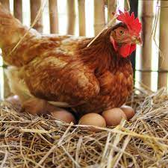
Wellbeing
Introduction
Calendar
Covid-19 safety
Class rules
Class Helpers
Warm up: Phonics, Tricky words, HFWs
Resources
Outcomes & Success Criteria
Starter: Prior learning, video, vocabulary
Main Activity: Video, vocabulary, Text book
Critical Thinking
Differentiated Activities
Plenary
UAE link
Self-Assessment
Enrichment
Exit ticket
Vocabulary
Let’s practise.
This is a hen.

Slide 10
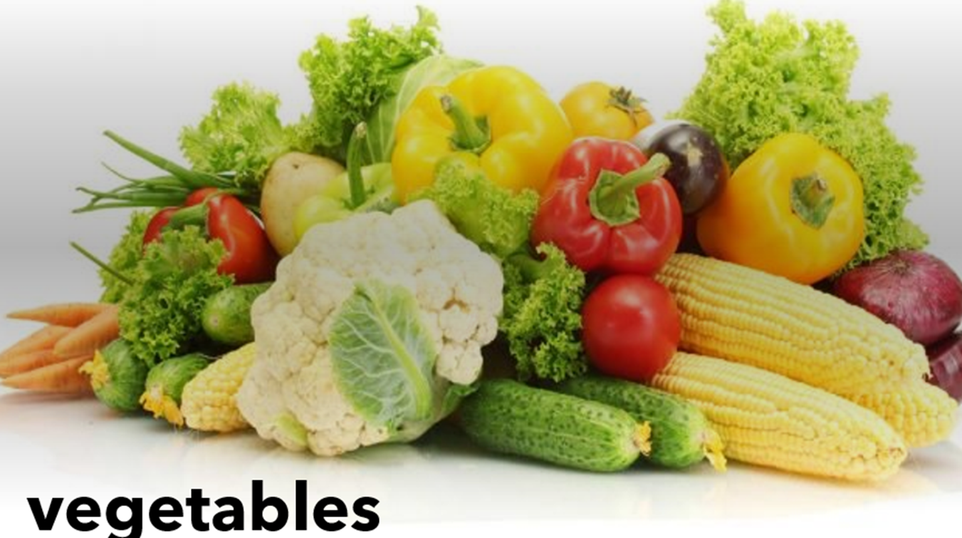
Wellbeing
Introduction
Calendar
Covid-19 safety
Class rules
Class Helpers
Warm up: Phonics, Tricky words, HFWs
Resources
Outcomes & Success Criteria
Starter: Prior learning, video, vocabulary
Main Activity: Video, vocabulary, Text book
Critical Thinking
Differentiated Activities
Plenary
UAE link
Self-Assessment
Enrichment
Exit ticket
Vocabulary
Let’s practise.
These are vegetables.

Slide 11
Wellbeing
Introduction
Calendar
Covid-19 safety
Class rules
Class Helpers
Warm up: Phonics, Tricky words, HFWs
Resources
Outcomes & Success Criteria
Starter: Prior learning, video, vocabulary
Main Activity: Video, vocabulary, Text book
Critical Thinking
Differentiated Activities
Plenary
UAE link
Self-Assessment
Enrichment
Exit ticket
Vocabulary
Let’s practise.
This is an egg.

Slide 12
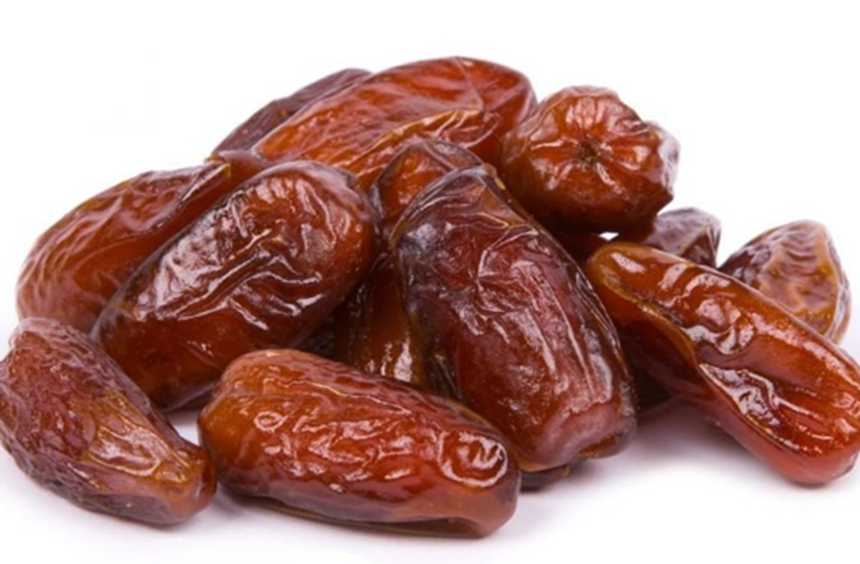
Wellbeing
Introduction
Calendar
Covid-19 safety
Class rules
Class Helpers
Warm up: Phonics, Tricky words, HFWs
Resources
Outcomes & Success Criteria
Starter: Prior learning, video, vocabulary
Main Activity: Video, vocabulary, Text book
Critical Thinking
Differentiated Activities
Plenary
UAE link
Self-Assessment
Enrichment
Exit ticket
Vocabulary
Let’s practise.
These are dates.

Slide 13
Wellbeing
Introduction
Calendar
Covid-19 safety
Class rules
Class Helpers
Warm up: Phonics, Tricky words, HFWs
Resources
Outcomes & Success Criteria
Starter: Prior learning, video, vocabulary
Main Activity: Video, vocabulary, Text book
Critical Thinking
Differentiated Activities
Plenary
UAE link
Self-Assessment
Enrichment
Exit ticket
Focus on talking about things on the pages where you see this:

Slide 14
Wellbeing
Introduction
Calendar
Covid-19 safety
Class rules
Class Helpers
Warm up: Phonics, Tricky words, HFWs
Resources
Outcomes & Success Criteria
Starter: Prior learning, video, vocabulary
Main Activity: Video, vocabulary, Text book
Critical Thinking
Differentiated Activities
Plenary
UAE link
Self-Assessment
Enrichment
Exit ticket
What animals can you
see on a farm?

Slide 15
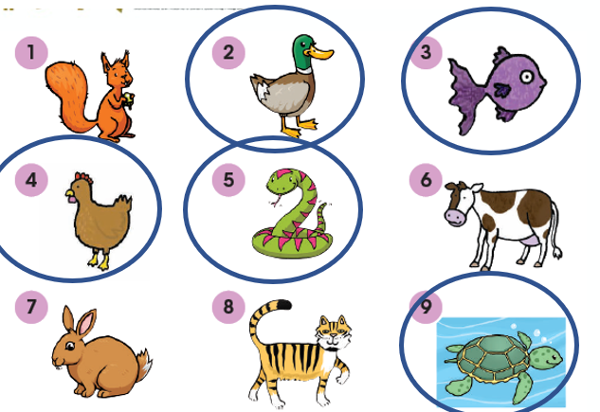
Wellbeing
Introduction
Calendar
Covid-19 safety
Class rules
Class Helpers
Warm up: Phonics, Tricky words, HFWs
Resources
Outcomes & Success Criteria
Starter: Prior learning, video, vocabulary
Main Activity: Video, vocabulary, Text book
Critical Thinking
Differentiated Activities
Plenary
UAE link
Self-Assessment
Enrichment
Exit ticket
Which animals lay eggs?

Slide 16
Wellbeing
Introduction
Calendar
Covid-19 safety
Class rules
Class Helpers
Warm up: Phonics, Tricky words, HFWs
Resources
Outcomes & Success Criteria
Starter: Prior learning, video, vocabulary
Main Activity: Video, vocabulary, Text book
Critical Thinking
Differentiated Activities
Plenary
UAE link
Self-Assessment
Enrichment
Exit ticket
Which things grow from seeds?

Slide 17
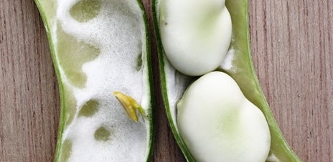
Wellbeing
Introduction
Calendar
Covid-19 safety
Class rules
Class Helpers
Warm up: Phonics, Tricky words, HFWs
Resources
Outcomes & Success Criteria
Starter: Prior learning, video, vocabulary
Main Activity: Video, vocabulary, Text book
Critical Thinking
Differentiated Activities
Plenary
UAE link
Self-Assessment
Enrichment
Exit ticket
New words
Let’s practise.
These are bean seeds.

Slide 18
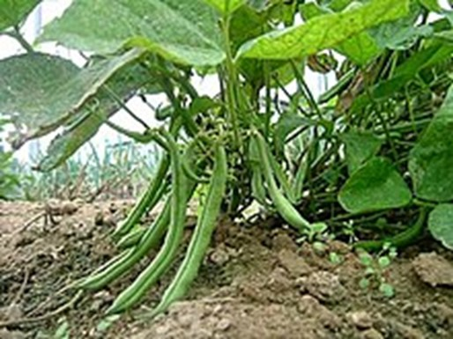
Wellbeing
Introduction
Calendar
Covid-19 safety
Class rules
Class Helpers
Warm up: Phonics, Tricky words, HFWs
Resources
Outcomes & Success Criteria
Starter: Prior learning, video, vocabulary
Main Activity: Video, vocabulary, Text book
Critical Thinking
Differentiated Activities
Plenary
UAE link
Self-Assessment
Enrichment
Exit ticket
New words
Let’s practise.
Bean seeds grow into bean plants.

Slide 19
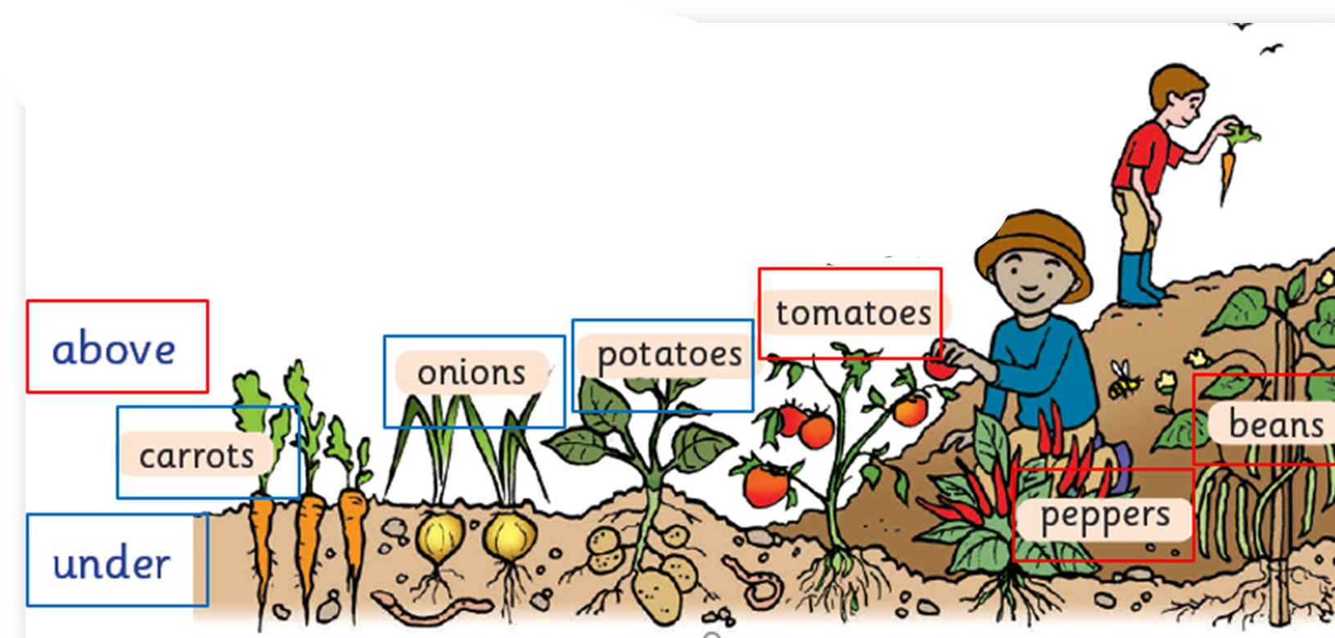
Wellbeing
Introduction
Calendar
Covid-19 safety
Class rules
Class Helpers
Warm up: Phonics, Tricky words, HFWs
Resources
Outcomes & Success Criteria
Starter: Prior learning, video, vocabulary
Main Activity: Video, vocabulary, Text book
Critical Thinking
Differentiated Activities
Plenary
UAE link
Self-Assessment
Enrichment
Exit ticket
Which vegetables grow above ground?
Which vegetables grow under ground?

Slide 20
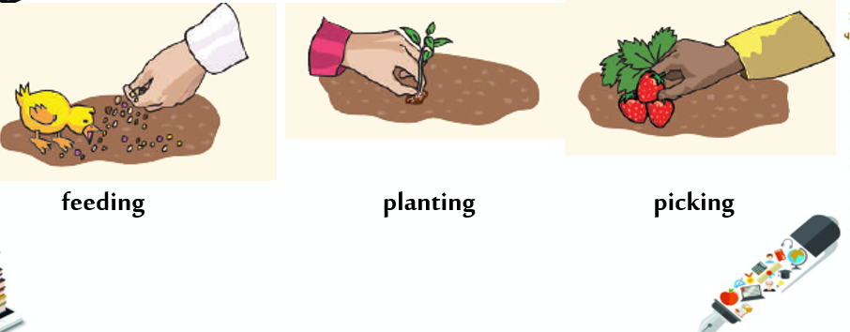
Wellbeing
Introduction
Calendar
Covid-19 safety
Class rules
Class Helpers
Warm up: Phonics, Tricky words, HFWs
Resources
Outcomes & Success Criteria
Starter: Prior learning, video, vocabulary
Main Activity: Video, vocabulary, Text book
Critical Thinking
Differentiated Activities
Plenary
UAE link
Self-Assessment
Enrichment
Exit ticket
Vocabulary
What can you do on a farm?
On the farm, you can feed the animals.
On the farm, you can plant seeds.
On the farm, you can pick fruit.

Slide 21
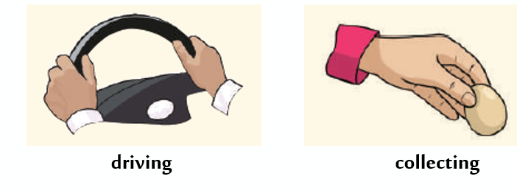
Wellbeing
Introduction
Calendar
Covid-19 safety
Class rules
Class Helpers
Warm up: Phonics, Tricky words, HFWs
Resources
Outcomes & Success Criteria
Starter: Prior learning, video, vocabulary
Main Activity: Video, vocabulary, Text book
Critical Thinking
Differentiated Activities
Plenary
UAE link
Self-Assessment
Enrichment
Exit ticket
What can you do on a farm?
Vocabulary
On the farm, you can drive a tractor.
On the farm, you can collect eggs.

