Slide 1


Grade 4
Writing Programme
Task 1

Slide 2
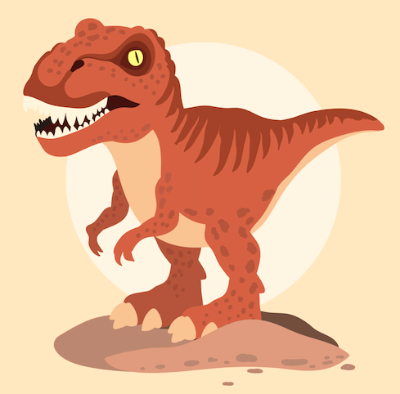
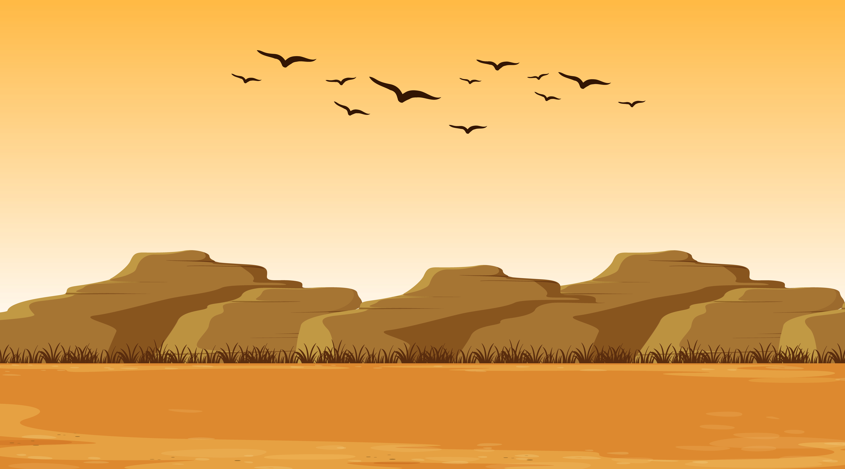
Activity 1 Brainstorm
Think of words to describe each picture.
1.
2.

Slide 3
Activity 2 Similes
Match each adjective with a noun. Then, make similes.
Similes compare two things using as.
as + adjective + as + noun→ He is as blind as a bat.
1. brave
bee
2. bright
lion
3. high
star
4. quiet
mouse
5. busy
sun
6. hot
mountains

Slide 4
Activity 3 Make Similes
Write a simile for each picture.
________________________________________________________________
________________________________________________________________
________________________________________________________________
________________________________________________________________
________________________________________________________________

Slide 5

Activity 4 Simile Poem
Fill in the gaps to complete the simile poem.
grass sun diamond sea lemon rose
The Colours of a Rainbow
Have you ever seen a rainbow after a storm?
It’s as beautiful as a daydream,
And it sparkles as bright as a ___________.
A rainbow is as colourful as a garden full of flowers,
As red as a ___________,
And as orange as the ___________ on a hot, hot day.
As yellow as a ___________,
As green as ___________ in springtime,
And as blue as the ___________ shining in the morning light.

Slide 6
Activity 5 Write a Simile Poem
Plan your own simile poem. Then, write your poem.
What’s it about?
My Simile Poem
What similes will I use?
What’s the title?
_________________________________________________
______________________________________________________________________________________
______________________________________________________________________________________
______________________________________________________________________________________
______________________________________________________________________________________
______________________________________________________________________________________

