Slide 1
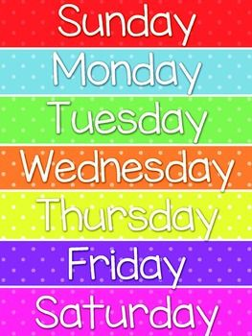
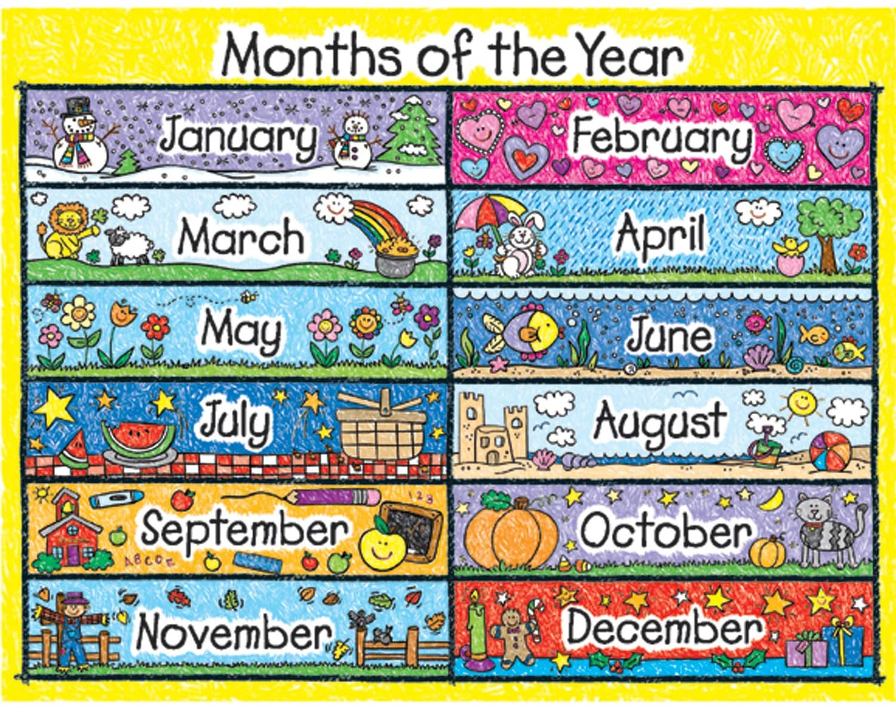
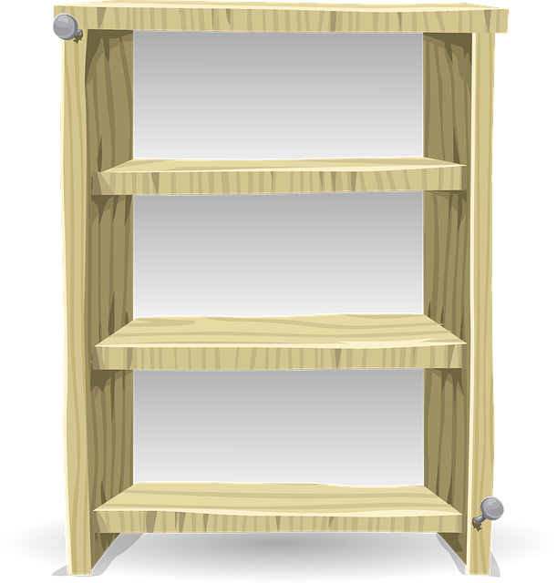
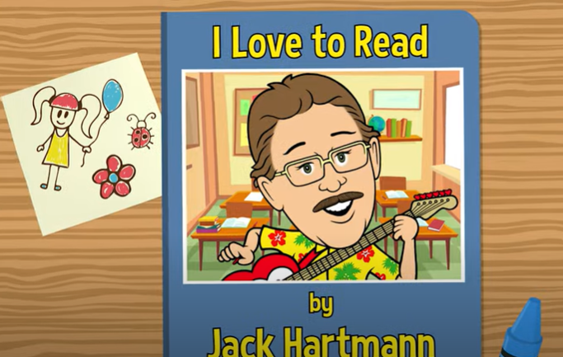
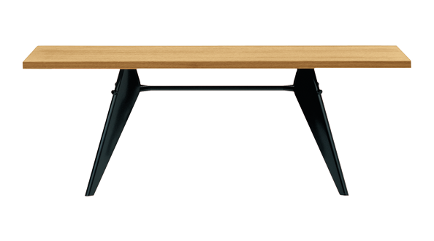
Good Morning Class
This Photo by Unknown Author is licensed under CC BY-NC
Notes:
Outline the 3 golden rules

Slide 2
National Anthem

Slide 3
Assistant Teacher of the week:
4A
Role:
To read the rules
To read out the instructions of each activity.

Slide 4
Assistant Teacher of the week:
4B
Role:
To read the rules
To read out the instructions of each activity.

Slide 5
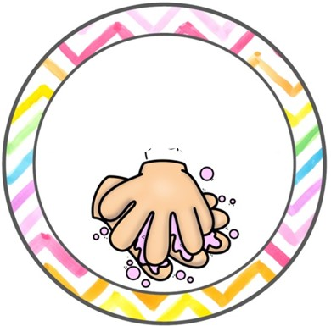
For your safety & the safety of others
Wash hands with
soap and water
Wear a mask when
going outside
Keep physical distancing
Use sterilizer
Take your temperature before leaving the house

Slide 6
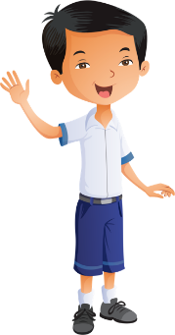
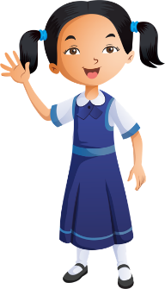
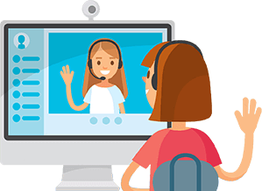
Distance learning and cybersecurity rules
Prepare books and school supplies
Wear school uniform
Be ready and on time
Sit in a quiet place
Open the camera when the teacher asks
Stay on mute & raise your hand to take part
Please do not interrupt anyone
Don’t share account information

Slide 7
Distance Learning: Week 1
At the end of the week, I will choose 3 children based on:
Attendance
Participation in lesson
Completed work in books
Completed work on LMS

Slide 8
Starter
New Sound
Green Words
Red Words

Slide 9
Starter
We use a full stop at the end of sentences.
The dinosaur has sharp teeth

Slide 10
Reading
Practice

Slide 11
Rex
Pants
Shocker
Pong

Slide 12
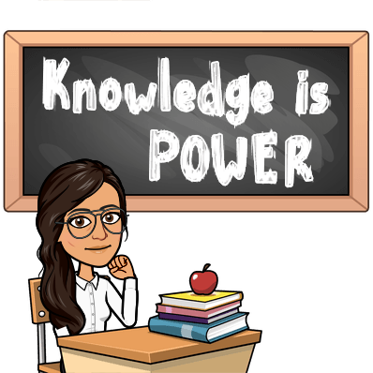
lesson 2
Term 2 – Week 1
Access Book 4
Week commencing 3rd January 2021
My pet dinosaur
Pages: 3 & 4

Slide 13
Lesson Objectives
LISTENING
Listen and read sentences about a pet dinosaur.
SPEAKING
Say the words and match to the dinosaur pictures.
READING
To read about a pet dinosaur.
WRITING
To write about a pet dinosaur.

Slide 14
Video

Slide 15
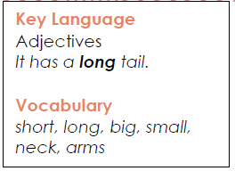
Pages: 3 & 4

Slide 16
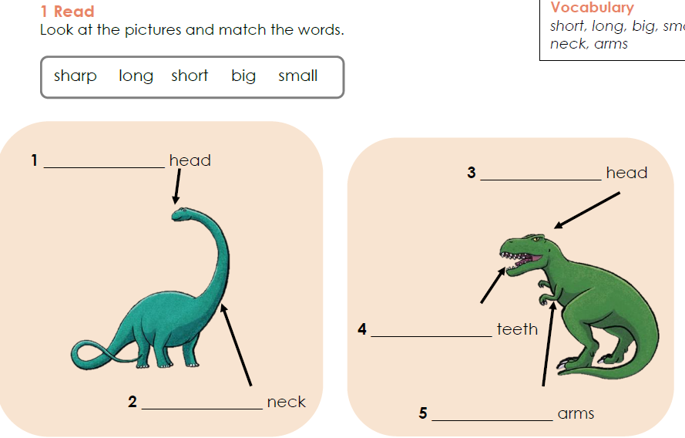
Pages: 3 & 4
small
big
sharp
long
short

Slide 17
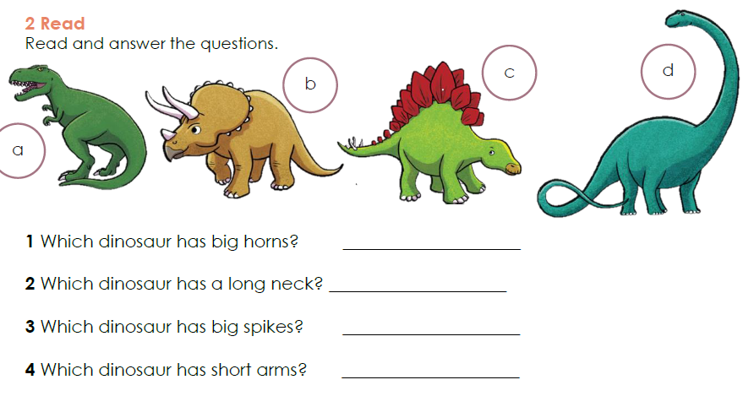
Pages: 3 & 4
b
d
c
a

Slide 18
Pages: 3 & 4

Slide 19
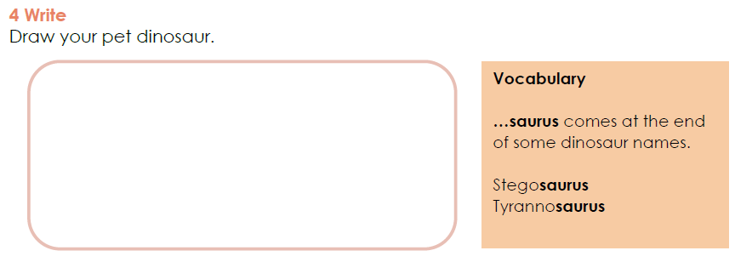
Pages: 3 & 4

Slide 20
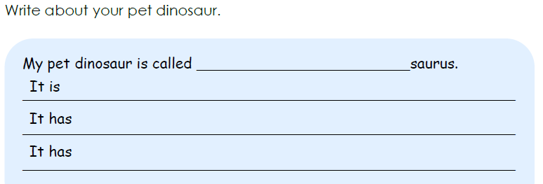
Pages: 3 & 4
Kiran
short arms.
sharp teeth.
a big tail.

Slide 21
Microsoft Teams
Take a picture!
Take a picture of today’s work in your books and upload it on Microsoft Teams.
Assignments – Week 1

Slide 22
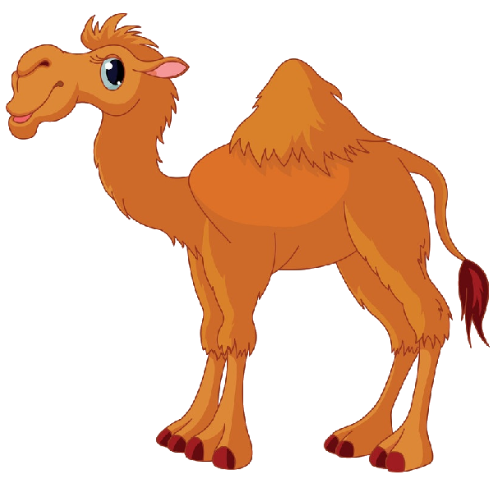
Online Activities
Website | Link | Challenges
Live Worksheet | https://www.liveworksheets.com/bj1294495hg | Easy Level
Padlet | https://padlet.com/kiranhussain/c6dws07xoaryzfc3 | Hard Level

Slide 23
Self - Assess
How do you feel about today’s lesson?

