Slide 1
unit6

Slide 2
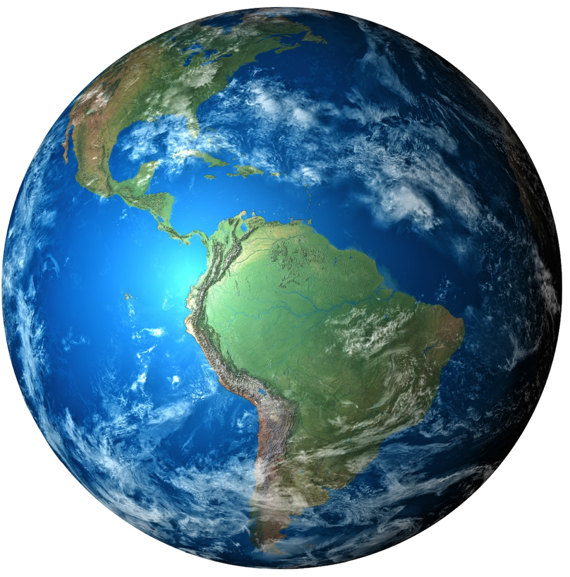
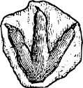
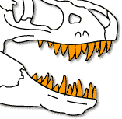
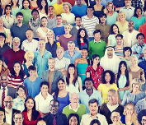
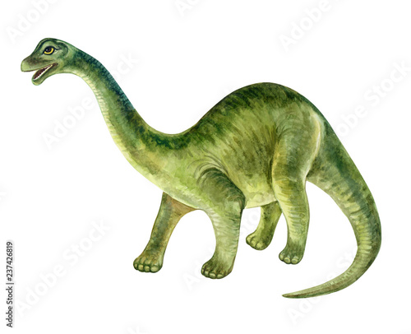
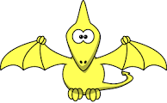
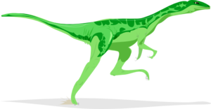
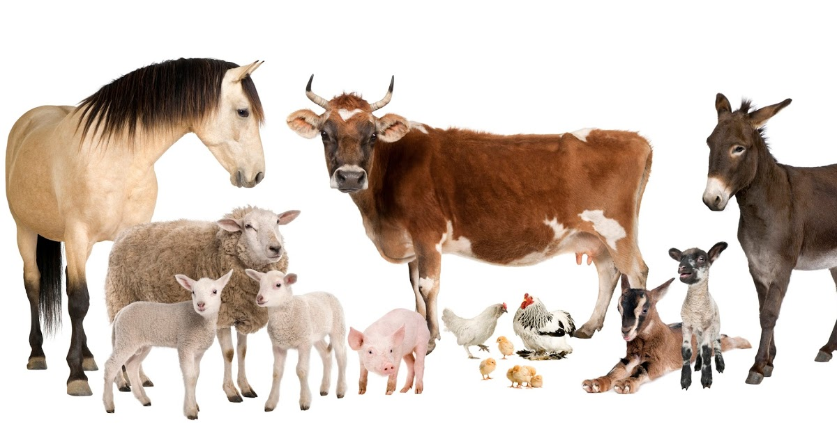
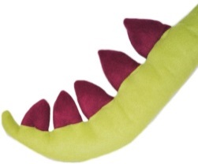
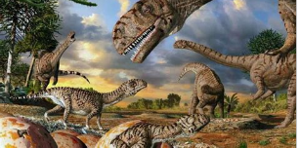
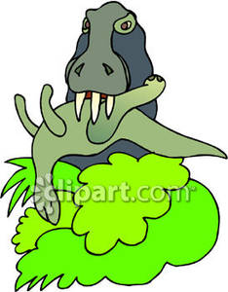
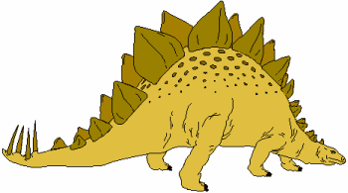
earth | scientists | footprint | Sharp teeth | Dangerous خطير
humans | diplodocus | beak | Timeline الجدول الزمني | Big كبير
animals | Kinds أنواع | tail | Years ago منذ سنوات | fast
dinosaurs | Sizes أحجام | horn | Discovery اكتشاف | Strong قوي
million | kill | spikes | long | loud
1
6
11
16
21
2
7
12
17
22
3
8
13
18
23
4
9
14
19
24
5
10
15
20
25
1, 000. 000

Slide 3
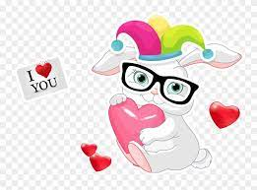
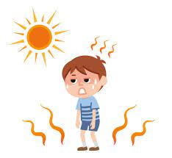
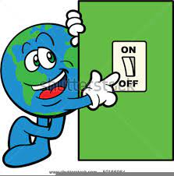
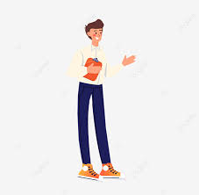
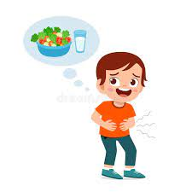
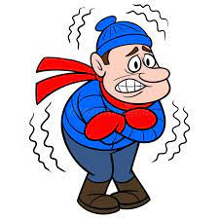
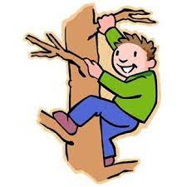
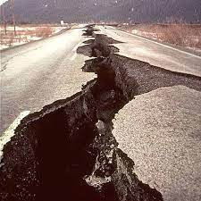
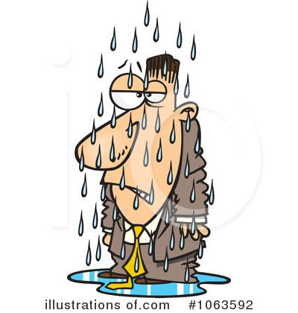
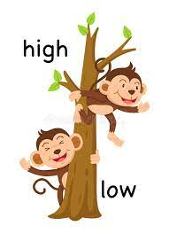
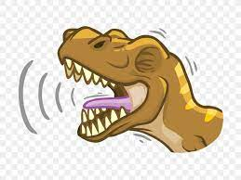
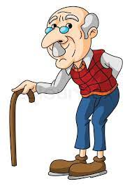
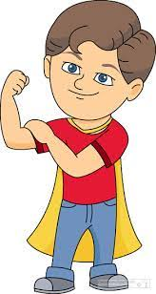
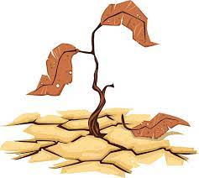
lovely | hot | happy | Switch on | bright
green | tall | hungry | Computer icon | tall
noisy | blue | climb | shake | cold
wet | quiet | haveيملك | roar | high
old | dry[جاف | Thinkيفكر | brave | quiet
1
6
11
16
21
2
7
12
17
22
3
8
13
18
23
4
9
14
19
24
5
10
15
20
25

Slide 4
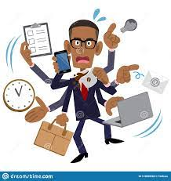
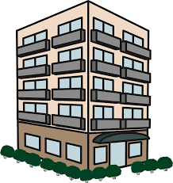
busy | orange | 220 millions
flat | green | 65 millions
hot | blue | 5 millions
white | yellow | 100 thousand years ago
red | 350 millions
1
6
11
16
21
2
7
12
17
22
3
8
13
18
23
4
9
14
19
24
5
10
15
20
25

Slide 5
unit7

Slide 6
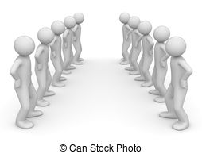
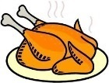
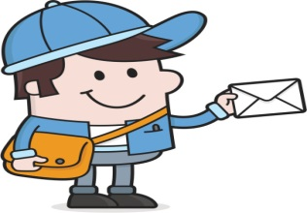
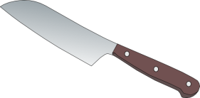
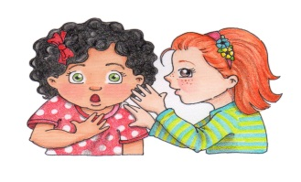
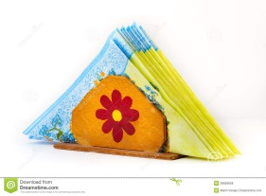
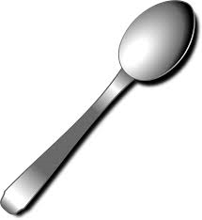
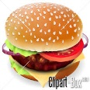
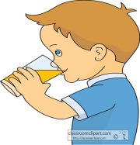
strips | opposite | cup | chicken | message
spots | Next to | knife | salad | code
centre | Each other | plate | sweetcorn | decode
withمع | between | napkin | fruit | secretسر
withoutبدون | spoon | burger | drink | Instruction تعليمات
1
6
11
16
21
2
7
12
17
22
3
8
13
18
23
4
9
14
19
24
5
10
15
20
25

Slide 7
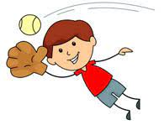
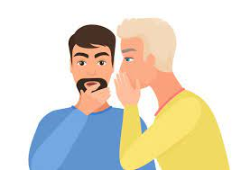
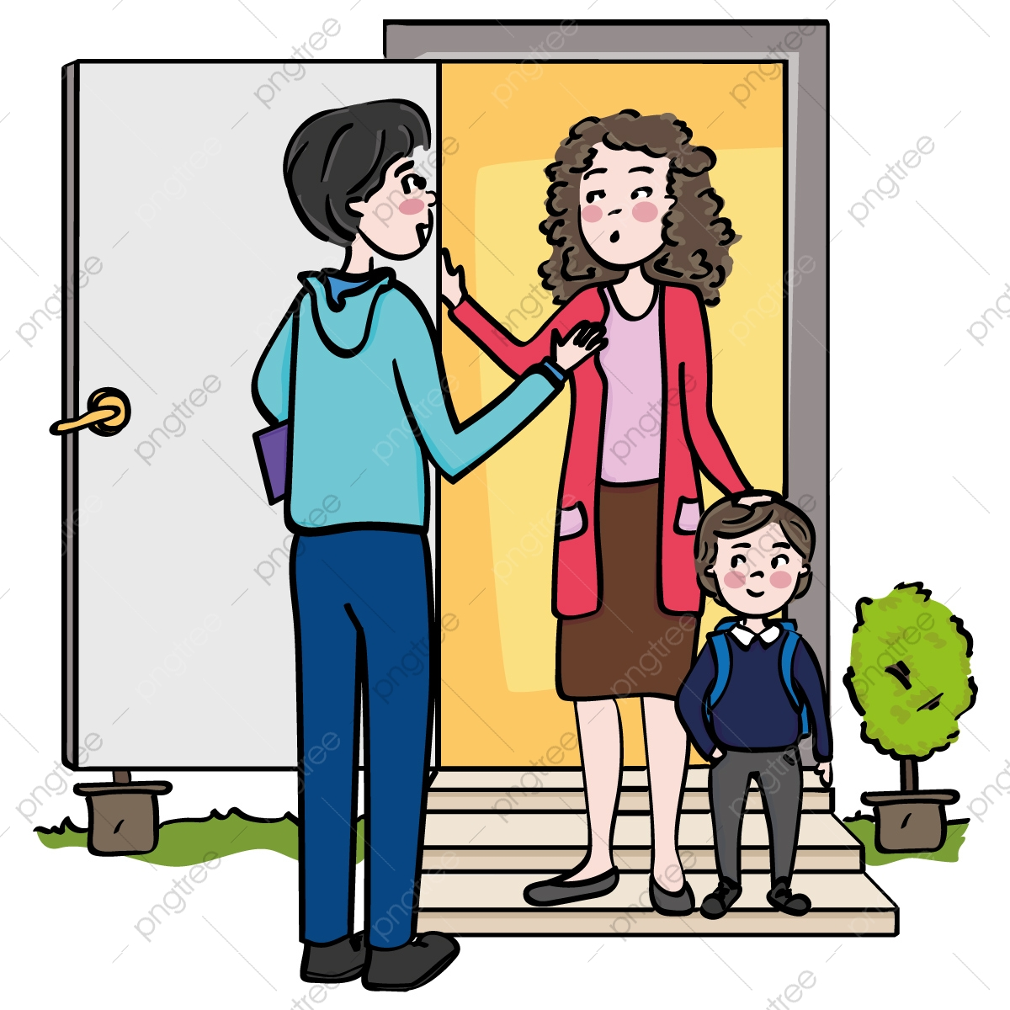
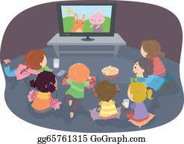
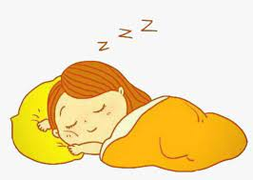
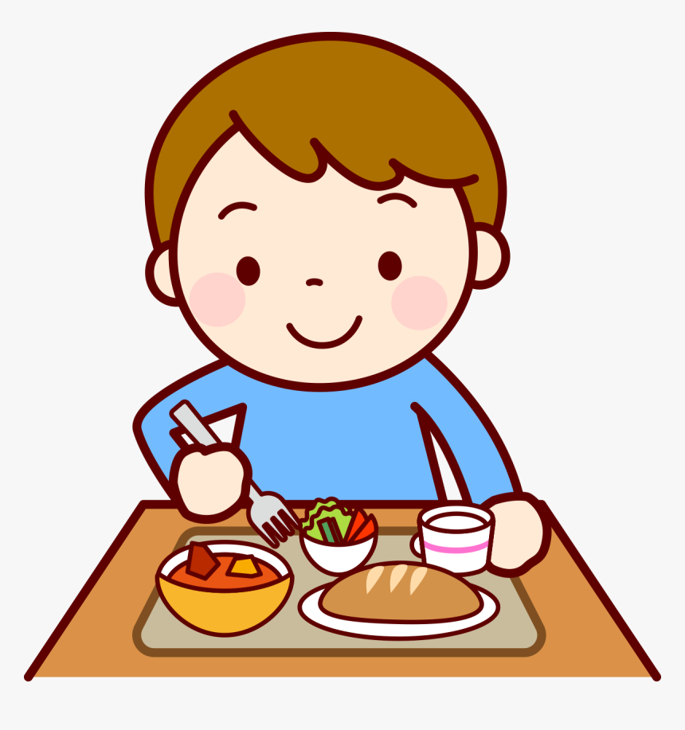
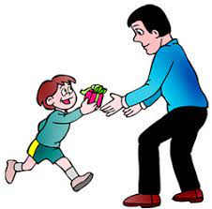
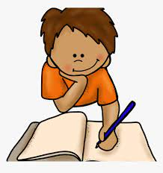
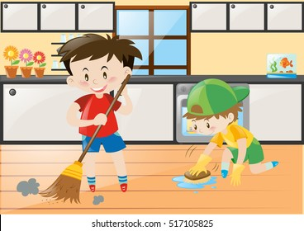
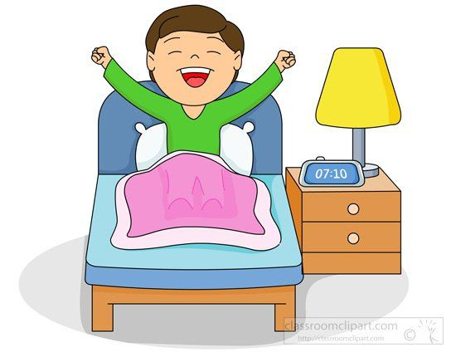
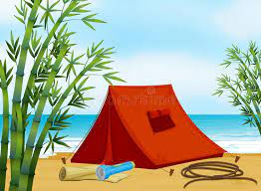
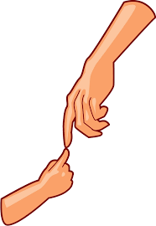
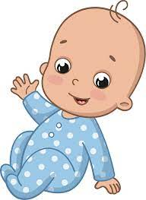
catch/caught | Tell/told | visit | Watch a movie | sleep
give/gave | Write/wrote | stay | Clean the kitchen | eat
eat/ate | live | awake | Camp at the beach | hear
fly/flew | travel | touch | ride | baby
Said/say | climb | Play the piano | see | wind
1
6
11
16
21
2
7
12
17
22
3
8
13
18
23
4
9
14
19
24
5
10
15
20
25

Slide 8
hawk | Pay يدفع | coins
fish | Expensive غالي
Expensive غالي | delicious
delicious | enjoying
enjoying | Pay يدفع
1
6
11
16
21
2
7
12
17
22
3
8
13
18
23
4
9
14
19
24
5
10
15
20
25

Slide 9
unit8

Slide 10
heart | bone | knee | exercise | brain
lungs | backbone | neck | vegetable | head
skull | muscles | wrist | water | tummy
muscle | ankle | Healthy food | soap | ear
ribs | elbow | sleep | muscles | throat
1
6
11
16
21
2
7
12
17
22
3
8
13
18
23
4
9
14
19
24
5
10
15
20
25

Slide 11
finger | arm | tummy | thumb | Ice pack
hand | A plaster | ear | knee | Glass of water
thumb | An ice pack | throat | elbow | cheers
knee | A glass of water | finger | arm | hands
elbow | head | hand | plaster | time
1
6
11
16
21
2
7
12
17
22
3
8
13
18
23
4
9
14
19
24
5
10
15
20
25

Slide 12
seat | rider | Reading books | Opinionرأي | fingernails
prize | Playing tennis | Visiting grandma | heart | toenails
saddle | Sweeping the floor | Playing football | pumpيضخ | teeth
hooves | Tidying her room | mammal | Heart beat | backbone
reins | Doing karate | factحقيقة | blood | brain
1
6
11
16
21
2
7
12
17
22
3
8
13
18
23
4
9
14
19
24
5
10
15
20
25

Slide 13
ribs | watch | stroke
bone | hear | smell
skull | point
lickيلعق | sniff
listen | chew
1
6
11
16
21
2
7
12
17
22
3
8
13
18
23
4
9
14
19
24
5
10
15
20
25

Slide 14
unit9

Slide 15
playground | spaceمساحة | town | shops | Sweeping the floor
classroom | big | city | museums | Tidying her room
noisy | small | cinemas | cafes | Doing karate
quietهادي | hugeضخم | space | traffic | Reading books
scary | tiny | Fresh airهواء نقي | Playing tennis | Visiting grandma
1
6
11
16
21
2
7
12
17
22
3
8
13
18
23
4
9
14
19
24
5
10
15
20
25

Slide 16
Playing football | Light | inventorيخترع | hourساعة | container
robots | camera | Inventionاختراع | dayيوم | shape
futureمستقبل | patient | sofa | weekأسبوع | sizeحجم
measureيقيس | toolsأدوات | secondثانية | monthشهر | tall
wheels | wheelchairs | minuteدقيقة | yearسنة | taleحكاية
1
6
11
16
21
2
7
12
17
22
3
8
13
18
23
4
9
14
19
24
5
10
15
20
25

Slide 17
earplug | enormous | scary | kind | helpful
Loaf of bread | angry | friendly | strong
syrup | kind | helpful | quiet
centimeters | strong | enormous | scary
ox | quiet | angry | friendly
1
6
11
16
21
2
7
12
17
22
3
8
13
18
23
4
9
14
19
24
5
10
15
20
25

