Slide 1
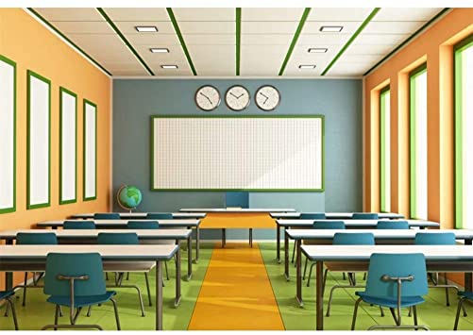
Good morning my dear students!
How are you?

Slide 2
Please keep quiet while your teacher is taking the attendance.

Slide 3
The National Anthem :

Slide 5
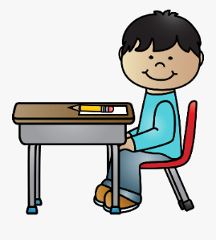
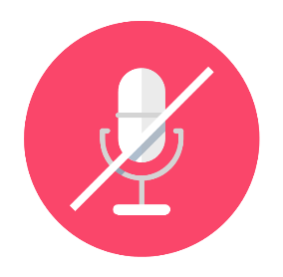
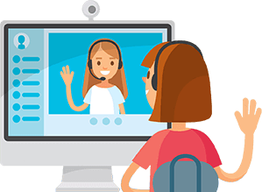
Class Rules
Be ready on time
Sit in a good position
Mute your microphone
Respect your friends

Slide 6
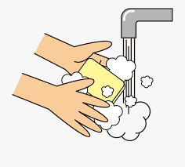
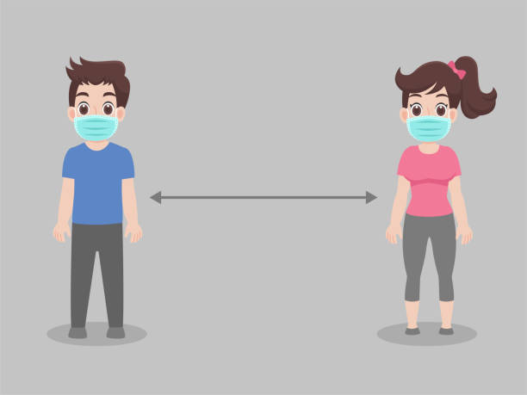
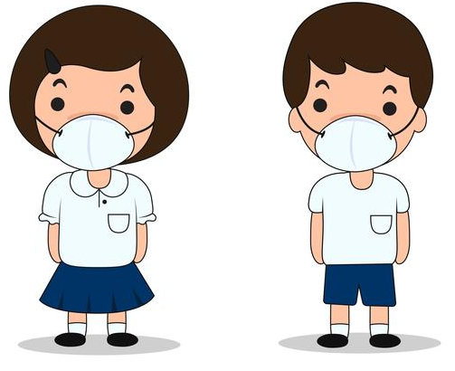
Read the message
Golden message
1
Stay at home
2
Wash your hands for 20 second
3
Wear a mask when you go out
4
Keep distance with others.
Stay at home For UAE and for your health.

Slide 8
Date: Wednesday, January 12th, 2022 Unit 6: Using Maps Lesson 8 Guided tour

Slide 9
LB P. 115

Slide 10
Learning Objectives:
Speaking: To develop learners’ ability to give and receive information about location and direction.
Reading: To develop learners’ ability to read and sequence a dialogue by using logic and signposting devices.
Writing: To develop learners’ ability to produce short factual answers in response to a request for information.

Slide 11
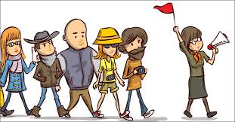
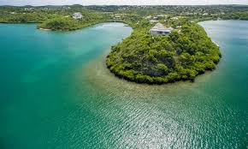
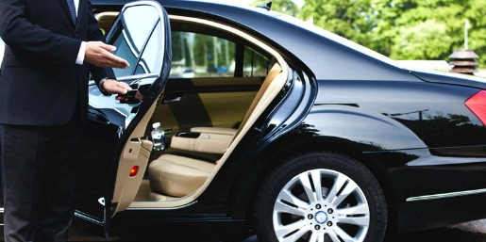
Key vocabulary:
guided tour
Peninsula
pick someone up
on the highway
Via
on board
go by boat
sail along the coast
arrive at
drive back to
dhow
جولة ارشادية سياحية
شبه جزيرة
يحمل شخص ما (يركب)
على الطريق السريع
بواسطة
يصعد على
يذهب بالقارب
يبحر على طول الساحل
يصل في
يعود الى
المراكب الشراعية

Slide 12
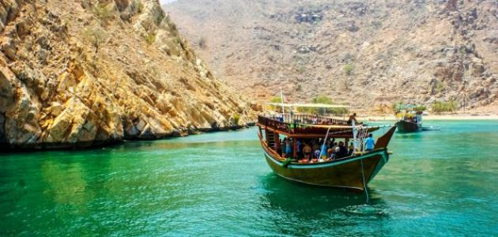

Slide 13
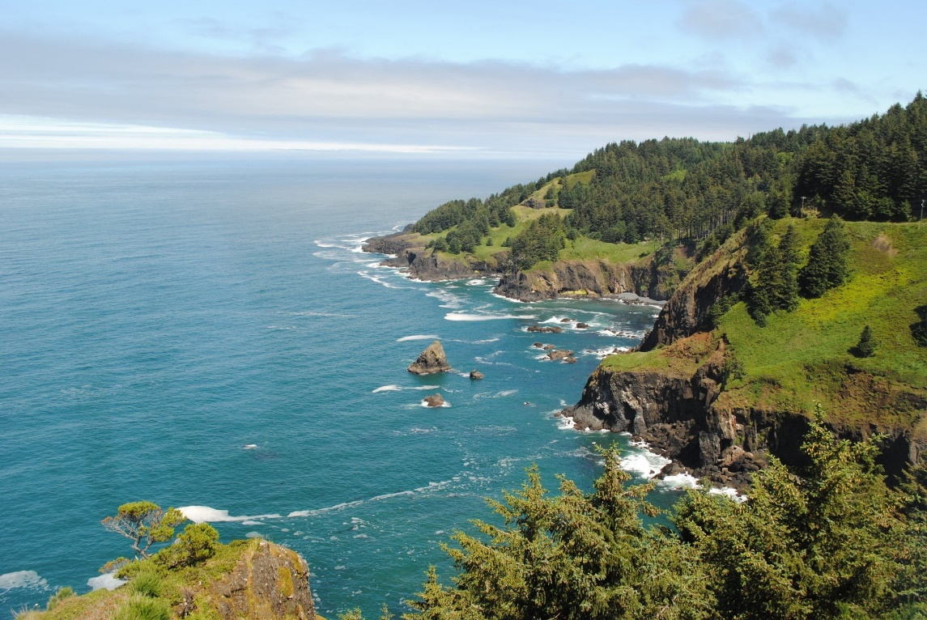
dhow
coast
coach bus

Slide 14
boat; coach; dhow

Slide 15
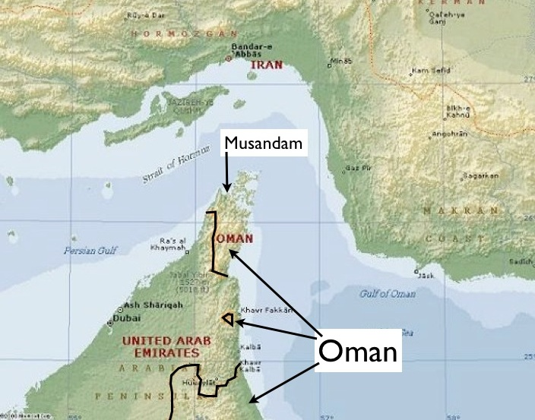

Slide 17
boat; coach; dhow

Slide 18
A (full) day
By boat
In the capital and in Dibba
Ras Al Khaimah
In Dibba
On board (the boat)

Slide 21
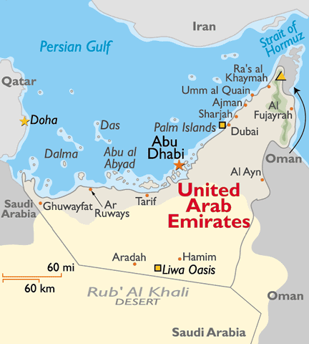

Slide 22
The trip will start in As Sila then to Bani Yas and will stop at Ras Al-Khaima
People will travel via coach bus.
People will have lunch in Jebel Ali in the coach bus.
People will enjoy sight seeing. They will take photos by phone. They will climb the mountains.

Slide 23
How do you feel about the lesson today?
Did you learn something new?
1
I need more help! (Hard!)
2
I am getting there. (It was ok!)
3
I can do it! (Easy!)

Slide 24
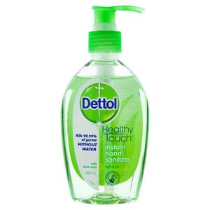
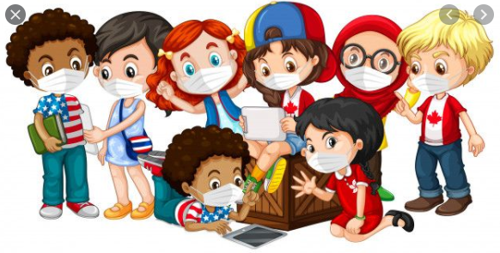
Golden message
Wash your hands every hour using water with soap for 20 seconds.
Wear your mask.

Slide 25
Our session has ended.
Bye – bye !

