Slide 1
Emirates Schools Establishment Assessment Unit
Cycle 1 Bridge to Success 2
English Listening Task
Term 2 2022
Level 1.2
Term 2 Academic Year 2021-2022

Slide 2
Emirates Schools Establishment Assessment Unit
Contents:
Part 1: Preparation - Vocabulary
Part 2: Grammar
Part 3: Listening Task
Level 1.2
Term 2 Academic Year 2021-2022

Slide 3
Part 1: Preparation – Vocabulary.
Learn these words for the listening task.

Slide 4
above: on top; over
The leaf is above the tiger.

Slide 5
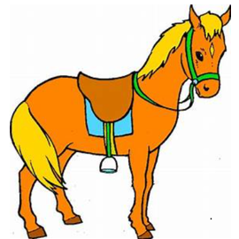
horse: an animal with that lives in a stable. It has four legs and says neigh.

Slide 6
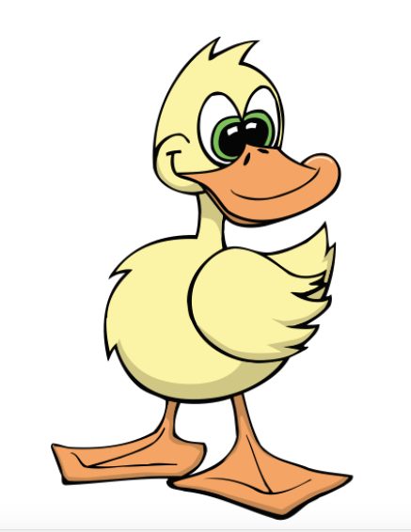
duck: a kind of bird that lives in water

Slide 7
driving: to make a car move or go

Slide 8
tractor: a short truck used on a farm

Slide 9
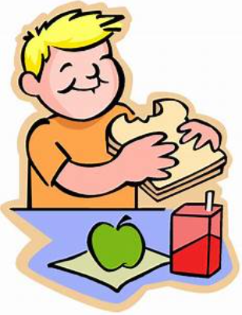
eating: to put in your mouth and chew
The boy is eating a sandwich.

Slide 10
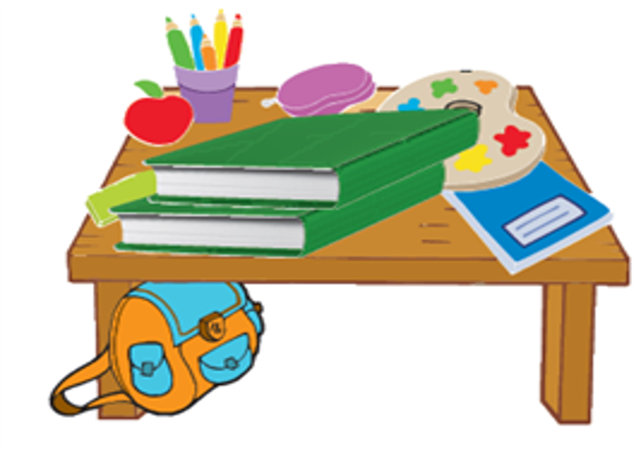
under: below
The bag is under the table.

Slide 11
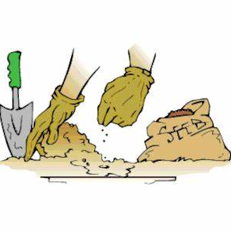
planting: to put into the ground to grow

Slide 12
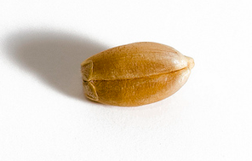
seed: the part of a plant that grows from the ground

Slide 13
fish: an animal that lives in water

Slide 14
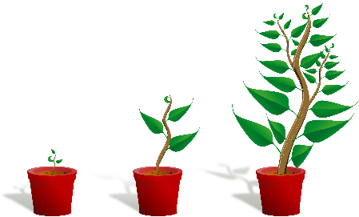
growing: to get bigger

Slide 15
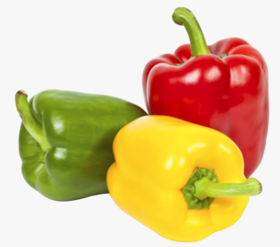
peppers: vegetables that may be green, red or yellow

Slide 16
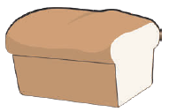
bread: a kind of food

Slide 17
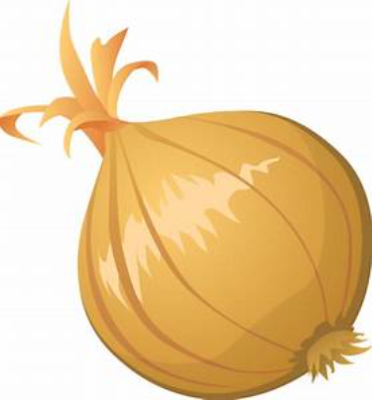
onion: a vegetable that has a strong taste and smell

Slide 18
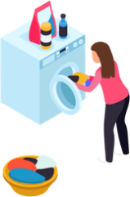
washing: to make clean

Slide 19
Part 2: Grammar

Slide 20
Key Grammar
NELCF Code | Grammatical structure
G.13.2 | Present continuous
G.12.1 | Prepositions; place

Slide 21
He is reading chapter books. She is drinking coffee. They are putting the food on the table.
Grammatical structure | Present continuous
Usage | Present continuous is used to express an action that is currently happening and/or may continue to happen.
Other examples | I am playing football today. We are going to the library. They are watching a movie at the cinema.

Slide 22
The book is under the bed. My house is next to the school. The pictures are on the table.
Grammatical structure | Prepositions of place
Usage | They are used to describe where things are.
Other examples | Alia is in the classroom. My football is under the desk. Is the bear next to the chair?

Slide 23
Part 3: Listening Task
Look at the pictures.
Listen and choose True or False.

Slide 24
Example:
True / False

Slide 25
Look at the pictures.
Listen and choose the correct answer A or B.

Slide 26
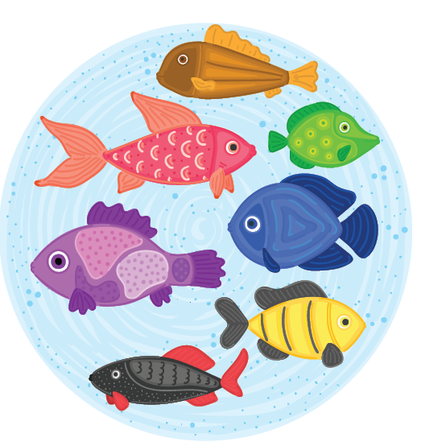
What is Ali collecting?
Example:
A. fish
B. leaves

