Slide 1
Unit 8: All living things
Lessons 10–11 Talking about animals

Slide 2
Lesson 10

Slide 3
Learning objectives:
Speaking: To ask and answer questions about polar bears.
Listening: To listen to questions about polar bears.
Writing: To write using which to join sentences.

Slide 4
1 It’s a mammal
2 in the Arctic regions of Russia, Alaska, Canada, Greenland and
Norway
3 seals, walruses and whales
4 25–30 years
5 to protect them against the cold and to help them walk on ice
6 over two years

Slide 5
1 they catch seals with their paws when the seals are resting on the ice or coming up to breathe
2 because of climate change
3 because as the ice melts, they can’t move around and hunt so freely
4 because they’re hungry
5 food in rubbish bins;
6 because they may attack them when they’re very hungry

Slide 7
2 On the bottom of their paws, they have fur, which protects them against the cold and helps them to walk on the ice.
3 Under their fur, the bears have black skin, which helps them to get as much heat as possible from the sun.
4 Females usually have two cubs, which live with their mother for over two years.
5 They feed mainly on seals, which are easy to catch when they are resting on the ice.

Slide 8
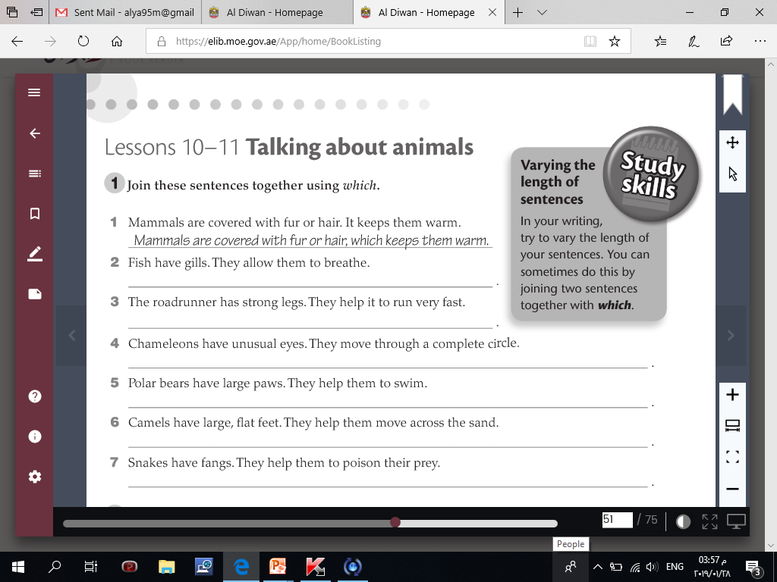
2 Fish have gills, which allow them to breathe.
3 The roadrunner has strong legs, which help it to run very fast.
4 Chameleons have unusual eyes, which move through a complete circle.
5 Polar bears have large paws, which help them to swim.
6 Camels have large, flat feet, which help them to move across the sand.
7 Snakes have fangs, which help them to poison their prey.

Slide 9
1 – c The Arabian oryx lives in the desert, which means it doesn’t need much water.
2 – a They have a white body, which helps deflect the sunlight.
3 – d However, their skin is dark, which helps protect them from the sun.
4 – e Their babies are sandy brown when born, which helps them to blend in with the sand.
5 – b They have long horns, which are very sharp.

Slide 10
Lesson 11

Slide 11
Learning objectives:
Listening: To listen to their peer’s ideas.
Speaking: To ask and answer questions about horses and their relationships with people.
Reading: To read for specific information and check if their predictions and recollections were correct.
Writing: To spell theme-related vocabulary accurately.

Slide 12
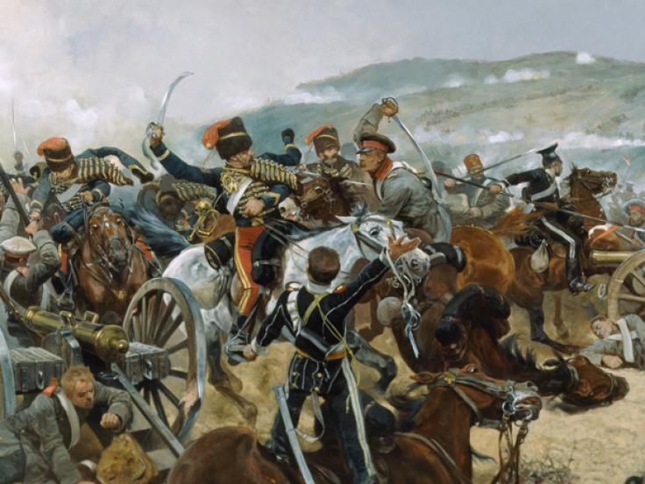
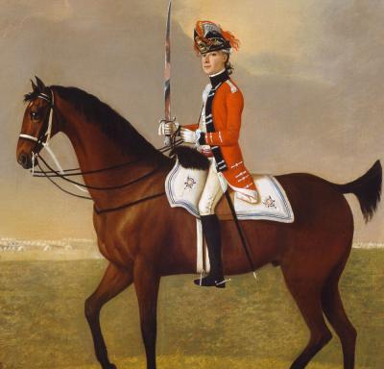
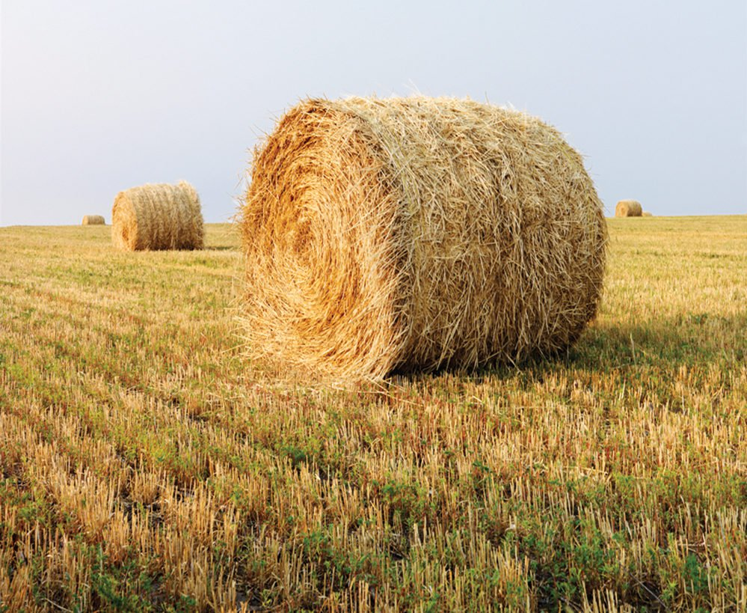
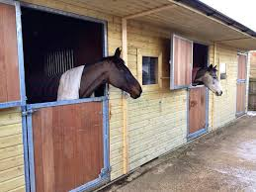
Key vocabulary:
horse
war
cavalry
stable
hay
separated
a bond
to own
an owner

Slide 14
1-bond
2-horse
3-War
4-cavalry
5-stable
6-Hay
7-separated
8-own

Slide 17
T
T
T
F
F
F
T

