Slide 1
English Online Class

Slide 2
UAE National Anthem

Slide 3
Notes:
NOTE: To change images on this slide, select a picture and delete it. Then click the Insert Picture icon in the placeholder to insert your own image.

Slide 4
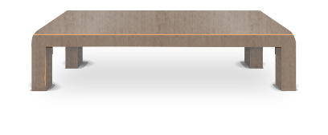
Classroom Rules:
Be on time to class
Keep your microphone on mute
Keep your Camera on
Unmute your microphone when you are called
Sit in a quiet area
Listen, share and Be Kind

Slide 5
Today is
Sunday
Monday
Tuesday
Wednesday
Thursday
Today’s weather is...
January
July
1
4
st
February
August
1
5
nd
2
6
rd
March
September
2
7
th
April
October
3
8
9
May
November
3
0
June
December

Slide 6
Term 2 – Week 7
Unit 7 – Let’s Go !
Unit 7
Lesson 1
LB Page: 137-138
AB Page: 110-111

Slide 7
By the end of the lesson , learners should be able to :
To identify and practice using the vocabulary of lesson .
To listen for specific information.

Slide 8
Video
https://www.youtube.com/watch?v=vmaUAzatAFc
https://www.youtube.com/watch?v=EMQC0GaP3hU

Slide 9
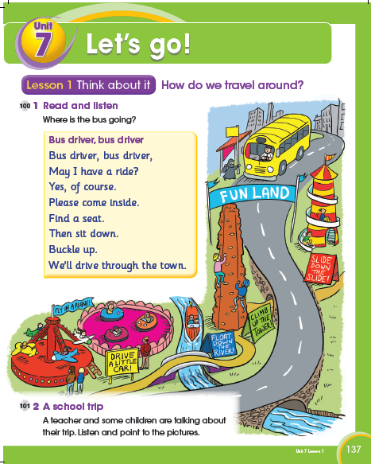
Term 2 – Week 7
Unit 7 – Let’s Go !
LB – Page 137

Slide 10
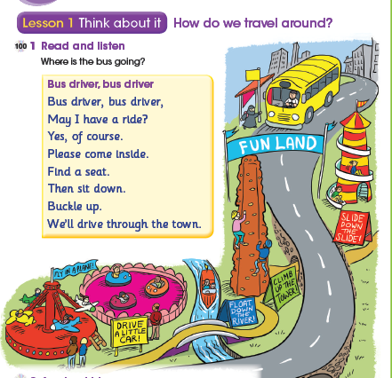
Term 2 – Week 7
Unit 7 – Let’s Go !
LB – Page 137

Slide 11
Term 2 – Week 7
Unit 7 – Let’s Go !
LB – Page 137

Slide 12
Term 2 – Week 7
Unit 7 – Let’s Go !
AB– Page 110

Slide 13
Term 2 – Week 7
Unit 7 – Let’s Go !
AB– Page 110

Slide 14
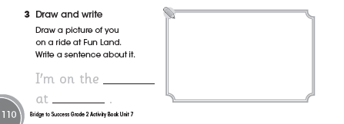
Term 2 – Week 7
Unit 7 – Let’s Go !
AB– Page 110

Slide 15
Lesson 2

Slide 17
Key words:
4
2
fly
1
Float
Slide
3
drive
5
7
climb
6

Slide 18
Term 2 – Week 7
Unit 7 – Let’s Go !
LB – Page 138

Slide 19
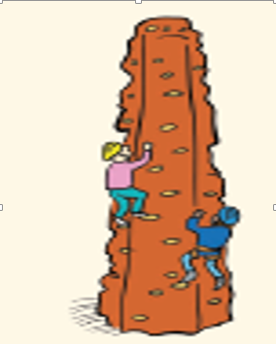
Climb

Slide 20
Slide

Slide 21
float

Slide 22
drive

Slide 23
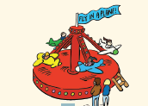
fly

Slide 24
Language detective
Term 2 – Week 7
Unit 7 – Let’s Go !
LB – Page 138

Slide 25
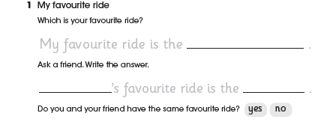
Term 2 – Week 7
Unit 7 – Let’s Go !
AB– Page 111
slide
Hessa
Plane

Slide 26
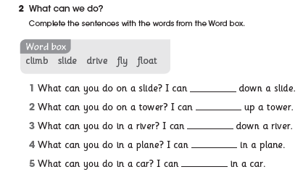
Term 2 – Week 7
Unit 7 – Let’s Go !
AB– Page 111
slide
climb
float
fly
drive

Slide 27
Evaluation
Send on the chat box

