Slide 1
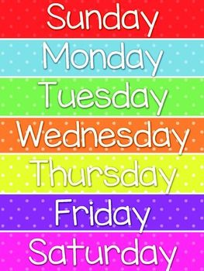
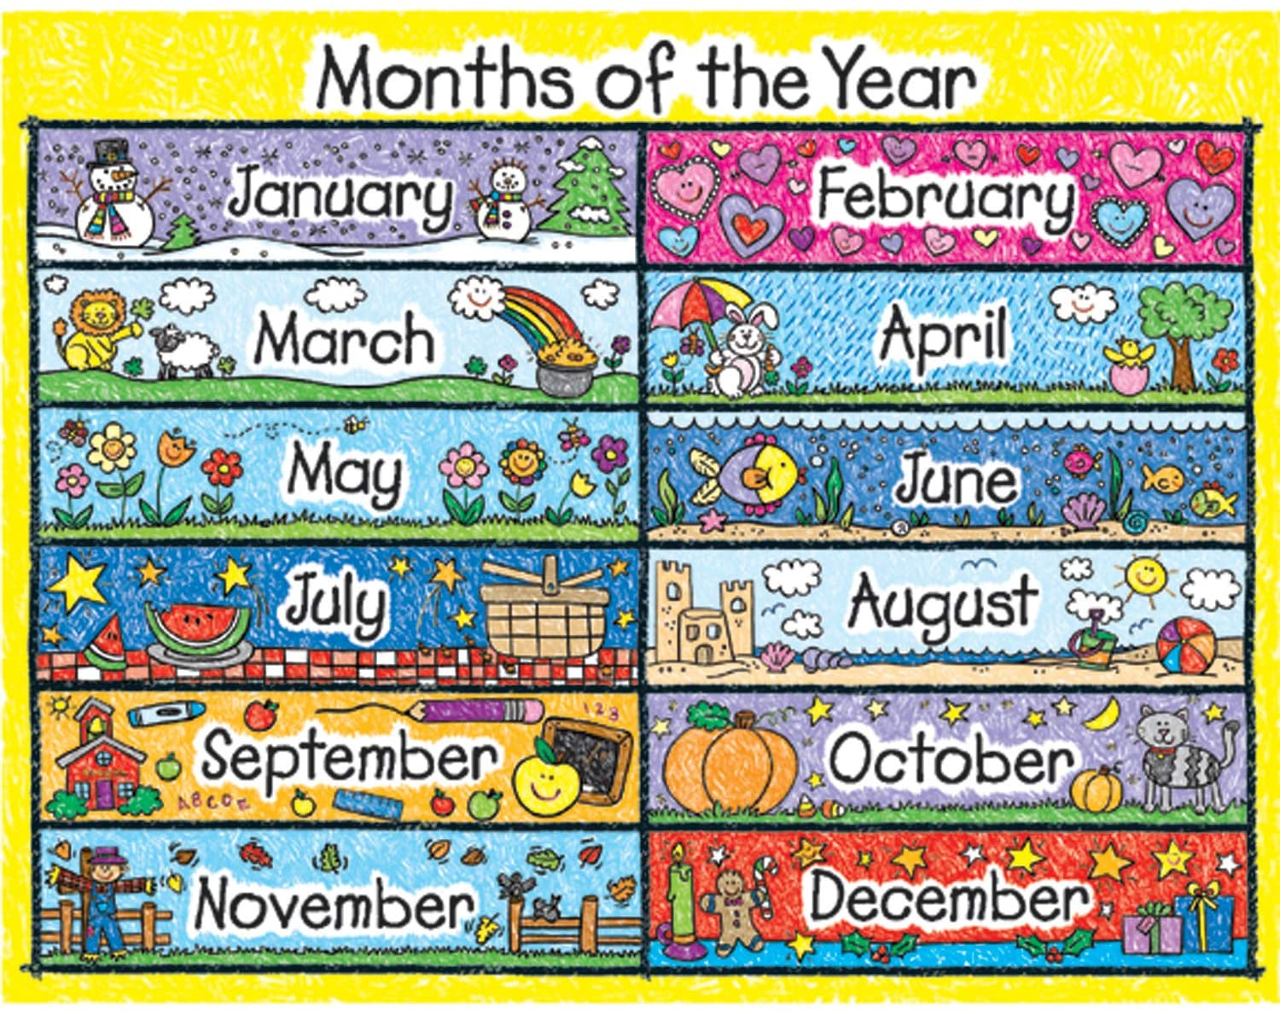
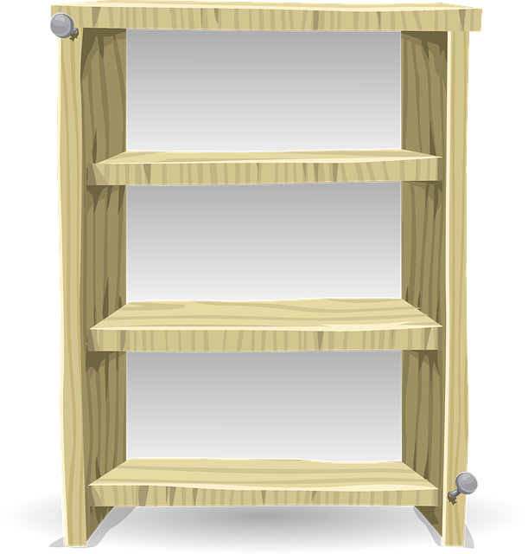
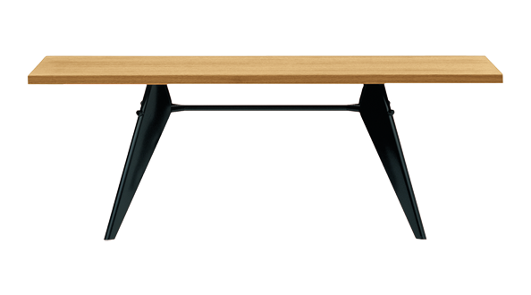
Good Morning Class
This Photo by Unknown Author is licensed under CC BY-NC
Notes:
Outline the 3 golden rules

Slide 2
National Anthem

Slide 3
For your safety & the safety of others
Wash hands with
soap and water
Wear a mask when
going outside
Keep physical distancing
Use sterilizer
Take your temperature before leaving the house

Slide 4
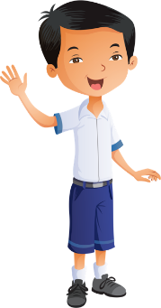
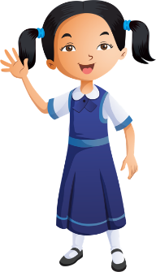
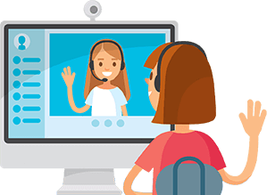
Distance learning and cybersecurity rules
Prepare books and school supplies
Wear school uniform
Be ready and on time
Sit in a quiet place
Open the camera when the teacher asks
Stay on mute & raise your hand to take part
Please do not interrupt anyone
Don’t share account information

Slide 5
Distance Learning: Week 1
3 stars
At the end of the week, I will choose 3 children based on:
Attendance
Participation in lesson
Completed work in books
Completed work on LMS

Slide 6
Starter
PHONICS
New Sound
Green Words
Red Words

Slide 7
Starter
GRAMMAR
We use a capital letter to begin a sentence.
there were trees and bees in the farm.

Slide 8
Reading
Practice

Slide 9
lesson 3
Term 2 – Week 2
Access Book 4
Week commencing 10th January 2021
Dinosaur footprints
Pages 13 and 14

Slide 10
Lesson Objectives
LISTENING
Listen to a scientist talk about her week.
SPEAKING
To talk about what you did last week.
READING
To read about the life of a scientist.
WRITING
To write sentences in the past tense.

Slide 11
Video

Slide 12
Pages 13 and 14

Slide 13
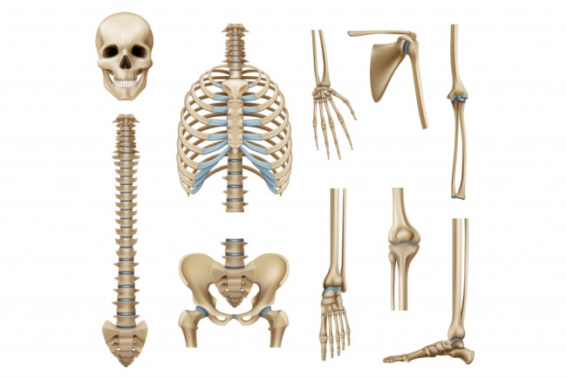
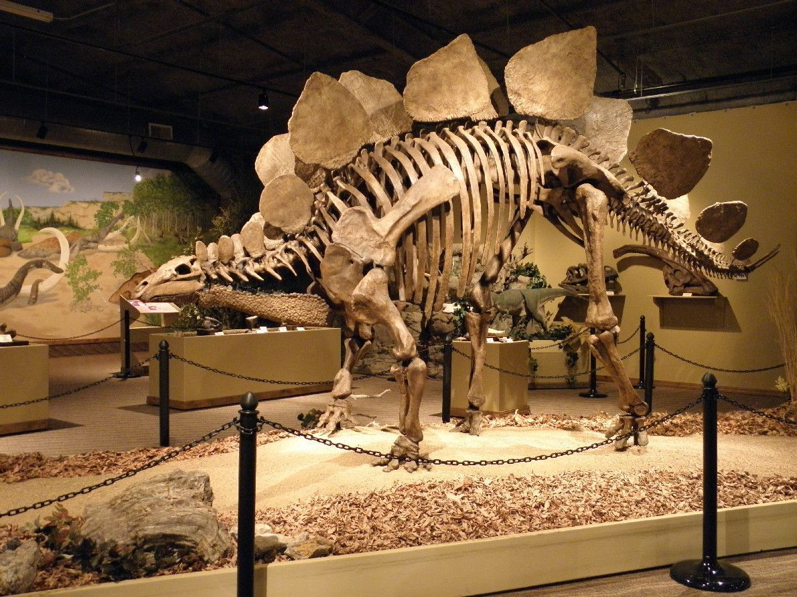
New Words
bone

Slide 14
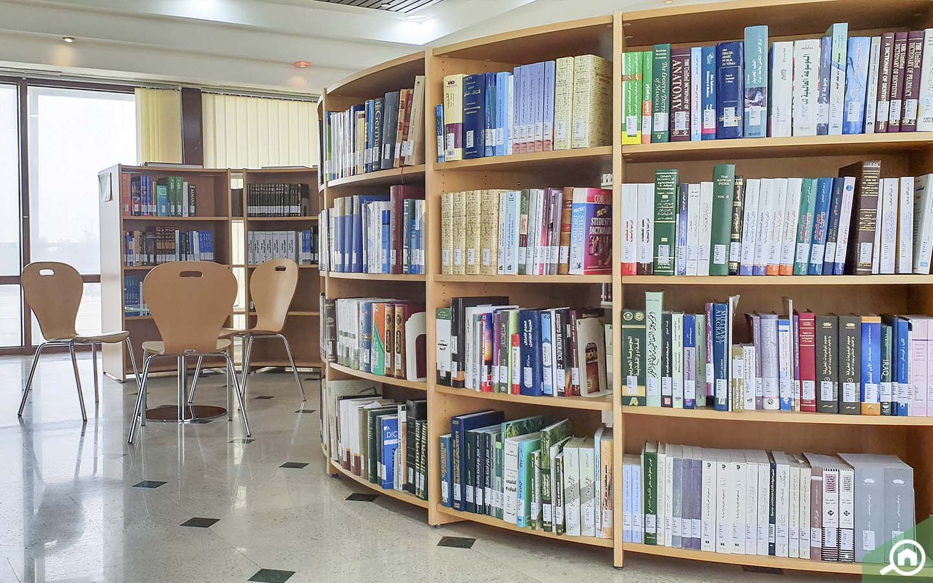
New Words
library

Slide 15
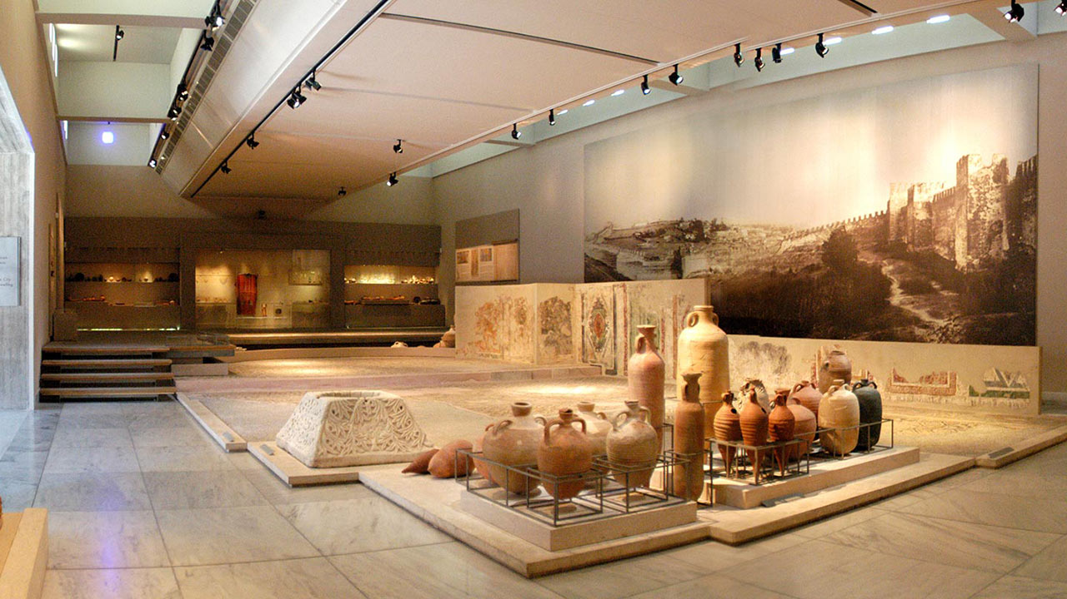
New Words
museum

Slide 16
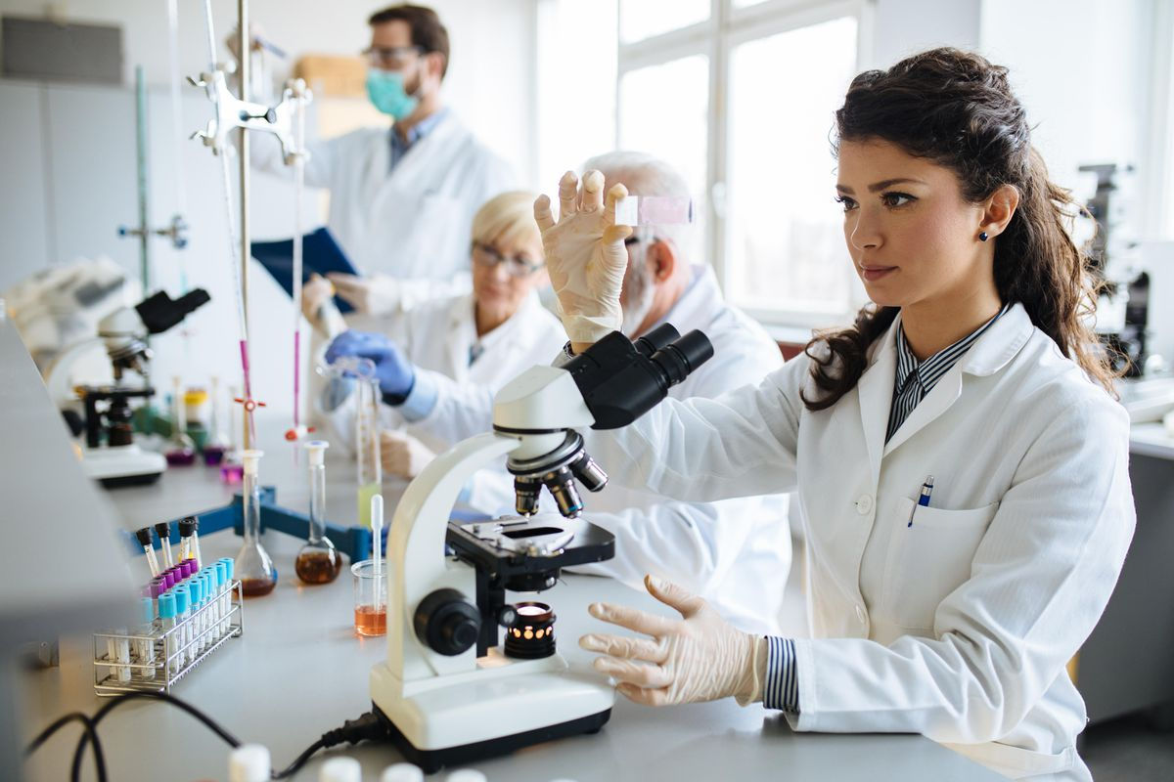
New Words
scientist

Slide 17
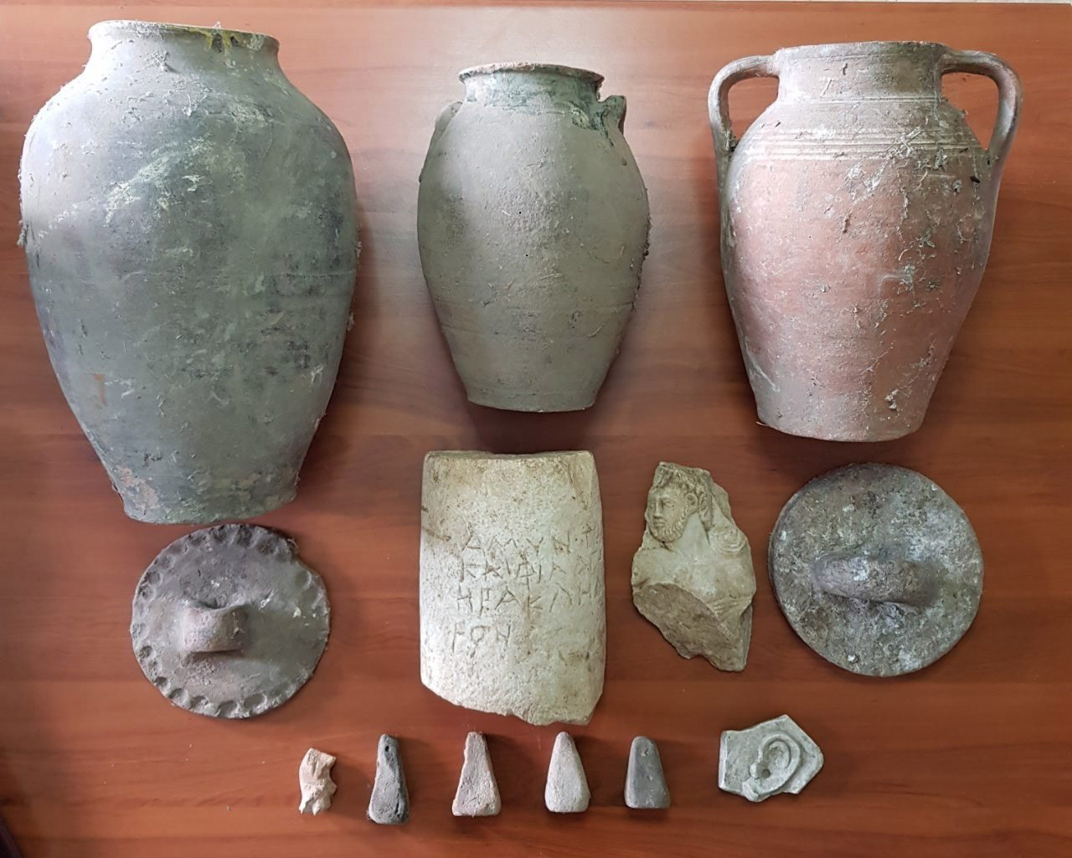
New Words
old

Slide 18
Pages 11 and 12

Slide 19
Pages 11 and 12

Slide 20
Pages 11 and 12
Monday
Tuesday
Wednesday

Slide 21
Pages 11 and 12
1
2
2
3

Slide 22
Pages 11 and 12

Slide 23
Exit ticket
Write three sentences about what you did last week.

Slide 24
Microsoft Teams
Take a picture!
Take a picture of today’s work in your books and upload it on Microsoft Teams.
Week 2

Slide 25
Please go to LMS
https://lms.moe.gov.ae/
You will find
Week 2 Term 2 Activities

Slide 26
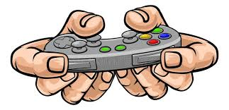
Level 1: Easy
https://wordwall.net/play/904/445/324426

Slide 27
Level 2: Medium
https://quizizz.com/admin/quiz/5f7bf9a6d8efba001b75b938/english-what-did-you-do-last-week

Slide 28
Level 3: Hard
https://quizizz.com/admin/quiz/5e02da1eee9c0e001b67e90b/english-simple-past-tense

Slide 29
Self - Assess
How do you feel about today’s lesson?

