Slide 1
Listening Task
Level 3.1
Term 2 2021-2022
Federal Entity | هيئة اتحادية

Slide 2
Contents:
Part 1: Preparation - vocabulary
Part 2: Top tips
Level 3.1
Term 2 Academic Year 2021-2022

Slide 3
Part 1: Preparation – Vocabulary

Slide 4
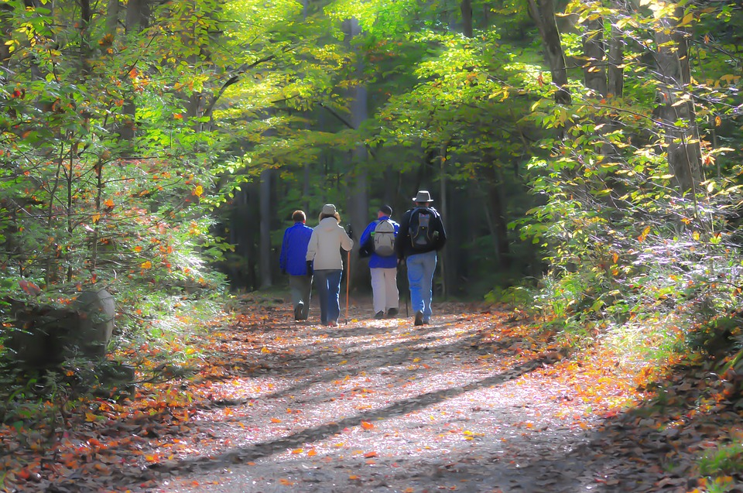
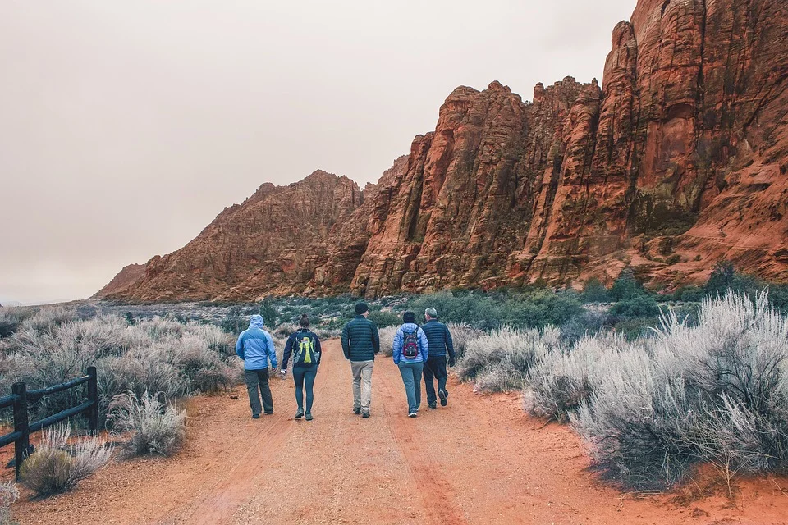
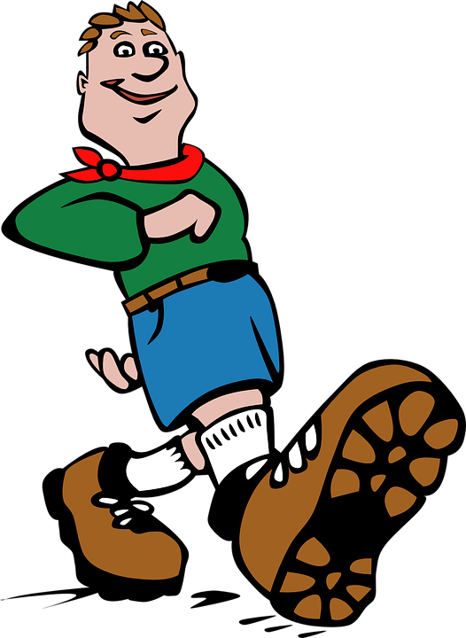
Hiking, Mickey Estes, 2015, Pixabay
hike
a long walk, usually in a beautiful place with nature
Group, Amy Spielmaker, 2018, Pixabay
Boy scout, Clker-Free-Vector-Images, 2015, Pixabay

Slide 5
word | class | definition | sentence
hike | noun | a long walk, usually in a beautiful place with nature | Take some water when you go on your hike.

Slide 6
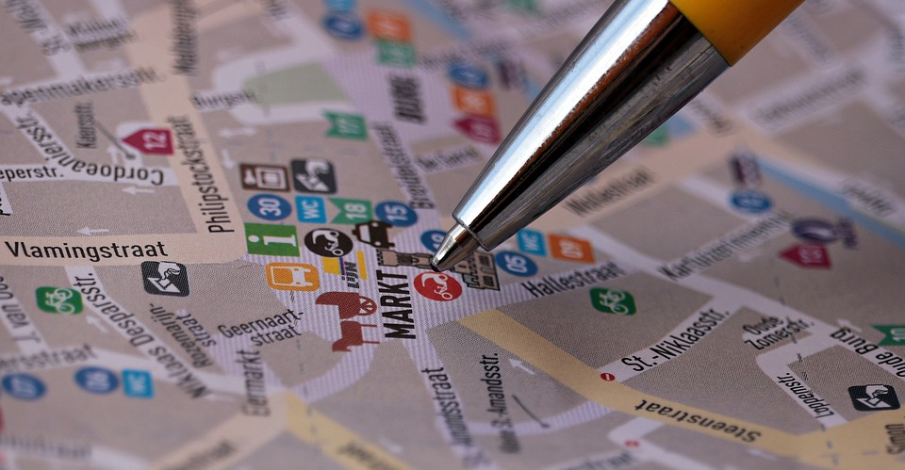
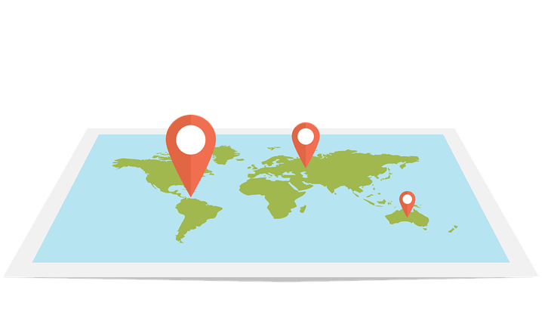
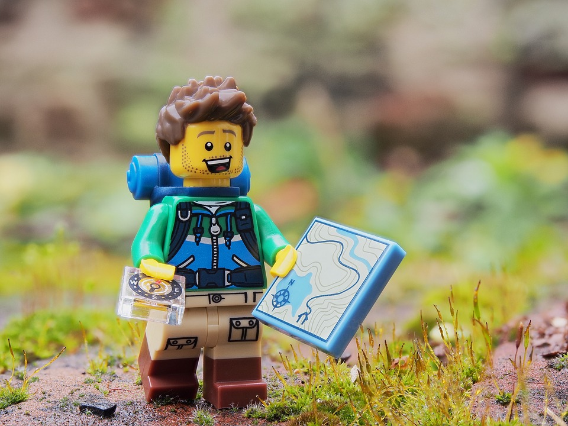
Web, dapple designer, 2018, Pixabay
Street map, S.Hermann & F.Richter, 2017, Pixabay
map
a picture that shows where countries, towns, roads, rivers etc. are
Hiker, Andrew Martin, 2017, Pixabay

Slide 7
word | class | definition | sentence
map | noun | a picture that shows where countries, towns, roads, rivers etc. are | He used the map to find his way around the city.

Slide 8
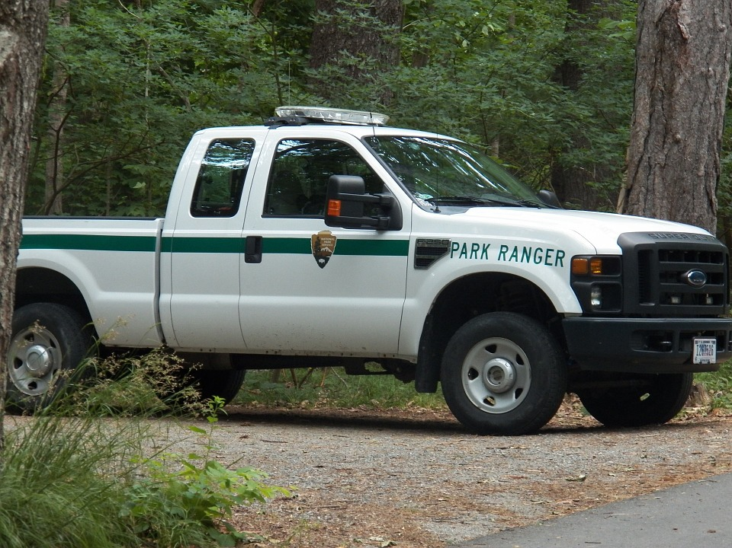
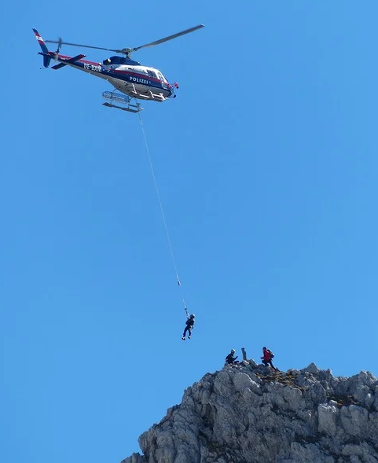
Park, PublicDomainPictures, 2013, Pixabay
Police, Clker-Free-Vector-Images, 2014, Pixabay
mountain police officer
someone who keeps people safe when they are in the mountains
Helicopter, Heinz Hummel, 2013, Pixabay

Slide 9
word | class | definition | sentence
mountain police officer | noun | someone who keeps people safe when they are in the mountains | The mountain police officer showed the hikers how to get down the mountain.

Slide 10
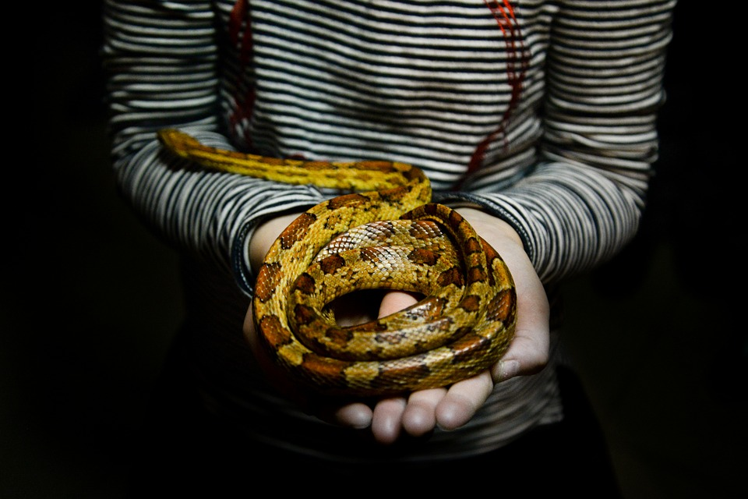
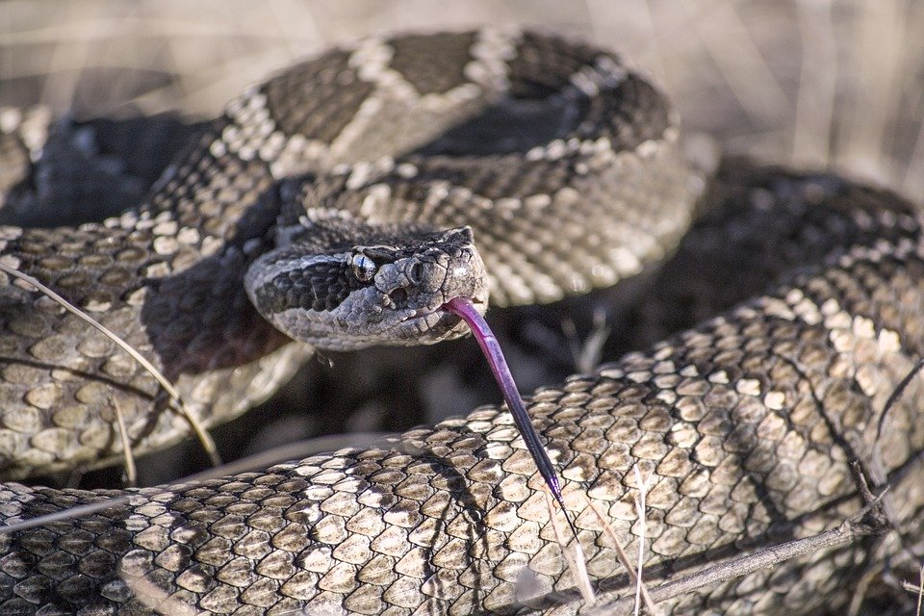
Snake, Rudy and Peter Skitterians, 2018, Pixabay
Snake, Alexander Lesnitsky, 2016, Pixabay
snake
a long, thin animal with no legs
Snake, M.Maggs, 2017, Pixabay

Slide 11
word | class | definition | sentence
snake | noun | a long, thin animal with no legs | When he saw the snake, he ran away.

Slide 12
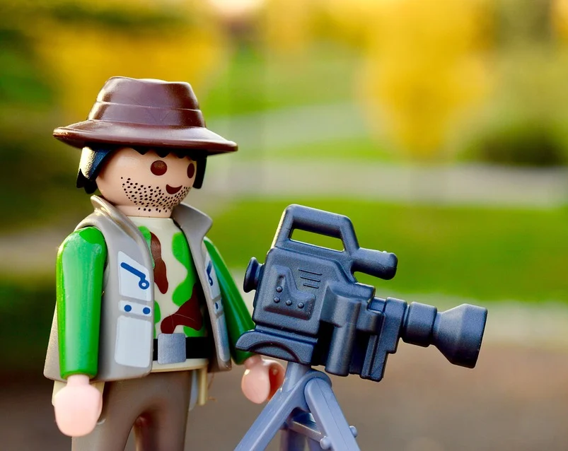
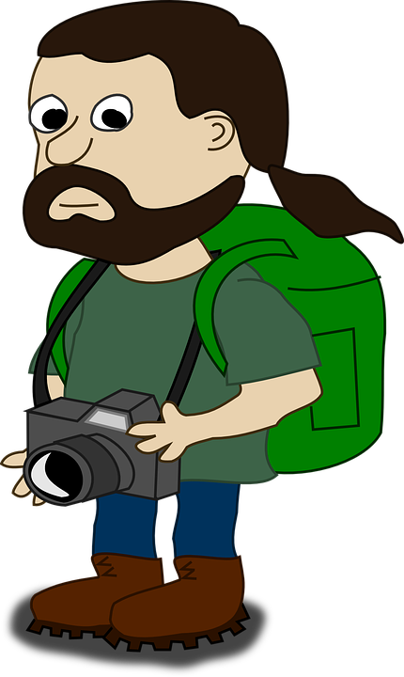
Photographer, Erika Wittlieb, 2016, Pixabay
Photographer, Michal Jarmoluk, 2014, Pixabay
Filmstrip, Clker-Free-Vector-Images, 2012, Pixabay
camera
something that is used to take photographs or make a film
Photographer, Clker-Free-Vector-Images, 2014, Pixabay

Slide 13
word | class | definition | sentence
camera | noun | something that is used to take photographs or make a film | He took some great photos with his camera.

Slide 14
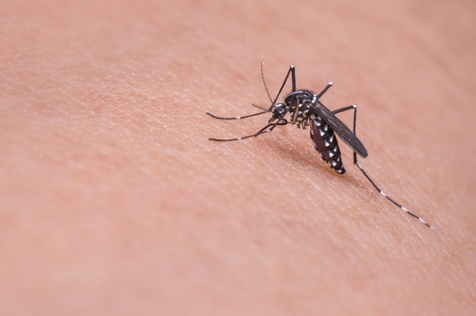
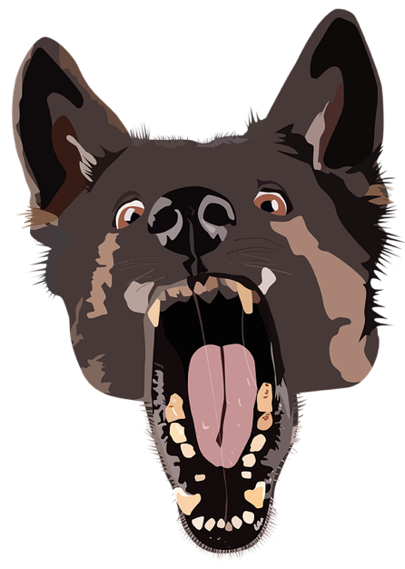
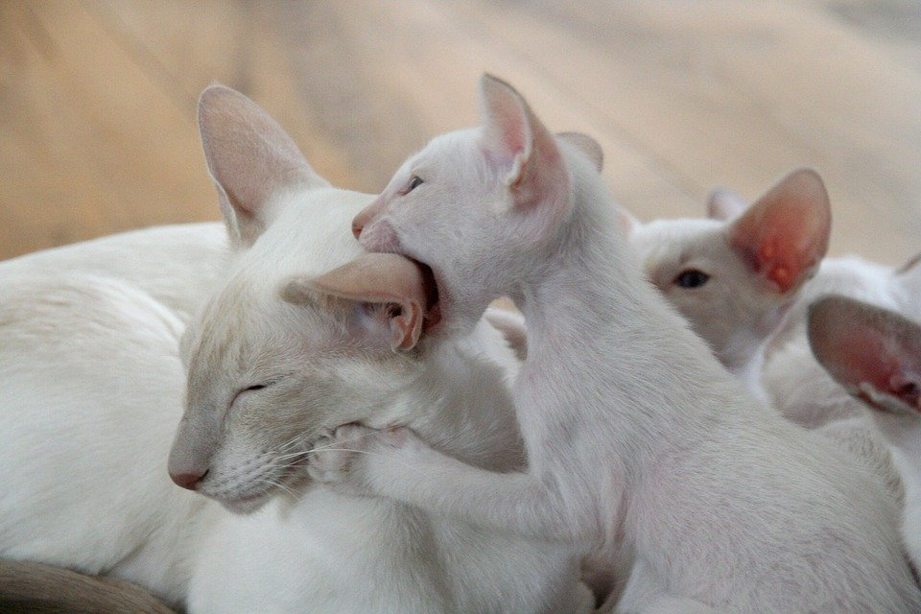
Flea, Clker-Free-Vector-Images, 2012, Pixabay
Shark, Akikio Nagamatsu, 2020, Pixabay
Carrot, Clker-Free-Vector-Images, 2012, Pixabay
Mosquito, Mika Mamy, 2015, Pixabay
Dog, Shaun, 2020, Pixabay
bite
use teeth to cut something, some animals can hurt people this way
Kitten, Tania Van den Berghen, 2011, Pixabay

Slide 15
word | class | definition | sentence
bite | verb | used teeth to cut something, some animals can hurt people this way | I cried when the dog bit me.

Slide 16
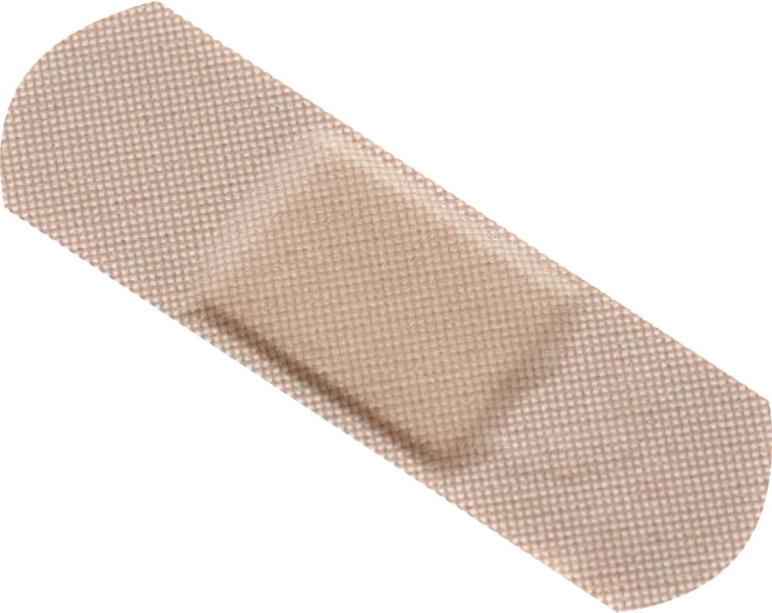
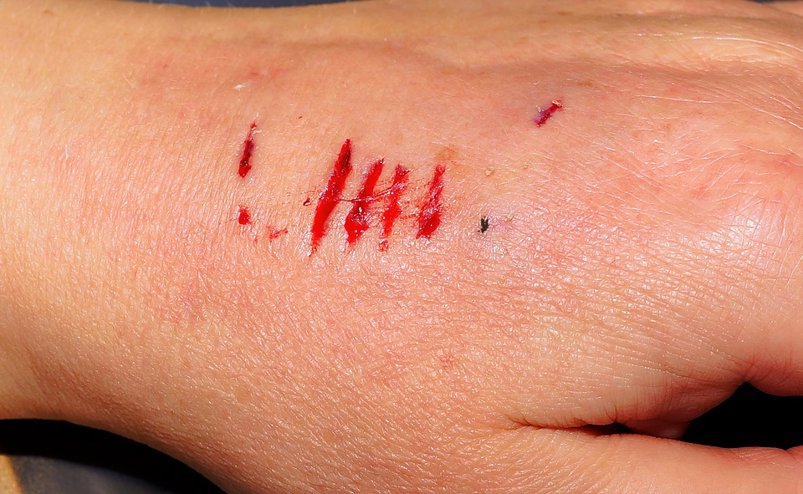
Injury, Emily Rosely, 2020, Pixabay
Finger, Tulia Colombia Torres Hurtado, 2016, Pixabay
Splatter, Clker-Free-Vector-Images, 2014, Pixabay
bleed
when a person or animal loses blood from a cut or bite
Hand, Karsten Paulick, 2017. Pixabay

Slide 17
word | class | definition | sentence
bleed | verb | when a person or animal loses blood from a cut or bite | Sit still, your nose is bleeding.

Slide 18
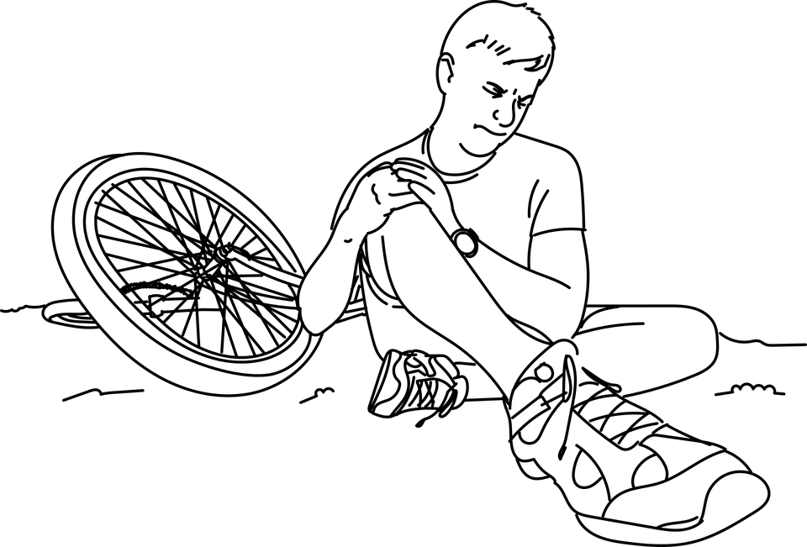
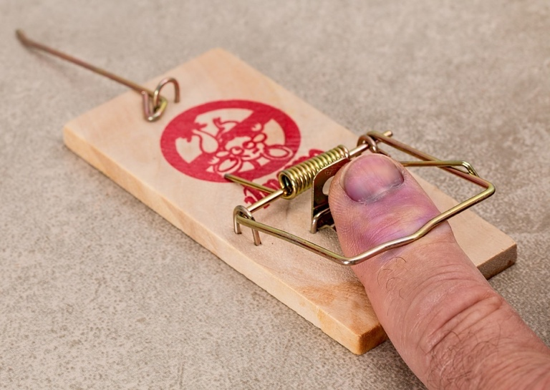
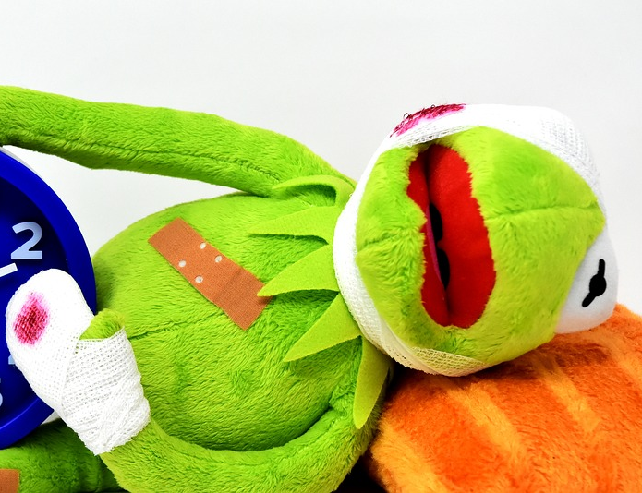
Fall, Augusto Ordonez, 2017, Pixabay
Mistake, Steve Buissinne, 2017, Pixabay
Dog, Clker-Free-Vector-Images, 2014, Pixabay
hurt
to be in pain
Time heals all wounds, Alexas_Fotos, 2018, Pixabay

Slide 19
word | class | definition | sentence
hurt | verb | to be in pain | His finger was hurting because he cut it with a knife.

Slide 20
Part 2: Top tips

Slide 21
Listening Task
You will listen to a narrative text - a story - to answer the questions for both Parts A and B.
The Listening Task is made up of two parts.
Part A: Multiple Choice Questions
Questions 1 - 6 are multiple choice questions. This is where you will need to listen to the speaker and choose the correct answer.
Part B: Short Response Question (Making a Prediction)
Question 7 requires a short response. This is where you will need to listen to the speaker and answer the question in full sentences.
Questions, ElisaRiva, 2016
Questions, ElisaRiva, 2016

Slide 22
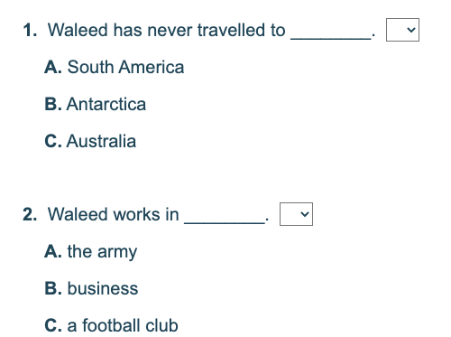
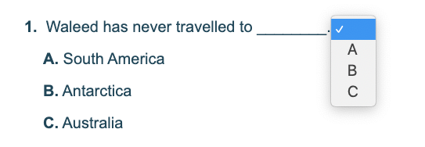
Multiple Choice Questions
Step 2: Read the questions then play the audio track.
Step 1: Read the instructions.
Step 3: Read each question and the options A, B, and C. Think about what you heard then select your answer. Which answer did you hear?
Notes:
Waleed Abbas gets to travel around the world. He has travelled to most of the continents, including Antarctica and Australia, but he hasn’t been to South America. He is not a businessman or a soldier, though. He is a player in a UAE football team called ‘Shabab Al-Ahli’.

Slide 23
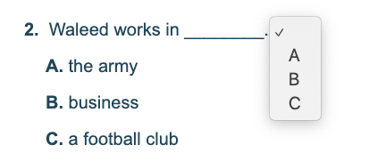
Multiple Choice Questions
Step 2: Read the questions then play the audio track.
Step 1: Read the instructions.
Step 3: Read each question and the options A, B, and C. Think about what you heard then select your answer. Which answer did you hear?
Notes:
Waleed Abbas gets to travel around the world. He has travelled to most of the continents, including Antarctica and Australia, but he hasn’t been to South America. He is not a businessman or a soldier, though. He is a player in a UAE football team called ‘Shabab Al-Ahli’.

Slide 24
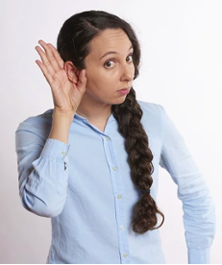
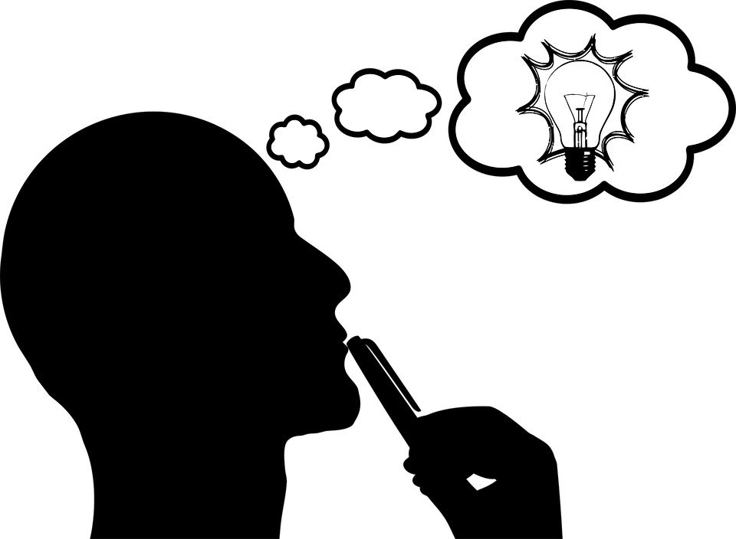
Making a Prediction
Question 7 is the short response question, and you will need to make a prediction.
This is where you will describe what might happen next in the story.
You will need to listen carefully and use information from the story to explain your ideas.
You will not be assessed on grammar, spelling or punctuation.
Listening, RobinHiggins, 2018
Think, OpenClipArt_Vectors, 2016

Slide 25
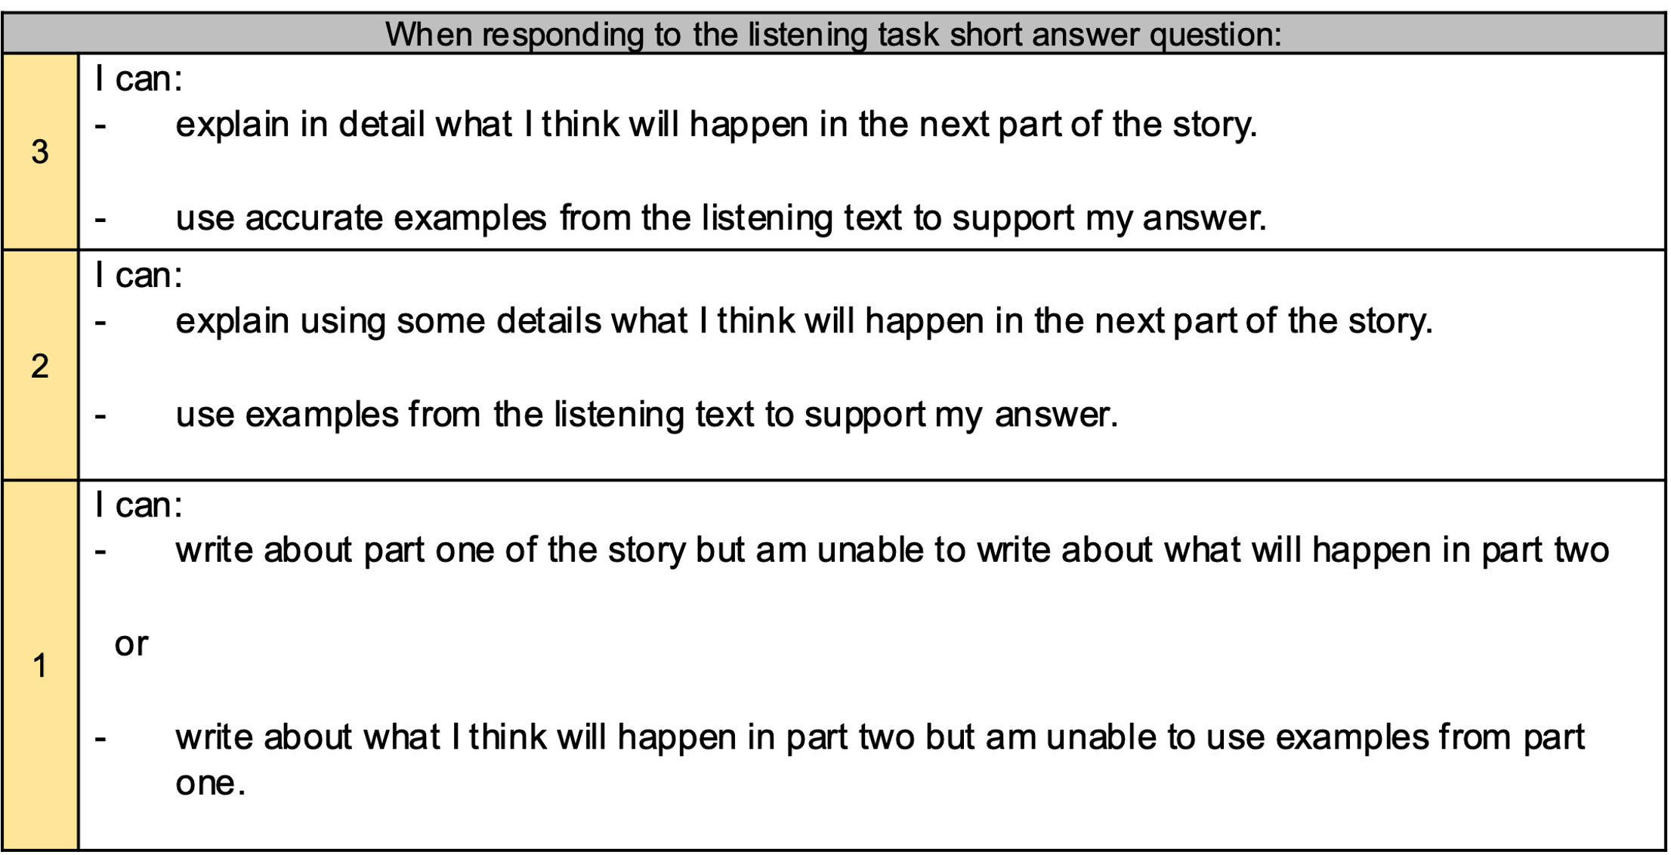
Making a Prediction
Below is a grid showing how your short response will be assessed.
Listening, RobinHiggins, 2018
Think, OpenClipArt_Vectors, 2016

Slide 26
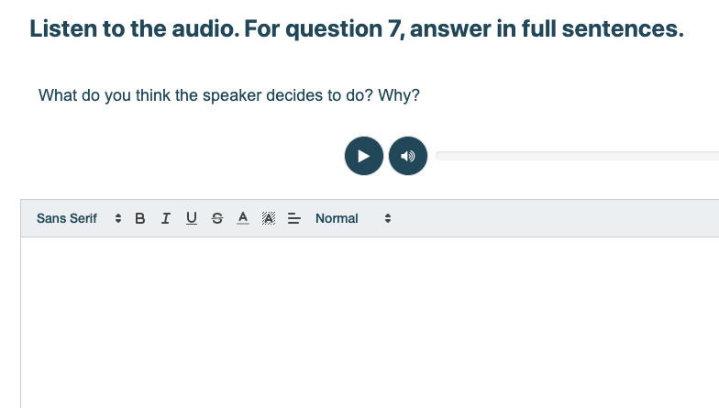
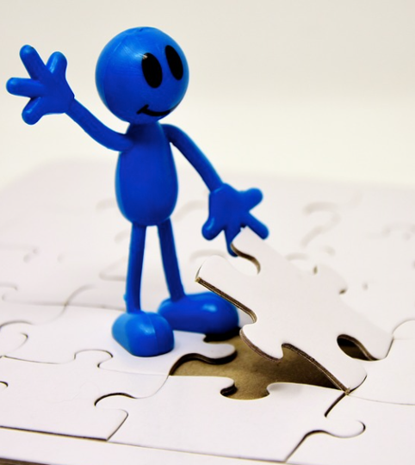
Step 1: Read the instructions.
Your Turn!
Step 2: Read the questions.
Complete, Alex_Fotos, 2018
Step 4: Write your answer in this box. What will you write? Have a go now! Remember to use ideas from what you heard.
Step 3: Listen to the audio track when you are ready. Using a pen and paper take notes as you listen.
Notes:
I didn’t know if I should knock on his door. He hadn’t seen me in over 3 years. We were best friends for so long and we always did everything together. I never had the chance to say thank you, for all the help he gave me at school. I got so busy with work, that I forgot about our friendship. As I stand by his front door, I am not sure what to do?

Slide 27
Listening Task Outcomes
Assessment Focus | Level 3.1 | Level 3.2 | Level 4.1 | Level 5.1 | Level 6.1
Listen and identify details. | X | X | X | X | X
Listen and understand the overall meaning. | X | X | X | X | X
Make and check predictions. | X | X | X | X | X
Make connections. | X | X | X | X | X
Listen and identify specific information. |  |  | X | X | X

Slide 28
Story Titles
Level | Name of Story
Level 3.1 | Danger in the Mountains
Level 3.2 | An African Safari
Level 4.1 | Day 57 (In the Wild)
Level 5.1 | The Jungle Home
Level 6.1 | Taking to the Skies

Slide 29
Top Tips
Multiple Choice Questions
Listen to the audio carefully
Answer each question
Listen to the audio again
Go over all your answer choices
Short Response Question
Think about the storyline and the characters
Read the question carefully
Take notes with a pen and paper when you listen
Think about what you think will happen next
Write your answer based on facts and information from the story
Give as much detail as possible
Complete, Alex_Fotos, 2018

Slide 30
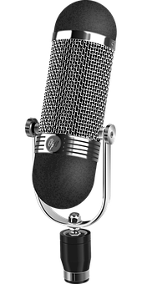
Assessment Timeline
Part 1 – Listening Task
Part 2 – Listening Exam
Speaking Exam
Introduction to the story as part of the Listening Task conducted in Week 5 on Swift Assess.
Listen to part two of the story as part of the Listening Exam conducted in Week 8 on Swift Assess.
Discuss the story as part of the Speaking Exam in Week 9. You will talk about your opinions as a group with your teacher.
Microphone, OpenClipart-Vectors, 2013

Slide 31
Follow us
ese.ae
Ese_ae

