Slide 1
Welcome to our class

Slide 2
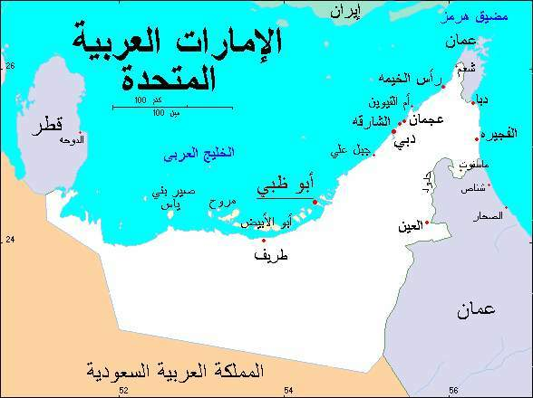
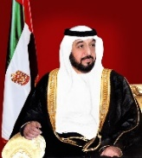

Slide 4
2021
My Calendar
2022
January
Day
Date
Month
Year
February
2021
March
2
2022
3
1
2
6
4
0
3
8
7
9
1
5
April
Today the weather is…
May
June
July
Date
weather
Sunday
Thursday
August
3
2
1
Monday
Friday
September
6
5
4
Tuesday
Saturday
October
9
8
7
Wednesday
November
3
2
1
December
0

Slide 5
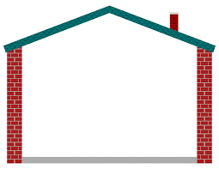
UNIT 5:
around the house

Slide 6
Lesson 9:
A dream house
Objectives :
1) To recognize present simple and present continuous forms.

Slide 7
A dream house

Slide 8
Warm up activity..

Slide 9
What do you do on Fridays?
I go to the park.
I eat an apple.
I drink coffee.
I play football.

Slide 13
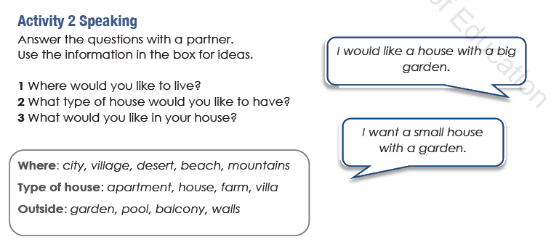

Slide 14
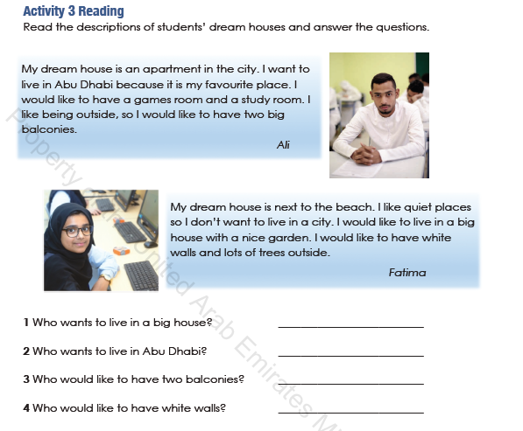
Fatima
Ali
Ali
Fatima

Slide 15
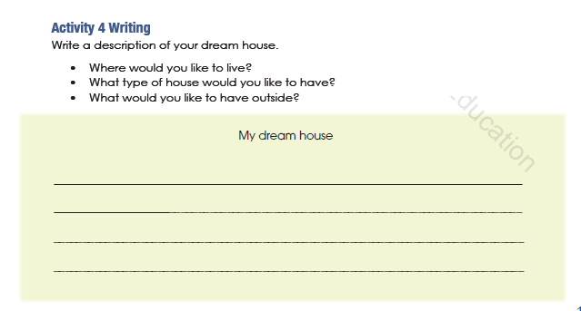
I would like to live in the village.
I would like to live a big house.
I would like to have a garden in front of my house.

Slide 16
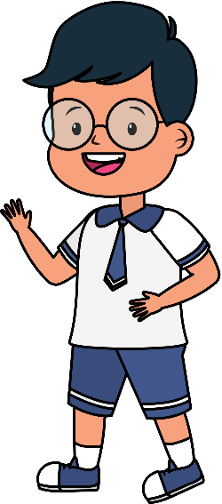
Attendance

Slide 17
Exit ticket ..
https://www.liveworksheets.com/worksheets/en/English_as_a_Second_Language_(ESL)/Present_simple_and_present_continuous/Present_Simple_vs_Present_Continuous_bv1700jq

