Slide 1
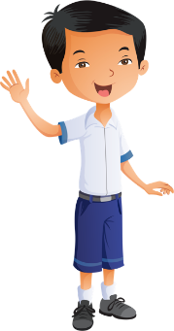
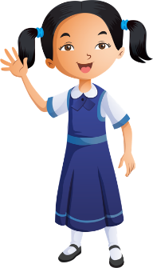
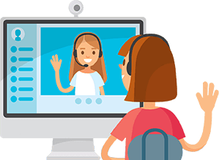
Distance learning and cybersecurity rules
Prepare books and school supplies
Wear school uniform
Be ready and on time
Sit in a quiet place
Open the camera when the teacher asks
Stay on mute & raise your hand to take part
Please do not interrupt anyone
Don’t share account information

Slide 2
Unit 7 : Amazing bodies

Slide 3
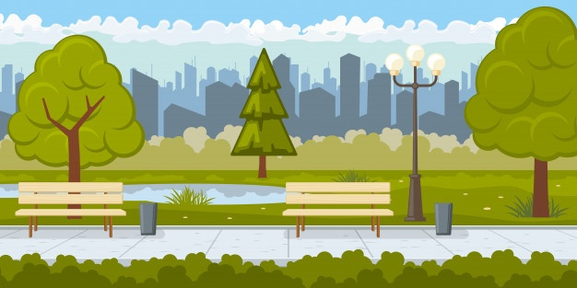
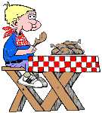
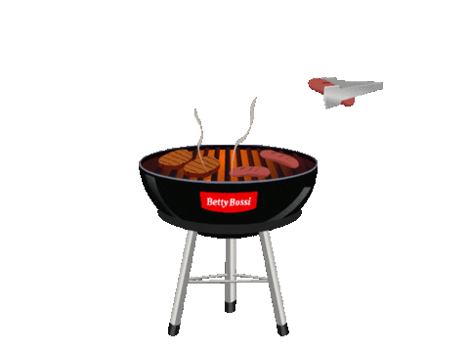
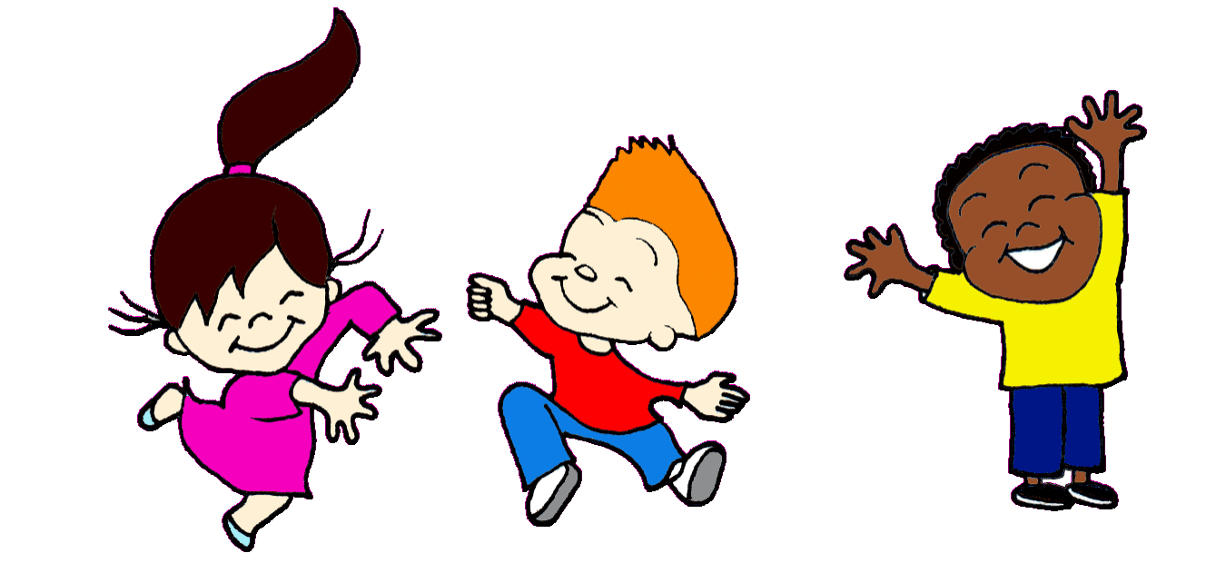
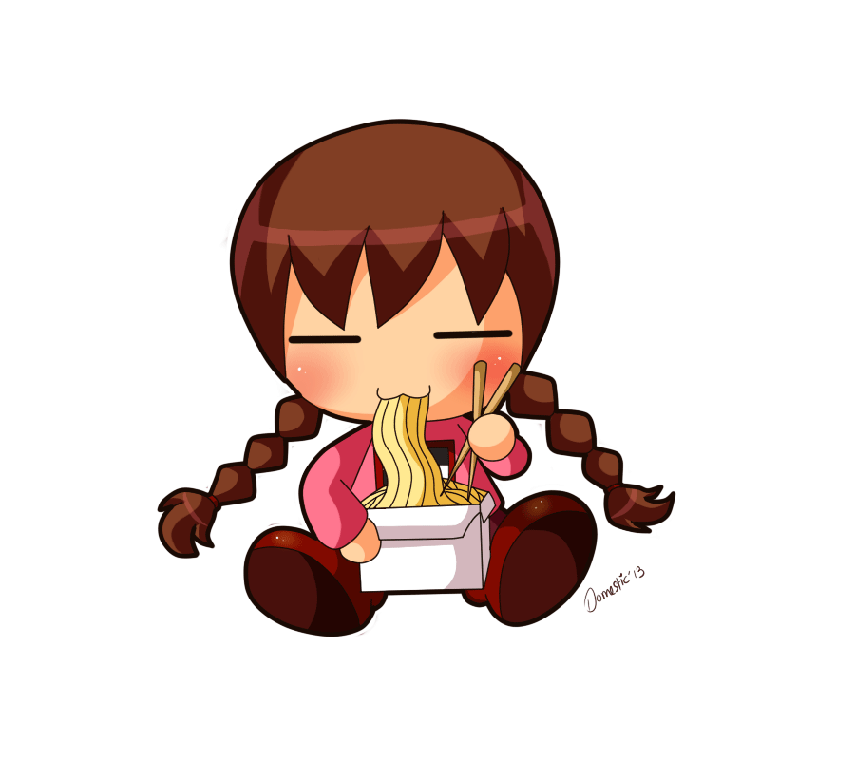
Brainstorming : What can you hear , smell , eat at the park ?

Slide 4
Unit 7 : Amazing bodies
Sounds – smell – taste

Slide 5
Learning out comes
SPEAKING
1-Talking about their favorite sounds, tastes ,smells .
2-Writing about their favorite sounds, tastes ,smells .
READING
WRITING

Slide 6
Five senses
Tigtag jr
Senses video
Click here

Slide 7
We smell with our nose
Vocabulary
smell

Slide 8
flowers
smell

Slide 9
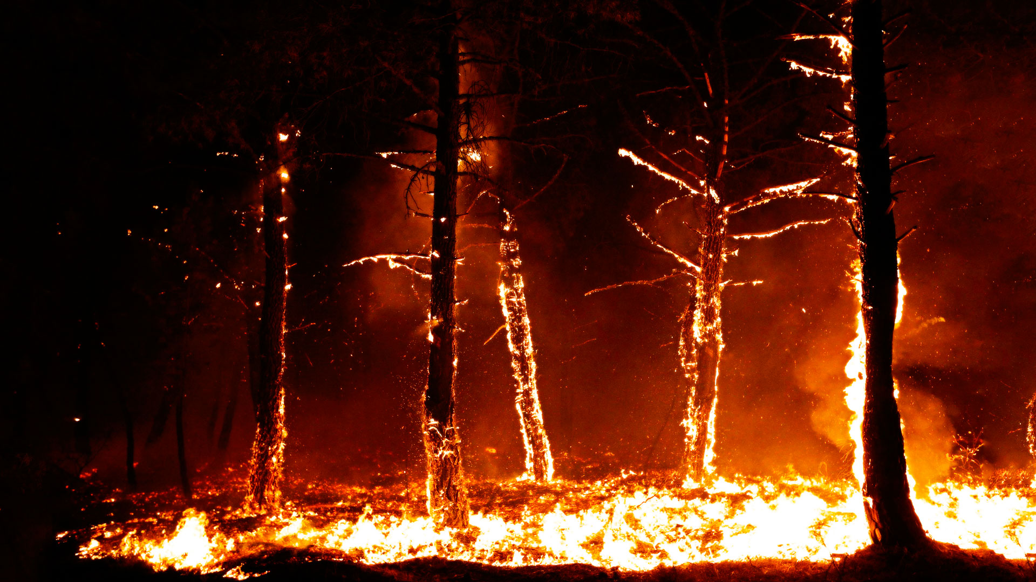

Slide 10
Online Activity
Sense of smell
Click here

Slide 11
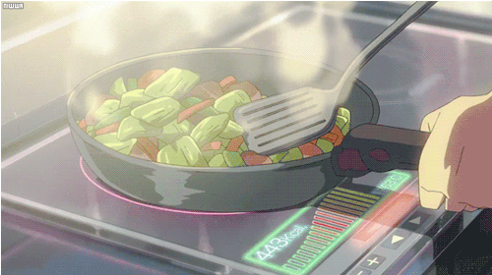
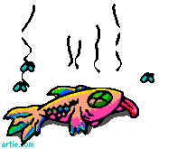
Ask and answer
What’s your favourite smell?
My favourite smell is ..................

Slide 12
We hear with our ears
Vocabulary
hear

Slide 13
hear

Slide 14
hear

Slide 15
rain
sound

Slide 16
music

Slide 17
Online Activity
Sense of hearing
Click here

Slide 18
Ask and answer
What’s your favourite sound?
My favourite sound is ……………

Slide 19
We taste with our tongue
Vocabulary
taste

Slide 20
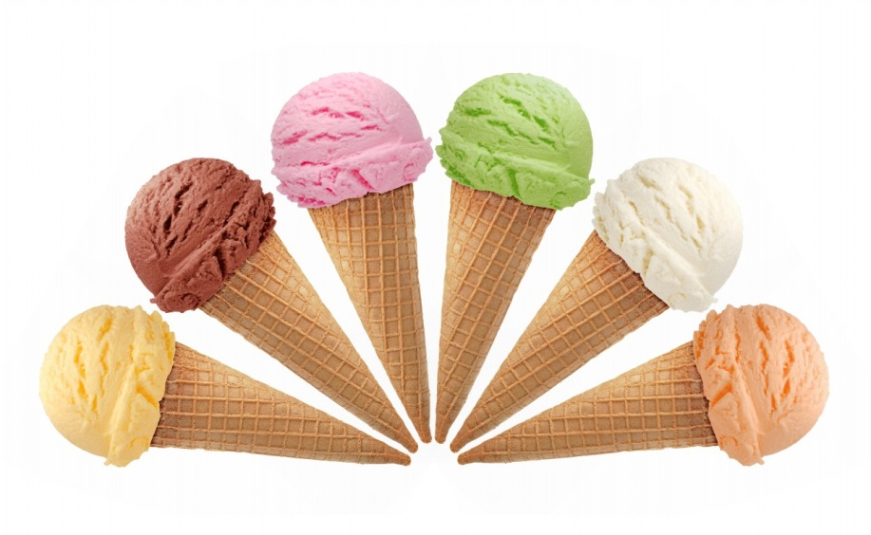

Slide 21
Video
I can taste
Click here

Slide 22
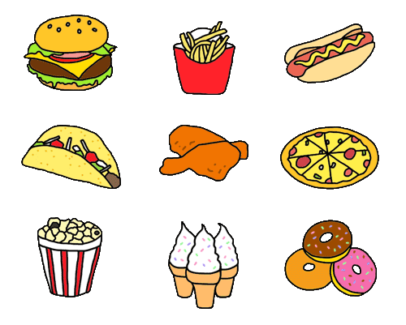
Ask and answer
What’s your favourite food?
My…………………………………………………………

Slide 23
2
5
4
3
1
6

Slide 26
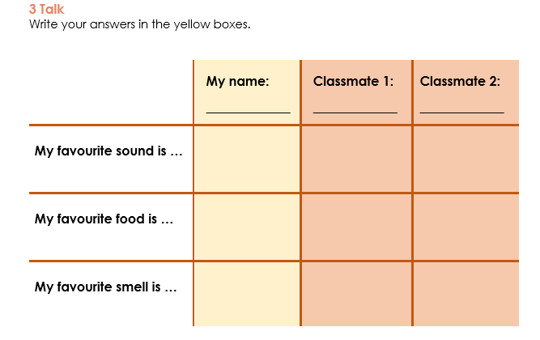
Fatema
birds singing
Pizza
flowers

Slide 27
Exit Ticket
Click here

