Slide 1
Al Hikmah Private School
BTS 5 - Term 3
English:
Unit 11 – Lesson 2
Special Jobs
Main question of the lesson:
What special job do you know of?

Slide 2
قوانين التعلم عن بعد والأمن الإلكتروني
Distance learning and cybersecurity rules
أجهز كتبي وأدواتي المدرسية
Prepare books and school supplies
أجلس في مكان هادئ
Sit in a quiet place
ارتداء الزي المدرسي
Wear school uniform
الالتزام بوقت الحصة
Be ready and on time
افتح الكاميرا عندما تطلب المعلمة
Open the camera when the teacher requests
أغلق الميكروفون وأرفع يدي للمشاركة
Stay on mute & raise your hand to participate
أشارك بالتعلم ولا أقاطع أحد Participate but do not
interrupt anyone
لا أشارك بيانات حسابي
Don’t share account information

Slide 3
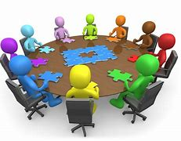
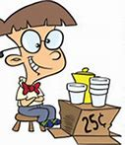
STREAM skills
Collaboration
Critical thinking
Creativity
Communication
Entrepreneurship
Innovation
During the lesson, we will talk about how we will link it to Social Studies, Science and DT.

Slide 4
Learning Objectives (What)
Learn and practice how to use “must be”, “can’t be” and “sure he is”.
Success Criteria (How)
To listen and find information about famous people.
To learn and practice how to use might, must and could be.

Slide 5
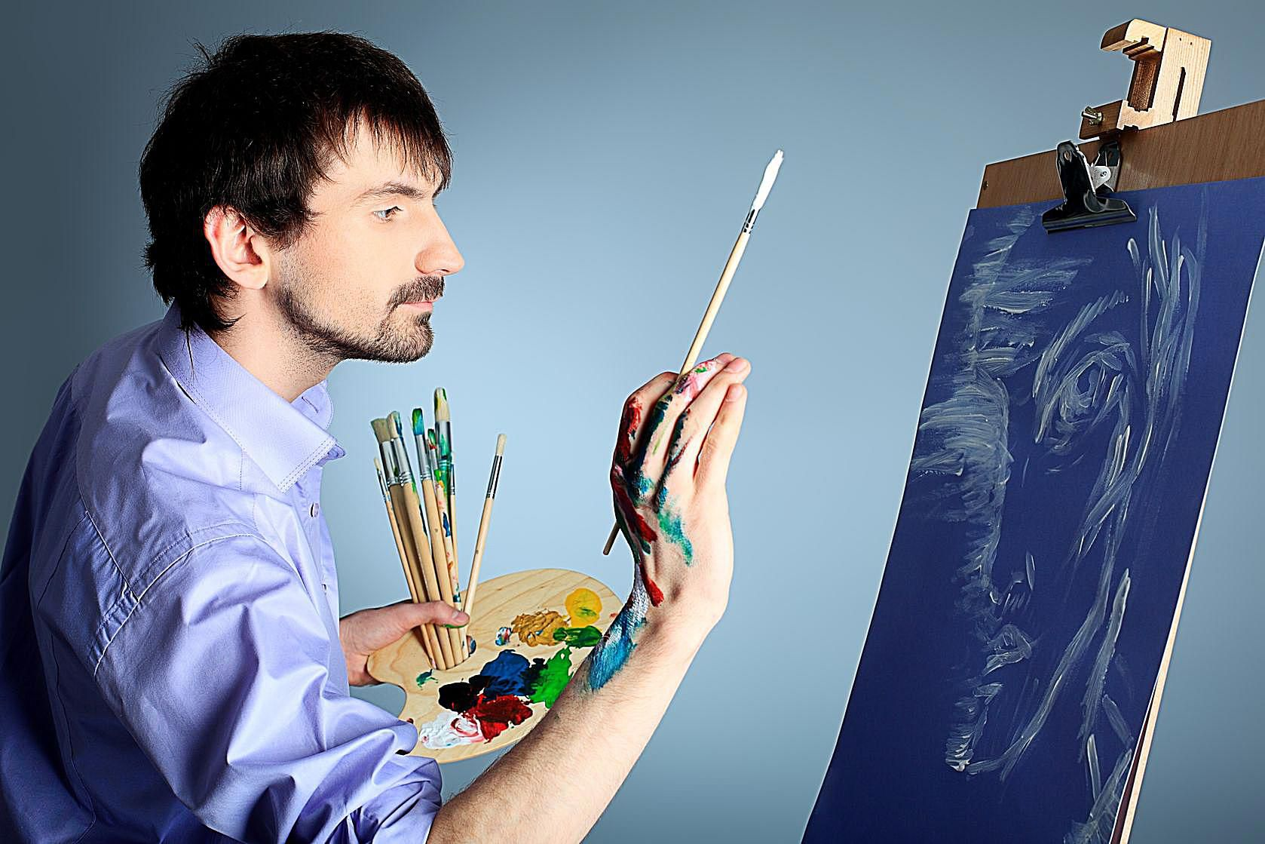
artist
He is
an

Slide 6
explorer.
He is
an

Slide 7
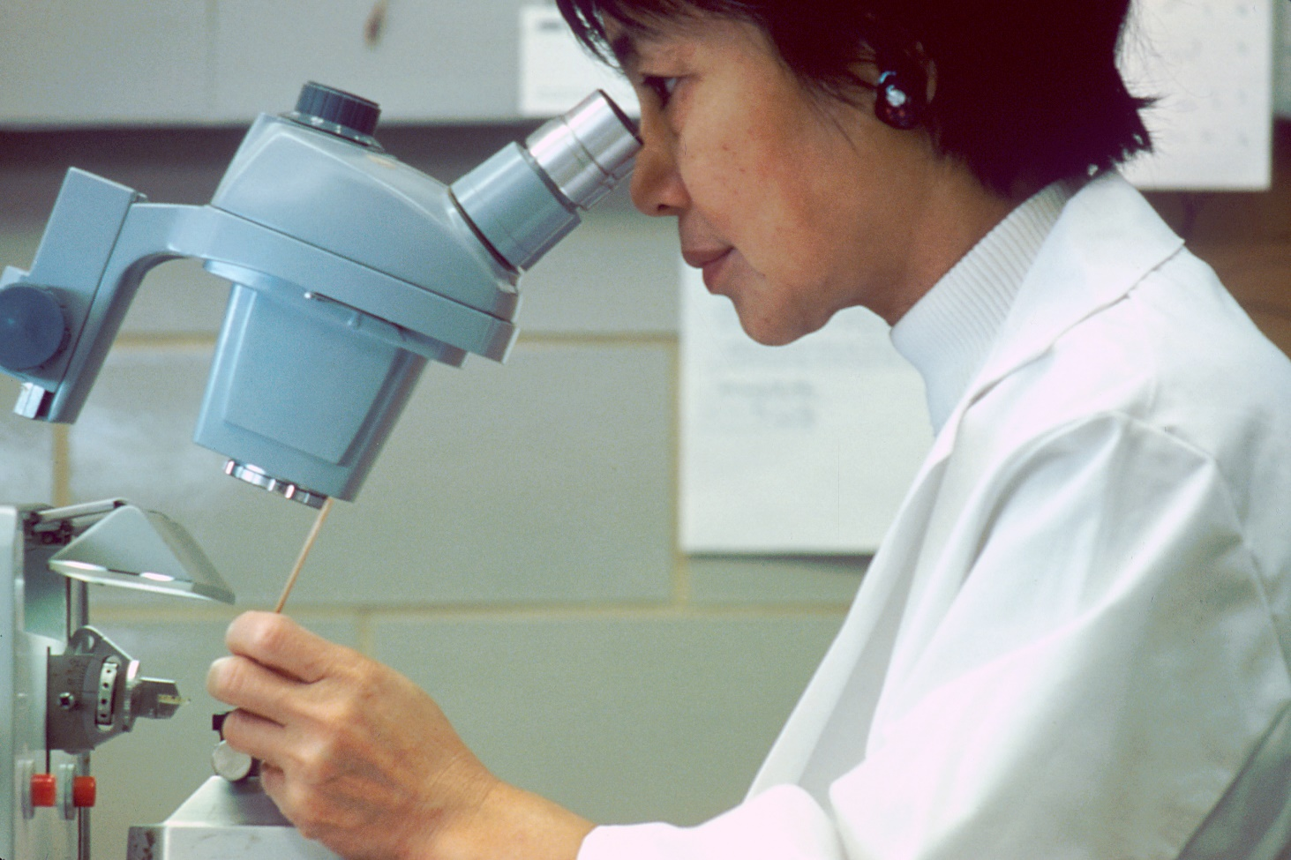
She is
scientist.
a

Slide 8
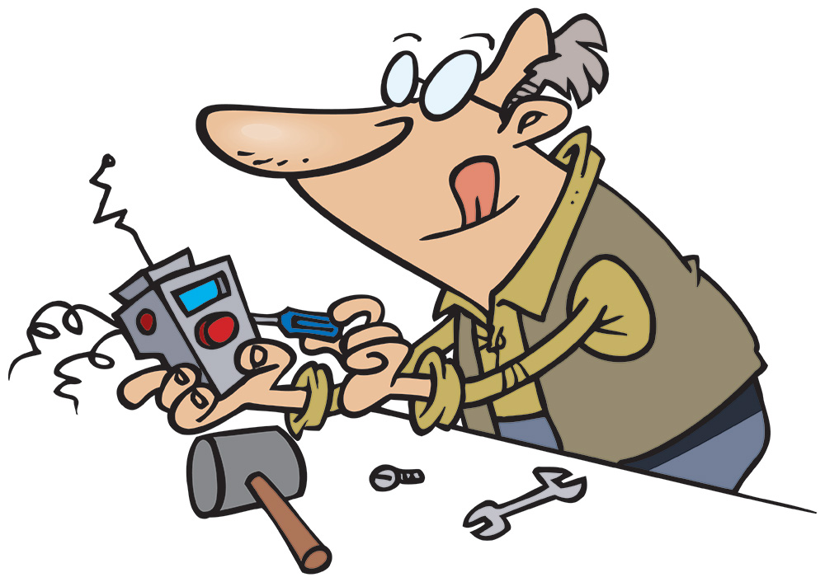
inventor.
He is
an

Slide 9
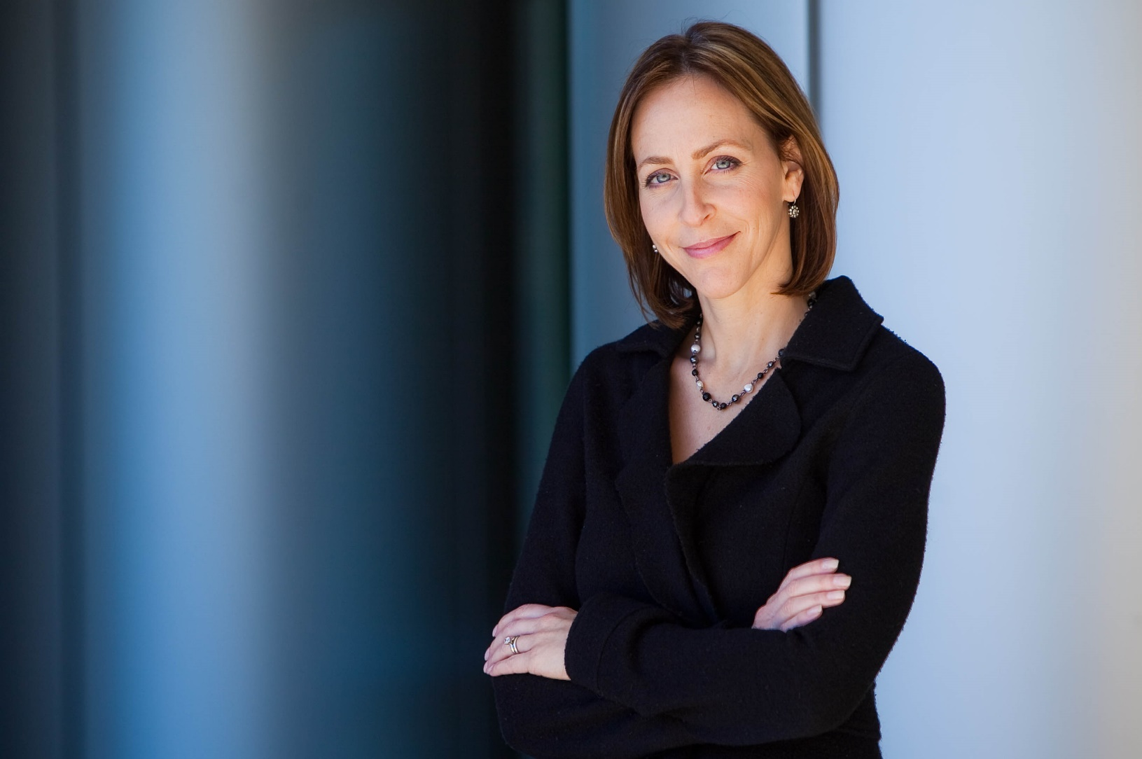
a
She is
business person.

Slide 10
Unit 11
Personal qualities

Slide 11
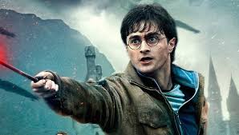
He is
brave.

Slide 12
He is
creative.

Slide 13
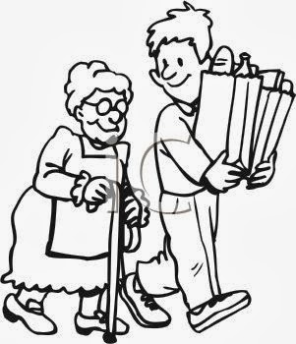
He is
kind.

Slide 14
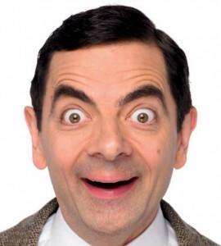
He is
fun.

Slide 15
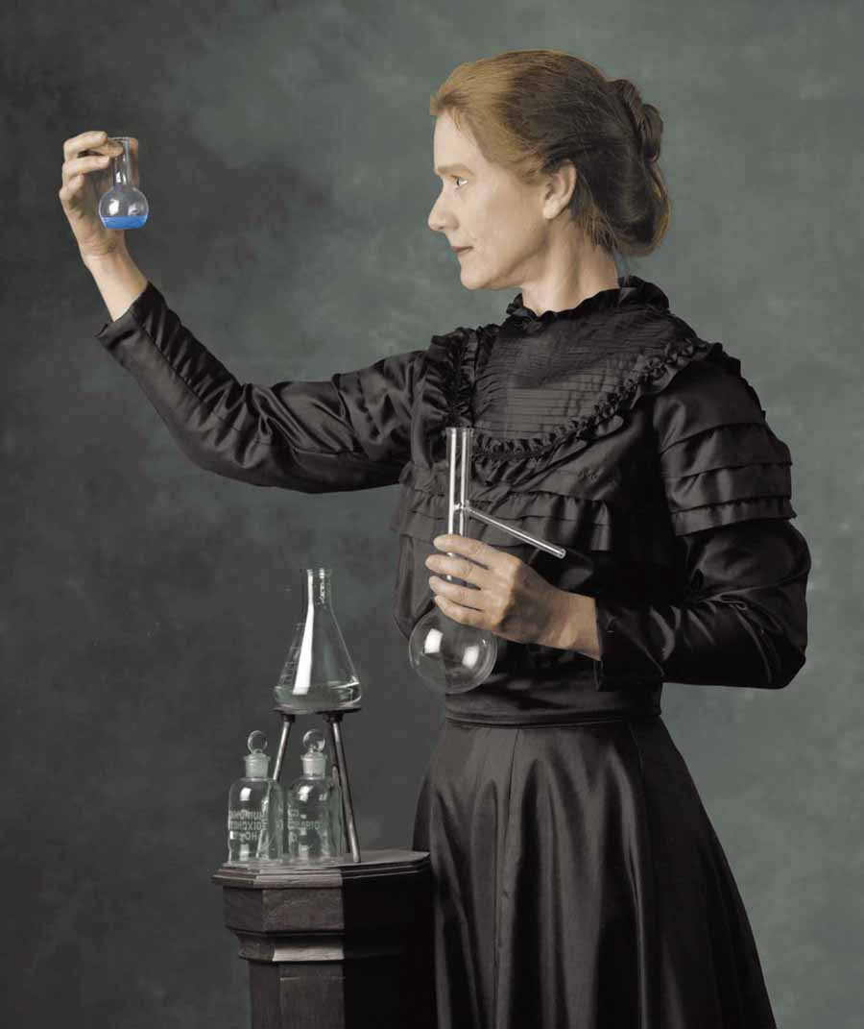
She is
intelligent.

Slide 16
caring.
She is

Slide 17
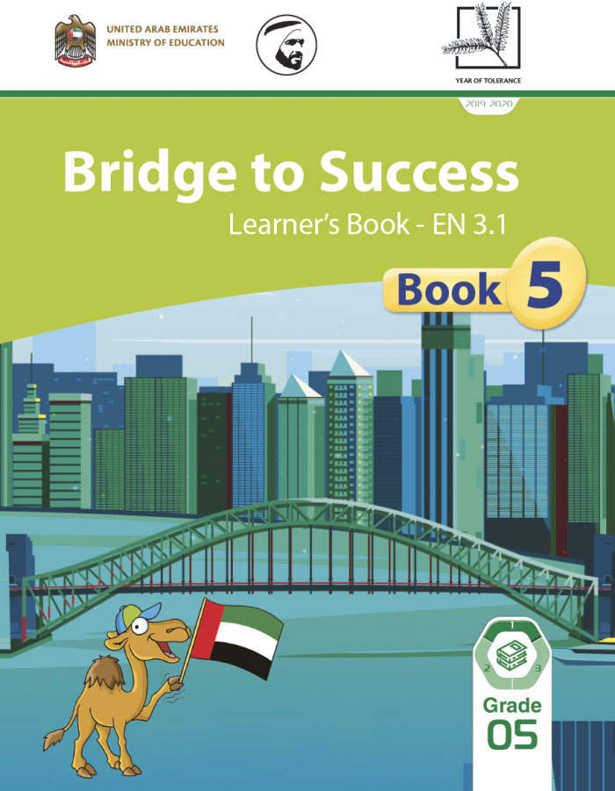
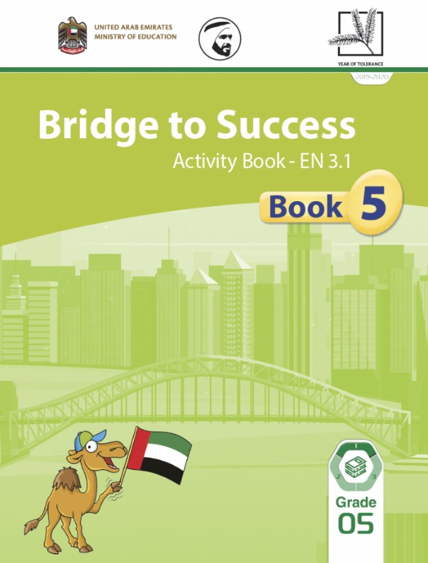
Open on page:
page 159
page 123

Slide 18
End
I can talk about special jobs.
1
2
3
4
5
6
7
8
9
10
11
12
13
14
15
16
17
18
19
20
21
22
23
24
25
26
27
28
29
30
p159

Slide 19
p159

Slide 20
Page 159
J.K. Rowling
Britain
1965
Writer
of Harry Potter!

Slide 21
Page 159
Hayou Miyasaki
Japan
1941
Film director, Manga artist

Slide 22
Page 159
Ed Viesturs
The USA
1959
Mountain climber

Slide 23
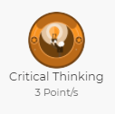
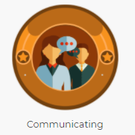
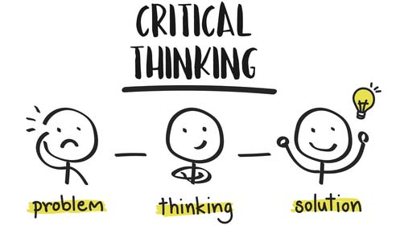
HOT Question
Suppose you could leave school now!
What would you do to make money?

Slide 24
She must be a…
I’m sure she’s a…

Slide 25
She could be a…
She might be a…

Slide 26
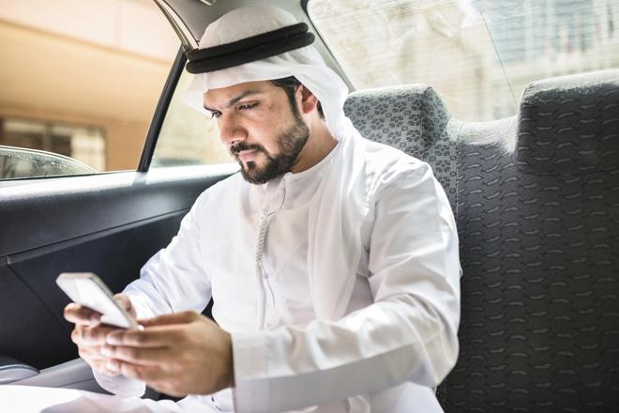
He could be a…
He might be a…

Slide 27
0:59
0:58
0:57
0:56
0:55
0:54
0:53
0:52
0:51
0:50
0:49
0:48
0:47
0:46
0:45
0:44
0:43
0:42
0:41
0:40
0:39
0:38
0:37
0:36
0:35
0:34
0:33
0:32
0:31
0:30
0:29
0:28
0:27
0:26
0:25
0:24
0:23
0:22
0:21
0:20
0:19
0:18
0:17
0:16
0:15
0:14
0:13
0:12
0:11
0:10
0:09
0:08
0:07
0:06
0:05
0:04
0:03
0:02
0:01
End
1:30
1:30
1:29
1:28
1:27
1:26
1:25
1:24
1:23
1:22
1:21
1:20
1:19
1:18
1:17
1:16
1:15
1:14
1:13
1:12
1:11
1:10
1:09
1:08
1:07
1:06
1:05
1:04
1:03
1:02
1:01
1:00
p123
might
could
can’t
must be
could
might

Slide 28
DIFFERIENTIATION: Complete the activity according to your group.
Special jobs
Apply
Critical thinking
1 | 2 | 3 | 4
https://www.liveworksheets.com/tr1526930yr | https://www.liveworksheets.com/tt1185543gu | https://www.liveworksheets.com/xl1345801ky | https://quizizz.com/join?gc=66755098

Slide 29
What did we learn today? (lesson objectives)
Lesson Review

Slide 30
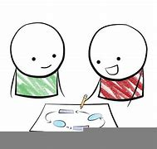
Enrichment
Post a picture of the job you would like to do and write about why you want to do this job!
POST on LMS COURSE HOME
like their work

Slide 31
LMS Activities
* Complete activities in: AB pages 123
Complete LMS activities…
Term 3 Week 1-6
Enrichment
Exit Tickets
Important

Slide 32
Before you leave…
Complete the LMS activity
To confirm you understood today’s lesson please complete the activity in
WEEK 6 period 1
Qimma Open Training
Maze 1 – LMS
https://lms.moe.gov.ae/Course#!/view/272820/false/915074/CourseMap/Unit/View/92da1bac-c55c-4da9-93ee-e49dbfe37daa/Session/View/269a36cb-e698-4384-bcb6-593aa2ac48a8?materialid=29f9eecf-3190-4353-b80d-8324d72d35cb&termid=19
Skills Check 1 – LMS
https://lms.moe.gov.ae/Course#!/view/272820/false/915074/CourseMap/Unit/View/92da1bac-c55c-4da9-93ee-e49dbfe37daa/Session/View/269a36cb-e698-4384-bcb6-593aa2ac48a8?materialid=65d5aa59-3ed1-4768-97df-7c6845f94957&termid=19

Slide 33
Self Evaluation
How do you feel about the lesson?
good
Not bad
bad

