Slide 1
Welcome
Unit 9
Lesson 7

Slide 2
Objectives
learners will be able to ...
To listen to and talk about future arrangements using –ing verbs (present continuous).
To use prepositions of time (on, in, at) in sentences

Slide 3
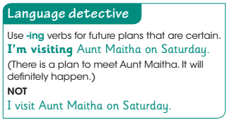
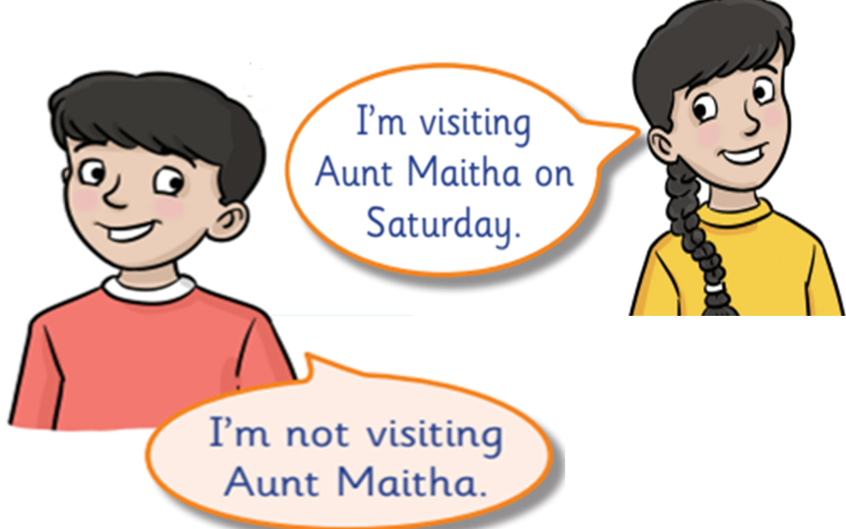
p.172
1 On Saturday
What are Jassem and Rasha doing on Saturday? Read and listen

Slide 5
Use ‘on’ with ➔ days of the week / dates
Use ‘in’ with ➔ morning, afternoon, evening
Use ‘next’ with ➔ months/years/days of the week
Use ‘at’ with➔ all times
On Saturday
On 24.feb
in the morning
in the afternoon
in the evening
next month
next year
next Sunday
at 5:00 pm

Slide 7
Fill-in below using the verbs. Add –ing if there is a strong plan!
visit drive eat
My dad is ________ the car to Al Ain on Thursday.
We are ________ our family on the weekend.
We are _______ our Iftar meal at 7pm.
driving
visiting
eating

Slide 8
1. My birthday is…………………. February .
in
on
at
2. UAE national day is…………………. 2nd of December.
in
on
at
3. I get up …………………. 7 o'clock .
in
on
at

Slide 10
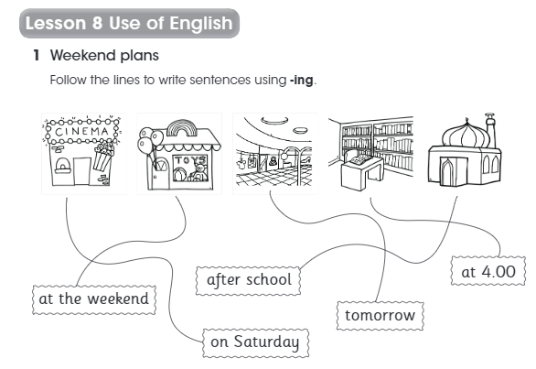
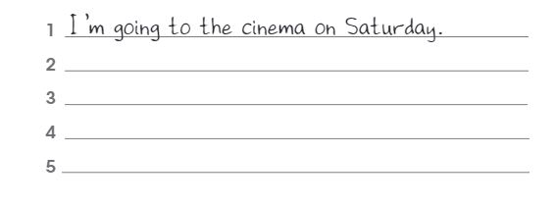
toy
store
Shopping
Center
I’m going to the toy store at the weekend.
cinema
library
mosque
I’m going to the shopping center tomorrow.
I’m going to the library at 4:00.
I’m going to the mosque after school.
p.148

Slide 11
Thank
you
Leave the conversation

