Slide 1
Welcome to our class

Slide 2
Unit 5: Lesson 2
Page
92

Slide 3
Objectives
To talk about rooms in a house.
To learn and use new words correctly.
To read for specific information .
To write about languages they speak .

Slide 5
New vocabulary

Slide 6
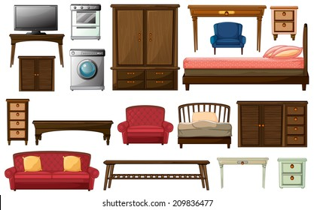
furniture

Slide 7
Book shelf

Slide 8
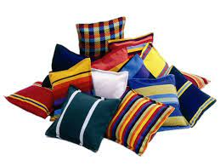
pillow

Slide 9
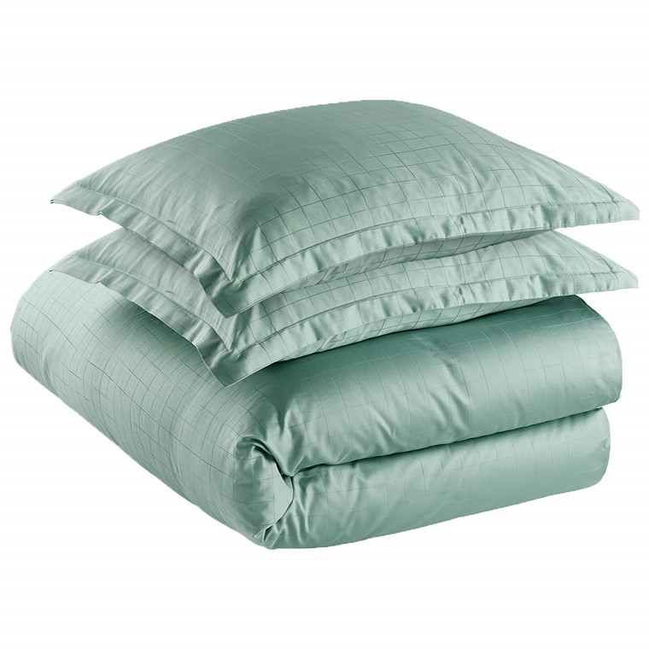
duvet

Slide 10
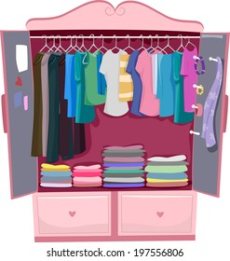
wardrobe

Slide 11
messy
Tidy

Slide 12
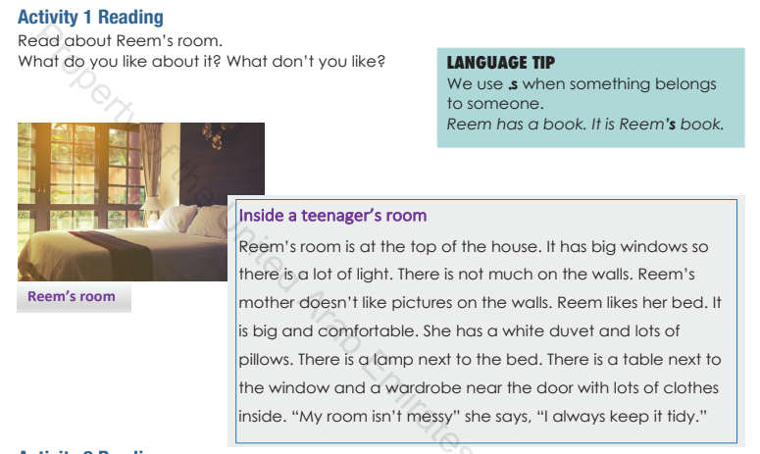

Slide 13
She likes her bed.
Bed, lamp, table and wardrobe
Yes

Slide 16
Padlet time write about your room
https://padlet.com/umnada228/3ls5847y7kbt8q1j

Slide 17
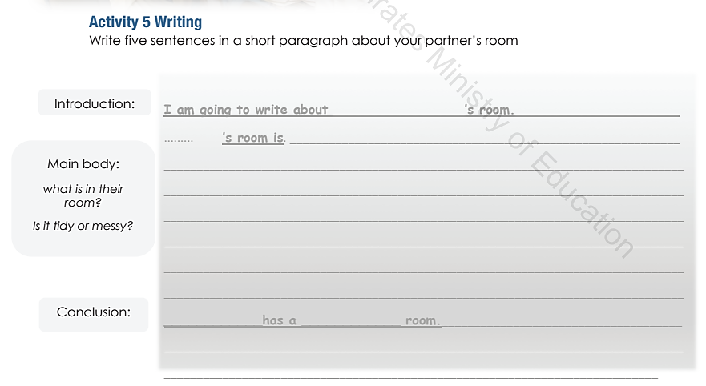

Slide 18
https://www.liveworksheets.com/hk371071ay
Quiz
Time
https://www.liveworksheets.com/ja90156ls
https://www.liveworksheets.com/dc673882gg

