Slide 1
ENGLISH
Grade 1
UAE Phonics
Term 3
Week 6
Writing revision
Ms. Liesa

Slide 2
Practice your sounds everyday!

Slide 3
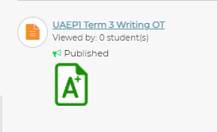
Writing OT revision
Ms. Liesa
Al Huiteen School
UAE Phonics 1 T3

Slide 4
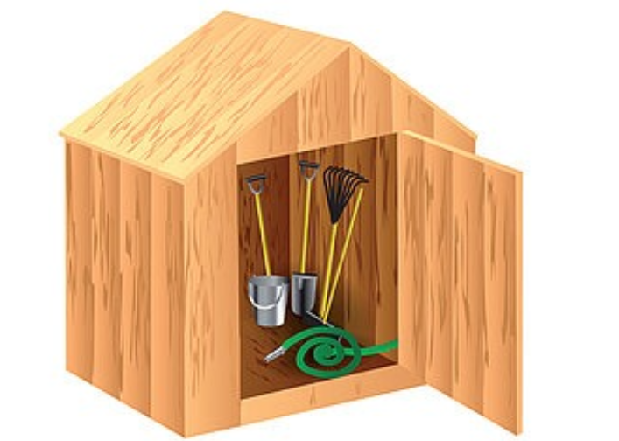
Listen and write the missing letter/s
s h
s h
_ _ed
_ _op

Slide 5
w
_ ind
p _ t
i
Listen and write the missing letter/s

Slide 6
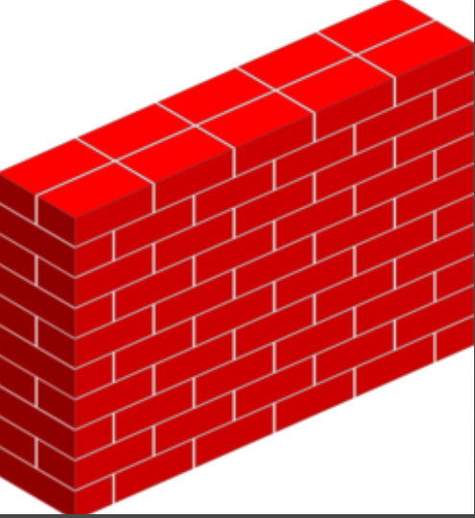
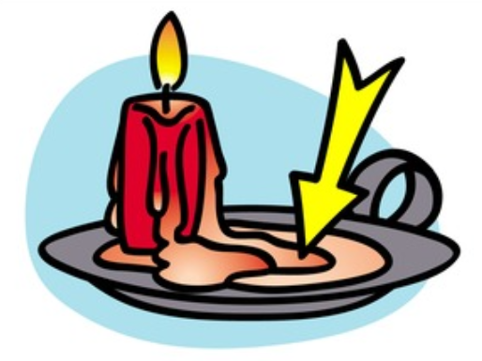
Listen and write the missing letter/s
wa_
x
w
_all

Slide 7
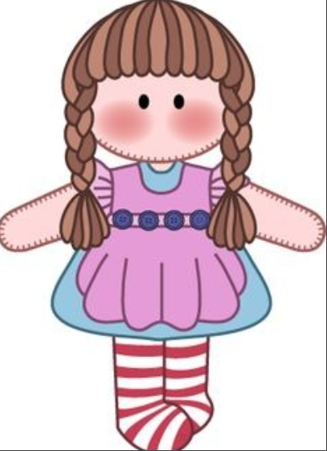
Listen and write the missing letter/s
ma_ _
l l
l l
do_ _

Slide 8
Look and write the word
four
six
eight

Slide 9
Look and write the word
red
pink
blue

Slide 10
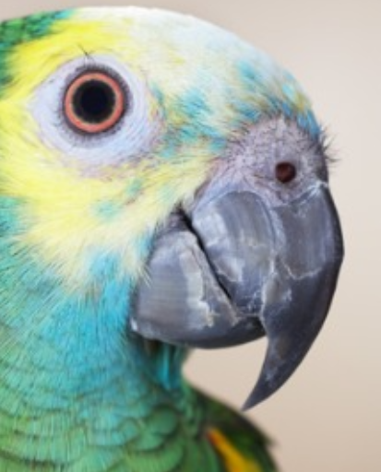
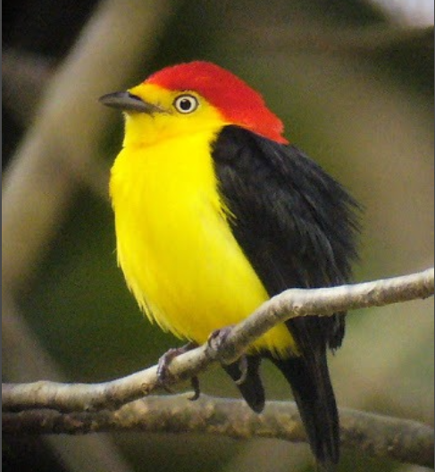
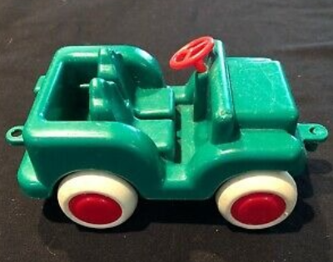
Look and write the word
bird
toy
beak

Slide 11
Look and write the word
star
square
triangle

Slide 12
I can see a kite.

Slide 13
Is she happy? Yes, she _____.
isn’t is
Complete the sentence.

Slide 14
Complete the sentence.
isn’t is

Slide 15
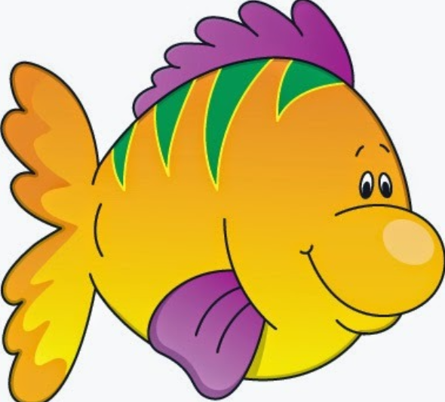
What can you see? I can see ...
a fish
I can see ______.

Slide 16
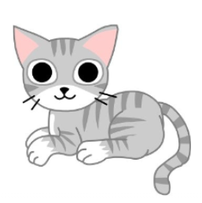
What can you see? I can see ...
a cat
I can see ______.

Slide 17
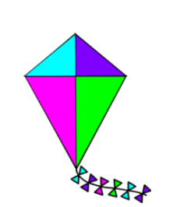
What can you see? I can see ...
a kite
I can see ______.

Slide 18
