Slide 1
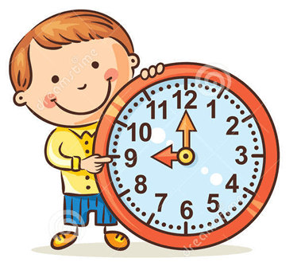
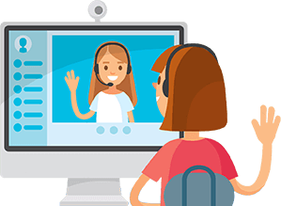
Our Class rules!
Be on time
Respect your friends and don’t disturb them
Be a good listener
Mute your Mic.

Slide 2
Unit :9
Lesson:4

Slide 3
Objectives
1- To recognize the new vocab .
2-To use superlative adjectives.
3- To read a text for specific information .

Slide 4
Vocabulary

Slide 5
the environment

Slide 6
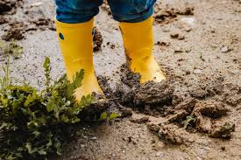
muddy

Slide 7
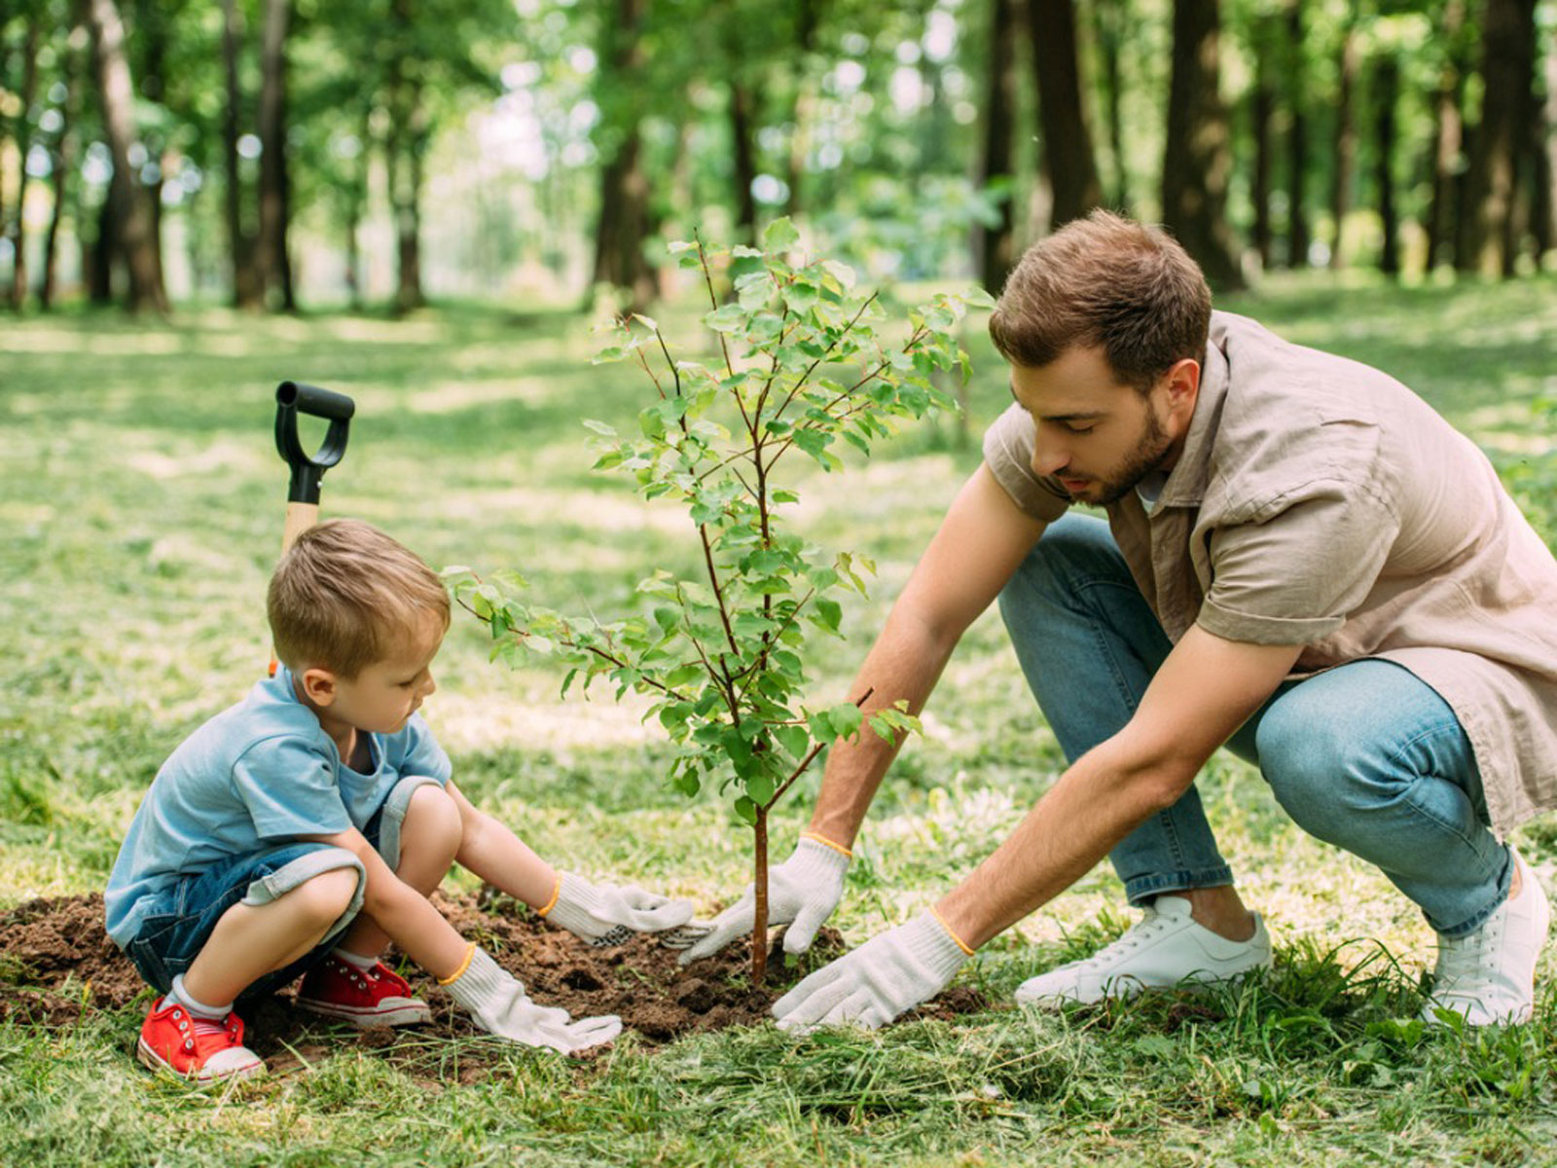
planting

Slide 9
What do trees do to the air?

Slide 10
Why did Noah think planting trees was fun?

Slide 14
https://www.liveworksheets.com/be1063186ke

