Slide 1

Learning objectives:
Lesson 3
To practice reading for specific details
To form adjectives using the suffixe (-ful)
Lesson 4
To practice listening for the general gist and for specific details
To define compound nouns and use them correctly

Slide 2
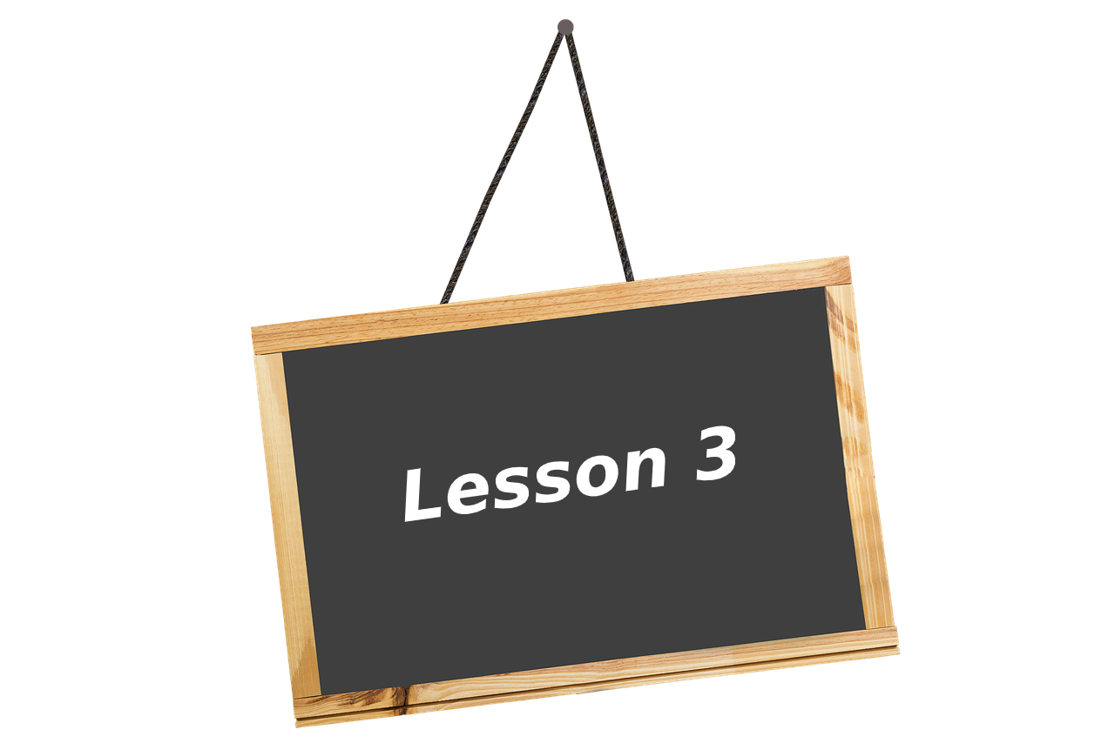

Slide 3


Have you ever lost something that was important to you? What was it and did you find it?
How do you feel when you lose things?
What is your most treasured possession?Why?

Slide 4
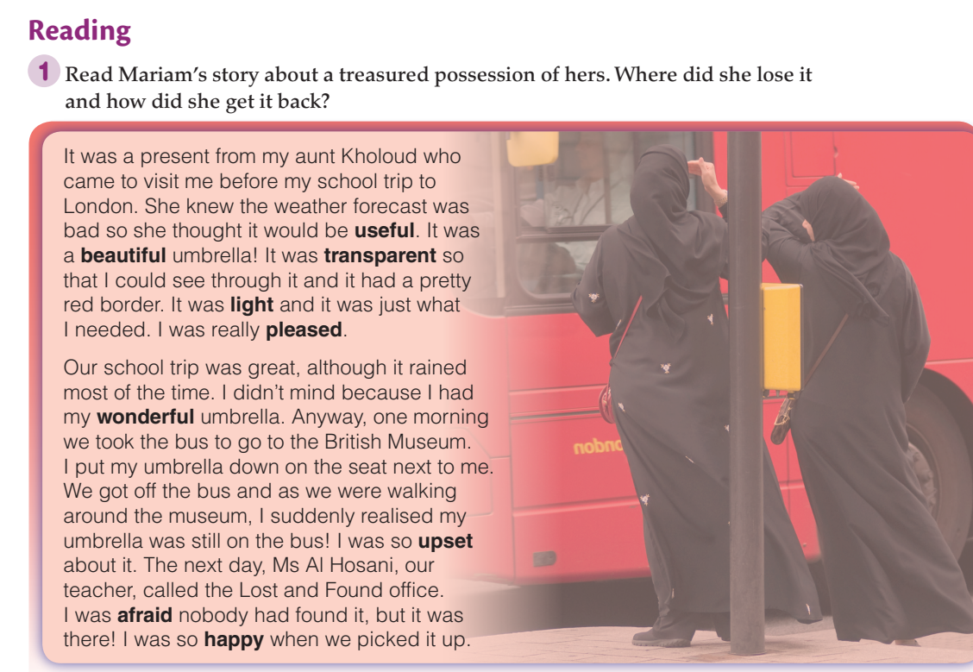

Slide 5
Answer

Slide 6
Match the adjectives with the category
Adjectives to describe people | Adjectives to describe feelings
happy excited beautiful smart worried enthusiastic shiny sad frustrated huge
embarrassed amazing handsome teeny round attractive chubby cheerful thankful

Slide 7
Which of these adjectives describe:
Mariam’s Feeling | Mariam’s Umbrella
Pleased upset afraid happy | Useful beautiful light wonderful

Slide 8
Which of the following adjectives can you add the suffix -ful to.
worry care help pain repair noise success colour annoy cheer stress
Fast finisher challenge: Use two of the adjectives ending with the suffix -full in sentences.

Slide 9
Choose a task
Writing
Write about a time you lost a treasured possession.
When?Where? What happened?
How did you feel?
What did you do to find it?
Speaking
Speak about a time you lost a treasured possession.
When?Where? What happened?
How did you feel?
What did you do to find it?

Slide 10


Slide 11
Learning objectives:
Lesson 3
To practice reading for specific details
To form adjectives using the suffixe (-ful)
Lesson 4
To practice listening for the general gist and for specific details
To define compound nouns and use them correctly

Slide 12
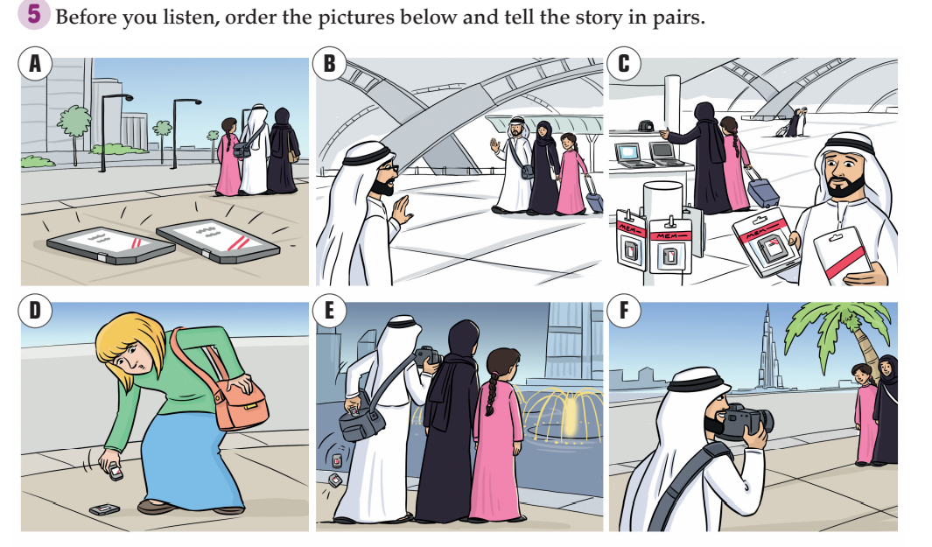

Slide 13

Listen to the first part of a radio show and check your answers. How do you think the memory cards reached Laila’s family?
Listen to the rest of Laila’s story and make notes. Check your answers to Activity 6.

Slide 14
Mrs Williams uploaded the photos on a website for lost cameras/photos. Laila’s cousin,
Huda, found the photos by accident while she was surfing
the Internet. Laila’s dad
contacted Mrs Williams and she posted the memory cards to Laila’s house.

Slide 15
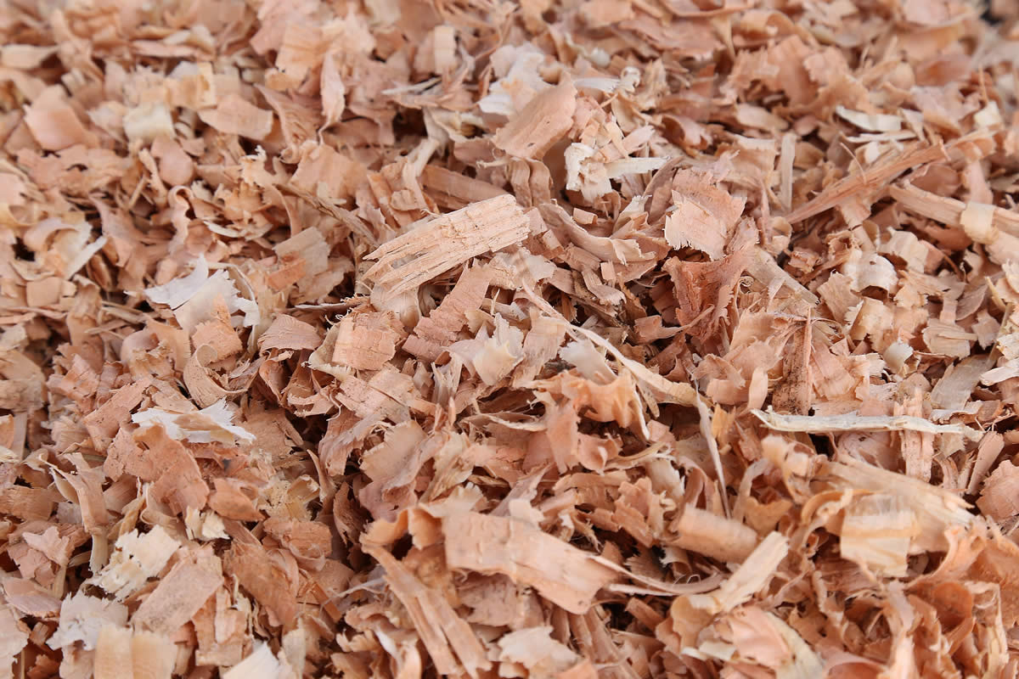
Compound Words
A compound word is made up of two words. Each word is able to stand by itself with its own meaning. The compound word creates a new meaning.
example:
sawdust = saw + dust

Slide 16
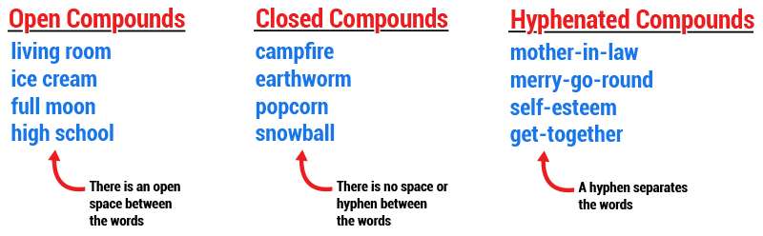
separable
inseparable
separated with a hyphen

Slide 17



What is the compound word? Is it separable or inseparable?
beachball

Slide 18
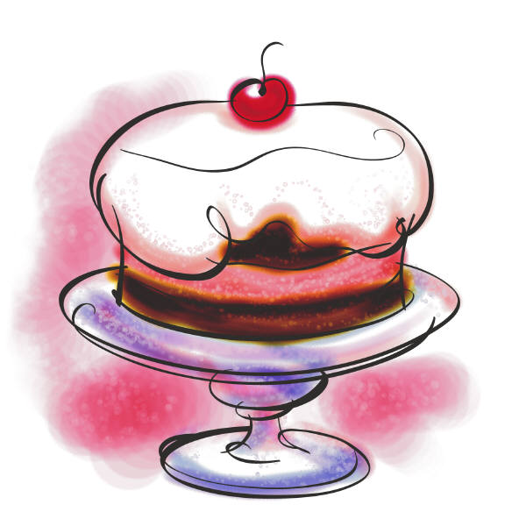


What is the compound word? Is it separable or inseparable?
pancake

Slide 19




What is the compound word? Is it separable or inseparable?
waterfall

Slide 20
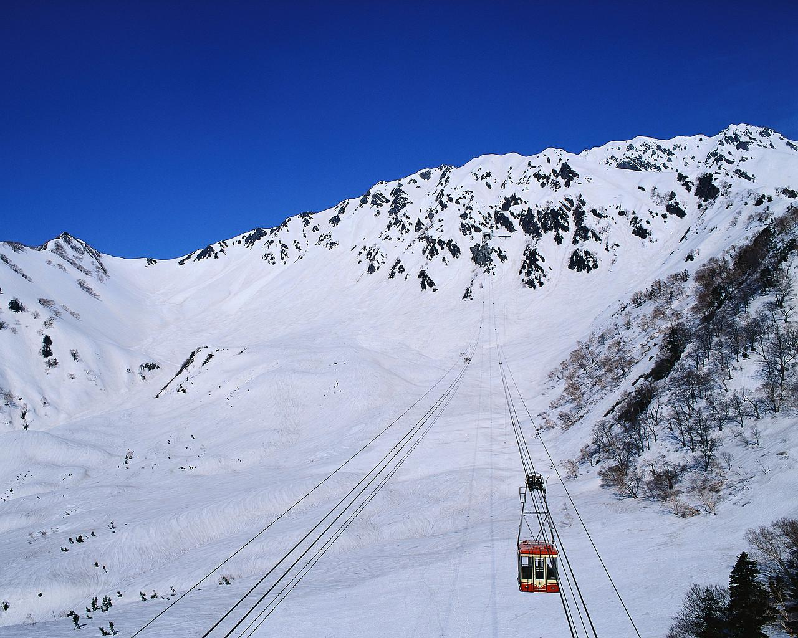


What is the compound word? Is it separable or inseparable?
snowman

Slide 21



What is the compound word? Is it separable or inseparable?
butterfly

Slide 22
Match the compound words
Air
sky
Web
Up
sight
Memory
palm
Fountain
Camera
Port
Tree
case
Scraper
card
Site
Show
Load
seeing
A1 B4 C6 D8 E9 F5 G2 H7 I3

Slide 23

Camera case
upload
website
Memory card
airport
Fountain show
skyscraper

Slide 24
Compound Words Games
https://www.turtlediary.com/quiz/identifying-compound-word-in-a-sentence.html
https://reviewgamezone.com/mc/candidate/test/?test_id=38715&title=Compound%20Words

