Slide 1
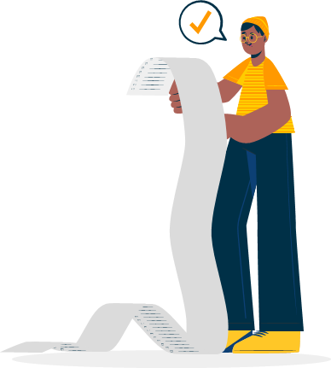

Federal Entity | هيئة اتحادية

Slide 2
English
Final Exam

Slide 3
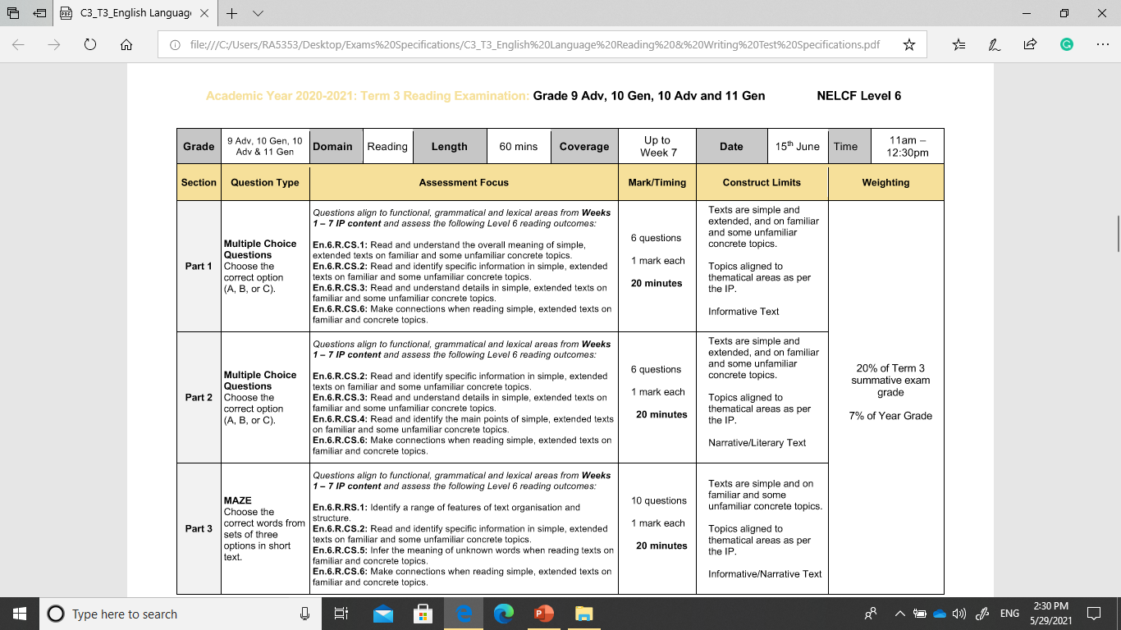
English Language Reading Test Specifications
SEP
OCT
NOV
DEC
JAN
FEB
MAR
APR
MAY
JUN
JUL
AUG
A
B
C
D
E
F

Slide 4
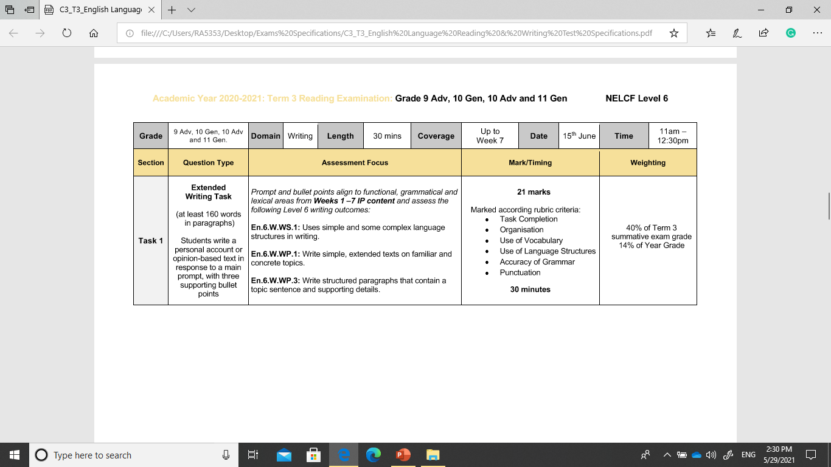
English Language Writing Test Specifications
SEP
OCT
NOV
DEC
JAN
FEB
MAR
APR
MAY
JUN
JUL
AUG
A
B
C
D
E
F

Slide 5
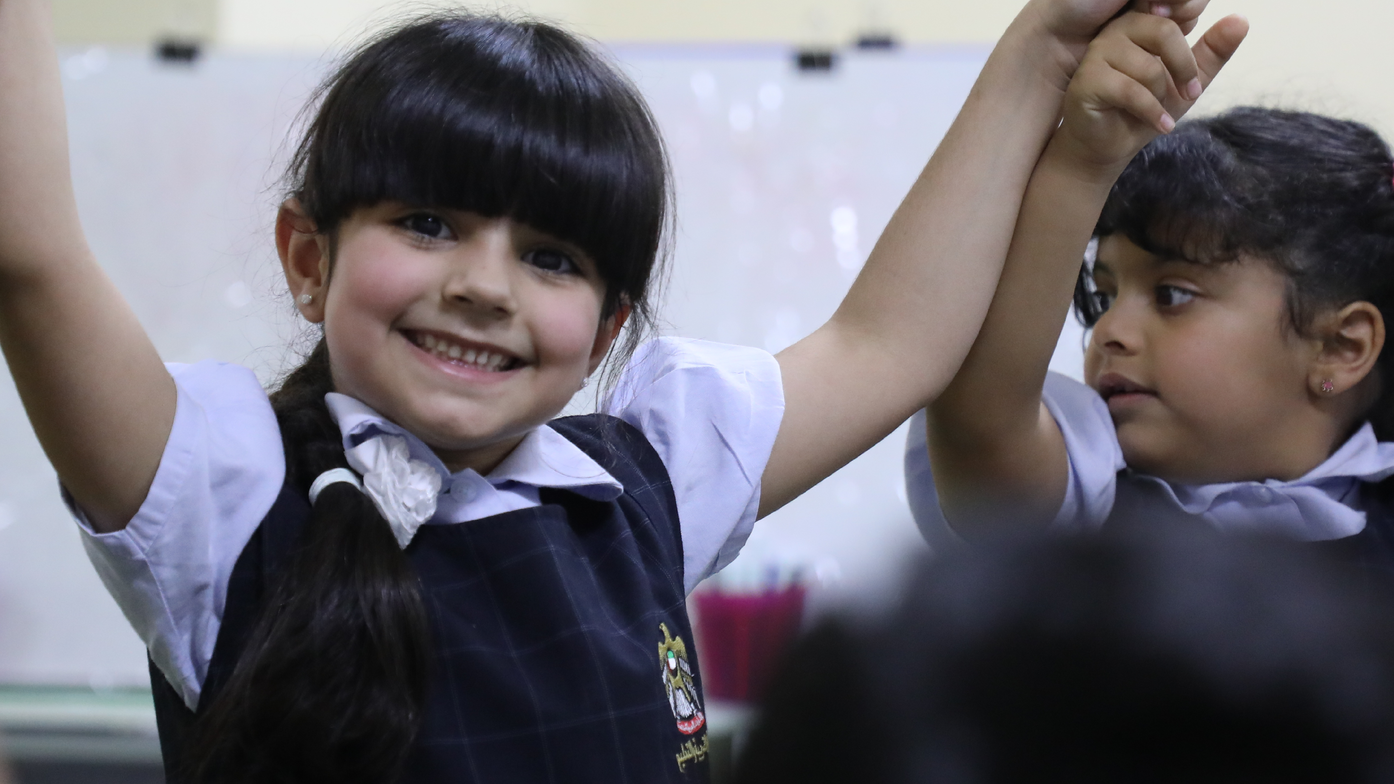


Slide 6
Part 1
Vocabulary

Slide 7
AWESOME WORDS to remember
SEP
OCT
NOV
DEC
JAN
FEB
MAR
APR
MAY
JUN
JUL
AUG
A
B
C
D
E
F

Slide 8
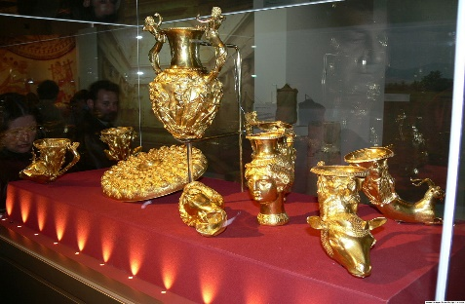
vocabulary
Wordsearch Activity
https://thewordsearch.com/puzzle/2239475/treasured-possession/
possession
treasured
fall apart
to look after
save up
throw away
stuffed toy

Slide 9
Vocabulary
pickpocket
skateboard
sunglasses
tablet
wallet
headphones

Slide 10
calendar
cushion
ladder
loft bed
reading lamp
rocking chair
snowboard
storage basket

Slide 11
Vocabulary
useful
beautiful
light
wonderful
upset
afraid
happy
pleased

Slide 12
phrasal verbs
fall apart: break into pieces;
take off: remove clothes or jewellery;
save up: keep money so that you can buy something;
look after: take care of something;
put away: put something in the place where it should be;
throw away: put something in the garbage

Slide 13
Unit 8 Vocabulary
SEP
OCT
NOV
DEC
JAN
FEB
MAR
APR
MAY
JUN
JUL
AUG
A
pickpocket, skateboard, sunglasses, tablet, wallet, headphones
B
useful, beautiful, light, wonderful, upset, afraid, happy, pleased
C
airport, skyscraper, website, upload, sightseeing, camera case, memory card
calendar, cushion, ladder, loft bed, reading lamp, rocking chair, snowboard, storage basket
D
alive, art, gallery, landscape, painting, portrait, self-portrait, style, support, valuable
E
F

Slide 14
good condition, savings, store, rent, bills, pop ups
severe, drought, urgent, malnourished, famine
sanitation, disease, generosity, donation
Moveable flood barrier, flat, dyke, dam, (river) bank,
moist, pressure, release, vibration, fuel, melt, burst, epicenter, earthquake, hurricane, wildfire
ripple, waves, volcanic eruption, tsunami, Richter scale,

Slide 15
support, conflict, basic needs, cost, natural disasters, supplies, money, international aid
coconut, prize, knock, bucket, float, teeth, jar, donkey, blindfolded, pin, competitor, sack

Slide 16
Maze

Slide 17
Choose the correct word

Slide 18
It was a present from my aunt Kholoud who came to visit me before my school trip to London. She knew the weather forecast was bad so she thought it would be 1--------( useful, strange , harmful ) It was a beautiful umbrella! It was transparent so that I could see through it, and it had a pretty red border. It was light and it was just what I needed. I was really 2 ------------( pleased, upset , angry )
Our school trip was great, although it rained most of the time. I didn’t mind because I had my wonderful umbrella. Anyway, one morning we took the bus to go to the British Museum. I put my umbrella down on the seat next to me. We got off the bus and as we were walking around-3 ------------------------ ( the museum, the park , the hotel ) ,I suddenly realised my umbrella was still on the bus! I was so upset about it. The next day, Ms Al Hosani, our teacher, called the Lost and Found office. I was afraid nobody had found it, but it was there! I was so happy when we picked it up.

Slide 19
My name’s George and I study Fine Arts at New York University. My teachers say I’m good at painting 1-----------------(self-portraits, landscapes , portraits ) with mountains. They say I have my own 2 ----------(style , alive, art galleries) of painting clouds and blue skies. I need to get better at 3 ---------------------- (self-portraits, landscapes , portraits ) though, so I often ask my friends to sit for me. I’ve also tried painting myself, but 4------------------------------------- (self-portraits, landscapes , portraits ) are so hard! In my free time, I usually go to the MoMA (Museum of Modern Art in New York) and other 5----------------- ( style , alive, art galleries) to look at modern paintings. I also study paintings from the past made by artists who aren’t 6---- ( alive, dead , valuable ) . Vincent van Gogh’s The Starry Night, probably his most 7--------------------------- ( valuable, available , acceptable) painting, is in the MoMA and it’s my favourite! One day, I hope I’ll become a famous artist and that my parents won’t have to 8--------(support , punish ,accept ) me any more.

Slide 20
Reading

Slide 21

Outcomes Focus Level 6
En.5.R.CS.1: Read and understand the overall meaning of simple extended texts on familiar and concrete topics.
En.5.R.CS.2: Read and identify specific information in simple extended texts on familiar and concrete topics.
En.5.R.CS.3: Read and understand details in simple, extended texts on familiar and concrete topics.
En.5.R.CS.6: Make connections when reading simple texts on familiar and concrete topics.

Slide 22

Reading 1
Read the news report about a natural disaster and answer the questions on the next page by choosing the best answer – A, B, C or D.
https://forms.office.com/Pages/ResponsePage.aspx?id=ZN_eq0qrBUuqA_TbXZ4ii-yPp7Qy3KZEkQ-XGk4ZNVdUOTFJTTFNSUNOMVlMWk80Rk9BVkRSVkFJVy4u

Slide 23
Read and answer the questions by choosing the best answer – A, B, C
When Salim visited Indonesia, he decided to walk to the top of a volcano with a group of tourists. They left their hotel at midnight so it wouldn’t be too hot outside. They reached the top of the mountain as the sun was rising, it was quiet and relaxing. After a short while, they all decided to go back down. Thirty minutes into the walk, Salim sat down to have a rest. When he got up, he realized everyone had gone. He hoped he could follow them down the mountain, so he began walking down alone. However, after walking for two hours, he realized he had gone the wrong way and he needed to walk back to the top. This was difficult because he could not see where he had come from. He was lost. Instead of panicking, Salim tried to use his phone to call for help, but there was no service.
Salim spent the rest of that day trying to find a way out, but it was impossible because he was in the middle of thick rainforest on the side of the volcano. That night, he sat down and looked in his bag. He had some water and a first aid kit, but he had to ration his water because he didn’t know how long he would be there for. He also wished he had brought a compass with him so he would know where he was going. Salim looked for a way out for three days and on the fourth day, he met some farmers in the rainforest. They did not expect to see anyone there. They talked to Salim and walked him to the nearest village. Salim was so happy to finally get some help.

Slide 24
1-Salim started the walk with the group at midnight ______.
A-to watch the sunrise B-to make sure they completed the walk C-so the weather would be nice and cool
2-Salim got separated from the group because ______.
A -he took a break B- he left two hours after them C-they didn’t reach the top of the mountain
3-Salim realised he should have brought a ______
A-first-aid kit B- water bottle C- compass
4- The farmers ______.
A- were looking for Salim B- took Salim to a nearby village C- were happy to see Salim
5-Which of the following is the best title for the text?
A- Stuck on a Volcano B- Hiking with Friends C- A Fun Trip to Indonesia

Slide 25
1-Salim started the walk with the group at midnight ______.
A-to watch the sunrise B-to make sure they completed the walk C-so the weather would be nice and cool
2-Salim got separated from the group because ______.
A -he took a break B- he left two hours after them C-they didn’t reach the top of the mountain
3-Salim realised he should have brought a ______
A-first-aid kit B- water bottle C- compass
4- The farmers ______.
A- were looking for Salim B- took Salim to a nearby village C- were happy to see Salim
5-Which of the following is the best title for the text?
A- Stuck on a Volcano B- Hiking with Friends C- A Fun Trip to Indonesia

Slide 26
Writing

Slide 27
Outcomes Focus Level 6
En.6.W.WS.1: Uses simple and some complex language structures in writing
En.6.W.WP.1: Write simple, extended texts on familiar and concrete topics .
En.6.W.WP.3: Write structured paragraphs that contain a topic sentence and supporting details

Slide 28
Level 6 Writing Rubric

Slide 29
Writing
Write about a time you lost a treasured possession.
When? Where? What happened?
How did you feel?
What did you do to find it?

Slide 30

1-Write about an extreme environment.
You should include:
• what type of environment it is
• why living there is difficult
• how animals have adapted to living there
Write at least 120 words.

Slide 31
Write a short paragraph about the painting Vincent’s Bedroom in Arles. Use the checklist below.
• Write 80–100 words.
• Describe what you can see.
• Explain some of the history behind the painting.
• Use one defining and one non-defining relative clause

Slide 32
Imagine you are a victim of a natural disaster. Write an email to the government of another country. Include the following:
• Where you are based • What the disaster is • What you can see and hear around you
What supplies you need • How the government might get the supplies to you • What problems they might have on the way.

Slide 33
3- Using an online editor:
Before you submit your answer, you need to proofread your writing.
An online editor can help you do this!
https://prowritingaid.com/Free
Use the following credentials:
Email: grade12advanced@yahoo.com
Password: 12advqatralnada

Slide 34

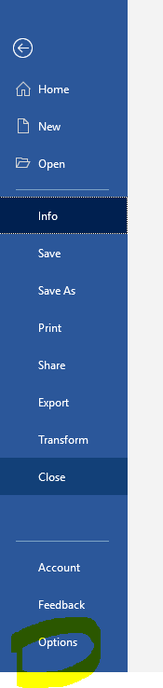
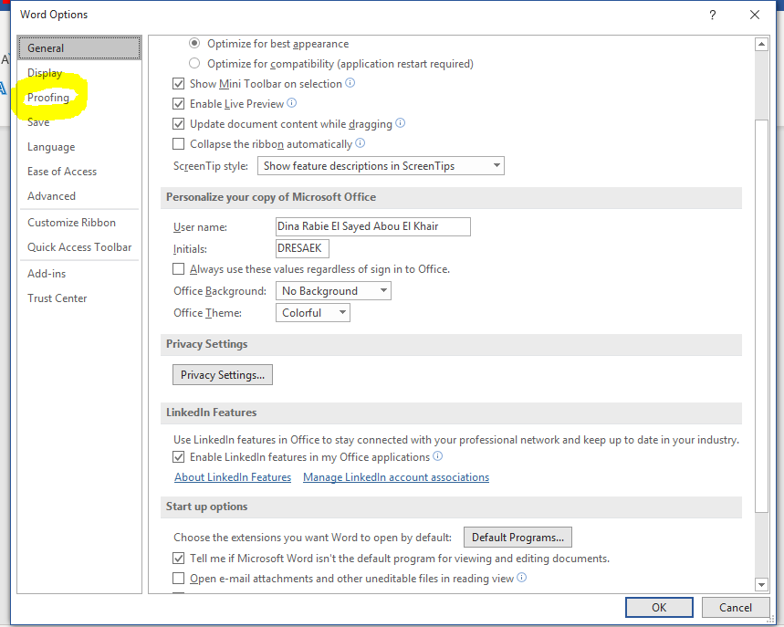
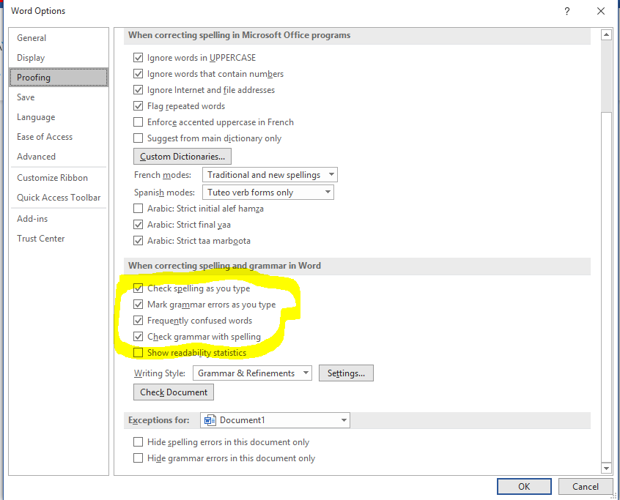
If you find this difficult, you can use the spellcheck option in Word as follows:
1- Click the file tab and then click options
2- Click proofing
3- Select the boxes highlighted here!

Slide 36
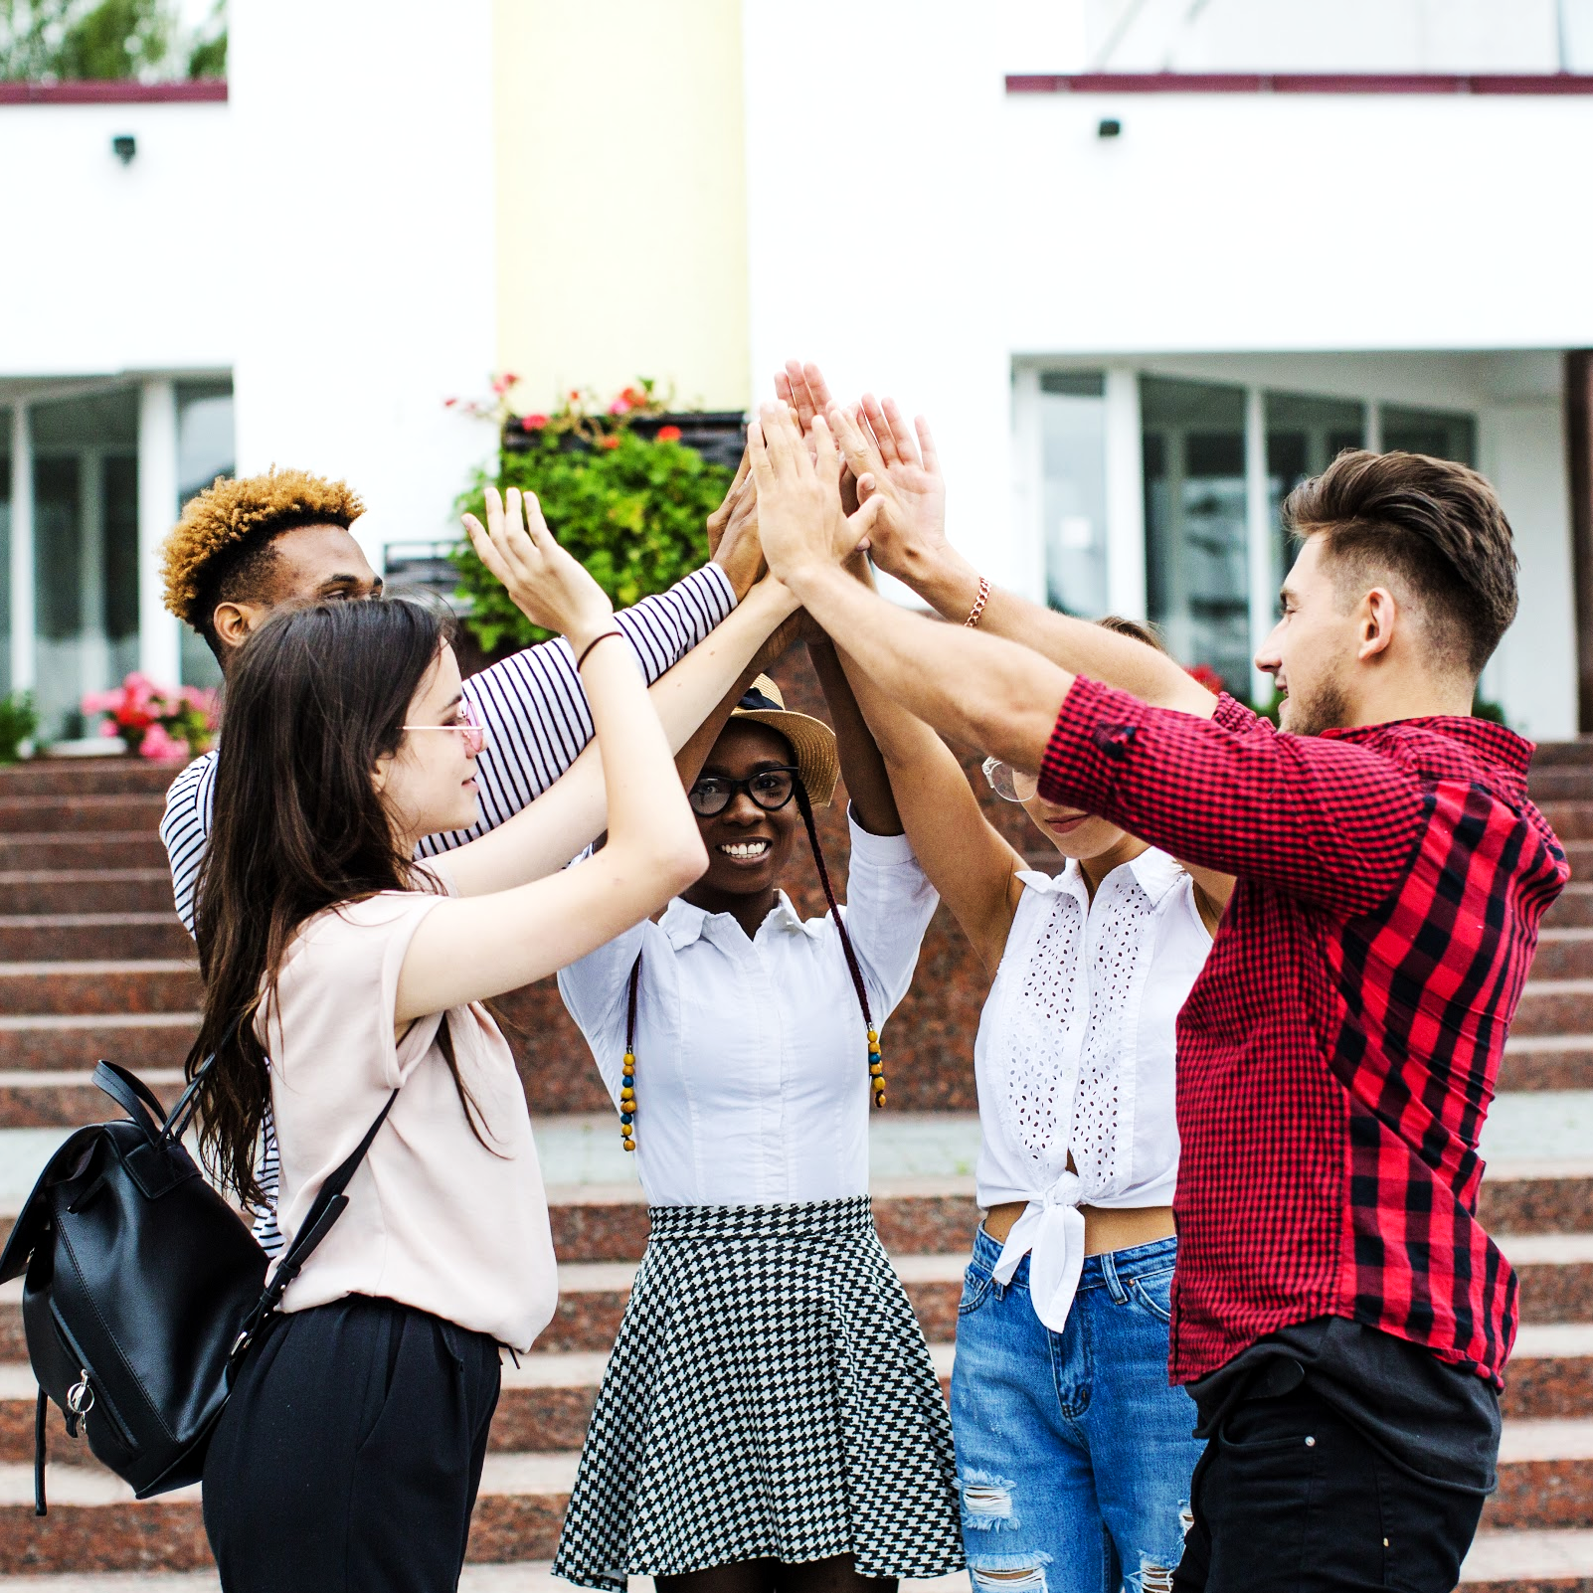
SEP
OCT
NOV
DEC
JAN
FEB
MAR
APR
MAY
JUN
JUL
AUG
A
B
Thanks!
C
D
E
F

