Slide 1
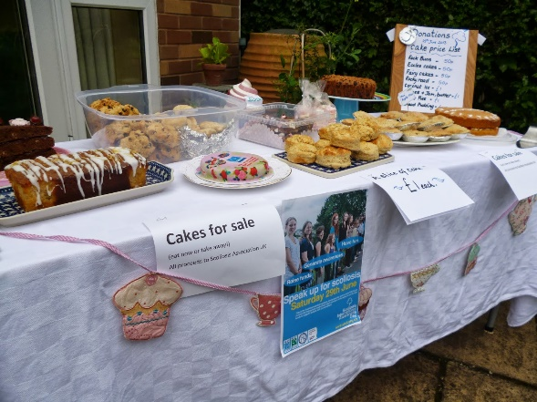
Unit 10: People and numbers
Lessons 7-10-11:
7: For a good cause
10-11: The kindness challenge
13th April, 2021
Grade 7-1
23 students
Learning Objectives:
Listening: To listen to suggestions for raising money for a good cause.
Speaking: To take part in a discussion about raising money for a good cause.
Reading: To read news articles about raising money for a good cause.
Writing: To write a news article about raising money for a good cause.
Recourses
video
liveworksheets

Slide 2
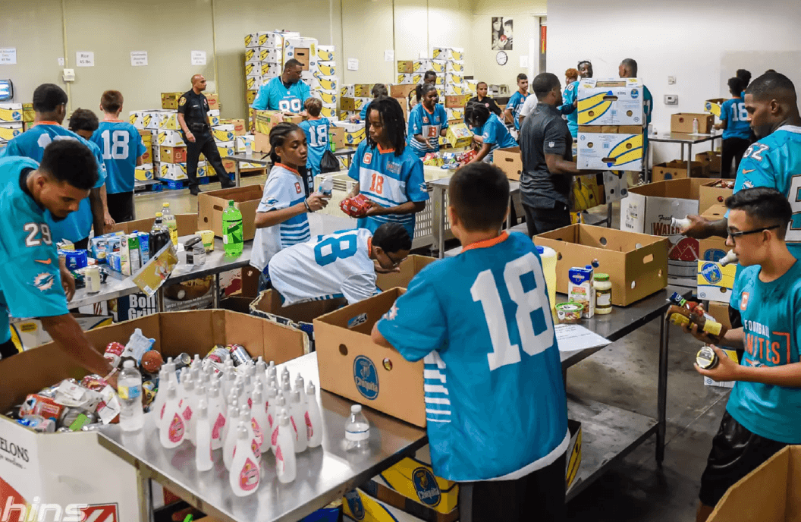
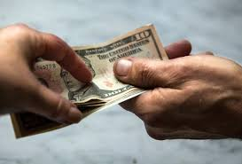
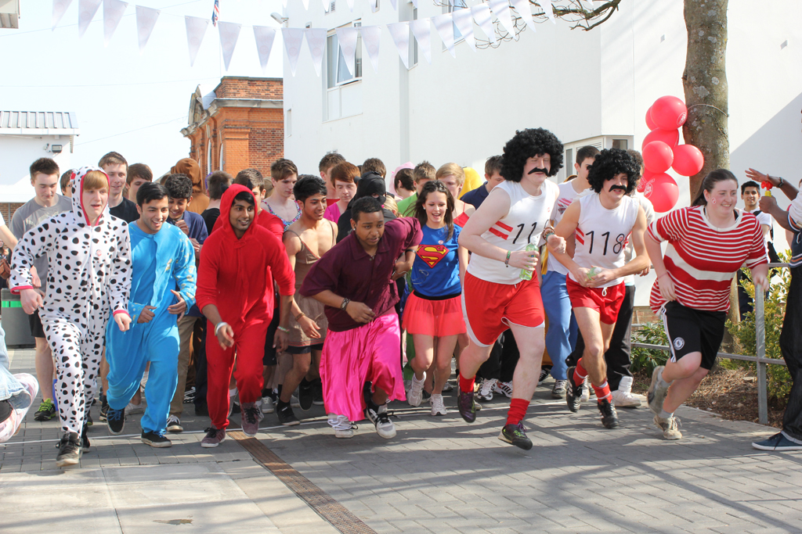
Key vocabulary:
raise funds
Fundraiser
Collect
Donate
Donation
volunteer
Generous
double (verb)
fun run
cake sale

Slide 3
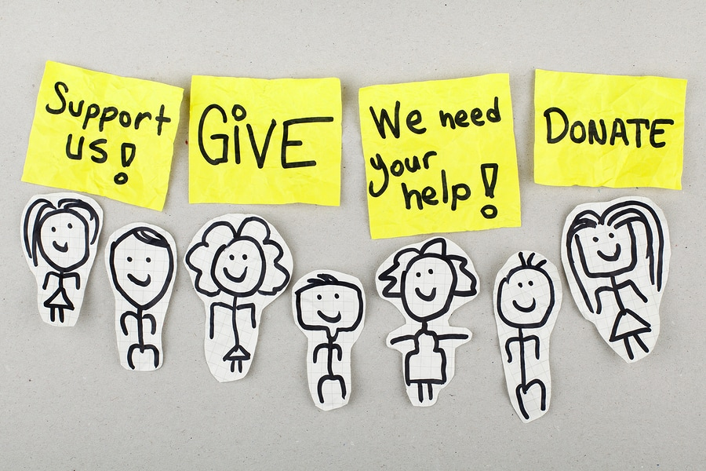

Slide 5
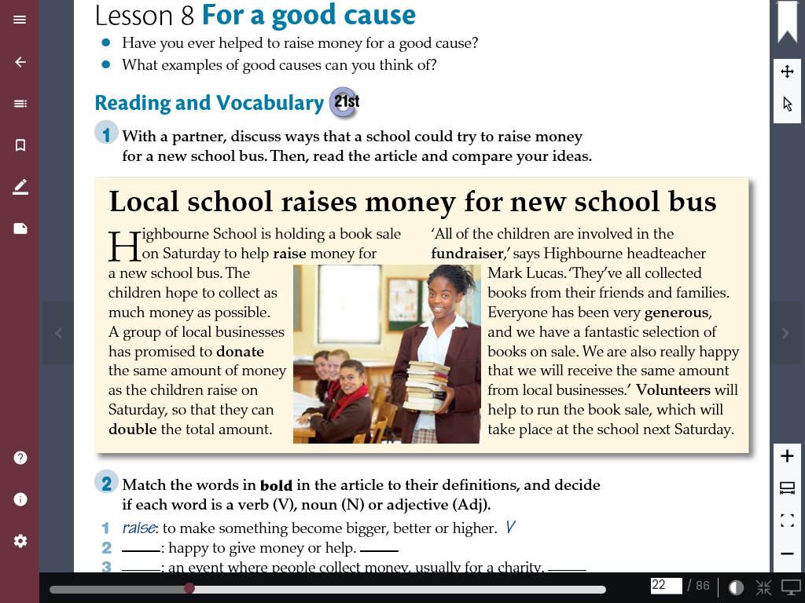
CB:174

Slide 6
CB:177
Schoolchildren
All over the country
The kindness challenge: doing acts of kindness for a competition to find out which school is the kindest

Slide 7
CB:178

Slide 8
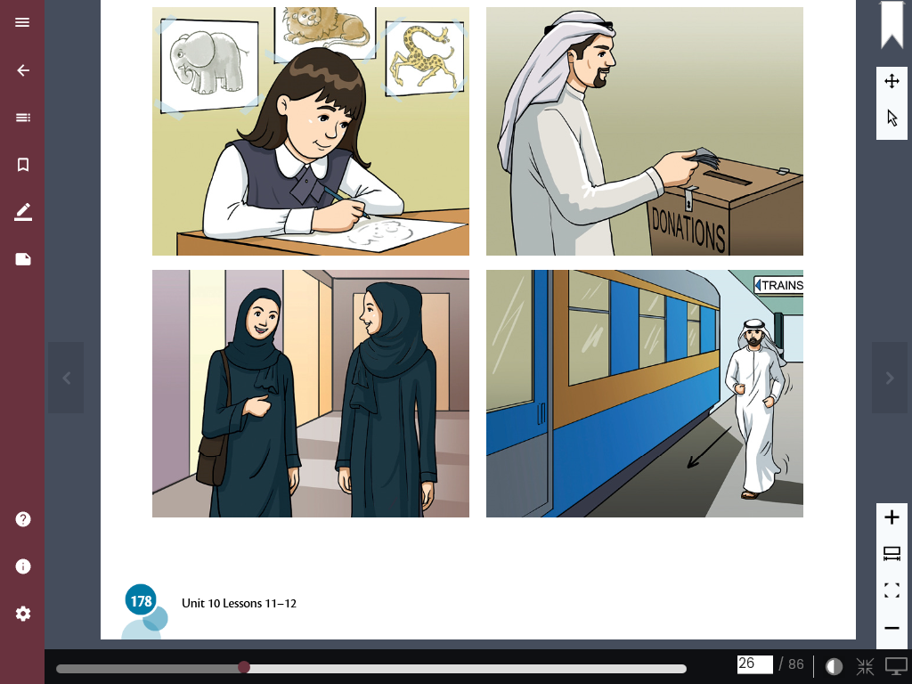
CB:178
Can you make sentences about the following pictures using:
looks/seems+ adjective
1
2
3
4

Slide 9
Name:………………………..
Use the following words to complete the article
Donation – volunteer – collect- raise
https://www.liveworksheets.com/1-lx1854012pu
raise
collect/raise
Volunteer
donation

Slide 10
Exit ticket
Will you help in raising money for a good cause?

