Slide 1
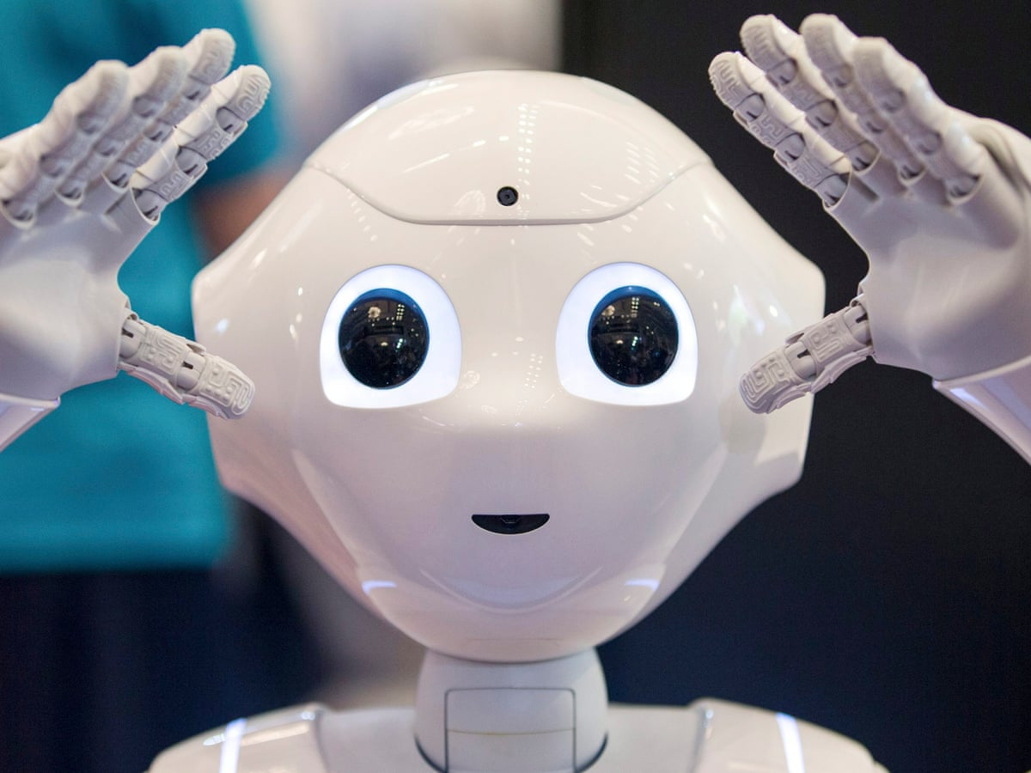
Welcome
Sunday
18 \April\ 2021
Term 3
Week 1
Unit 9
Technology
Lesson 4

Slide 2

Starter
Grade 4 A/B
Starter
Writing Routine
Where can a robot do.
Writing routine
Introduction & Objectives
Video
New words
Learning
Practice
Assessment
What
?

Slide 3
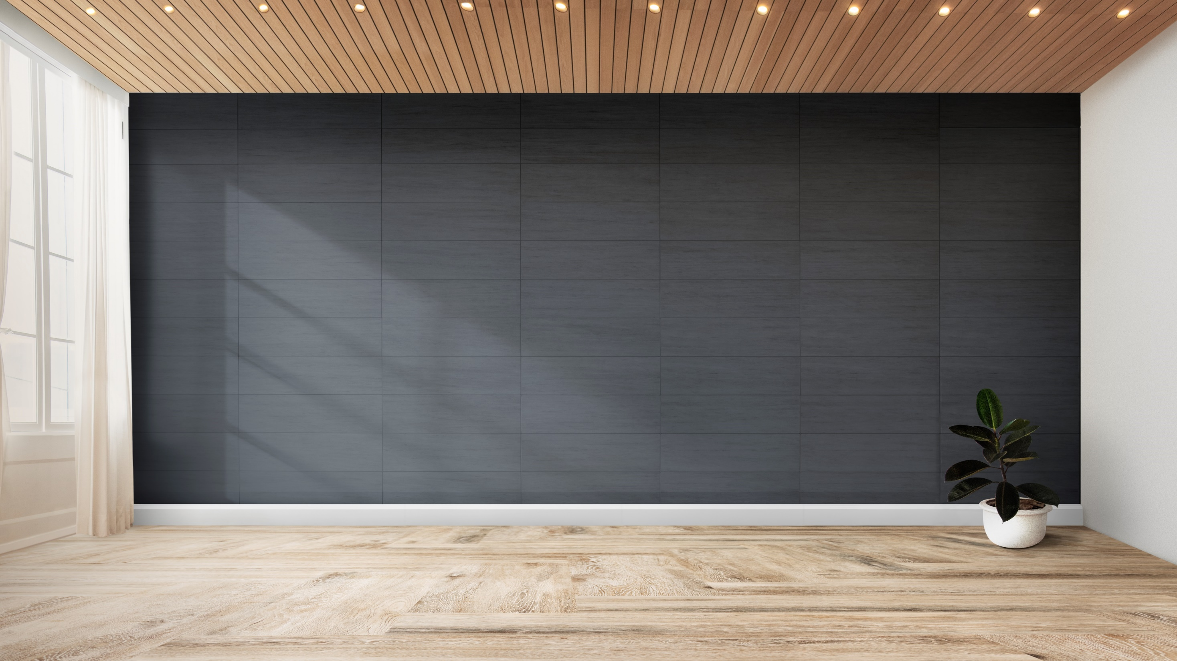
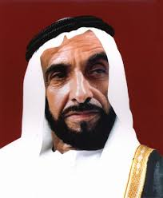

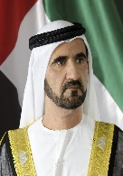




Day: Sunday
Date:18-3-2021
Subject: English
Lesson Objectives:
Speaking: To talk about the differences between humans and robots.
Reading: To read and understand about robots.
Writing: To write questions about a text and answer them.

Slide 4



Learning Objective Question:
To write about their own robot
Enter Keywords and meanings
Learning Skills Focus
What do the words below mean? Work with a partner and discuss what they mean and how to use it in a sentence.
robot, hospital, doctor, tool, scientist
Say the word to your partner.
Tell your partner what it means.
Together write a sentence with the word.
Identifying and classifying. Ask and answer
Discussion
Cross curricular links:
Technology Robots | IBT Listening / Reading comprehension
Notes:
Notes to presenter:

Slide 5
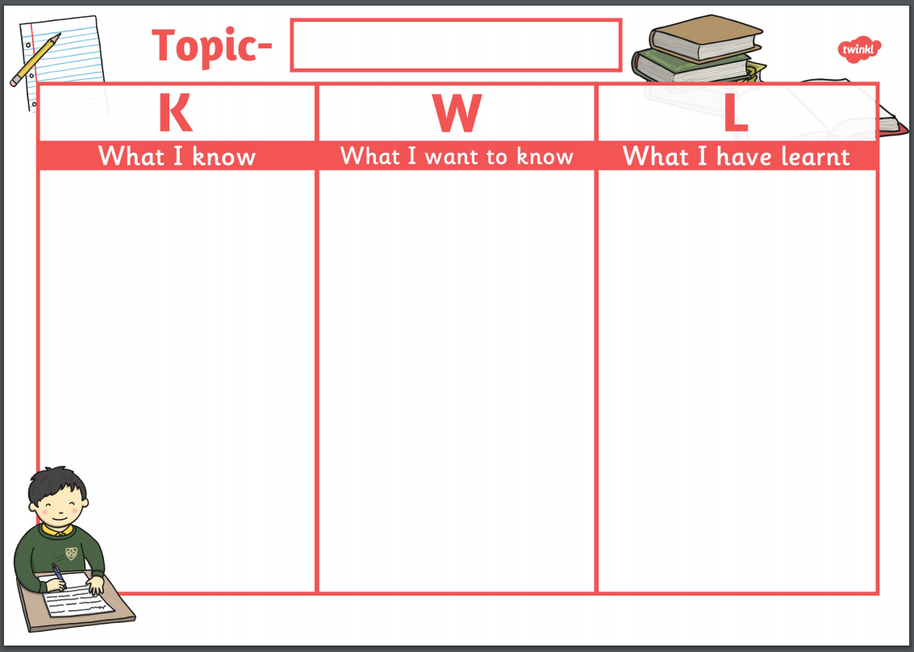
What I already know about the question ?
Making connections
To write about their own robot

Slide 6

Success Criteria
To write about their own robot
1-Students will describe their own and others’ robots.
2-Students will read about robots and Adeeb al Baloushi.
3- Students will write about their own robot
Notes:
Some Practical Ideas
Create a problem / pose a question and scaffold the task so that they can answer it themselves by exploring a variety of resources.
Model a technique and ask students to find another way of solving the problem etc
Make them passionate about the topic by relating it to real life

Slide 7





Learning input
To write about their own robot
What sort of robots did we find out about? Can you describe them?
What can a robot do that a human can not do?
How big is it?, What does it do?, How does it move?, Where does it go?
Robots
Where can you see robots in the UAE ?
Notes:
Some Practical Ideas
Create a problem / pose a question and scaffold the task so that they can answer it themselves by exploring a variety of resources.
Model a technique and ask students to find another way of solving the problem etc
Make them passionate about the topic by relating it to real life

Slide 8
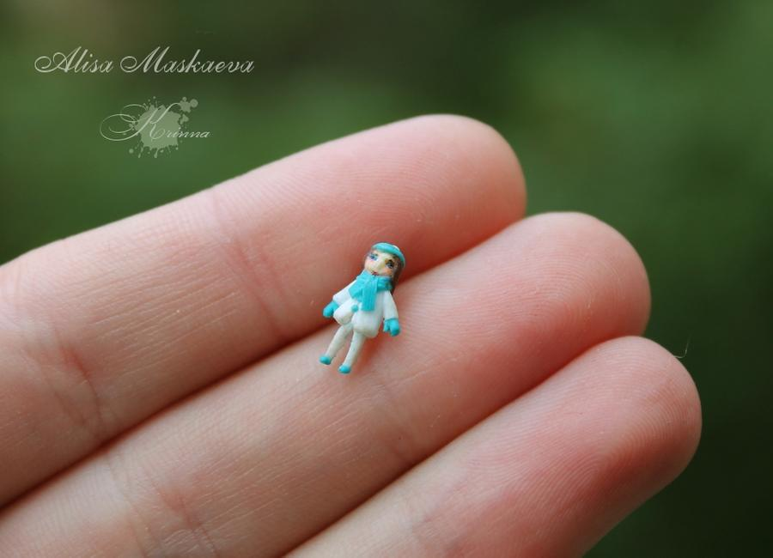
Tiny
Learning input
To write about their own robot

Slide 9
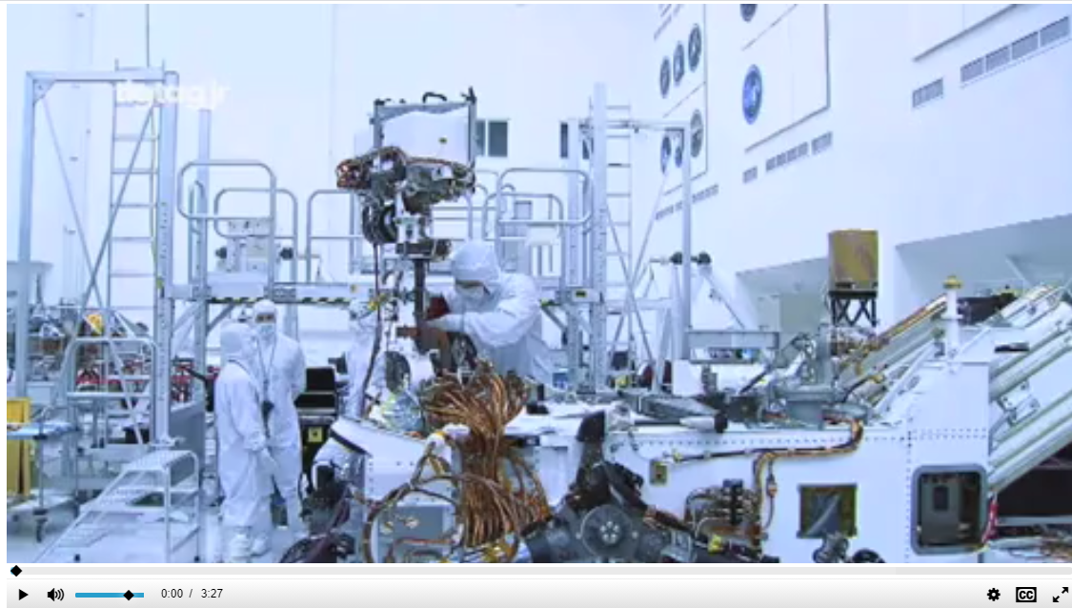
Let’s watch this short film about robots
Learning input
To write about their own robot
https://www.tigtagjunior.com/film/mission-to-mars-TTJ00031/
Writing routine
Introduction & Objectives
Video
New words
Learning
Practice
Assessment

Slide 10
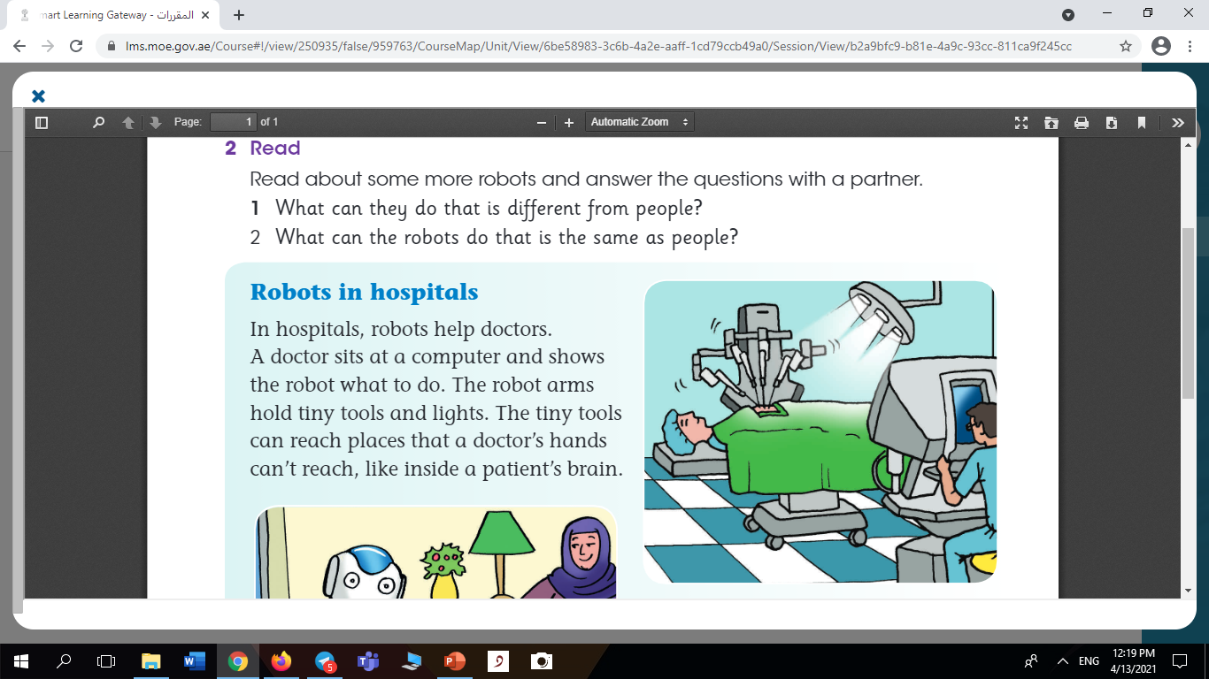
Learning input
To write about their own robot
Writing routine
Introduction & Objectives
Video
New words
Learning
Practice
Assessment
Learner’s book page 152

Slide 11
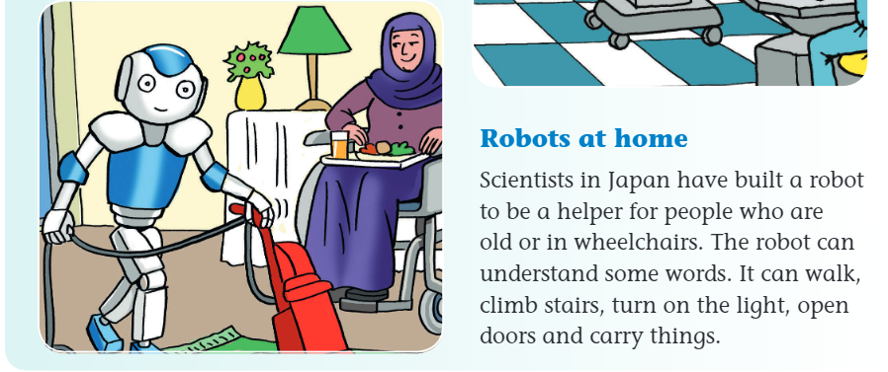
Learning input
To write about their own robot
Writing routine
Introduction & Objectives
Video
New words
Learning
Practice
Assessment
Learner’s book page 152

Slide 12

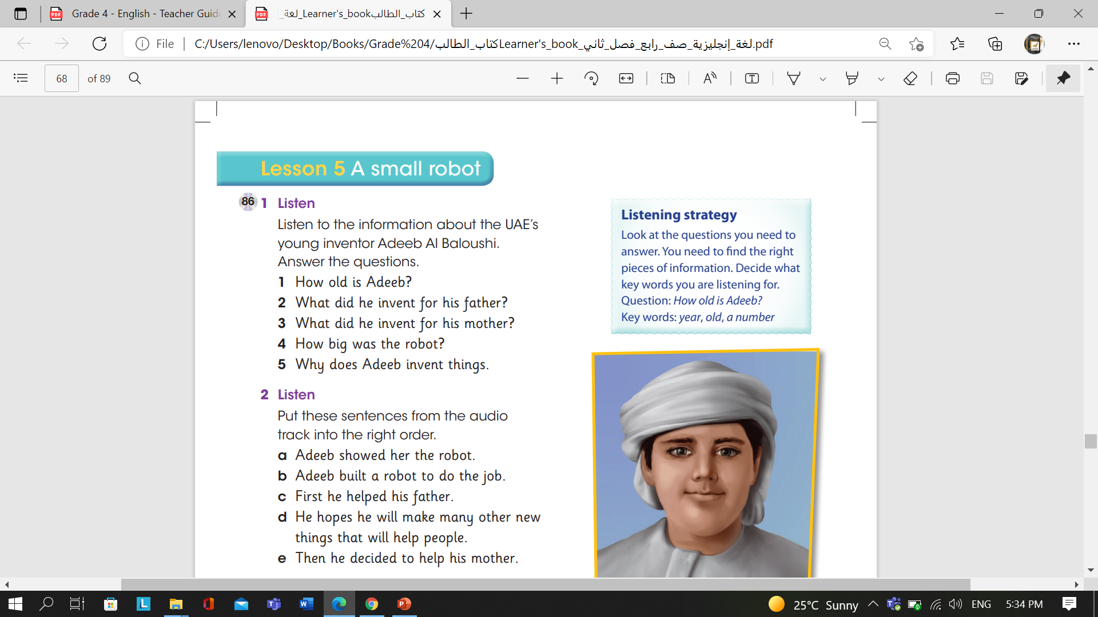
Learning input
To write about their own robot

Slide 13

Learning input
To write about their own robot
p.153
4
3
1
5
2

Slide 14

Adeeb is 12 years old.
He invented an artificial leg for his father.
He invented a cleaning robot for his mother.
The robot was very small.
Adeeb invents things because he wants to help people.

Slide 15
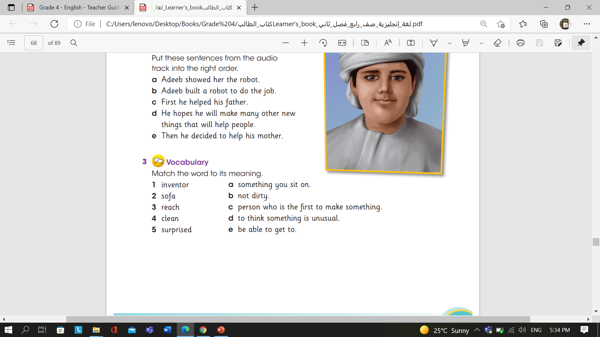
Learning Activity
To write about their own robot

Slide 16
Learning Activity
To write about their own robot
p.153

Slide 17
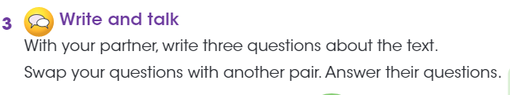
Learning Activity
To write about their own robot
Writing
Read the texts again.
Write three questions about them.
Swap your questions with another group.
Answer their questions.
Writing routine
Introduction & Objectives
Video
New words
Learning
Practice
Assessment

Slide 18
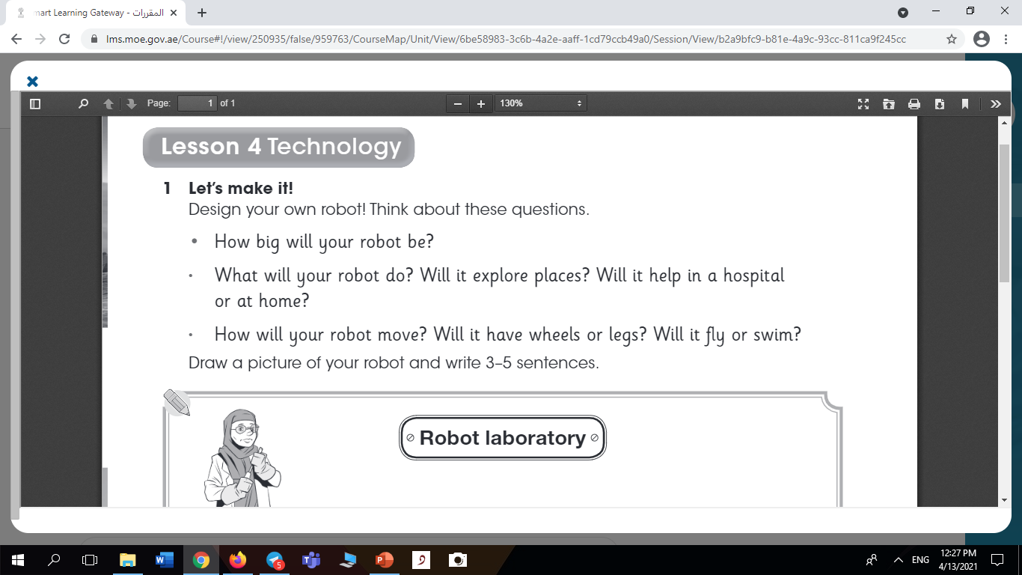
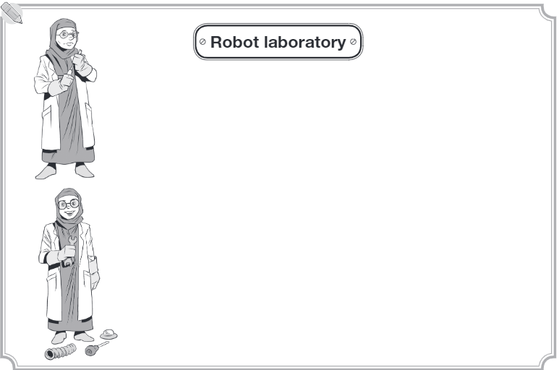
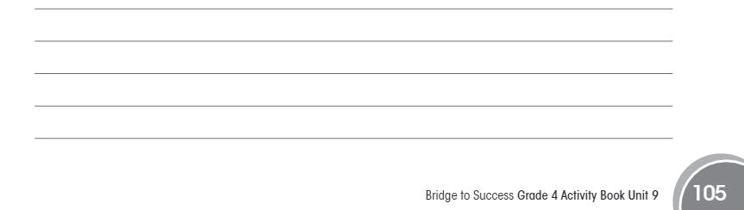
Learning Activity
To write about their own robot
Writing routine
Introduction & Objectives
Video
New words
Learning
Practice
Assessment

Slide 19
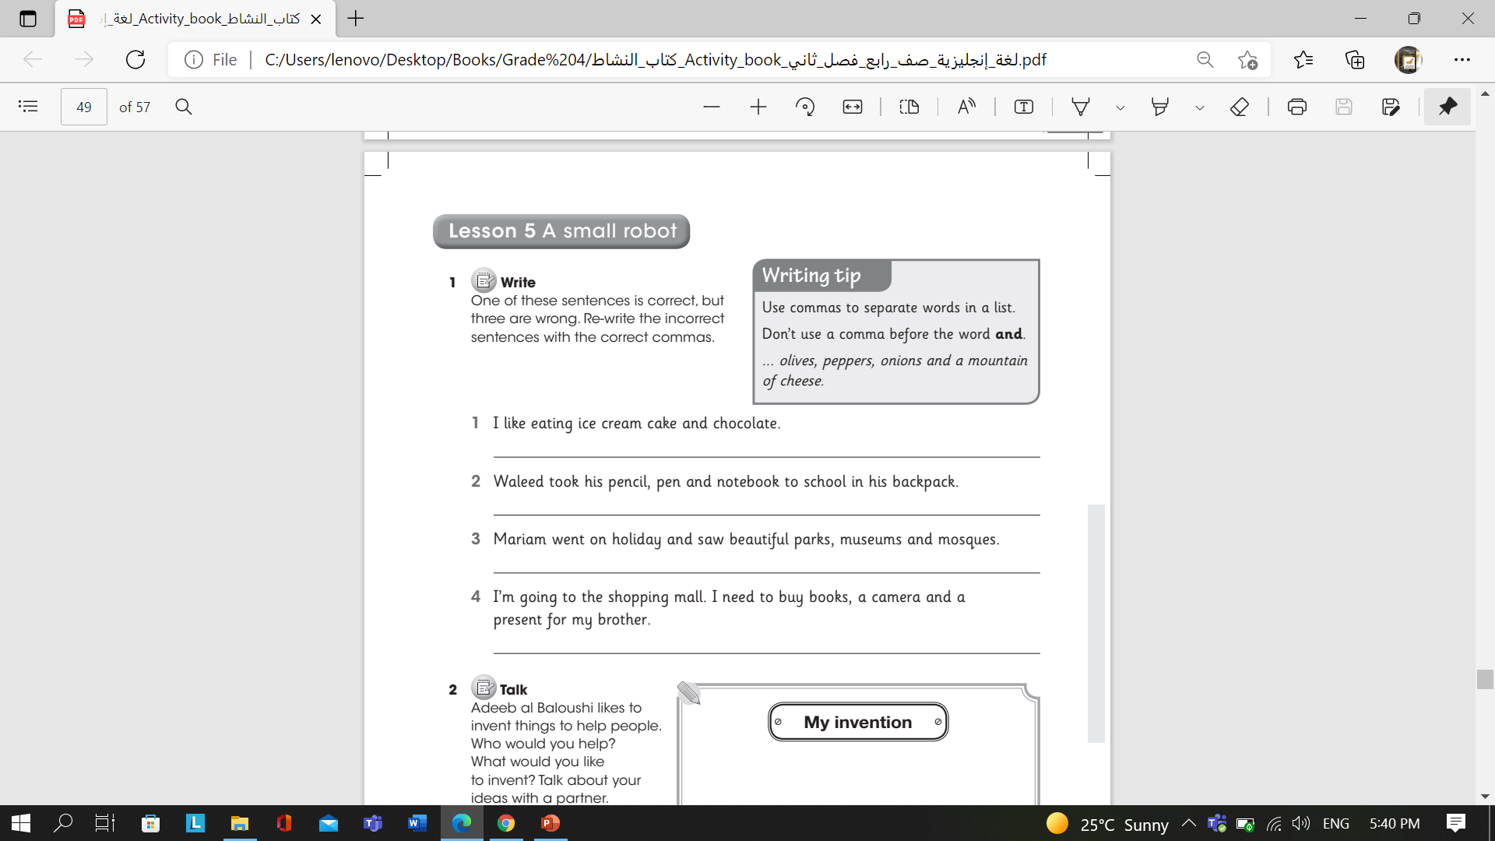
Learning Activity
To write about their own robot
I like eating ice cream, cake and chocolate.
Waleed took his pencil, pen and notebook to school in his backpack.
(Correct)
I’m going to the shopping mall. I need to buy books, a camera and a present for my brother.

Slide 20
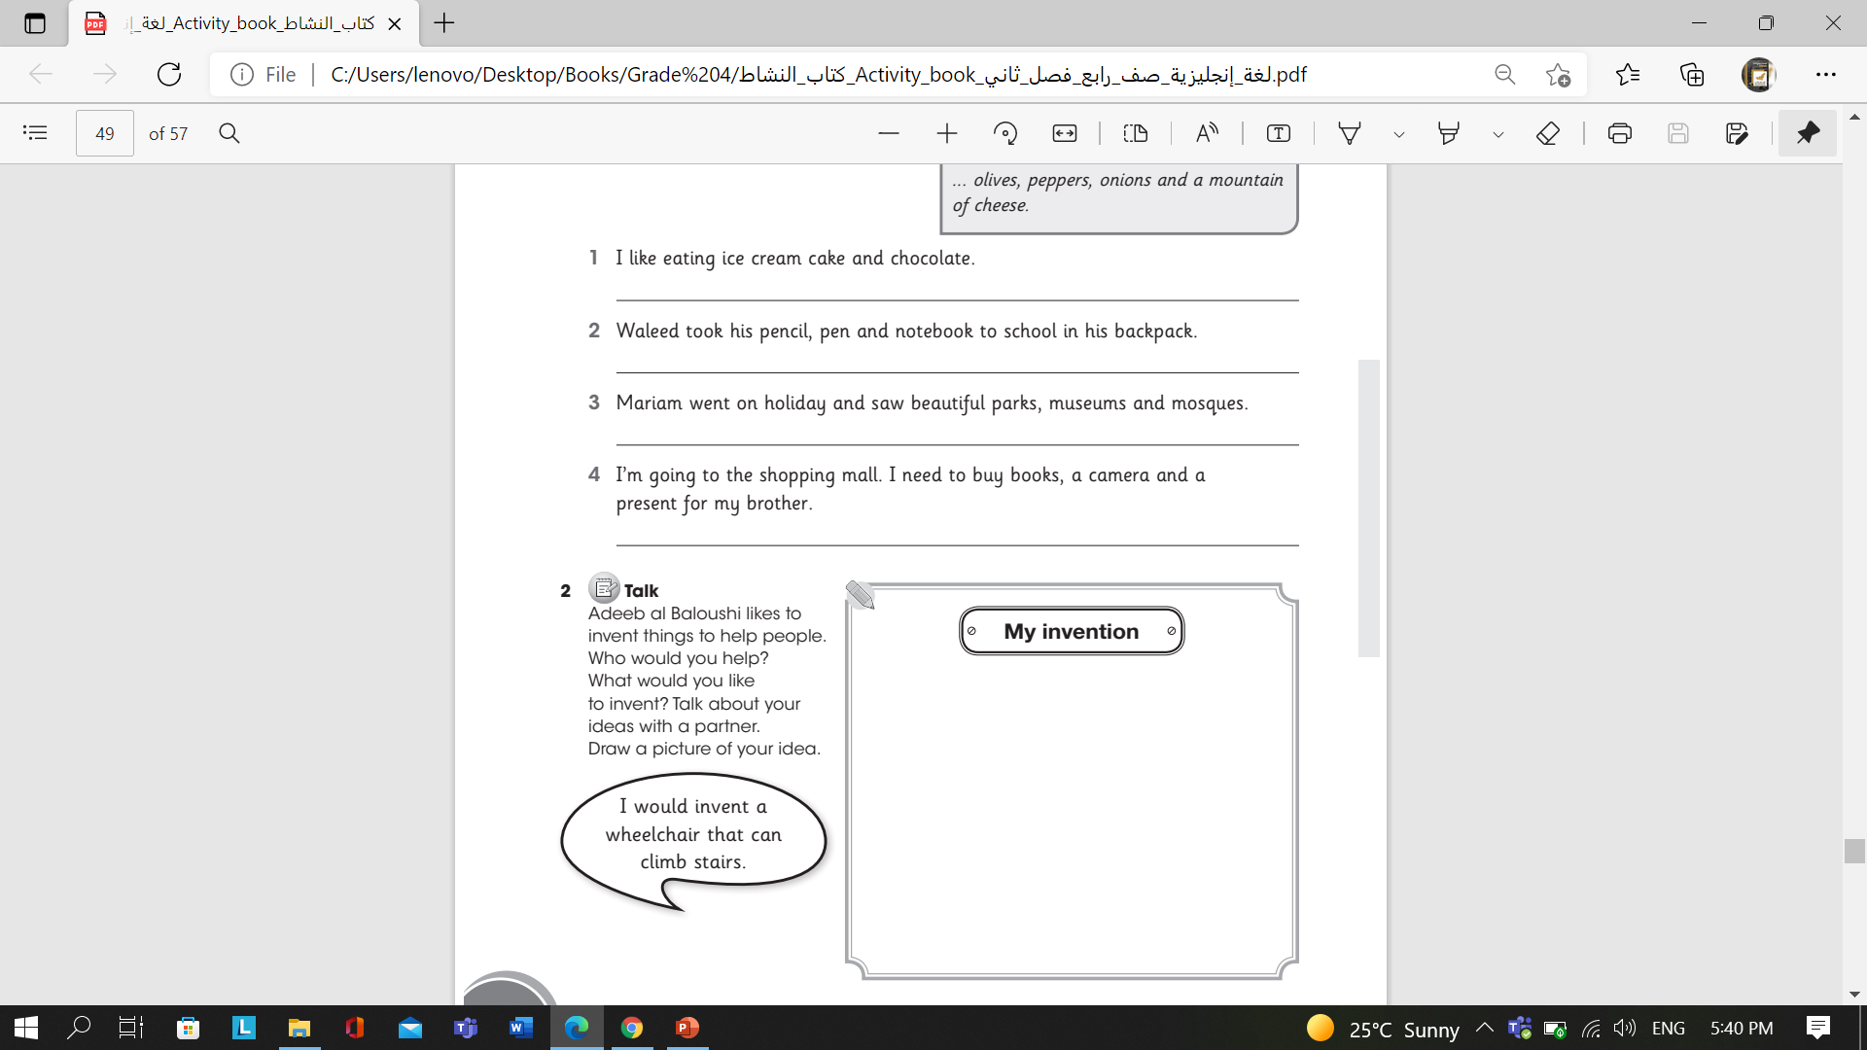
Learning Activity
To write about their own robot

Slide 21

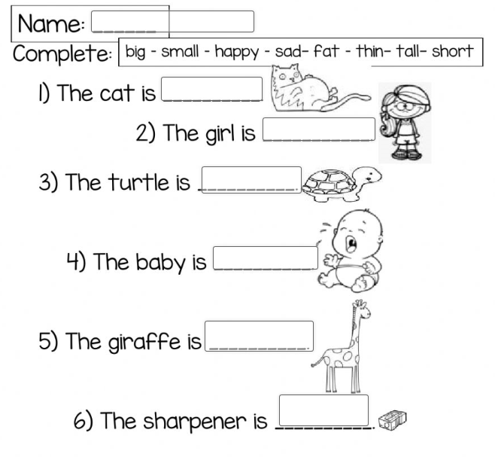

Plenary
https://www.liveworksheets.com/ea378153eg
Writing routine
Introduction & Objectives
Video
New words
Learning
Practice
Assessment
https://www.liveworksheets.com/cr1532145cn

