Slide 1
Chapter 2 : Ecosystems Module 1: Matter in Ecosystems
Lesson 1 : Plant Survival
18/4/2022
5A1
Page- 16
Transportation in Plants
For this lesson you will need your…
Science notebook
Pencil case
Textbook

Slide 2
Learning Objectives:
Students are expected to:
Explain the process of transpiration and role of phloem in plants
Keyword
Xylem, Phloem, Transpiration

Slide 3
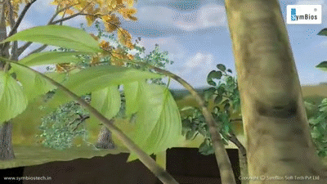
Lesson Starter
what do you observe? Write your answer in chat box. You have 1 min

Slide 4
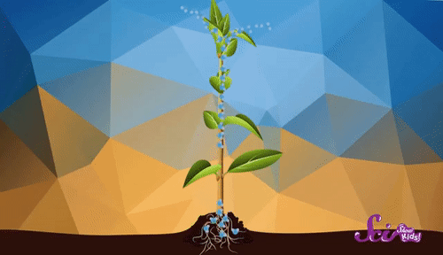
Explain role of stomata and xylem in plants
EXPLORE
Other plant structures obtain the other materials that the plant needs.
Water is absorbed by a plant's roots.
It travels up the center of the stem through specialized tissues called xylem

Slide 5
Explain role of stomata and xylem in plants
ENGAGE
Listening Activity- xylem
what is the function of xylem?
Write down answers in chat box.

Slide 6
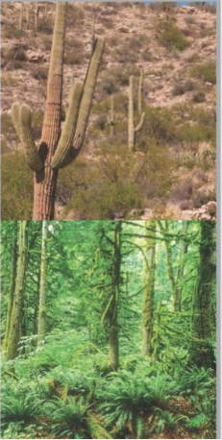
Explain the process of transpiration and role of phloem in plants
ENGAGE
Plants need enough space where they grow for their roots to spread out and absorb water and nutrients from the soil.
Some plants need more water than others.
Cacti can survive in deserts with little rain, while the plants in a rain forest live in a very wet area
Why would it be a disadvantage if plants grow too close together?

Slide 7
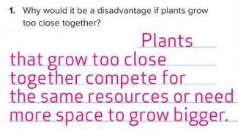
Explain the process of transpiration and role of phloem in plants
EVALUATE

Slide 8
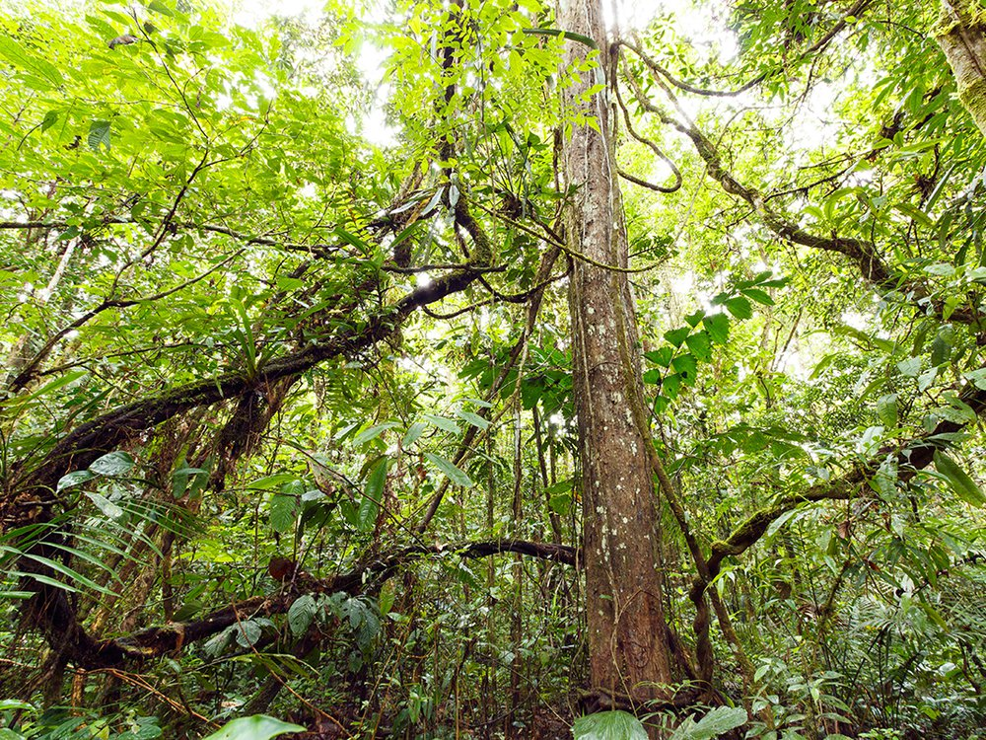
Explain the process of transpiration and role of phloem in plants
ELABORATE

Slide 9
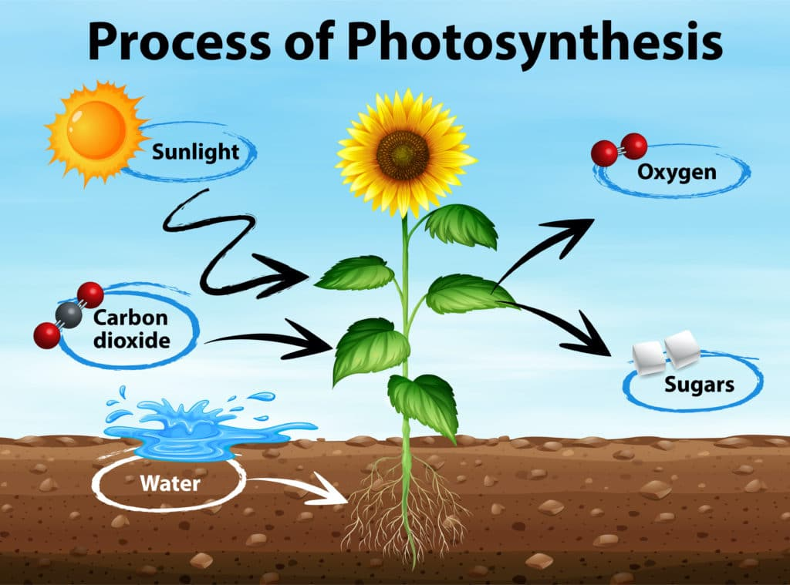
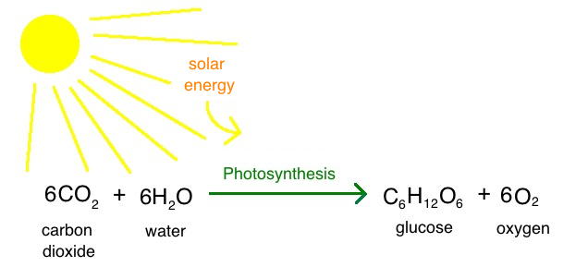
Explain the process of transpiration and role of phloem in plants
EXPLAIN
Water and carbon dioxide combine in the presence of light energy to produce sugar and oxygen.
Energy from the sunlight is now contained in the sugars.
The sugars are what the plant uses for food.

Slide 10
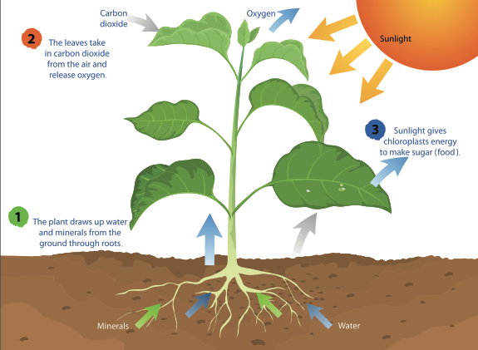

Slide 12
Explain the process of transpiration and role of phloem in plants
ENGAGE
Listening Activity- Transportation in plants
How does phloem work?
2. what is the role of xylem?
Write down answers in chat box.

Slide 13
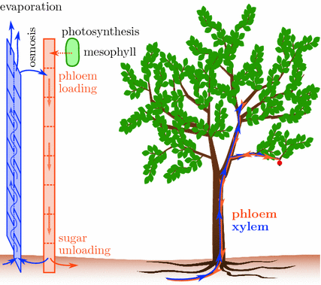
Explain the process of transpiration and role of phloem in plants
EXPLORE
The food is then available to the plant for growth, storage, and other life processes.
Phloem are tissues that transport sugars to all parts of the plant.
It drives the movement of materials throughout a plant.

Slide 14
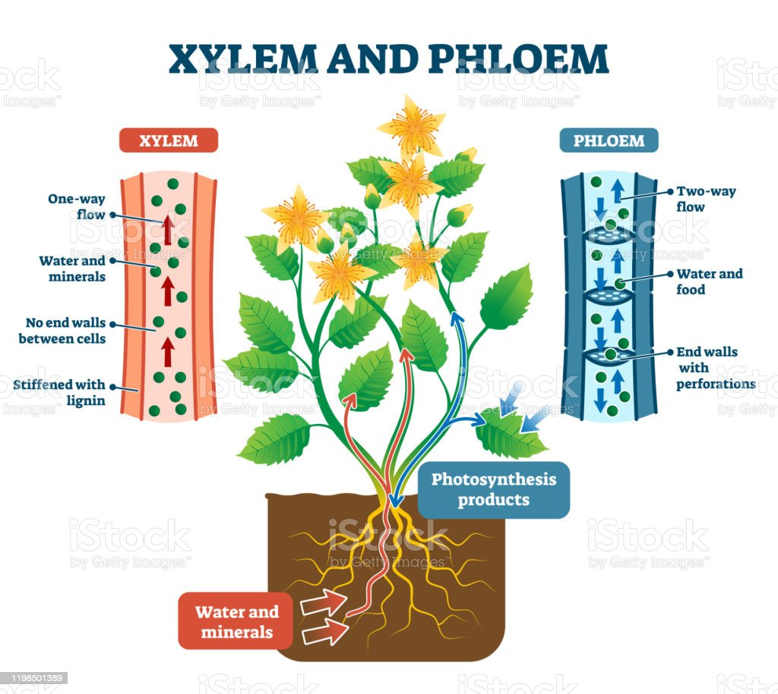

Slide 15
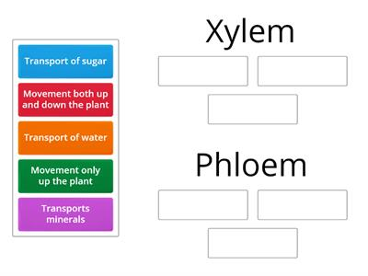
Explain the process of transpiration and role of phloem in plants
EVALUATE
https://wordwall.net/resource/21644376

Slide 16
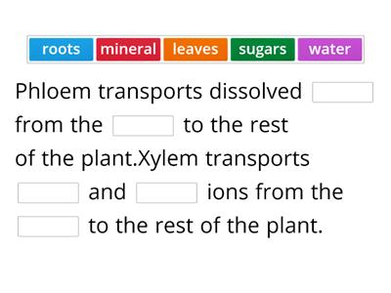
Explain the process of transpiration and role of phloem in plants
EVALUATE
https://wordwall.net/resource/17642834

Slide 17
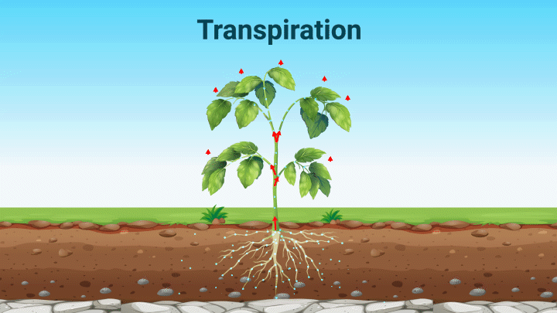
Explain the process of transpiration and role of phloem in plants
EXTEND
Transpiration is the evaporation of water from a plant’s leaves.
As water evaporates from the leaves, more water is carried from the bottom of the plant to the top.
Water moves into the leaf, replacing the water that has evaporated.

Slide 18
Explain the process of transpiration and role of phloem in plants
EXPLORE

Slide 19
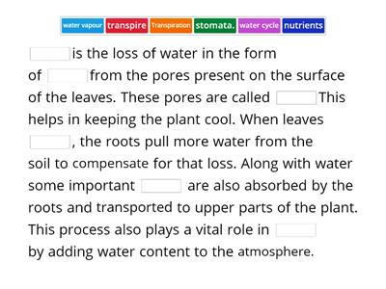
Explain the process of transpiration and role of phloem in plants
EXTEND
https://wordwall.net/resource/3319105

Slide 20
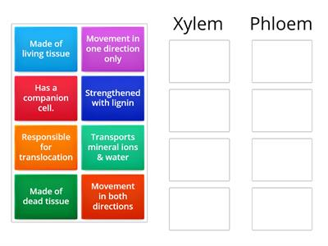
Explain the process of transpiration and role of phloem in plants
EVALUATE
https://wordwall.net/resource/28481169

Slide 21
Learning outcome
Explain the process of transpiration and role of phloem in plants

Slide 22
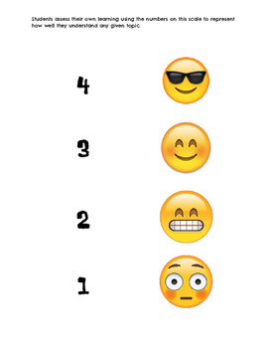
Plenary/ Exit ticket
Self assessment Type your name and self-assessment in the chat box.
I totally understand! - 9 or 10/10 or 5/5
I get it! – 7 or 8 /10
or 4/5
I’m nearly there! - 5 or 6 / 10
or 3/5
I need more help please! – 4 or less
or 2/5 or less

