Slide 1
Chapter 2 : Ecosystems Module 1: Matter in Ecosystems
Lesson 1 : Plant Survival
22/4/2022
5A1
Page- 17
Lab Virtual plant
For this lesson you will need your…
Science notebook
Pencil case
Textbook

Slide 2
Learning Objectives:
Students are expected to:
Describe the factors affecting growth of plant by using virtual Plant simulation
Keyword
Phloem, xylem and transpiration

Slide 3
Lesson Starter
Write your answer in chat box. You have 1 min
What is the role of xylem and phloem in plants
https://quizizz.com/join?gc=29664629

Slide 4
Describe the factors affecting growth of plant by using virtual Plant simulation
ENGAGE
Listening Activity- Transpiration
what do you observe?
2. what is transpiration?
Write down answers in chat box.

Slide 5
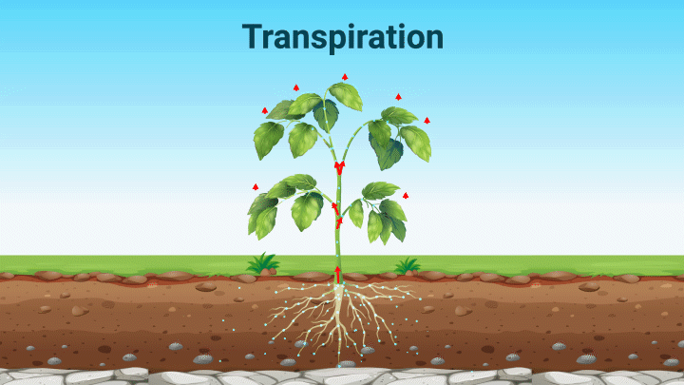
Explain the process of transpiration and role of phloem in plants
EXTEND
Transpiration is the evaporation of water from a plant’s leaves.
As water evaporates from the leaves, more water is carried from the bottom of the plant to the top.
Water moves into the leaf, replacing the water that has evaporated.

Slide 6
Explain the process of transpiration and role of phloem in plants
EXPLORE

Slide 8
Explain the process of transpiration and role of phloem in plants
ENGAGE

Slide 9
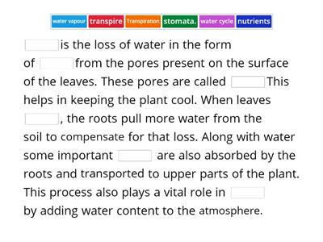
Explain the process of transpiration and role of phloem in plants
EXTEND
https://wordwall.net/resource/3319105

Slide 10
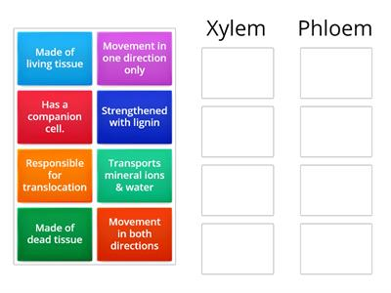
Explain the process of transpiration and role of phloem in plants
EVALUATE
https://wordwall.net/resource/28481169

Slide 11
Explain the process of transpiration and role of phloem in plants
EVALUATE
Quick-check
Which of the following are located on a plant's leaves
A. stomata
B. xylem
C. Phloem
D. roots
2 . Plant use water, sunlight and _________ to produce sugar and ______.
3. The main job of the _______________ is to take in nutrients and water from the soil.

Slide 12
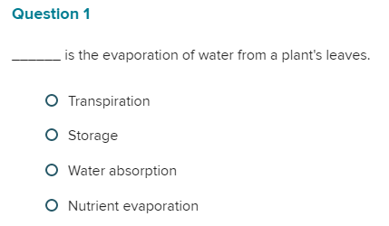
Explain the process of transpiration and role of phloem in plants
EVALUATE
2. Water is carried from the roots through the stem by tissues called ________.

Slide 13
Describe the factors affecting growth of plant by using virtual Plant simulation
ENGAGE

Slide 14
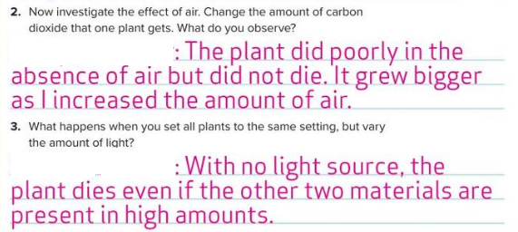
Describe the factors affecting growth of plant by using virtual Plant simulation
EXPLAIN

Slide 15
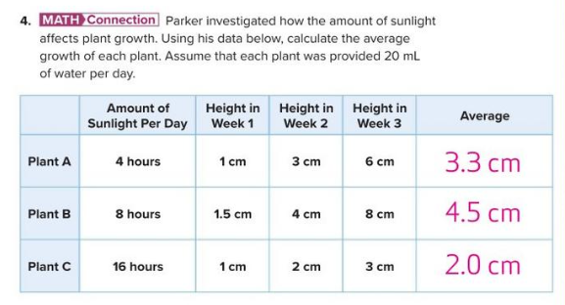
Describe the factors affecting growth of plant by using virtual Plant simulation
EXPLORE

Slide 16
Describe the factors affecting growth of plant by using virtual Plant simulation
EXPLORE

Slide 17
Learning outcome
Describe the factors affecting growth of plant by using virtual Plant simulation

Slide 18
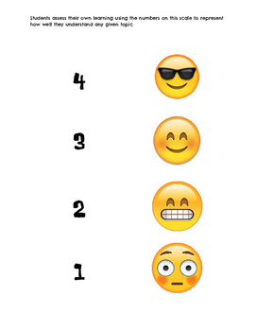
Plenary/ Exit ticket
Self assessment Type your name and self-assessment in the chat box.
I totally understand! - 9 or 10/10 or 5/5
I get it! – 7 or 8 /10
or 4/5
I’m nearly there! - 5 or 6 / 10
or 3/5
I need more help please! – 4 or less
or 2/5 or less

