Slide 1
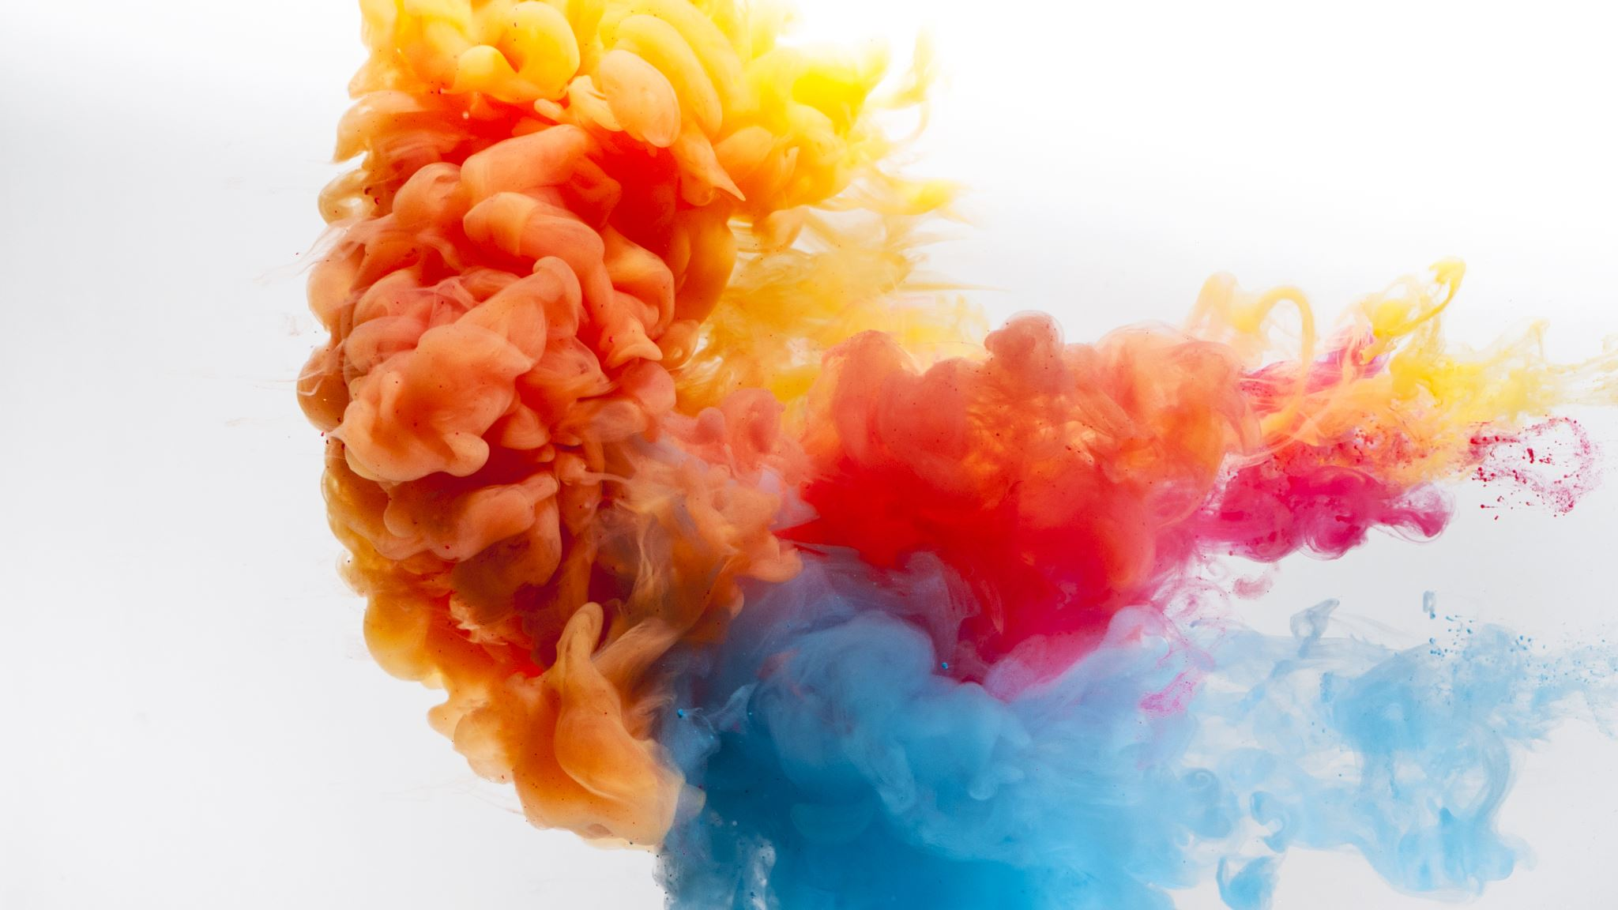
GRADE 8
ACCESS

Slide 2
UNIT 8
World Festivals
LESSON 1
The Islamic Pilgrimage to Mecca

Slide 3
LEARNING OBJECTIVEs
Reading (a passage) for details.
Listening to a pilgrim talk
Proper nouns and Capital Letters.

Slide 4

VOCABULARY
Let’s have a look at the new vocabulary
Journey
Pilgrim
Holy
Pilgrimage
Incredible
Wonderful
Amazing
Magnificent

Slide 5
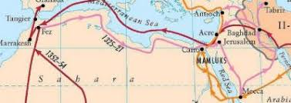
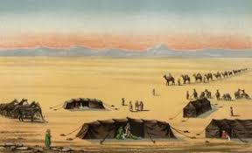
Journey
(Travelling from one place to another)
Notes:
© Copyright PresentationGO.com – The free PowerPoint and Google Slides template library

Slide 6
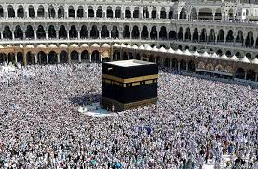
Pilgrims
Notes:
© Copyright PresentationGO.com – The free PowerPoint and Google Slides template library

Slide 7
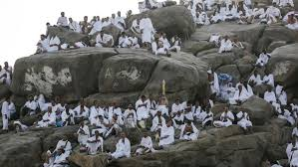
Pilgrimage / Hajj
Notes:
© Copyright PresentationGO.com – The free PowerPoint and Google Slides template library

Slide 8
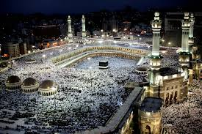
This place is (Holy)
Kaaba is the holiest place for Muslims
Notes:
© Copyright PresentationGO.com – The free PowerPoint and Google Slides template library

Slide 9
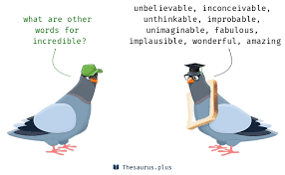
The hajj experience is (incredible)
Notes:
© Copyright PresentationGO.com – The free PowerPoint and Google Slides template library

Slide 10
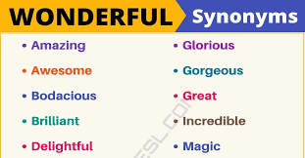
Wonderful
Notes:
© Copyright PresentationGO.com – The free PowerPoint and Google Slides template library

Slide 11
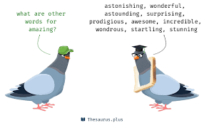
Amazing
Notes:
© Copyright PresentationGO.com – The free PowerPoint and Google Slides template library

Slide 12
Warm up Activity
What do you know about Mecca?
What is your favorite festival? Why?
SPIN
Why is Mecca an important place for Muslim world?
What is Islam about?
Why do Muslims go to Mecca?
Notes:
You spin the wheel, and you stop it

Slide 13
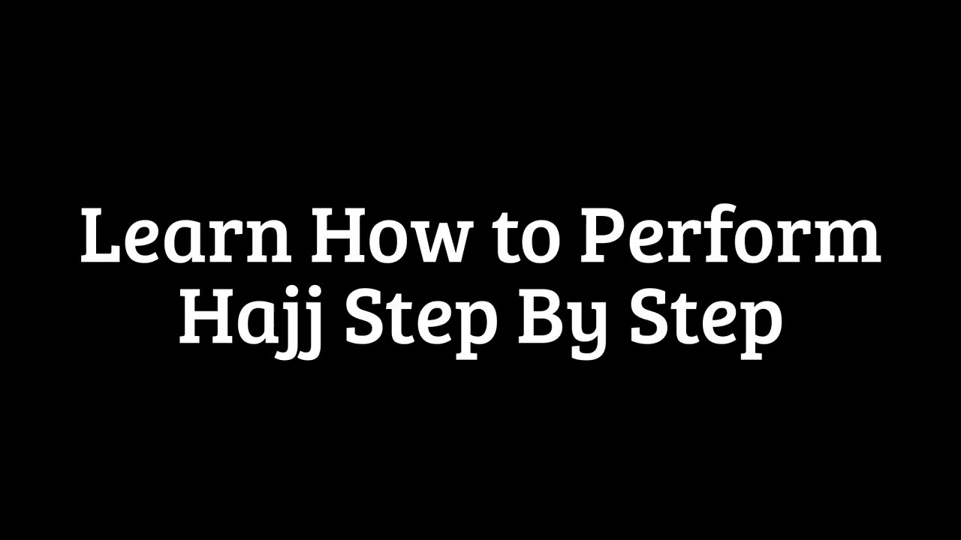
Performing Pilgrimage

Slide 14
Title of your Slide
Notes:
© Copyright PresentationGO.com – The free PowerPoint and Google Slides template library

Slide 15

Notes:
© Copyright PresentationGO.com – The free PowerPoint and Google Slides template library

Slide 16
Title of your Section
Amazing
Incredible
Wonderful
Magnificent
Notes:
© Copyright PresentationGO.com – The free PowerPoint and Google Slides template library

Slide 17
Here goes the subtitle of your section
Notes:
© Copyright PresentationGO.com – The free PowerPoint and Google Slides template library

Slide 18
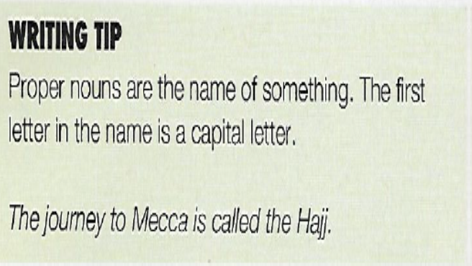
The word Hajj means ‘a journey to Mecca’.
It was incredible to see the Kaaba for the first time.
I was eighteen when I did my first pilgrimage to Mecca.
The Kaaba is inside the walls of the Great Mosque.
Notes:
© Copyright PresentationGO.com – The free PowerPoint and Google Slides template library

Slide 19
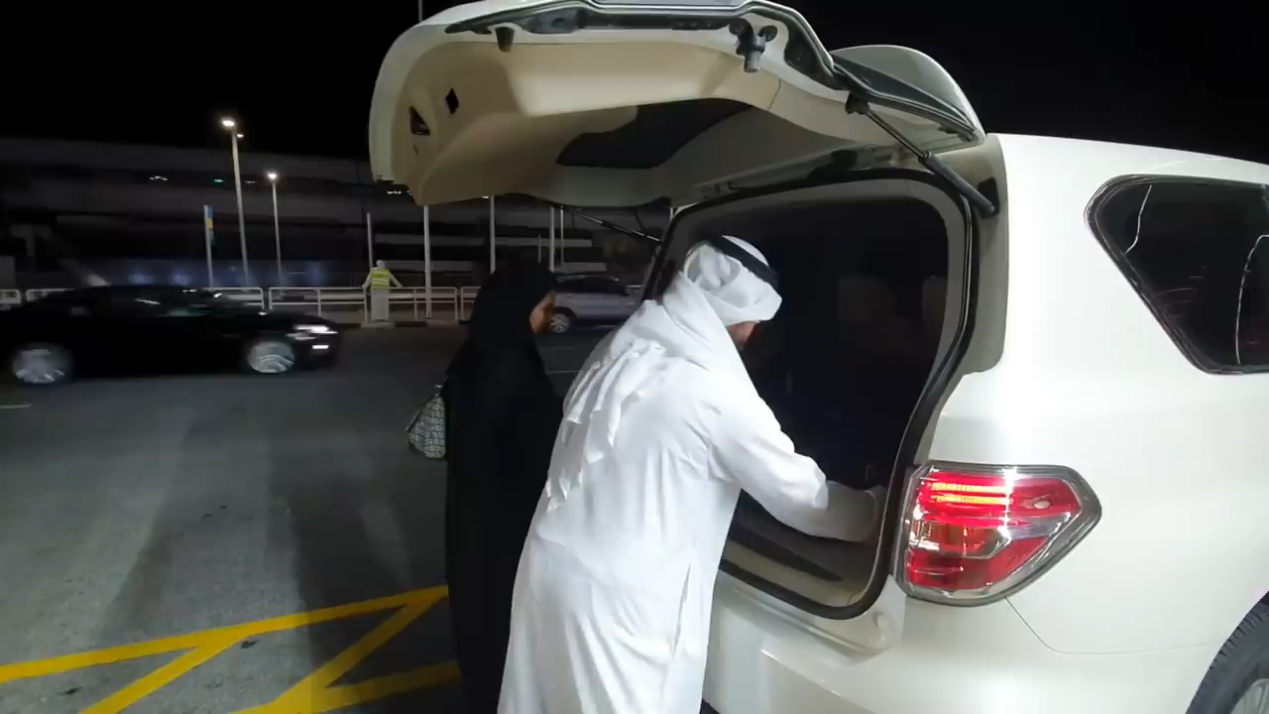
Performing Minor Pilgrimage (Umrah)

