Slide 1
Chapter 2 : Ecosystems Module 1: Matter in Ecosystems
Lesson 1 : Plant Survival
20/4/2022
5A1
Page- 17
Transport system in plants
For this lesson you will need your…
Science notebook
Pencil case
Textbook

Slide 2
Learning Objectives:
Students are expected to:
Explain the process of transpiration and role of phloem in plants
Keyword
Transpiration

Slide 3
Lesson Starter
Write your answer in chat box. You have 1 min
xylem

Slide 4
Why does transport need to occur?
Explain the process of transpiration and role of phloem in plants
EVALUATE
Materials need to be transported between the root system and the shoot system

Slide 5
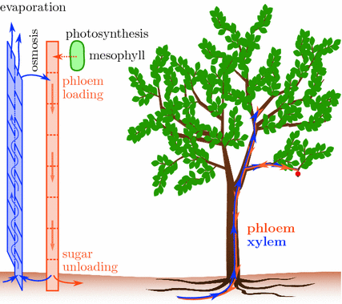
Explain the process of transpiration and role of phloem in plants
EXPLORE
The food is then available to the plant for growth, storage, and other life processes.
Phloem are tissues that transport sugars to all parts of the plant.
It drives the movement of materials throughout a plant.

Slide 6
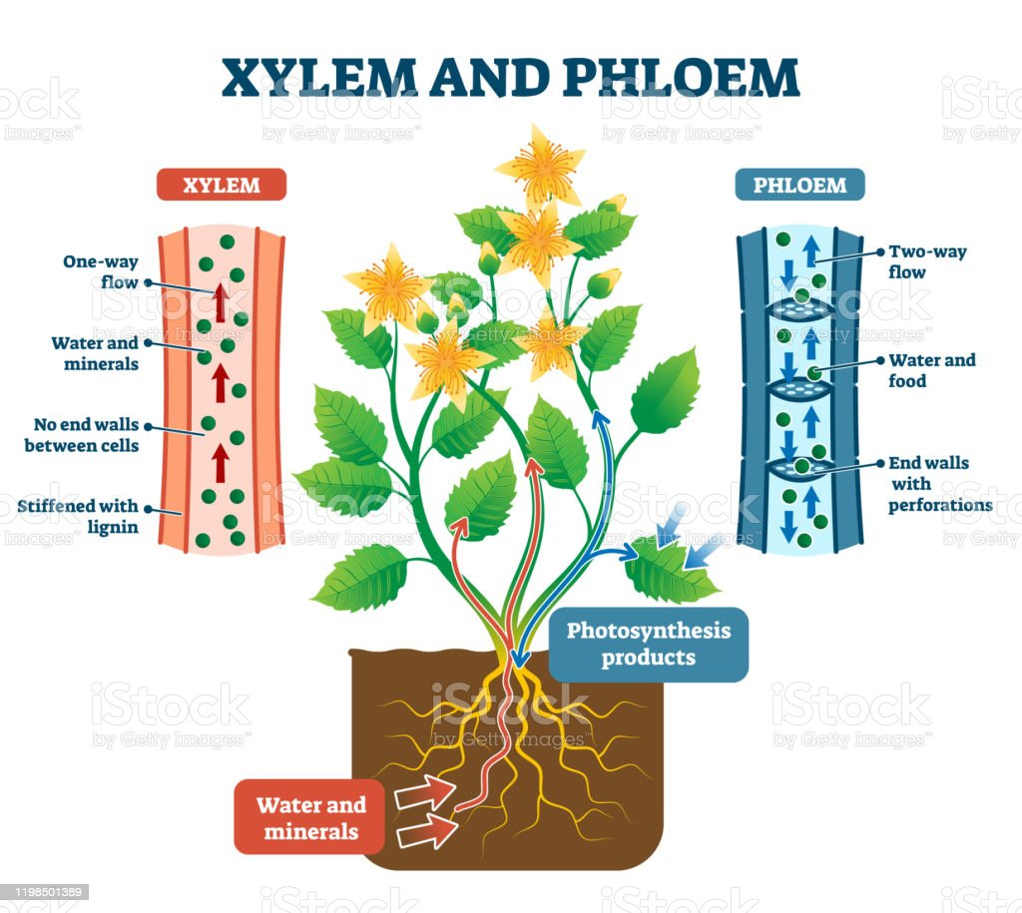

Slide 7
Transport Within Plants
Water and minerals absorbed by roots are drawn upward in the xylem to the shoots
Sugar produced by photosynthesis is exported from leaves to other organs via the phloem

Slide 10
Explain the process of transpiration and role of phloem in plants
ELABORATE

Slide 11
Phloem – Sugar Transport
Phloem carries phloem sap (food) from a sugar source to a sugar sink
Sugar source:
an organ where sugar is being produced
Usually leaves
Sugar sink:
an organ that consumes or stores sugar
Usually roots, growing stems, buds, and fruits

Slide 12
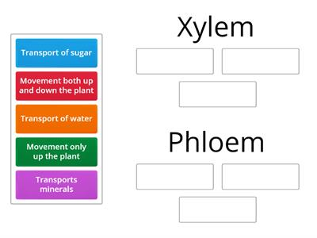
Explain the process of transpiration and role of phloem in plants
EVALUATE
https://wordwall.net/resource/21644376

Slide 13
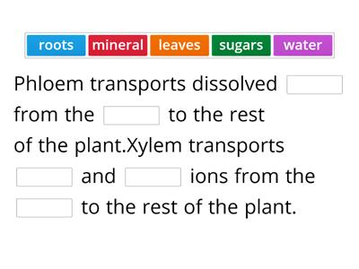
Explain the process of transpiration and role of phloem in plants
EVALUATE
https://wordwall.net/resource/17642834

Slide 14
Explain the movement of particles in solids, liquids and gases
ENGAGE
Listening Activity- Transpiration
what do you observe?
2. what is transpiration?
Write down answers in chat box.

Slide 15
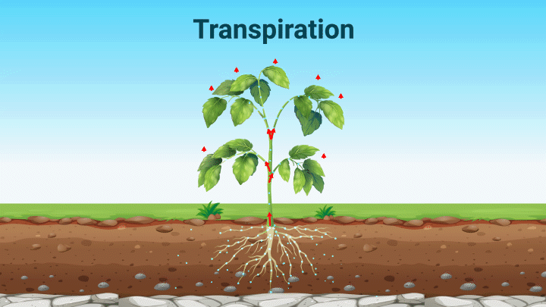
Explain the process of transpiration and role of phloem in plants
EXTEND
Transpiration is the evaporation of water from a plant’s leaves.
As water evaporates from the leaves, more water is carried from the bottom of the plant to the top.
Water moves into the leaf, replacing the water that has evaporated.

Slide 16
Explain the process of transpiration and role of phloem in plants
EXPLORE

Slide 18
Explain the process of transpiration and role of phloem in plants
ENGAGE

Slide 19
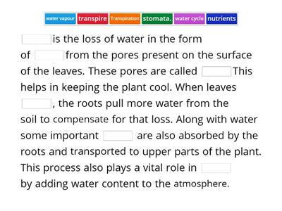
Explain the process of transpiration and role of phloem in plants
EXTEND
https://wordwall.net/resource/3319105

Slide 20
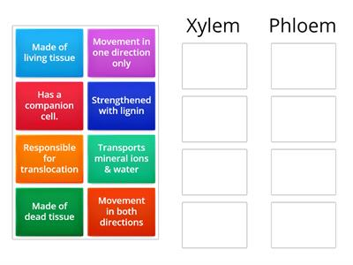
Explain the process of transpiration and role of phloem in plants
EVALUATE
https://wordwall.net/resource/28481169

Slide 21
Explain the process of transpiration and role of phloem in plants
EVALUATE
Quick-check
Which of the following are located on a plant's leaves
A. stomata
B. xylem
C. Phloem
D. roots
2 . Plant use water, sunlight and _________ to produce sugar and ______.
3. The main job of the _______________ is to take in nutrients and water from the soil.

Slide 22
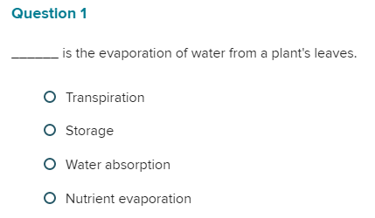
Explain the process of transpiration and role of phloem in plants
EVALUATE
2. Water is carried from the roots through the stem by tissues called ________.

Slide 23
Learning outcome
Explain the process of transpiration and role of phloem in plants

Slide 24
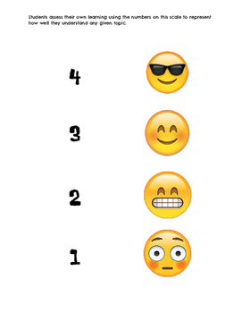
Plenary/ Exit ticket
Self assessment Type your name and self-assessment in the chat box.
I totally understand! - 9 or 10/10 or 5/5
I get it! – 7 or 8 /10
or 4/5
I’m nearly there! - 5 or 6 / 10
or 3/5
I need more help please! – 4 or less
or 2/5 or less

